Slide 1
Update
Fastswap
Benchmark from AIFM paper
Scaling Kona
Paper feedback

Slide 2
Microbenchmarks
Hopscotch hashing
Lookup ~4.5 Mops (250ns)
Made thread-safe ~3.5 Mops (+60ns)
Snappy-C zipping
8 KB objects ~300 Kops (+3µs)
AES Encryption
Not used for now ~ 100 ops

Slide 3
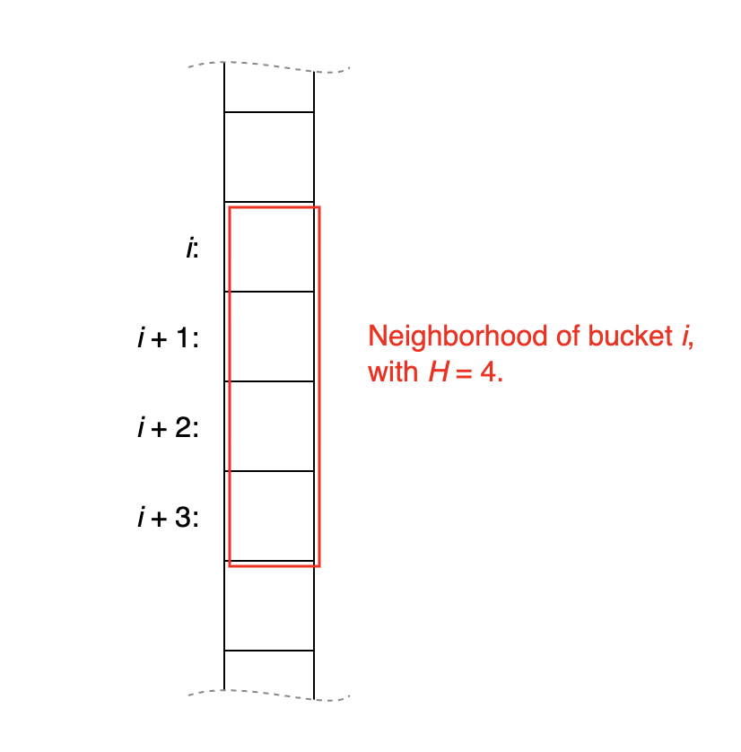
Hopscotch hashing
How does it work?
Cache-friendly lookup
Expensive updates
Our benchmark just does lookups

Slide 4
Thread-safe lookup
No locks
Timestamp on bucket
Atomic data access – bucket can only hold:
Small data
Pointer to data –> an extra page fault
Fine-grained locking
Timestamp on bucket
Locking just the data access. Where to store the lock?
In the bucket –> write-protect faults
Separately –> extra page fault & lock contention depending on the size
Coarse locking
Lock entire operation
Hurts scalability

Slide 5
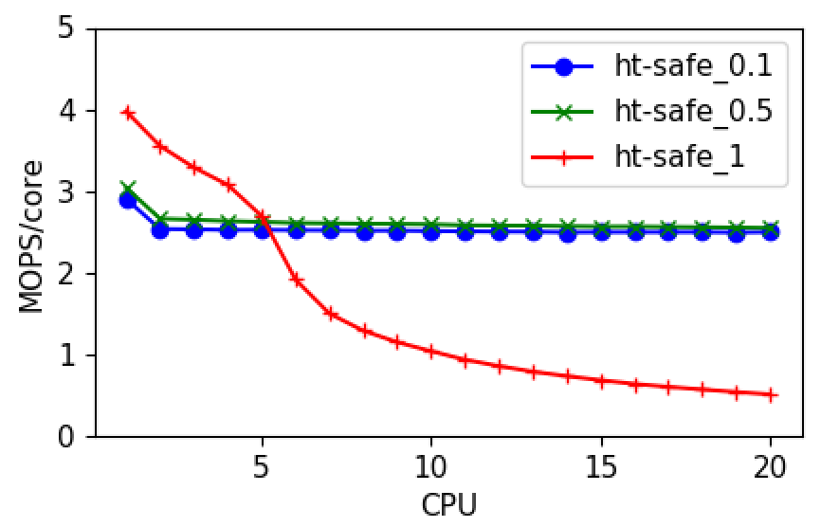
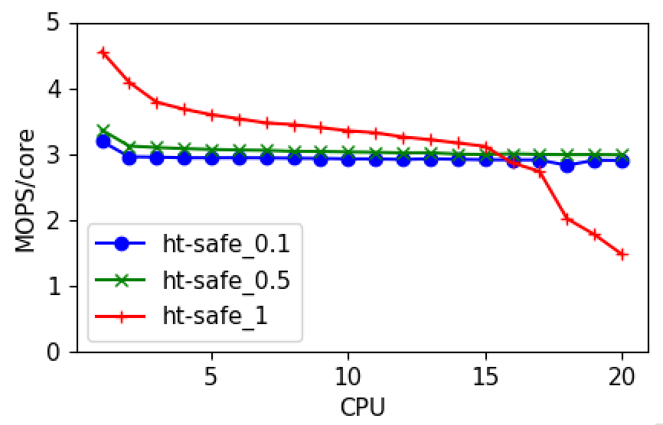
Thread-safe lookup
Coarse-grained
Fine-grained

Slide 6
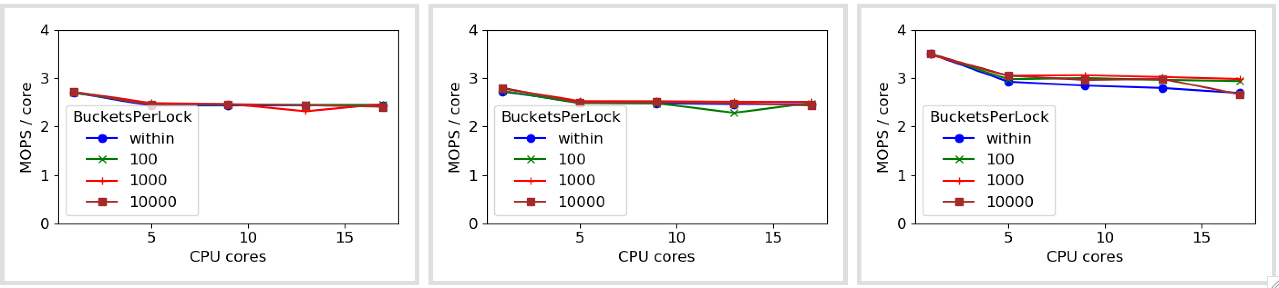
Thread-safe lookup
Perf under lock contention
s=0.1
s=0.5
s=1

Slide 7
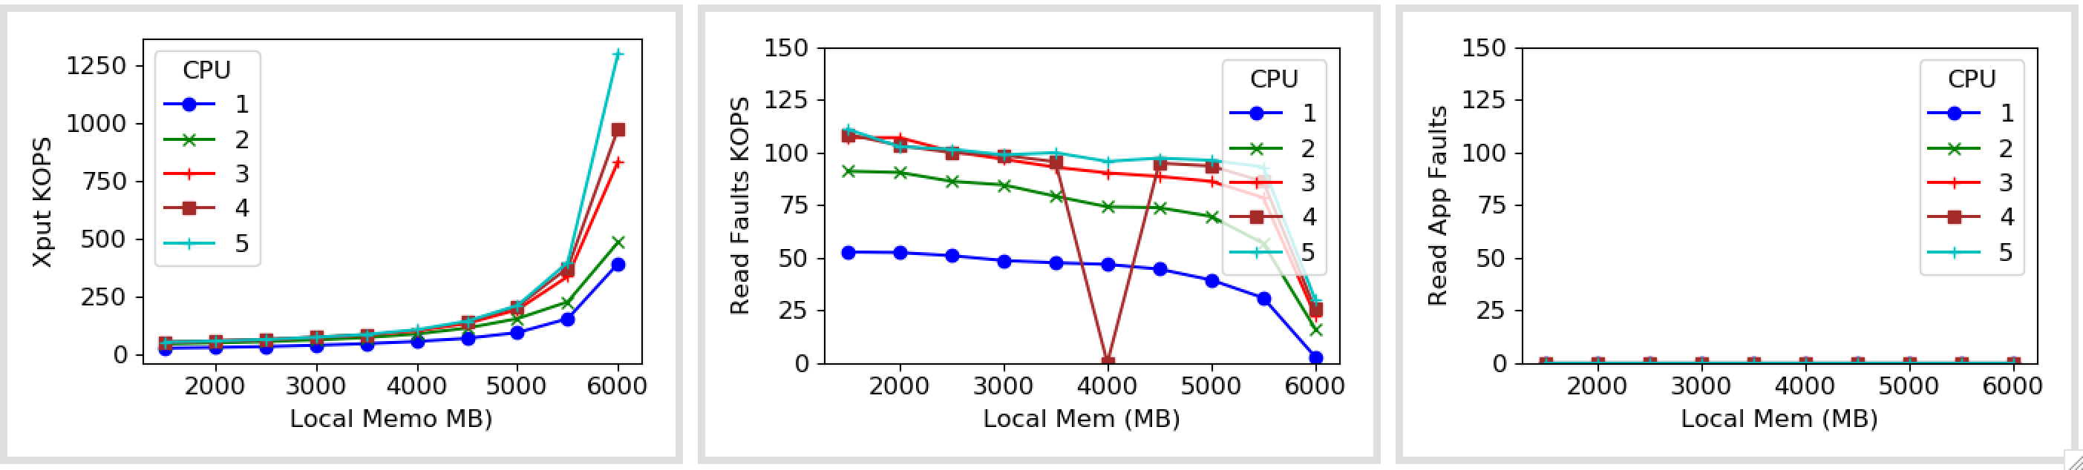
With Kona

Slide 8
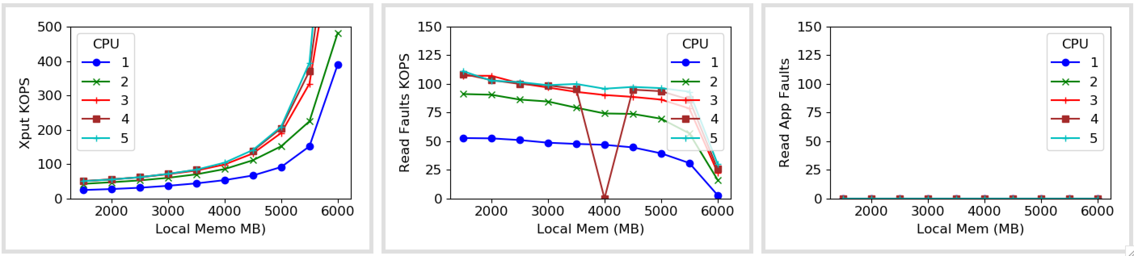
With Kona

Slide 9
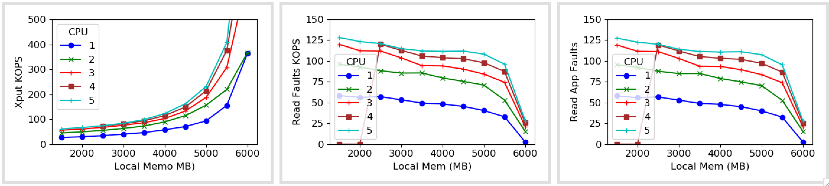
With Async faults

Slide 10
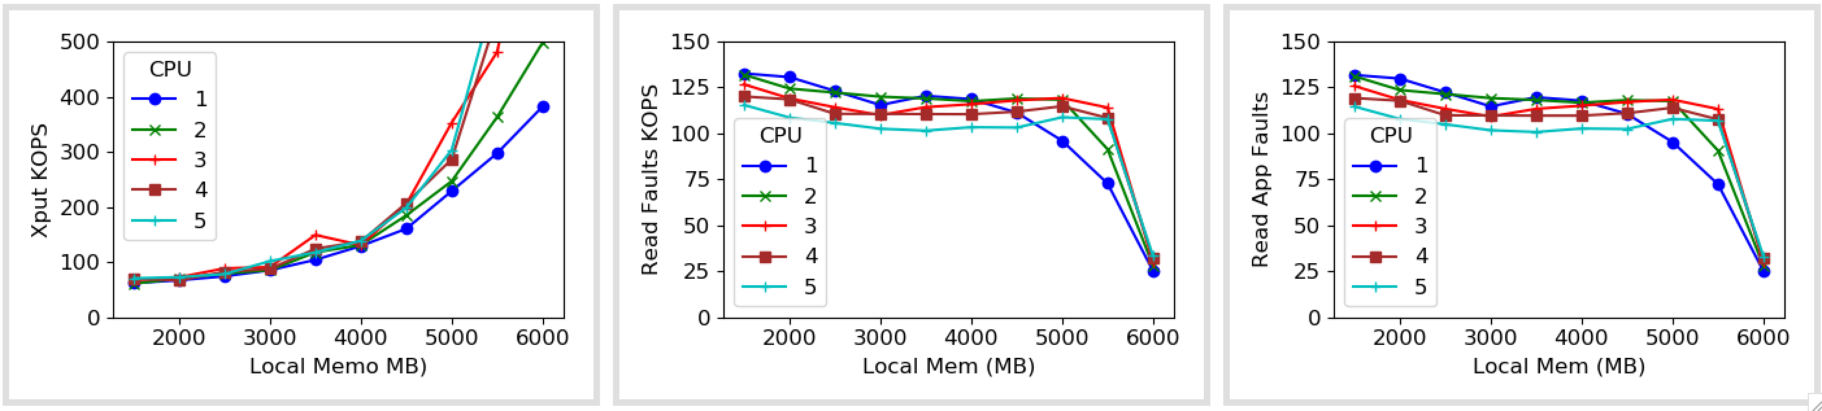
With Async faults: More Concurrency

Slide 11
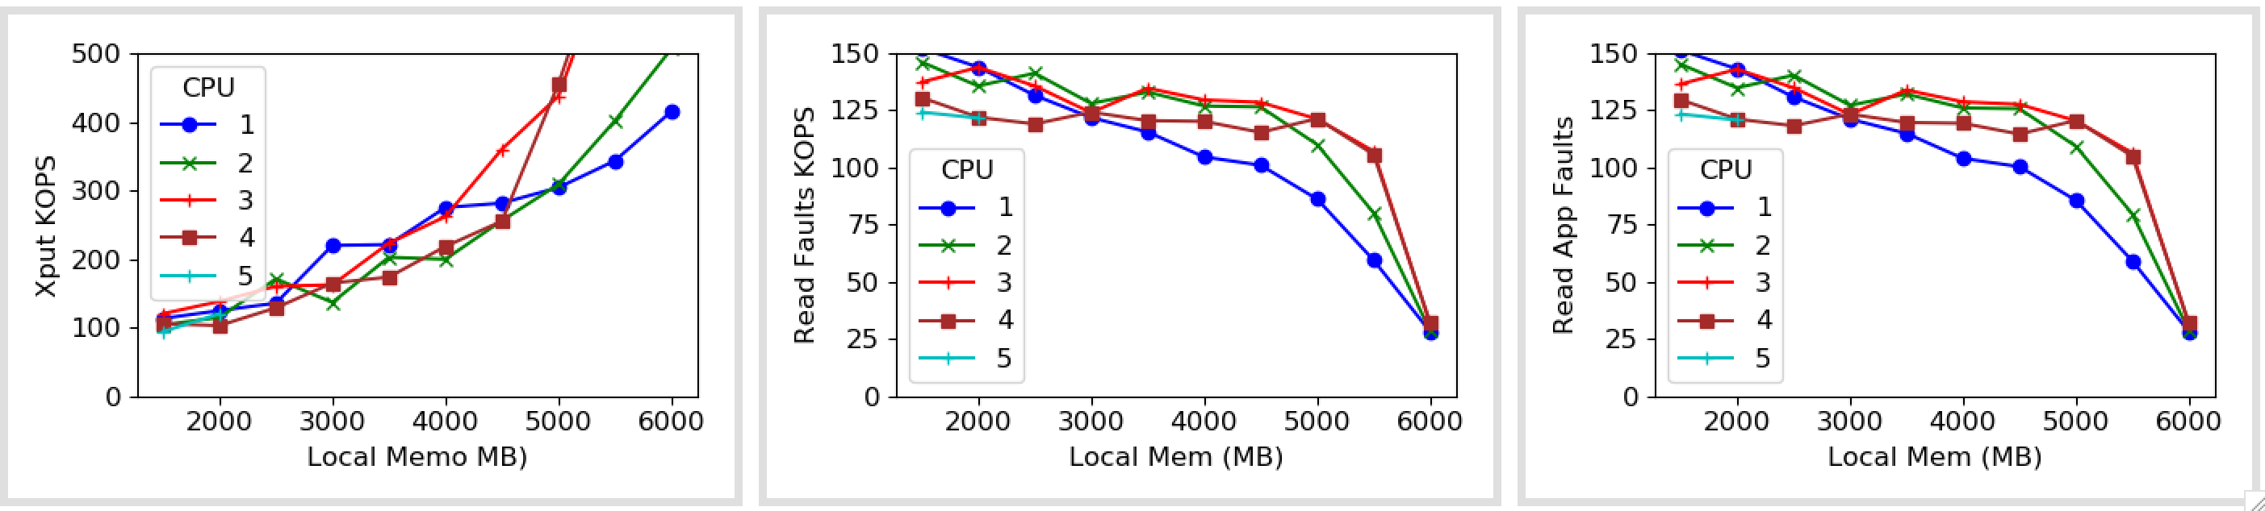
With Async faults: More Concurrency
Notes:
More compute intensity
Use the cpp enc from AIFM

Slide 12
Next Week
Get numbers with
More threads
Other zipf skews
Batching page faults
Another revision by end of the month
Need to send out to Nadav as well
Another app?
that is not latency-sensitive

Slide 13
This month
Another paper revision
Need to send out to Nadav as well
Fastswap
Another app?
that is not latency-sensitive

Slide 14
Misc

Slide 15
Decoupling from Kona
Talked to Nadav
Umap as root
Umap scales with page fault load
Umap does proper LRU eviction
Provides baseline
We’re not using any of the Kona’s contributions

Slide 16
Decoupling from Kona
Contribution | UMAP | Kona/Kailua | Nadav’s Kona (Future of Kailua)

Slide 17
Breakdown (Single core, 1M keys)
176 Mops baseline ~ 12 cycles
57 Mops with rdtsc ~ 25 cycles
4.6 Mops with HT lookup ~ 450 cycles/200 ns
6.6 Mops with just hash ~ 300 cycles
3.2 Mops with safe GT lookup ~ 690 cycles
0.4 Mops with Zip ~ 6k cycles/3 µs
Cross-checked Zip outputs
Less-randomized zip input

Slide 18
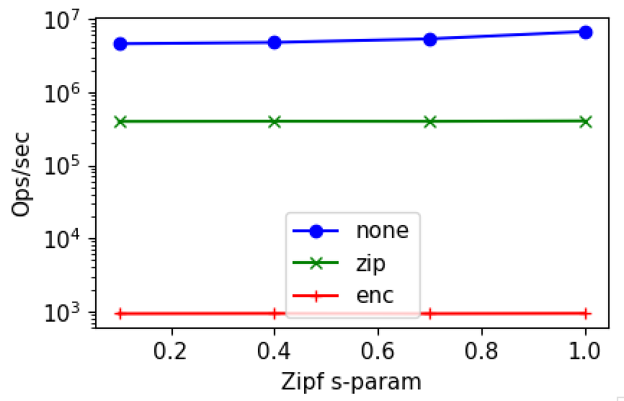
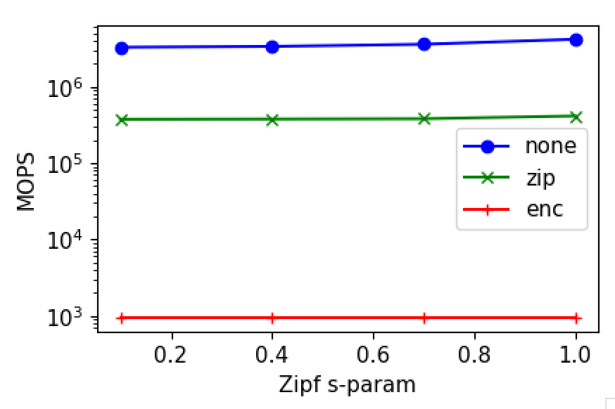
Rudimentary benchmark
Single core
No page faults yet
1M keys
8KB array items

Slide 19
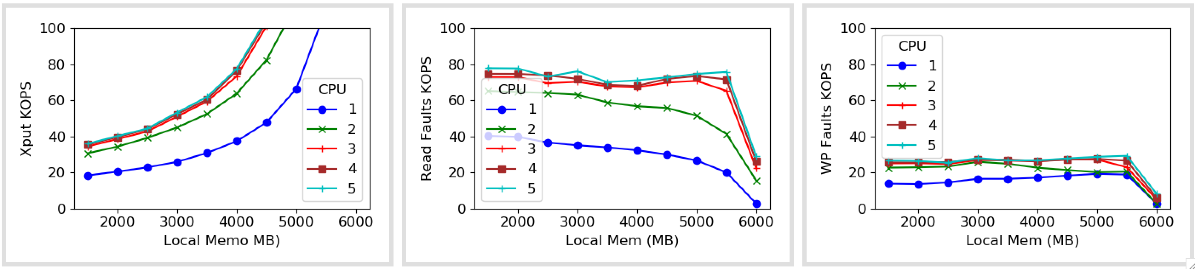
With Kona

Slide 20
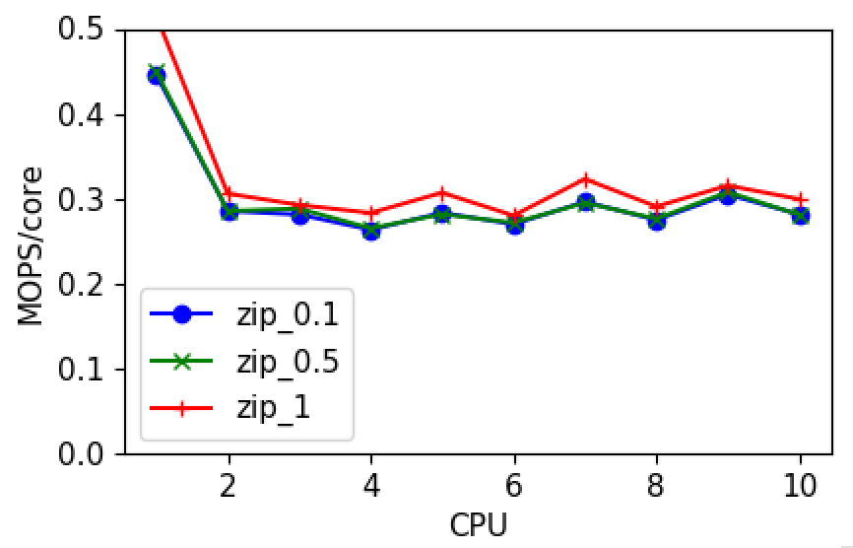
Scaling snappy compression

Slide 21
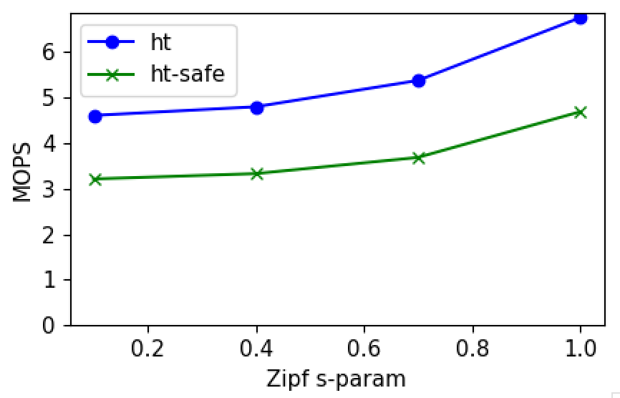
Cost of thread-safety

Slide 22
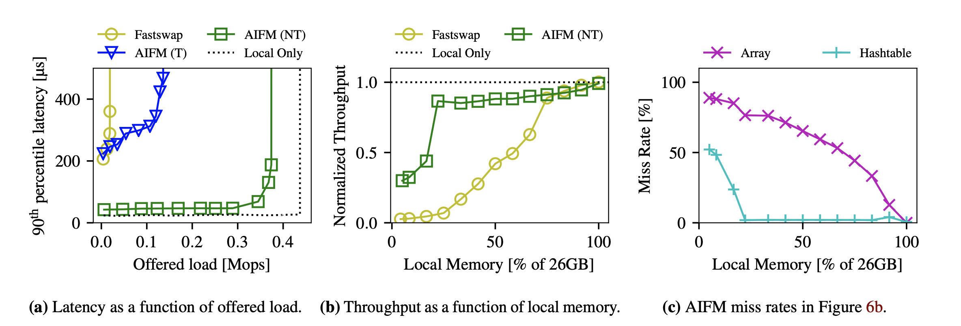
AIFM numbers
26GB total memory (10 GB hash table, 16 GB blob array)
5 GB local memory for (a), s = 0.8

Slide 23
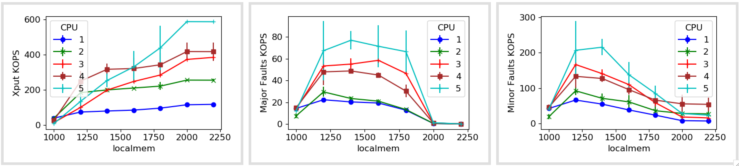
Fastswap with error bars
Notes:
Add more cores
Add more x-axis data points

