Slide 1
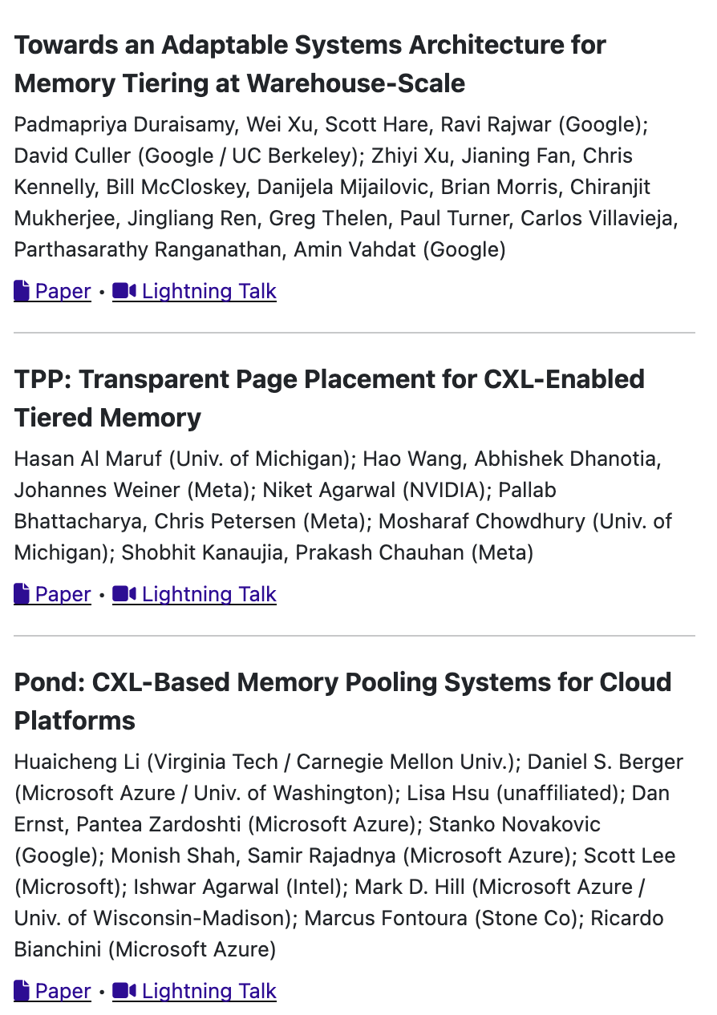
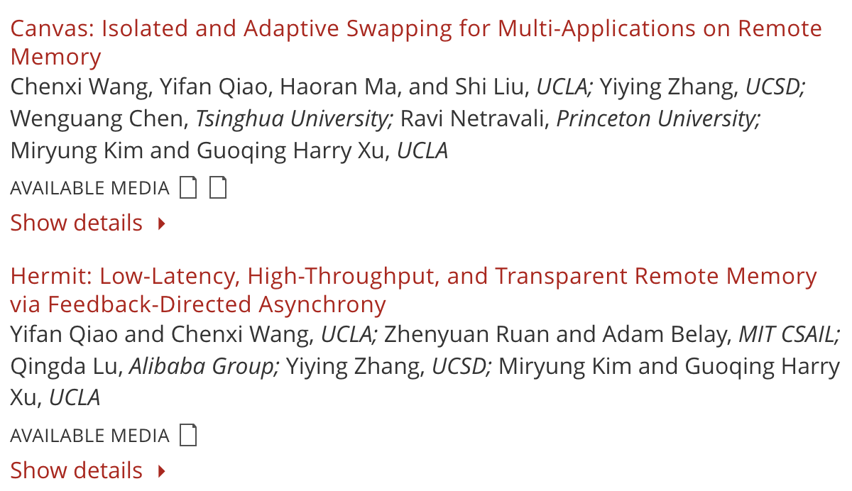
Memory-tiering Papers
NSDI
ASPLOS

Slide 2
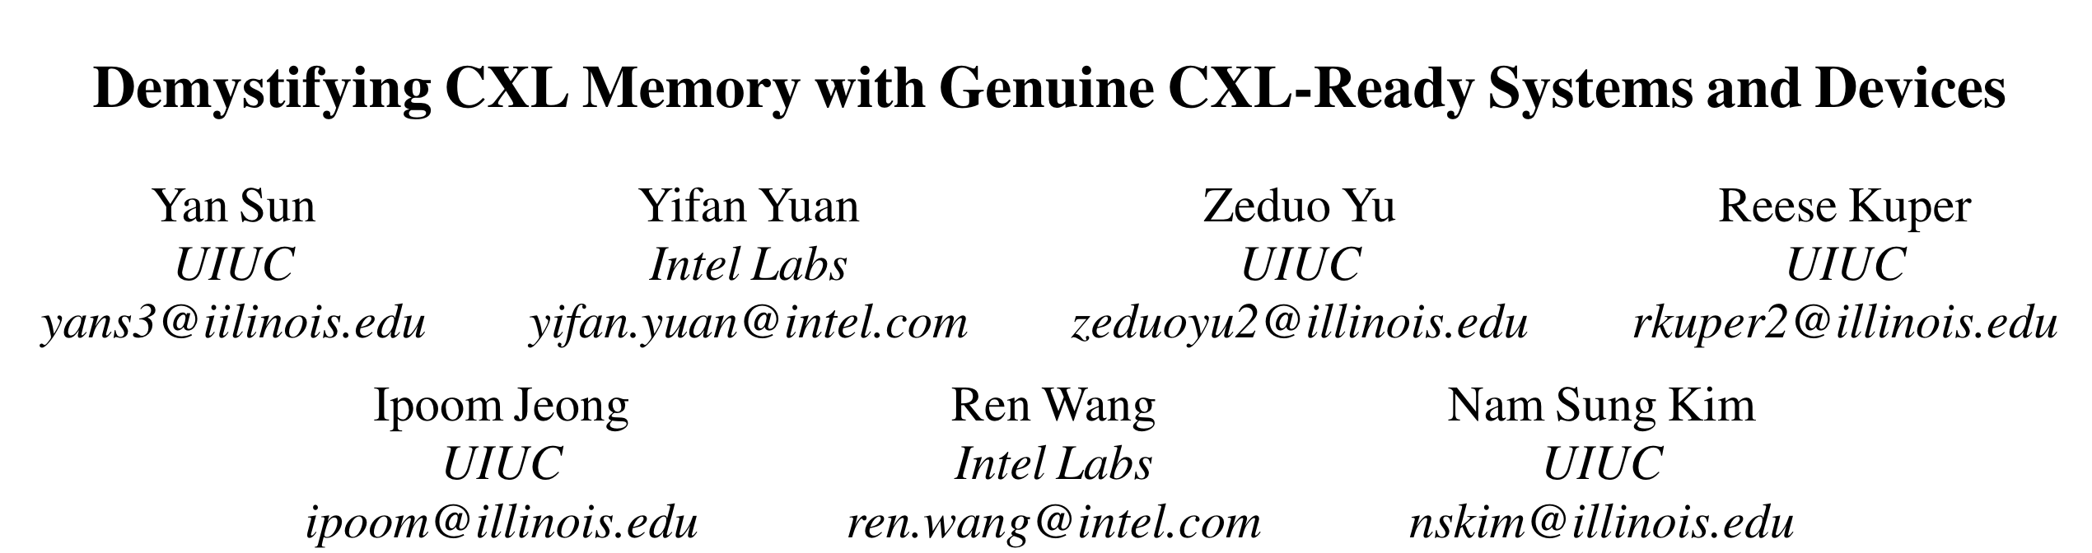
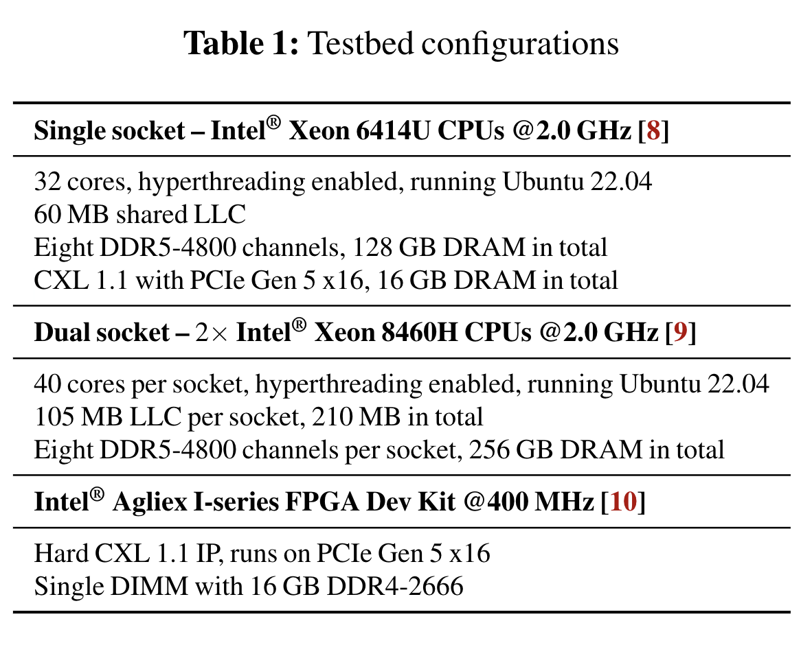
https://arxiv.org/abs/2303.15375
CXL hardware “more realistic” numbers
Comparison with remote NUMA socket

Slide 3
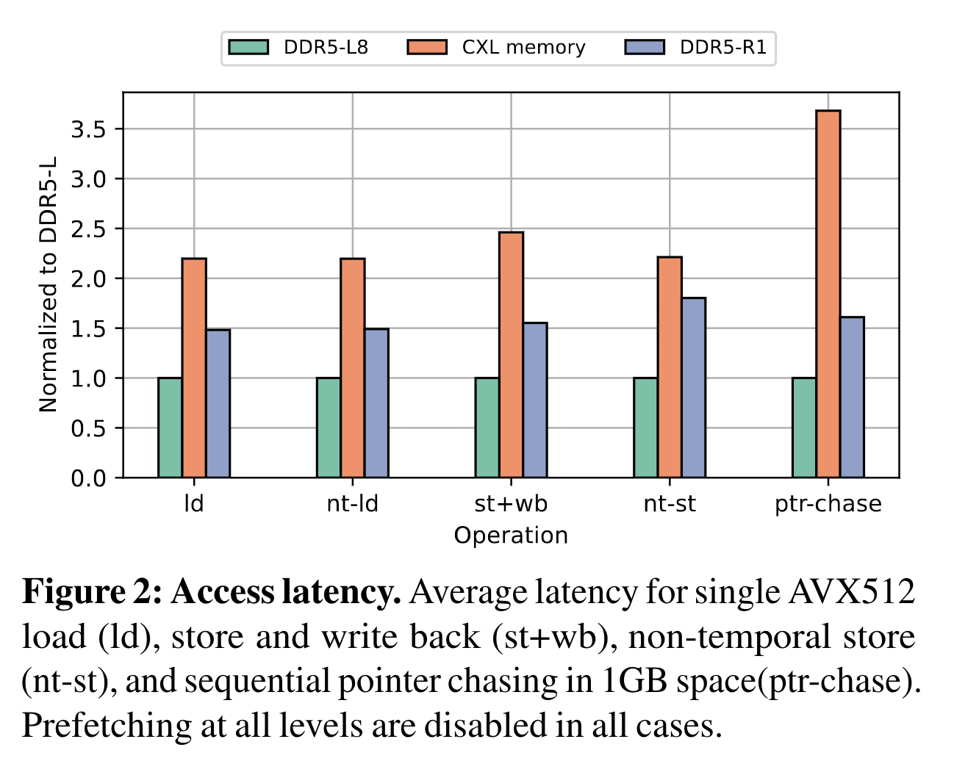
Latency
2.5-4 times longer
Remote NUMA falls short

Slide 4
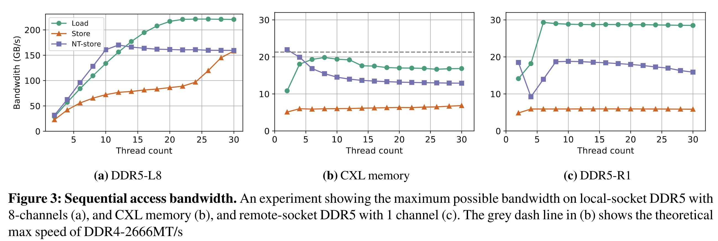
Bandwidth
Emulation with remote socket seems fine to me

Slide 5
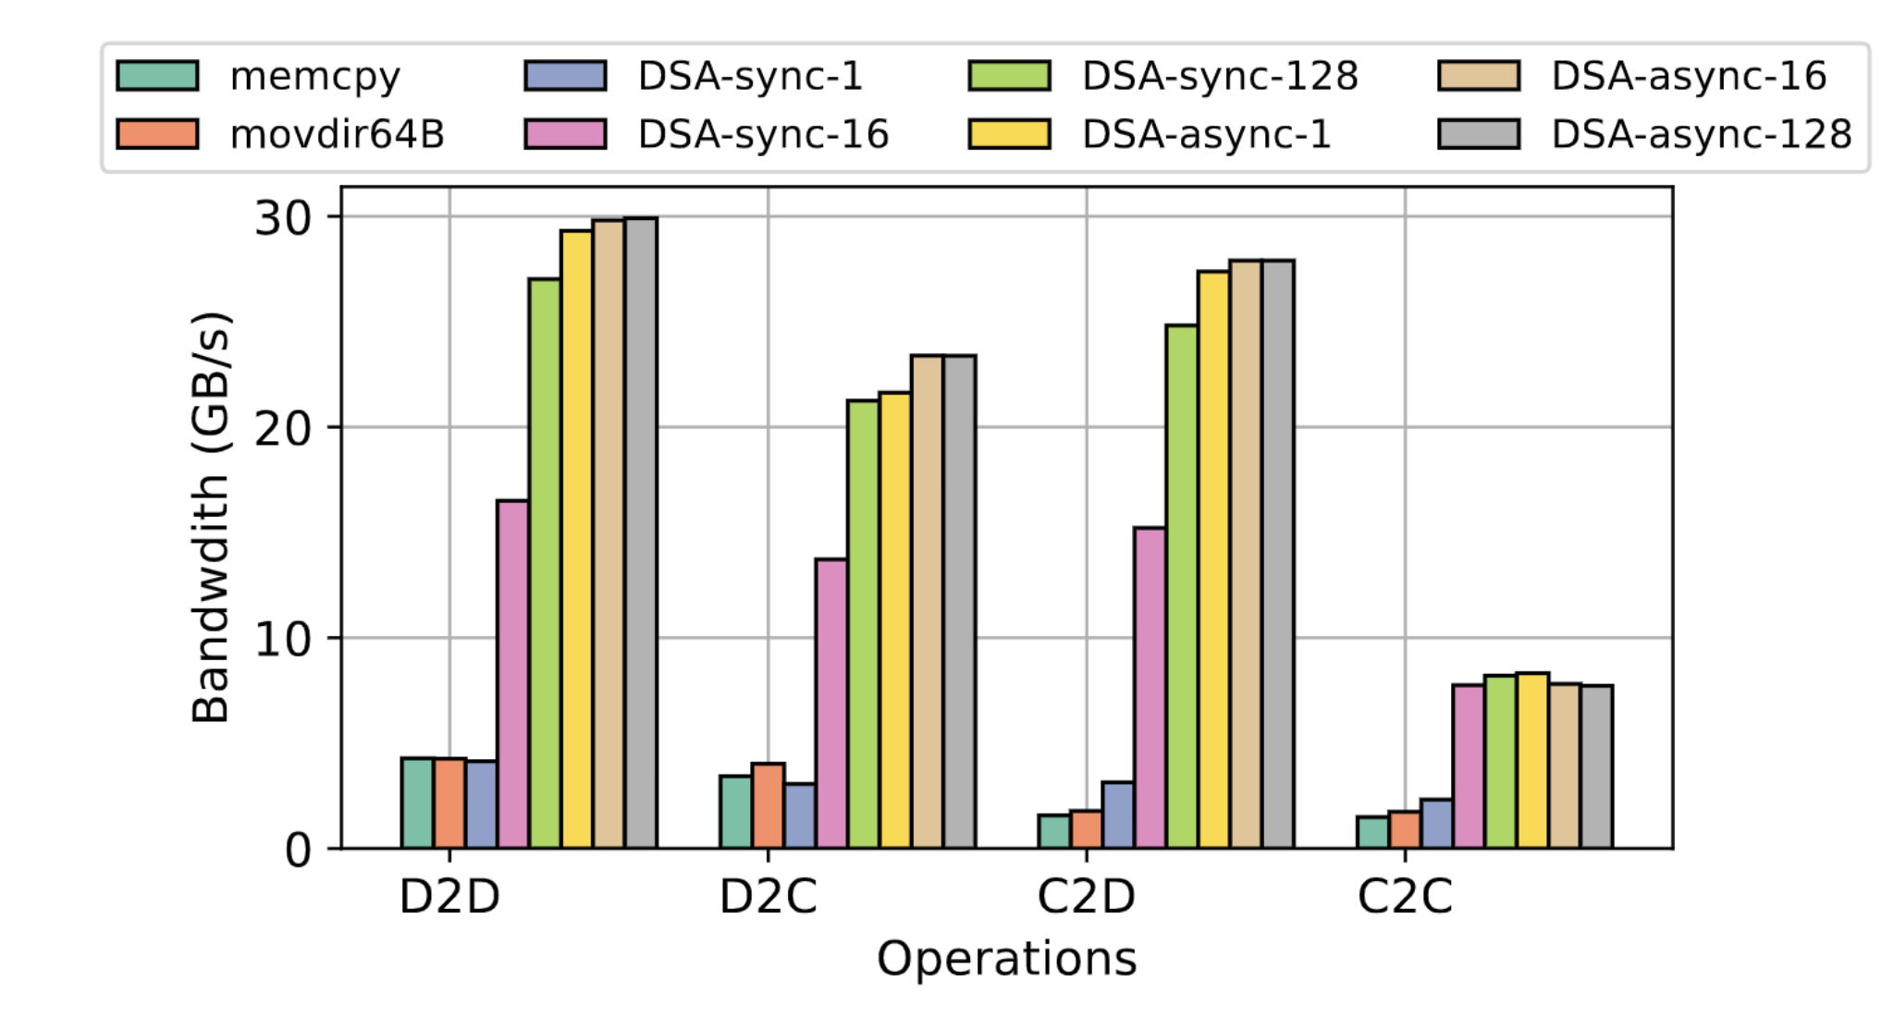
Use DSA for copying

Slide 6
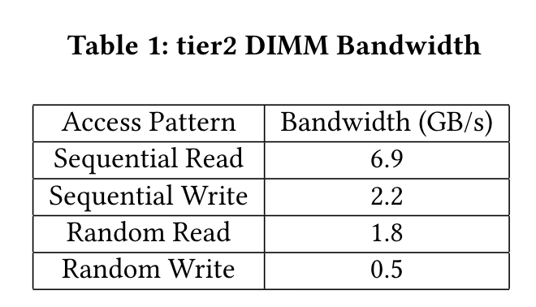
TMTS (Google)
Goal: 25% in tier2 for < 5% perf impact
Optane “memory-mode” as tier2
100K applications, study with A/B testing
HILS vs Non-HILS applications
Page promotion/demotion decisions
Tiering-aware cluster scheduler

Slide 7
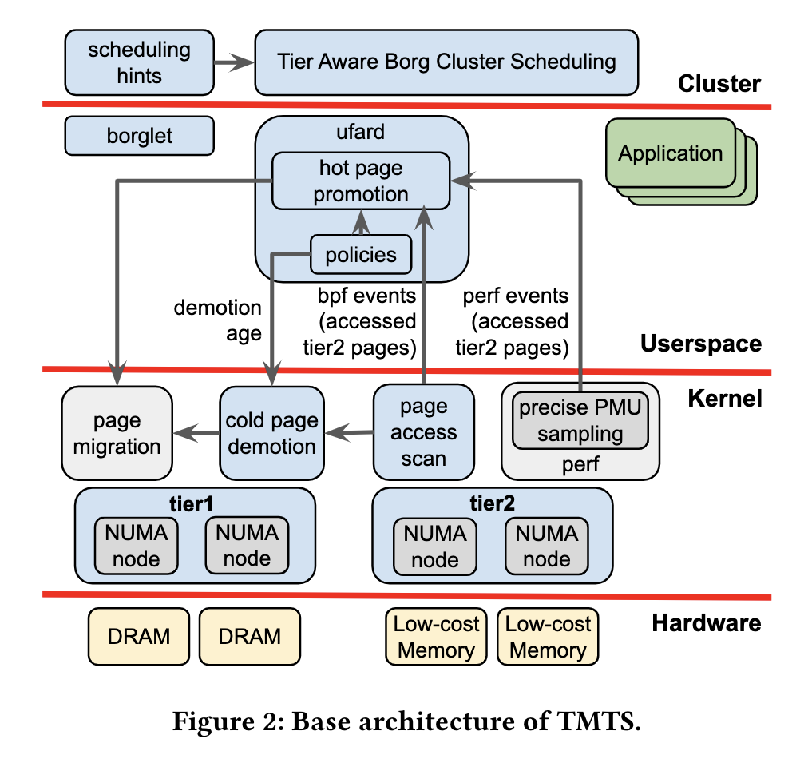
Architecture
Collect A-bit scans and PEBS info
Page promotion/demotion decisions in Userspace

Slide 8
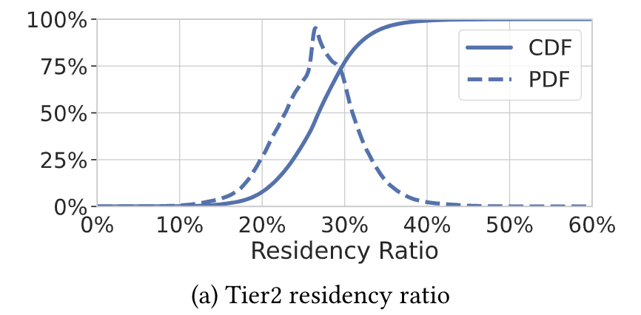
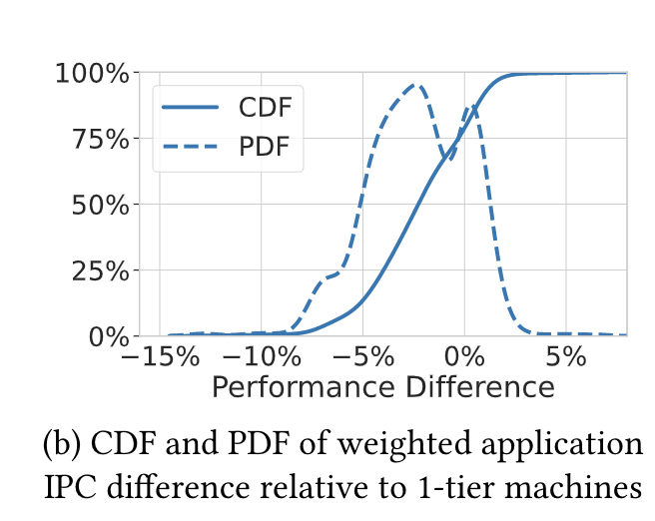
Takeaways
All kinds of eval – very large scale
Simple promotion policies
25% memory may be too conservative; didn’t see a lot of variance in the results given 1000s of applications

Slide 9
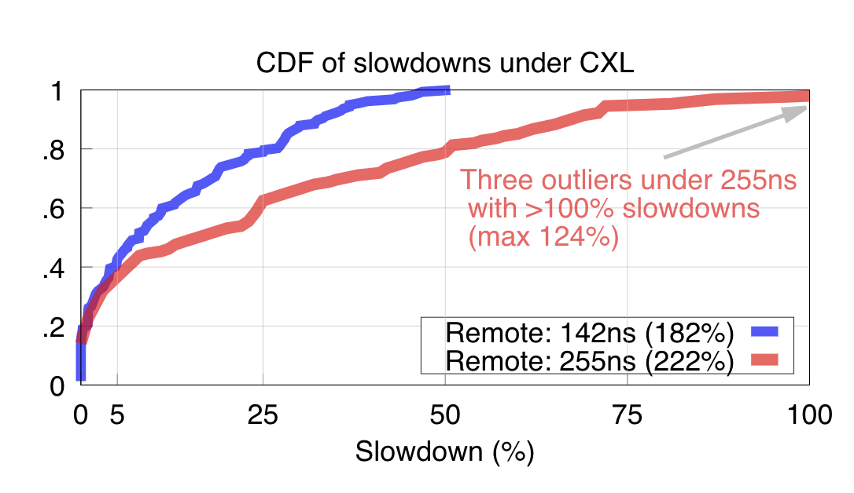
Pond (Microsoft)
Similar but for VMs
CXL but with remote-socket emulation (two socket types)
Premise: there’s a lot of untouched/frigid memory for customer VMs

Slide 10
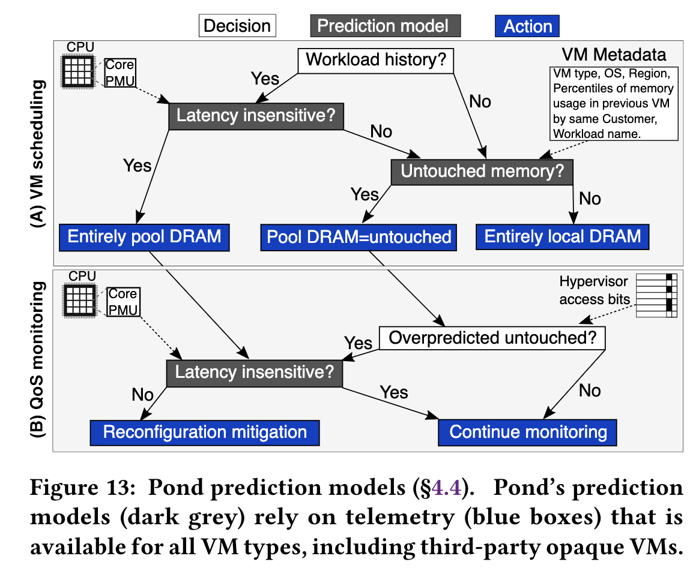
Contribution
ML-based tiering decisions
Whether VM is latency-sensitive
How much memory can go in tier2?
Nothing novel for memory access sampling or migration policies

Slide 11
TPP (Meta)
Focus on single application performance
No cluster-scheduling in picture
Main contributions:
Workload characterization
Tiering rules based on these observations

Slide 12
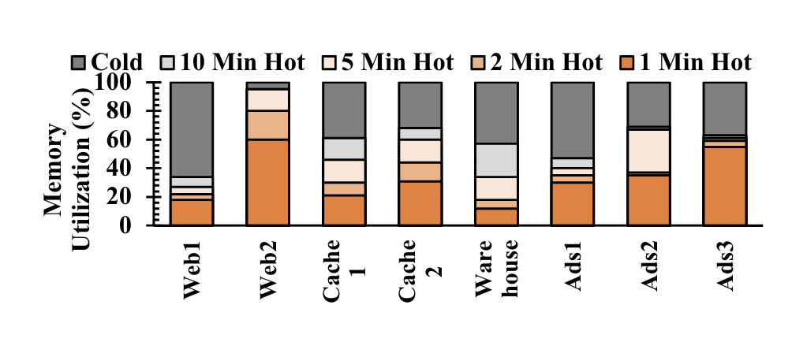
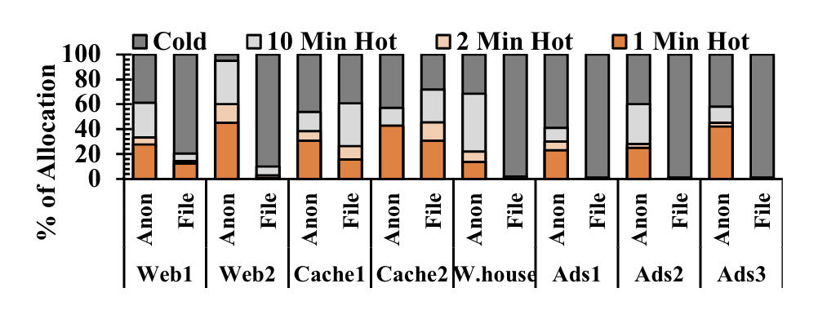
Workload characterization
Using PEBS
Factors:
App types
Page types
A lot of memory tends to be cold for minutes
Anon pages tends to be hotter than file pages

Slide 13
Solution
Improvements to Kernel-based tiering
Decoupling Allocation and Reclamation
Page Type-Aware Allocation
Not sure how some of these tie back to observations

Slide 14
Swapping works
Improvements to Swap backends
(both are Fastswap extensions)
Hermit improves swapping throughput
Canvas works with perf isolation

Slide 15
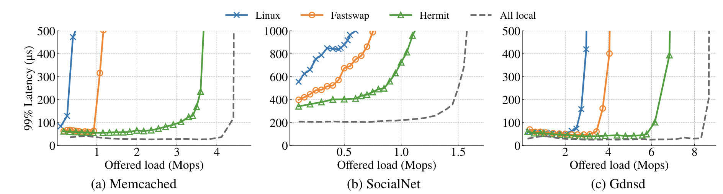
Hermit
Key-ideas:
Current reclamation is (mostly) synchronous
Adaptive asynchronous reclaim based on swap rate
Batched reclaim
To batch TLB flushes

Slide 16
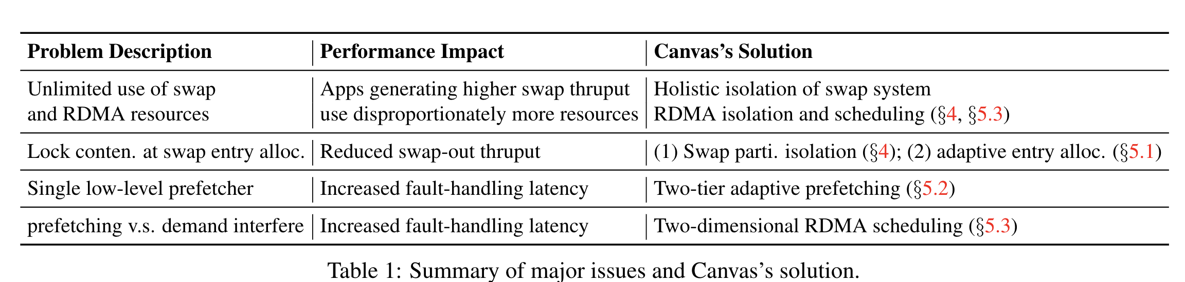
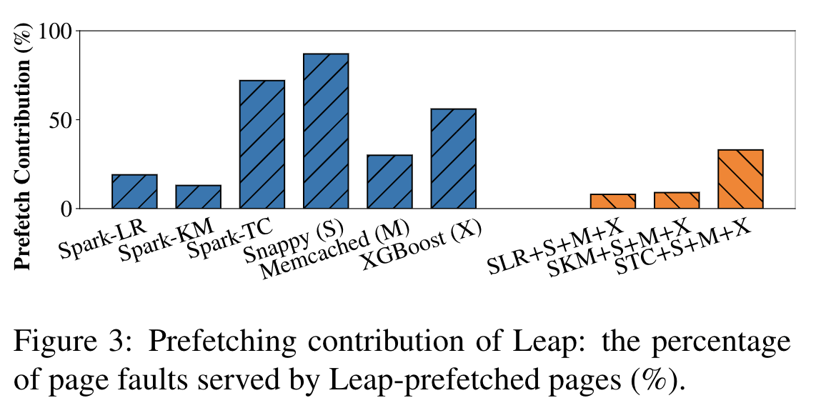
Canvas

Slide 17
Other interesting papers
SRNIC: A Scalable Architecture for RDMA NICs
Nu: Achieving Microsecond-Scale Resource Fungibility with Logical Processes
Understanding RDMA Microarchitecture Resources for Performance Isolation
Persistent Memory Disaggregation for Cloud-Native Relational Databases
Propeller: A Profile Guided, Relinking Optimizer for Warehouse Scale Applications
Going Beyond the Limits of SFI: Flexible Hardware-Assisted In-Process Isolation with HFI

