Slide 1
Page Fault Locality
% of
Faults
Faulting code locations

Slide 2
Outline
HotOS submission (Study on page faulting code)
OSDI submission (Eden work)
Ongoing/future work

Slide 3
Motivation: Eden’s page fault hints
Eden showed the benefits of replacing page faults with page fault hints to an user-space pager
Application
Application
Far Memory
Pager
OS
Far Memory
OS
Pager
Userfaultfd
Fastswap, etc.
Page faults + OS swap system
Eden
Page fault hints + user-space pager powered by Userfaultfd

Slide 4
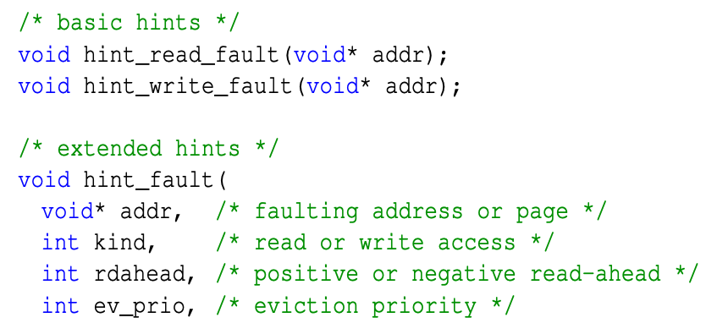
Motivation: Eden’s page fault hints
What hints enabled | How it helped Eden’s performance
Keep control in user-space | Light-weight thread switching
Pass additional information to the pager | AIFM-like benefits e.g., specify non-temporal access
Bypass Userfaultfd page fault vectoring | User-space paging performs as good as OS paging

Slide 5
Motivation: Eden’s page fault hints
What hints enabled | How it helped Eden’s performance
Keep control in user-space | Light-weight thread switching
Pass additional information to the pager | AIFM-like benefits e.g., explicit
Bypass Userfaultfd page fault vectoring | User-space paging performs as good as OS paging
But manually hinting every page fault is infeasible?
Turns out you only need a few!
How general is this observation?

Slide 6
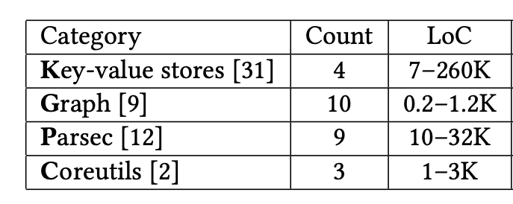
Applications
SQL Databases [2] - TBA

Slide 7
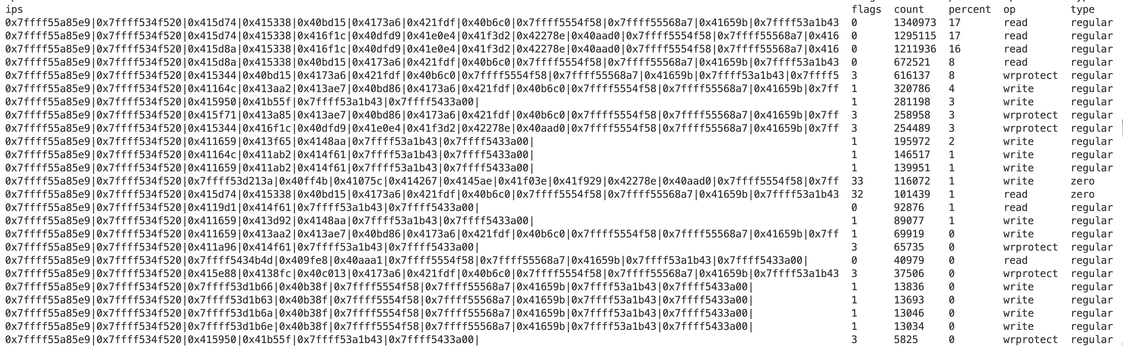
Tracing tool: fltrace
LD_PRELOADed and interposes on malloc(), calloc(), mmap(), etc.
All anon page allocations and their fault handling with Userfaultfd
Records stack trace for each fault with backtrace() in signal handler

Slide 8
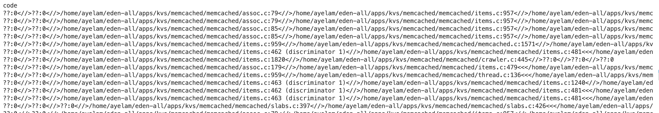
Post-processing
Remove zero-page faults
look up the symbols with addr2line
This requires no-pie builds and sometimes not easy to do!
Visualize with flame graphs

Slide 9
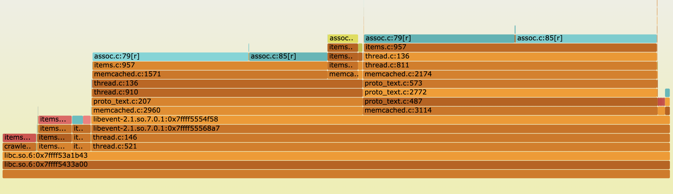
Nice example: Memcached
LRU
Maintenance
SET path
GET path

Slide 10
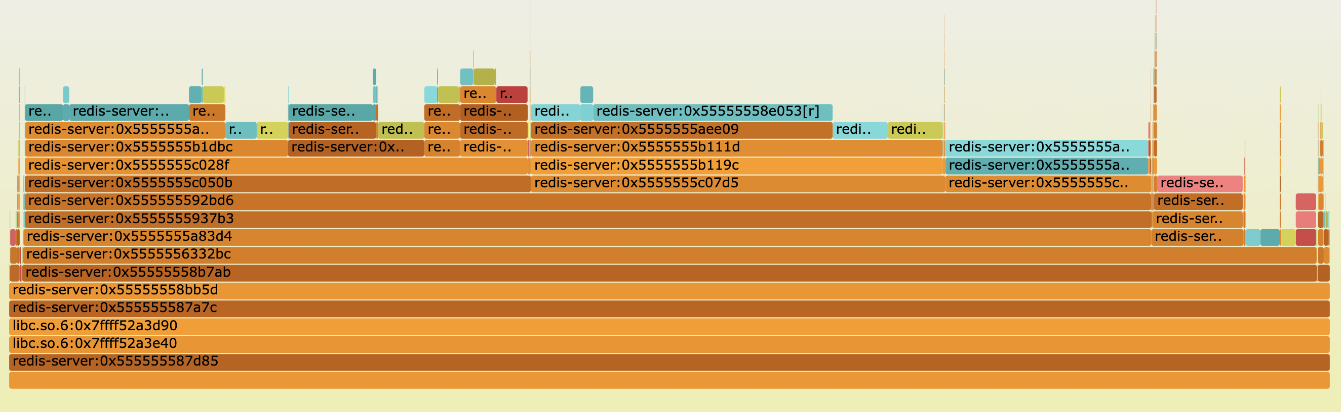
Not-so-nice example: Redis
Could not rebuild redis-server static lib with no-pie… yet
Flamegraphs do not merge same locations reached through different code paths

Slide 11
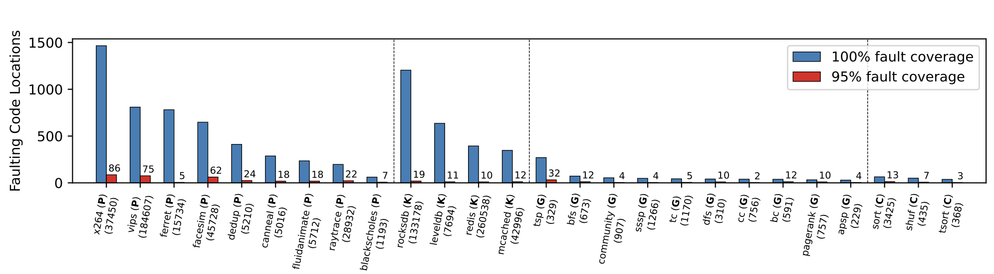
How general is the locality?
Looking at code locations where 100% vs 95% of page faults occur.
Notes:
Ask why this matters first?

Slide 12
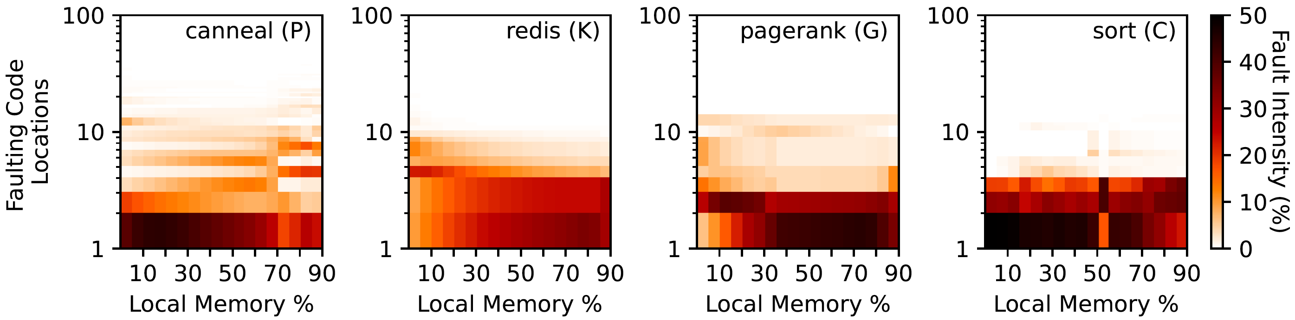
Are the locations predictable?
Do the heavy-hitters change based on runtime factors like local memory size, threads, etc.
Notes:
Ask why this matters first?

Slide 13
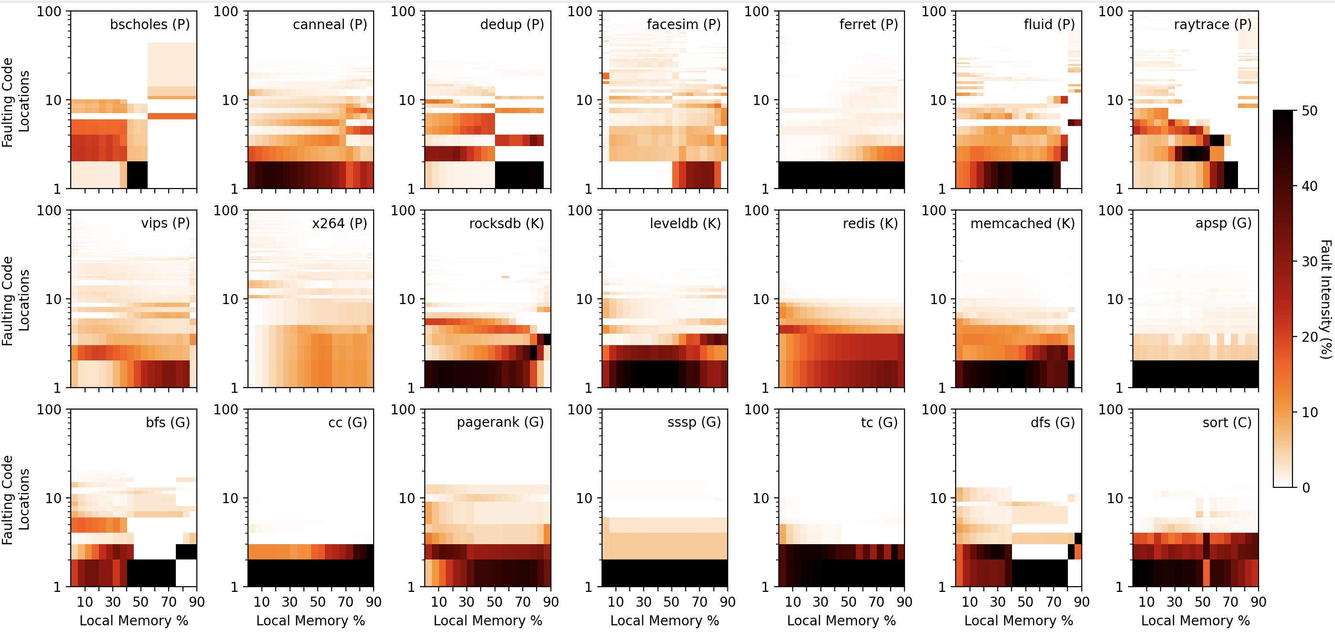

Slide 14
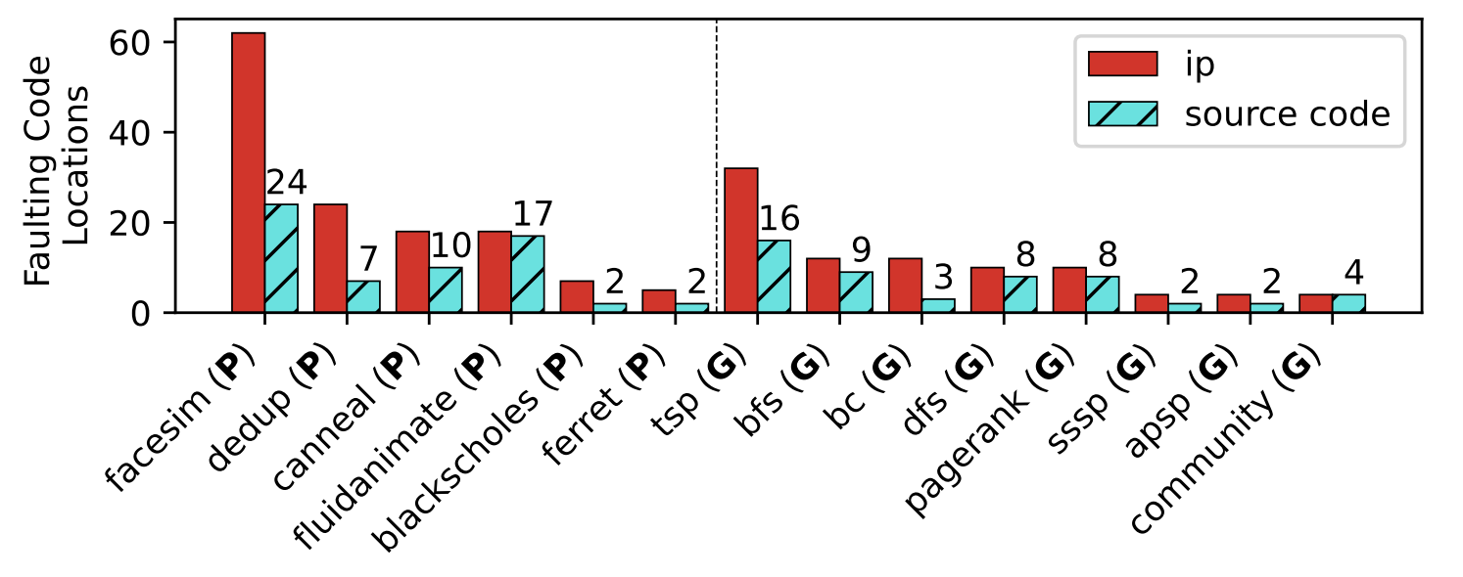
What if code paths converged in libraries?
Example: most accesses in C++ vector iterator
Does the locality extend to application source code?
We excluded library code to check
95% access locations in binary vs source code
Notes:
Ask why this matters first?

Slide 15
What explains this behavior?
We think that it’s a combination of:
Dominant code paths/segments in applications
Longer page lifetimes in the larger local memory
I’m studying the apps further to understand this.

Slide 16
Uses besides Eden
Far memory-friendly programming
e.g., Can the locations help point out data structure implementations that do not go well with far memory?
Context-aware prefetching
e.g., labelling GC faults to not confuse the prefetcher, like Memliner [OSDI’23]
What other use cases can you think of?

Slide 17
How is CXL different?
Key differences
Cache-line based access i.e., no page faults
Smaller far memory latencies
CPU
CPU
LLC
LLC
LLC Miss
Local Memory
Far Memory
Page
Faults
(On-path)
Local Memory
CXL-attached Memory
Page
Promotion
(Async)
Paging-based
CXL-based

Slide 18
Implications for System Design
Asynchronous, calculated page promotion instead of page faults
→ Not every far page needs to be promoted
→ Only promote a page if the benefit exceeds promotion and reclaim costs (~20µs) and a hotter page is not evicted
“Page temperature” – number of cache lines used in a page – is also important
Need more fine-grained page access information for better decisions

Slide 19
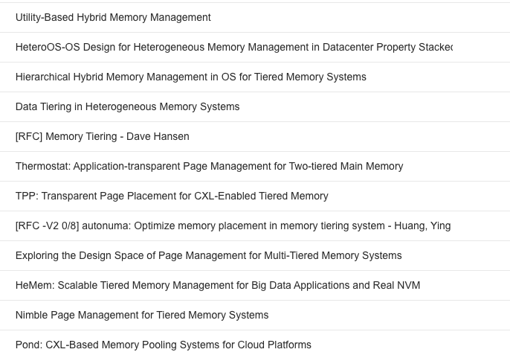
Page promotion in previous systems
Various ways to estimate hotness
Page access bits
TLB misses with “false” page faults
L3 and TLB misses with PEBS
The premise is that first two are not enough while the third may incur prohibitive overhead at runtime

Slide 20
A profile-guided CXL runtime with hinting?
Faulting locations still capture first accesses in dominant code paths
Hinting at these locations may provide a cheaper way to convey statically-profiled access information to the runtime
Premise: that we find consistent access behavior
For example, hints can encode:
Custom priority for pages, like in Eden
Profile-guided page “temperature”
Cache lines to prefetch for later accesses in the page
Zero-page hints can guide near/far allocation policy

Slide 21
Things to do
Validating premises
Benchmark the overhead of PEBS
Profiling apps for consistent cache-line access behavior near the faulting locations
Build a CXL emulator
Using another NUMA socket as remote node e.g., Pond [ASPLOS’23]
Bandwidth control with “DRAM thermal control feature”
Latency emulation with software-added delay
e.g., HP Quartz NVM emulator

