Slide 1
Update
Some progress on Synthetic app and Fastswap
Will send out a draft by EOD

Slide 2
Synthetic App
Fixing bugs
Still seeing issues with asynchronous hints at higher cores
Looking at benefit of hiding latencies
Yet to try out custom read-ahead & eviction

Slide 3
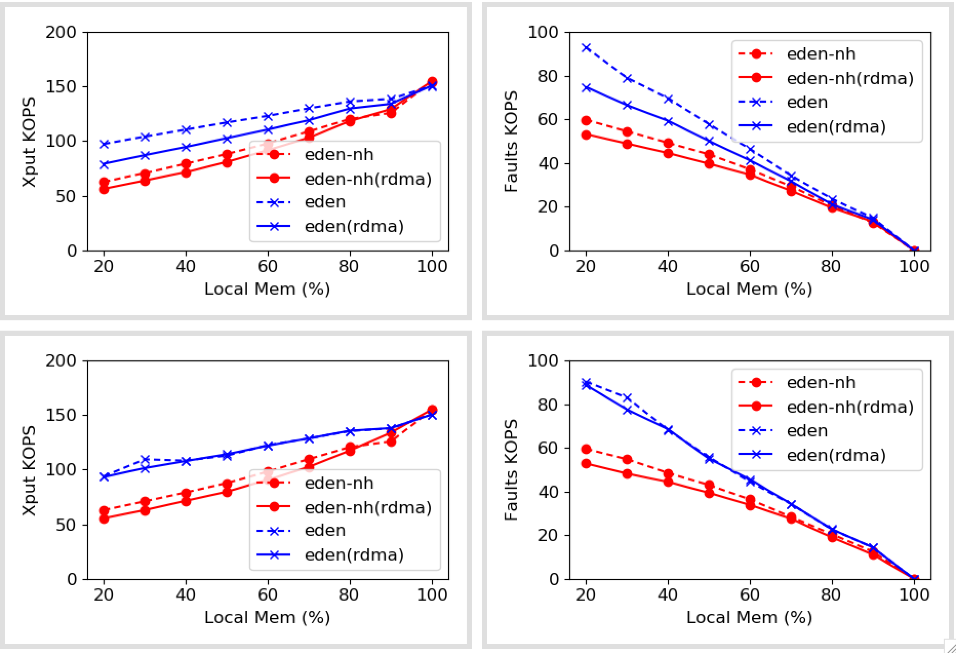
Synthetic
1 Thread
Per core
5 Threads
Per core
1 cores

Slide 4
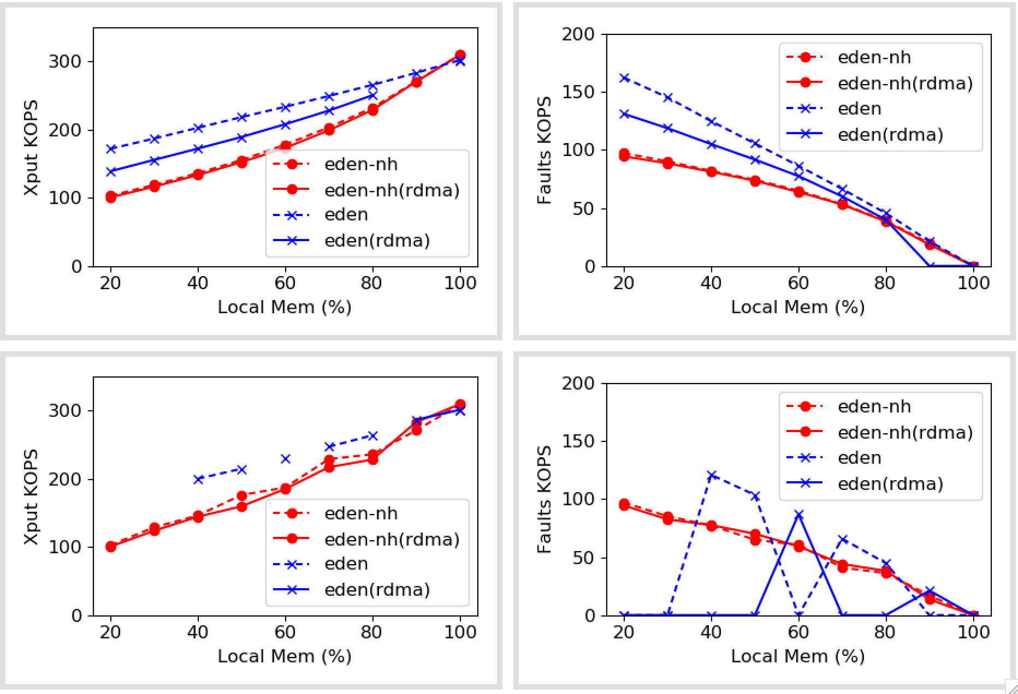
Synthetic
1 Thread
Per core
5 Threads
Per core
2 cores

Slide 5
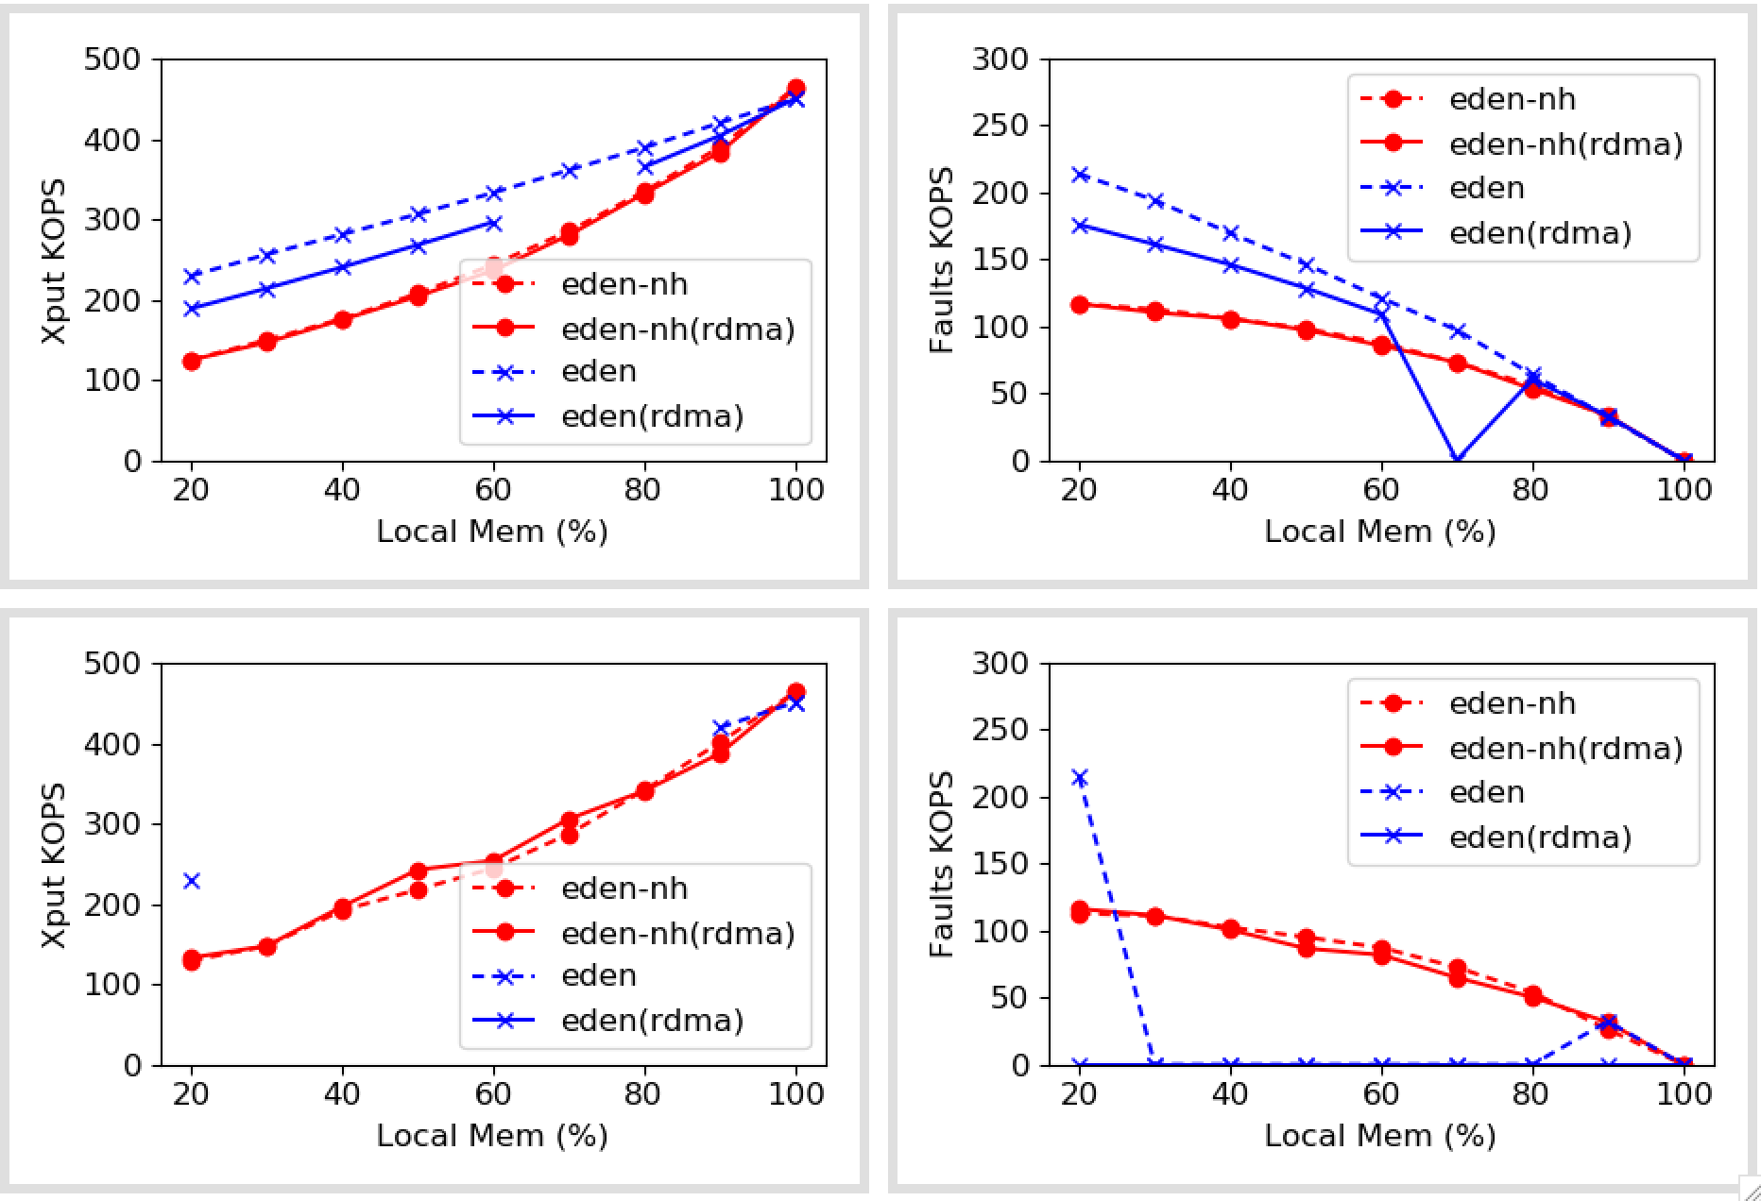
Synthetic
1 Thread
Per core
5 Threads
Per core
3 cores

Slide 6
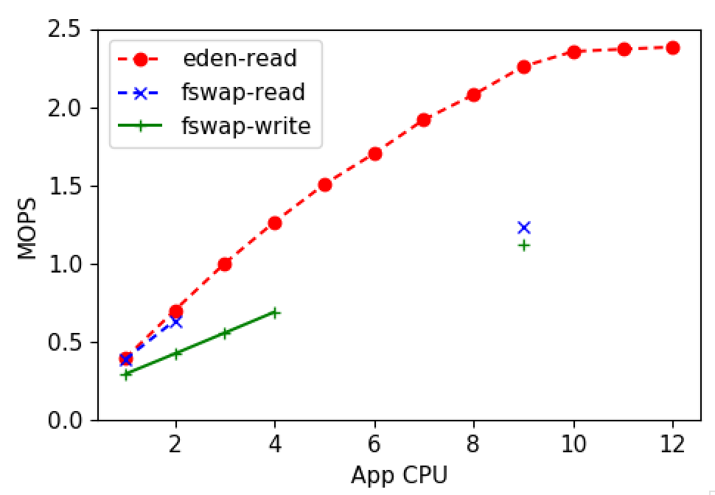
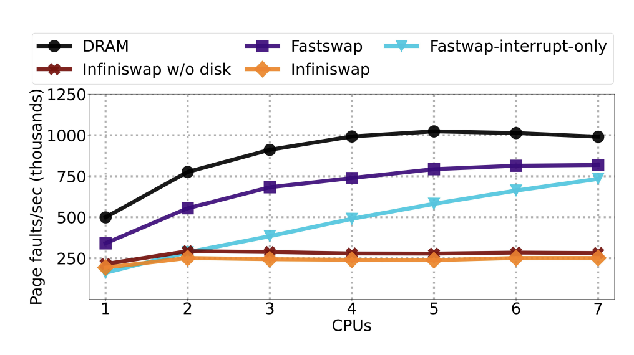
Fastswap
Still running on 4.11
Benchmark fails often
Rebased on 5.15, checked with Emmanuel
Yet to test 5.15

