Slide 1
Outline
Memcached Fault Flame Graph
Discussion

Slide 2
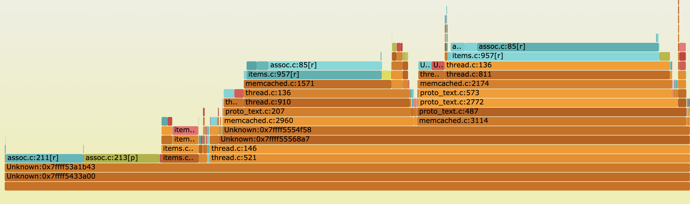

Memcached
Data issues:
Unknown locations: libevent?
Locations often off by a few lines; would be challenging for other apps. macros?
Unwrapped inlined functions
Some observations:
Read followed by write is very common → less unique locations than we see
Unknown main locations due to thread entry points
Trying to understand the small medleys, lot of them disappear at higher mem %
Get path
Set path
LRU code
Expand code
Notes:
Why is it that the big ones dominate?
What fraction of the calls cause a fault in the faulting IP and the locations higher in the stack?
Color coding: just color the leaf nodes. Or just the top faulting locations.
Sanity check with the previous numbers
Talk to Deians students

Slide 3
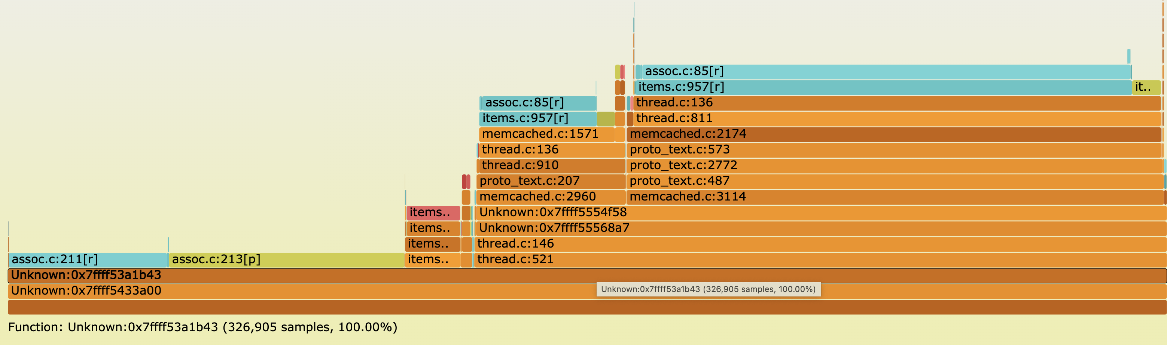
Memcached (50% mem)

Slide 4
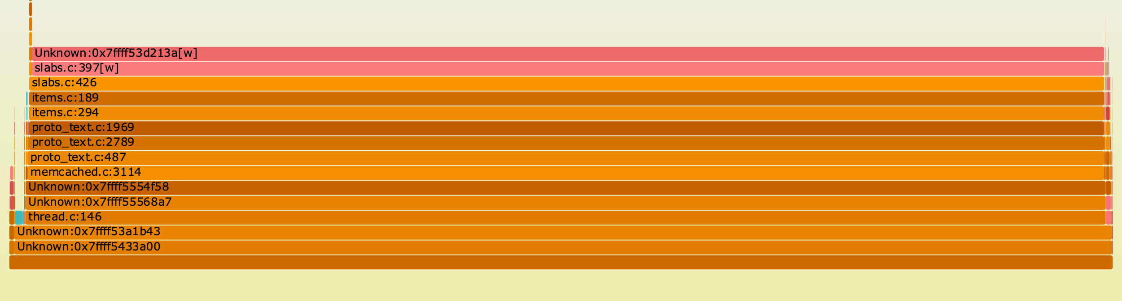
Memcached
Allocation Faults
Mostly just one place: new slab allocation on writes
These might be important in the CXL world

Slide 5
Next
Coming meetings (Mar 8th, 15th)
OSDI Rebuttal – Mar 6th to 8th
More flame graphs: Redis, PARSEC and Graph

