Slide 1
Outline
Recap: high-level questions
We no longer need no-pie builds!
We’ll look at code locations for all KVS apps
CXL emulator discussion

Slide 2
Refresher
Reasons behind fewer locations
Looking into source code for few more apps: KVS apps in-progress.
How to prove/disprove the current hypothesis?
Hints for CXL-based memory tiering
Intuition: hints can encapsulate static profiling information
Premise: consistent memory access behavior follows major faulting locations e.g., cache-lines accessed, page access intensity, intensity-aware allocation, etc.
Where to start?

Slide 3
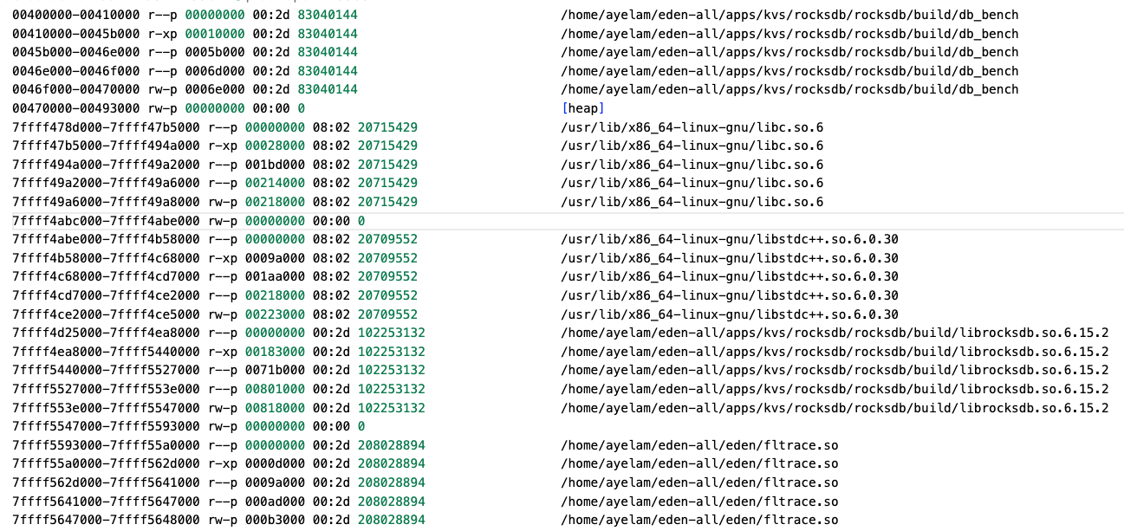
Avoiding no-pie
/proc/<pid>/maps

Slide 4
Avoiding no-pie
Fltrace dumps the proc map along with fault traces
Post-processing scripts look up the library base address & file path
addr2line the relative position in the library
Always gets the trace!

Slide 5
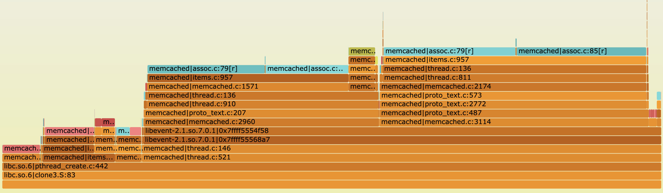
Memcached (HotOS version)
LRU
Crawler
LRU
juggles
LRU
bumps
pointer table access
Item access
Connection handling

Slide 6
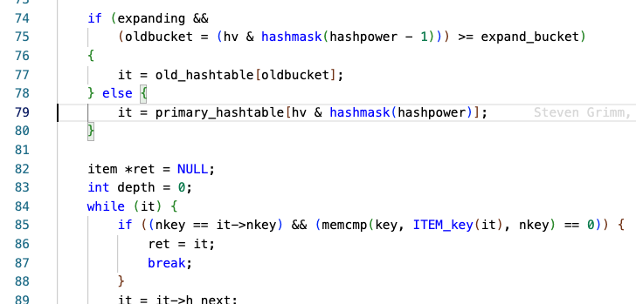
assoc:85
Item access
Eden’s major hinting location

Slide 7
assoc:79
Hash table bucket access
Would have been a nice reclaim priority candidate!
And to pin in local memory, in the CXL case
More generally, can we see the span of memory the locations bring in vs how intense they are to estimate their weight in local memory?

Slide 8
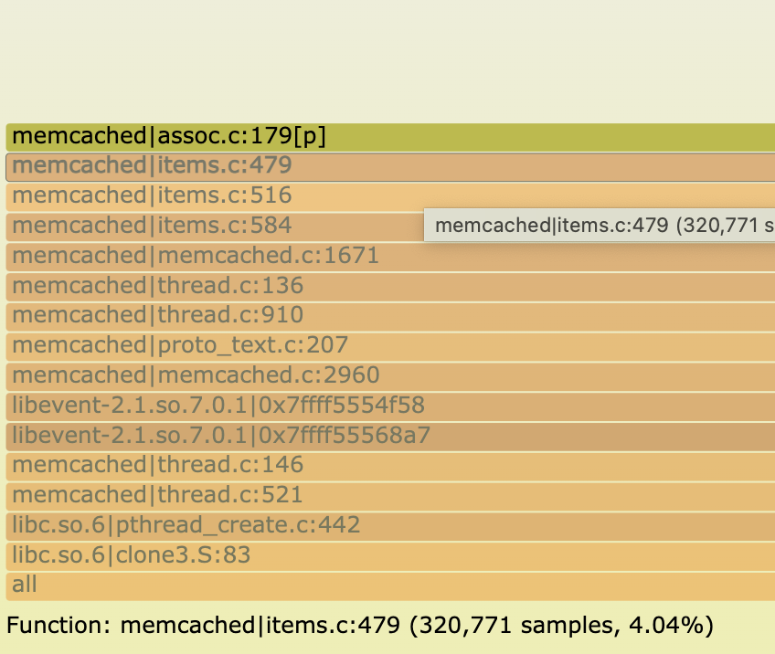
assoc:179
Item delete or unlink path
Stack trace doesn’t quite line up

Slide 9
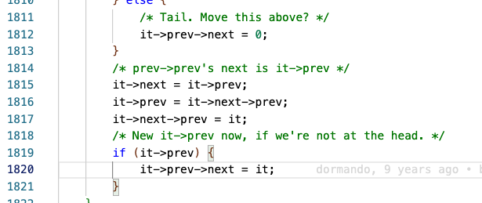
items:1820 (LRU Crawler)
Dedicated thread for kicking out expired items
Moves the special crawler item along the linked list

Slide 10
items:1820 (LRU Crawler)
Dedicated thread for kicking out expired items
Moves the special crawler item along the linked list

Slide 11
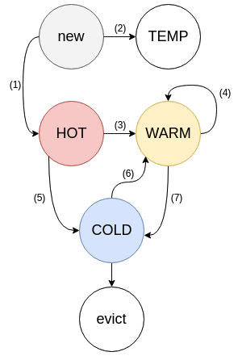
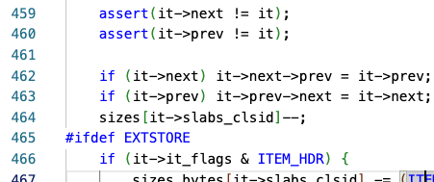
items:463 (LRU Maintainer juggles)
Dedicated thread for “maintaining” LRU lists
This line removes an item from a list (to add to higher list or evict)

Slide 12
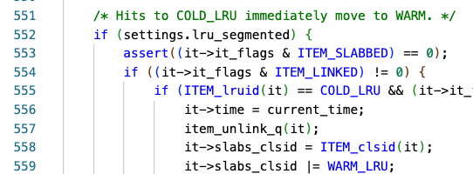
items:554/556 (LRU Maintainer bumps)
Same maintainer thread
Asynchronous bumps for accessed cold items

Slide 13
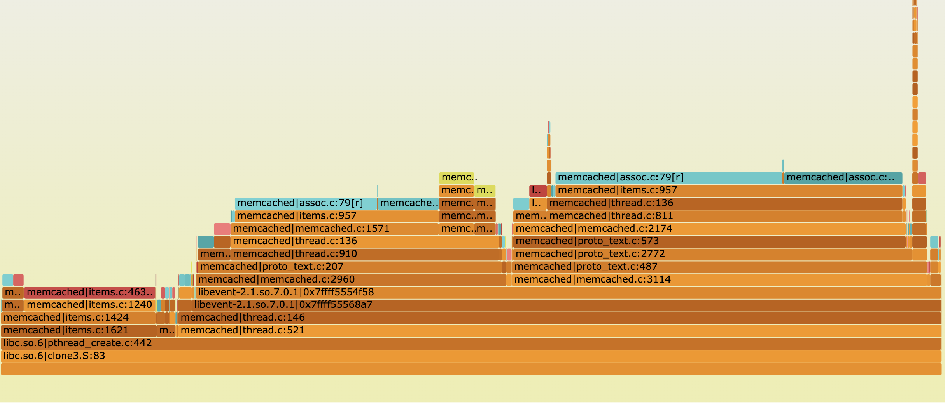
New learnings?
Code paths were mostly disjoint
At the same memory size, running a smaller input highlights more locations

Slide 14
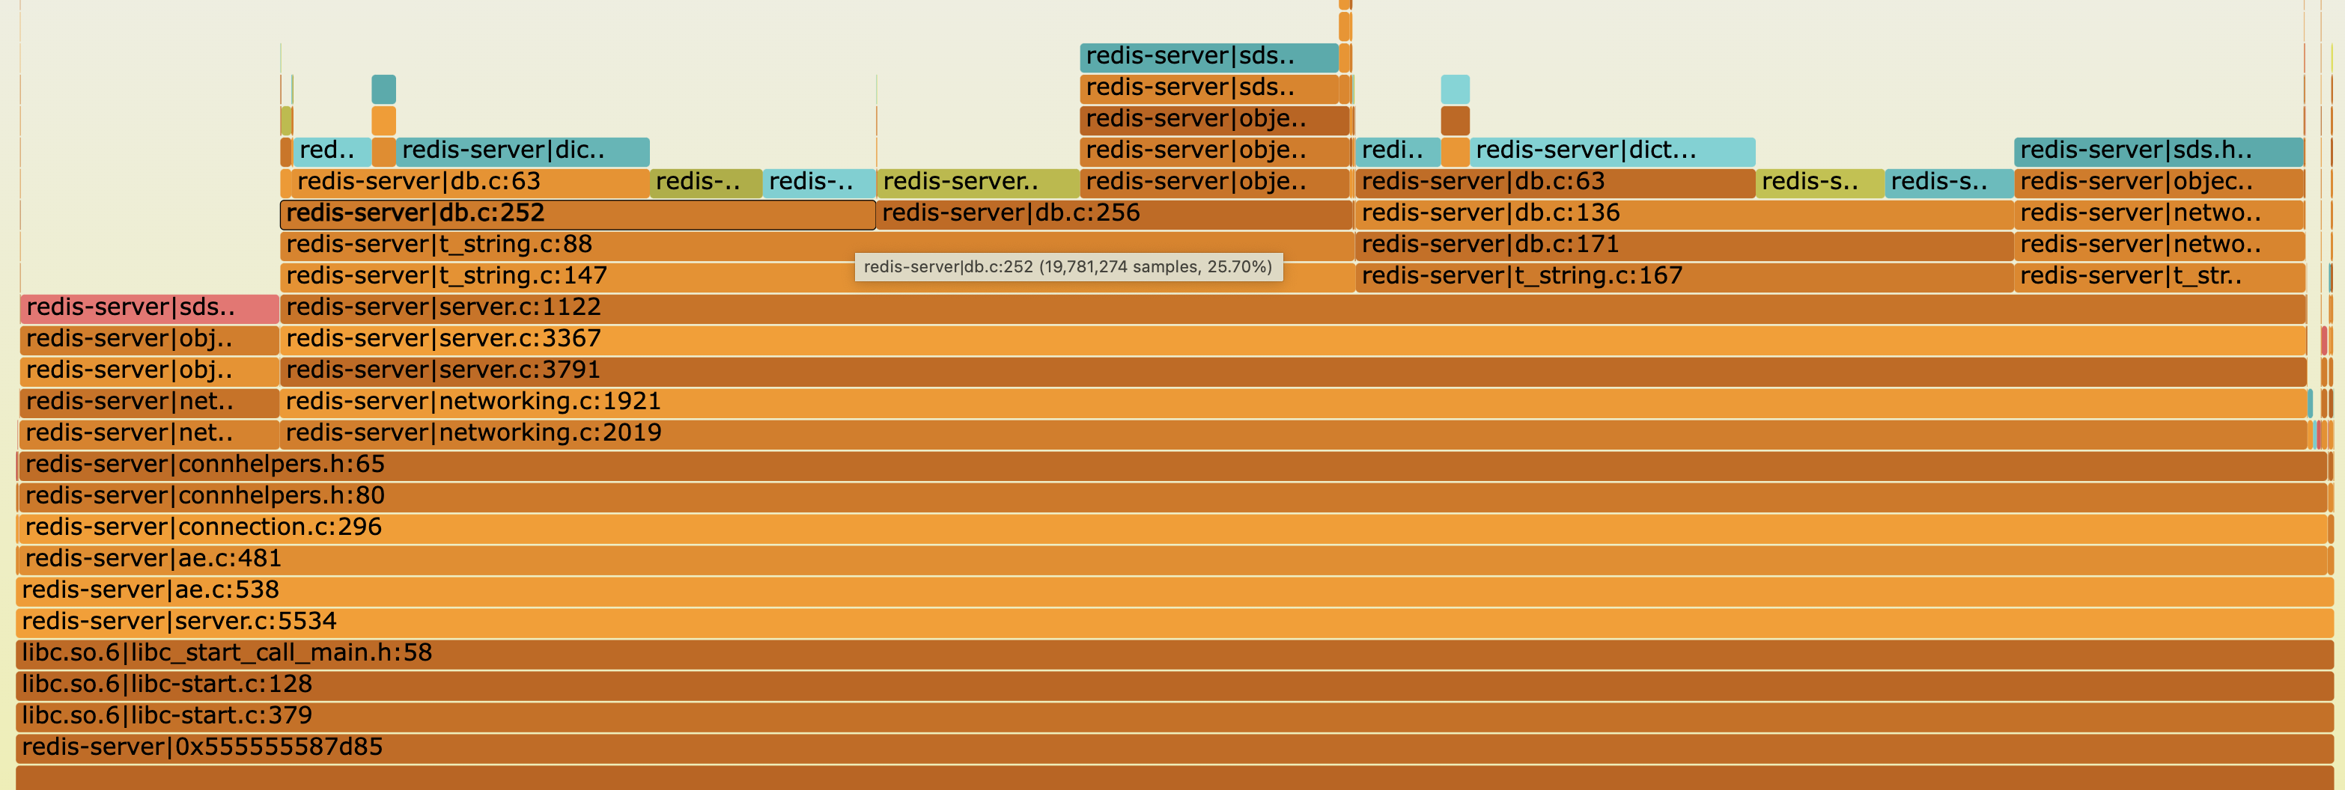
Redis: Preview
Get command
Set Command

Slide 15
Next
Redis drilldown
CXL: thinking about next steps

Slide 16
Misc

Slide 17
Emulator Candidates
Using another NUMA socket as remote node
Bandwidth control with “DRAM thermal control feature”
Latency emulation with software-added delay
Intel PMEM, HP Quartz, etc.

Slide 18
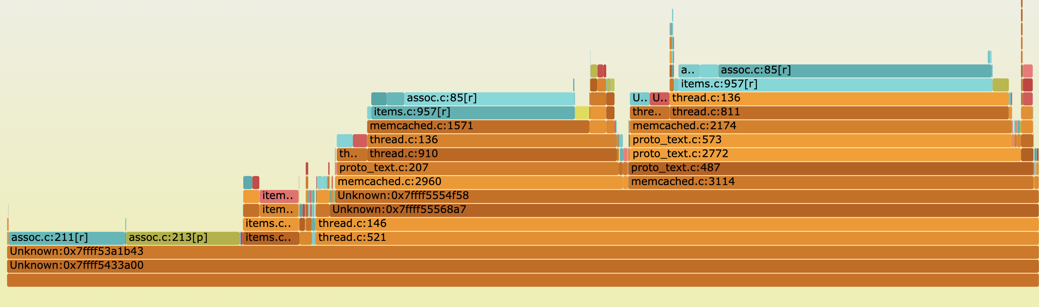

Memcached
Data issues:
Unknown locations: libevent?
Locations often off by a few lines; would be challenging for other apps. macros?
Unwrapped inlined functions
Some observations:
Read followed by write is very common → less unique locations than we see
Unknown main locations due to thread entry points
Trying to understand the small medleys, lot of them disappear at higher mem %
Get path
Set path
LRU code
Expand code
Notes:
Why is it that the big ones dominate?
What fraction of the calls cause a fault in the faulting IP and the locations higher in the stack?
Color coding: just color the leaf nodes. Or just the top faulting locations.
Sanity check with the previous numbers
Talk to Deians students

Slide 19
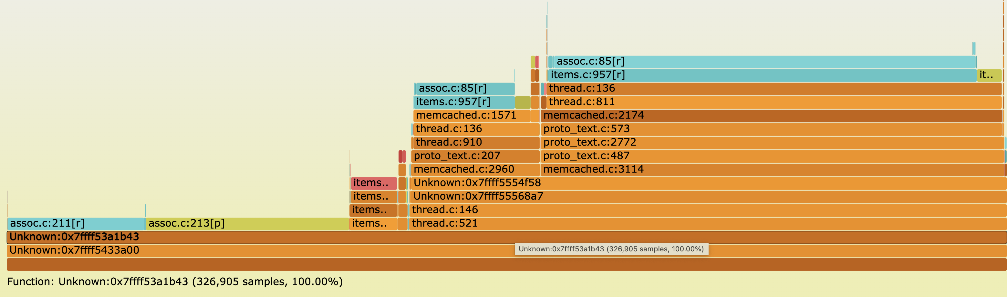
Memcached (50% mem)

Slide 20
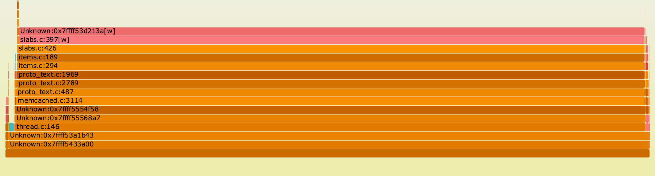
Memcached
Allocation Faults
Mostly just one place: new slab allocation on writes
These might be important in the CXL world

Slide 21
Next
Coming meetings (Mar 8th, 15th)
OSDI Rebuttal – Mar 6th to 8th
More flame graphs: Redis, PARSEC and Graph

