Slide 1
Agenda
Pond results repro
Emulating/modelling higher latencies
Eden backlog
DataFrame number of hints/LOC/etc.
DiLOS comparison

Slide 2
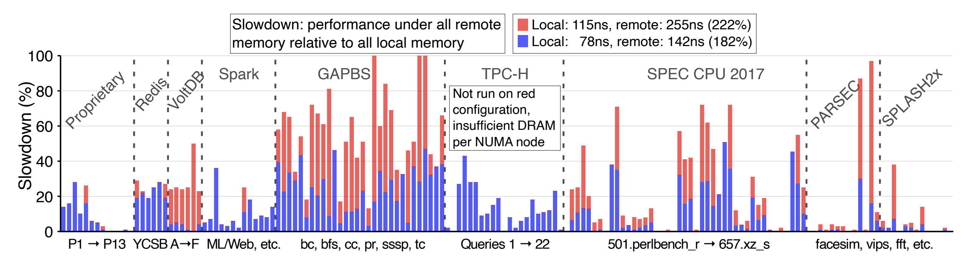
Pond: Latency-sensitivity study
Slowdown generally doubles when remote latency goes from 1.8x to 2.2x.
How would it look at, say, 5x? Is there a good way to estimate?
Should we be worrying about bandwidth sensitivity too?

Slide 3
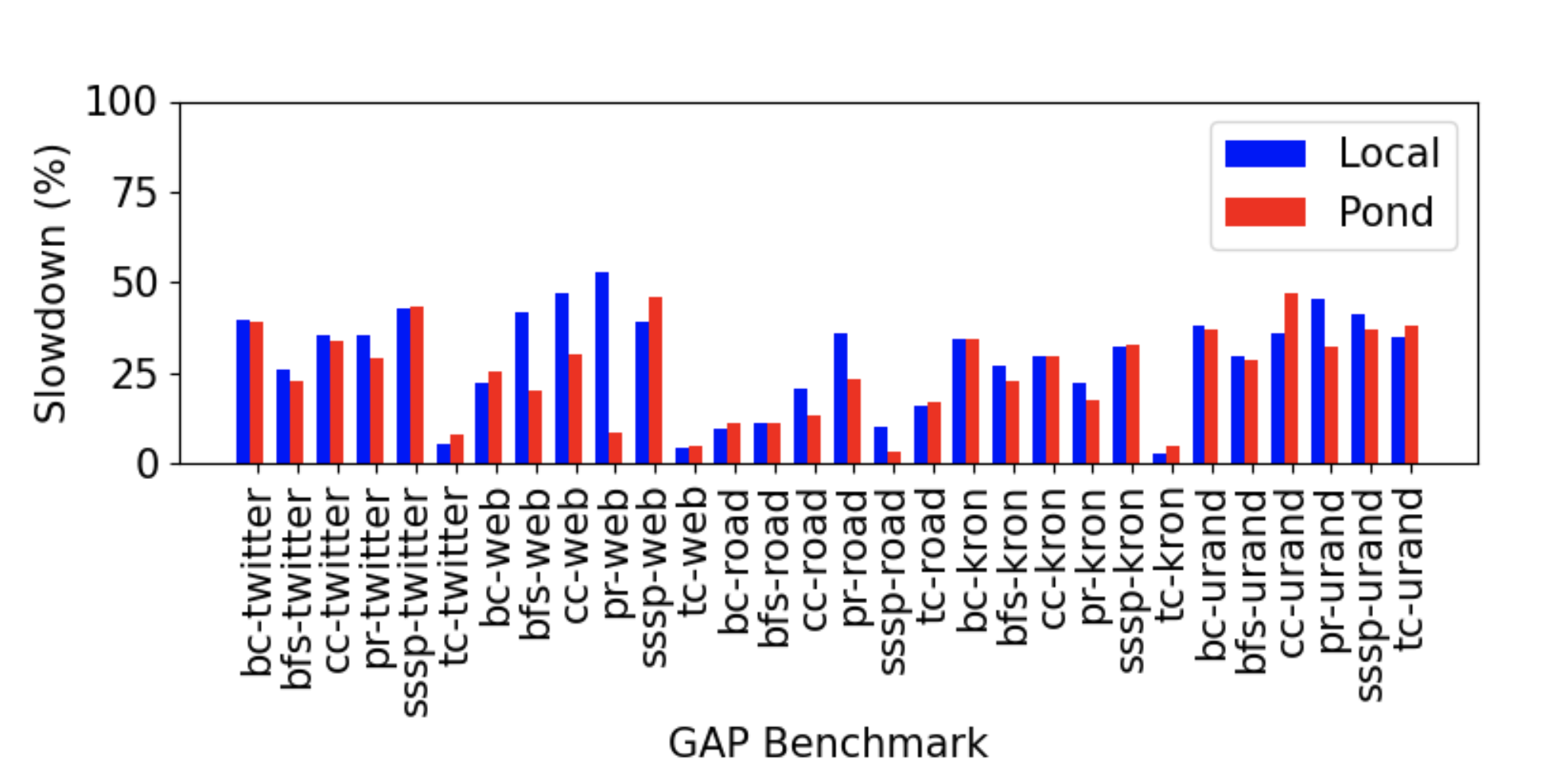
GAPBS Ours v. Pond
From Intel MLC tool
Our testbed
Local: 89 ns / 65 GBps
Remote: 153 ns / 31 GBps (171%)
Pond: 183%

Slide 4
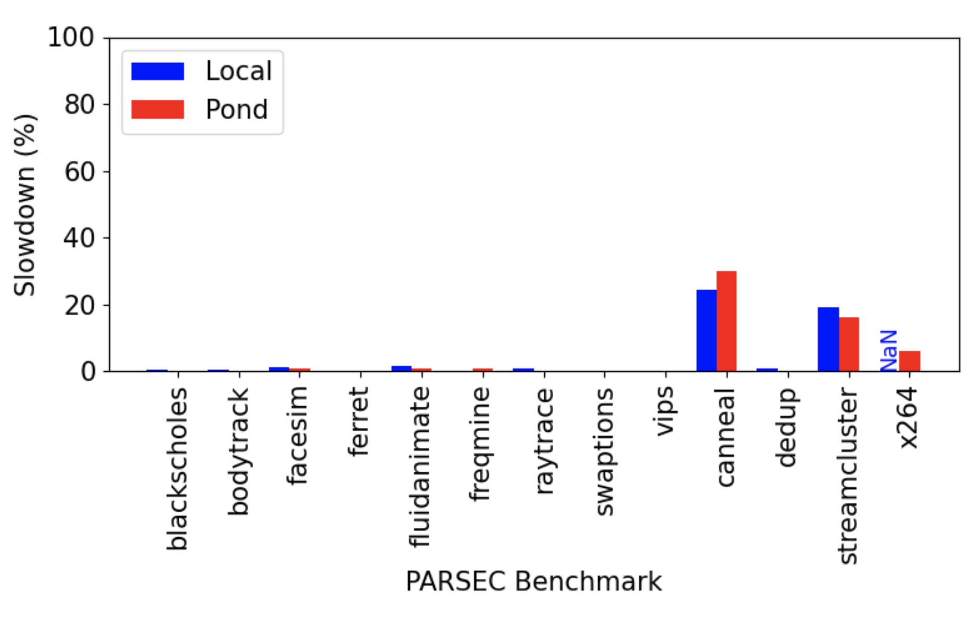
PARSEC Ours v. Pond
From Intel MLC tool
Our testbed
Local: 89 ns / 65 GBps
Remote: 153 ns / 31 GBps (171%)
Pond: 183%

Slide 5
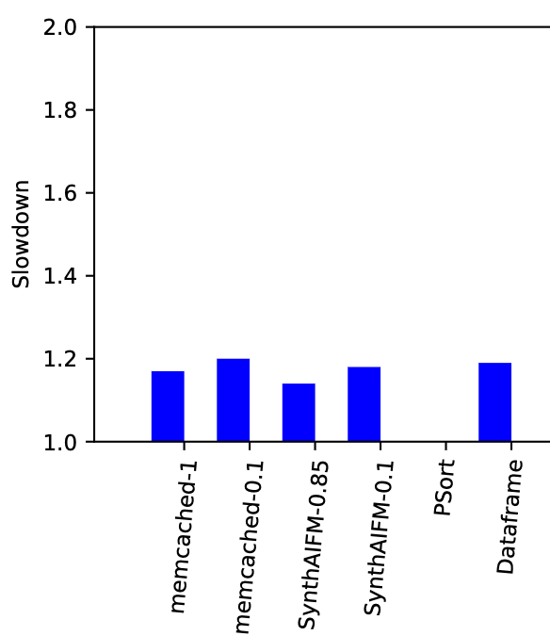
Eden apps
From Intel MLC tool
Local: 89 ns / 65 GBps
Remote: 153 ns / 31 GBps (171%)

Slide 6
Performance at higher latencies
Intel PMEP – best but deprecated?
Extrapolate based on memory access counters
Runtime = memory_ops * mem_latency + C
Does not account for architecture-level latency hiding, prefetching, etc.
Memory accesses from perf counters
mem_load_l3_miss_retired.local_dram
mem_load_l3_miss_retired.remote_dram
Not sure if they (or how to) capture stores yet…

Slide 7
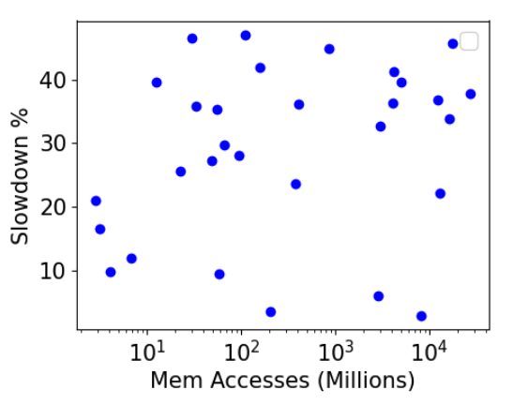
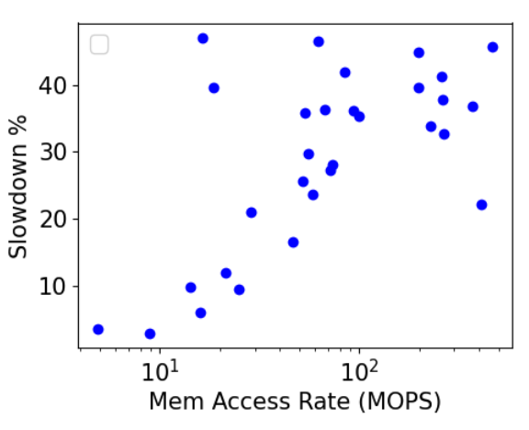
GAP slowdown v. remote accesses
Very little correlation with total accesses, some correlation with the access rate
Reasons?
Bandwidth
store accesses
Total Memory Accesses
Correlation: 0.14
Memory access rate
Correlation: 0.44

Slide 8
Next steps
Correlation with memory bandwidth
Get fine-grained memory access stats
Any other ways you can think o

Slide 9
Misc

Slide 10
HotBox
Better move_pages call
Hotness fragmentation

Slide 11
DilOS v. Eden

Slide 12
Look at web workloads
PMEM testbed
Eden on sysnet testbed
VMware lease
Any new experiments for Eden

