Slide 1
EdenOS
עדן פרנקל

Slide 2
The Boot Process
Bootloader (sets the environment for the 32bit kernel and loads the kernel to the memory( - written in Assembly
Jumps to
Bootstrap (the beginning of the kernel code that jumps to the main kernel function) - written in Assembly
Jumps to
Main Kernel (the main kernel code, also initiates the system: interrupts handling, process management and more) - written in C

Slide 3
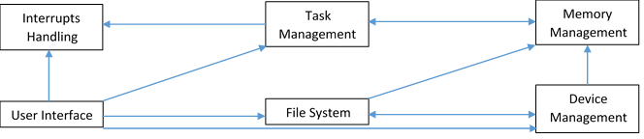
Communication Between Parts of the OS

Slide 4
Modules
EdenOS
Console
Command Line
Dynamic Memory
Paging
Memory Management
Keyboard
Processing
USB
BBB (Bulk Only Transport)
Time
SCSI
EdenFS (Filesystem)
Interrupts
IDT (Interrupt Descriptor Table)
String
Main Kernel
Printing to the screen
Preforming operations on strings and memory areas
Getting input from the keyboard
Handling interrupts
Setting up and manipulating the IDT
Keeping track of time
Providing the User Inteface
Managing the allocation and deallocation of pages from the memory
Managing the allocation and deallocation of pages from the memory
Managing the Paging data structure of virtual to physical pages
Managing the multitasking and the context switching.
Managing the communication with the USB devices
Managing the communication with the Mass Storage BBB device.
An interface to create SCSI Command Packets
Formatting and managing the filesystem.
The main kernel code that is executed after boot
PCI
Getting the information about the devices of the system

Slide 5
Paging
Register CR3 (pointer to the Page Directory)
Page Directory
Page Table 1
Page Table 2
Page Table 3
…
Page Table 1024

Slide 6
Interrupt Handing
IDT Entry
The IDT entry points to the ISR (interrupt Service Routine) of the Interrupt.
ISR
The ISR pushes the IRQ (Interrupt Request) number and jumps to the Interrupt Handler.
Interrupt Handler
The Interrupt Handler checks the IRQ number and jumps to the handler of the specific Interrupt.
Specific Handler
The Interrupt is handled.

Slide 7
Command-Prompt
Input
Getting input from the user.
Parsing the Input
The input is parsed into a command name and arguments.
Searching for Command
Searching for the command in the Commands data structure
A new thread is created, and the Command is executed. The arguments are passed to the Command’s function.
Starting the Operation
Waiting
Unless explicitly specified, the Command Prompt waits for the thread to terminate before continuing to the next Command.

Slide 8
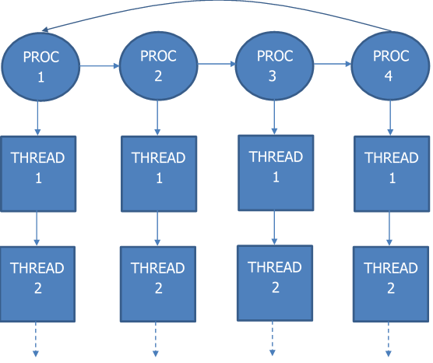
Multitasking

Slide 9
Levels of Communication with the USB Device
UHCI (Universal Host Controller Interface)
The basic level of communication. Here are the packets transferred.
SCSI (Small Computer System Interface)
Mass Storage Class—BBB (Bulk-Only Transport)
The first level of the packets. Here are used two wrappers to wrap the packets: Command Block Wrapper and Command Status Wrapper.
On this level of communication, the actual commands to the chipset inside the USB Drive are passed. This is the uppermost level of communication.

Slide 10
EdenFS Directory Part and File Part Structures
Directory Part
Part Size Field
Entry (Name + Directory Pointer or File Pointer)
Entry (Name + Directory Pointer or File Pointer)
…
Pointer to next part of the Directory, or 0, with additional flags
File Part
Part Size Field
Data
Data
Pointer to next part of the File, or 0, with additional flags
…

