Slide 1

PyBank
Simplified Banking System with Tkinter and SQLite

Slide 2
Index
Objective
Introduction
Methodology, Approach & Techniques
Result
Source Code (screenshots)
Conclusion
Reference

Slide 3
OBJECTIVE
Develop a simple banking system using Python's Tkinter library for GUI and SQLite for database management.
Provide functionality for users to withdraw funds, ensuring sufficient balance and maintaining a minimum balance constraint.
Implement a feature to display account details including name, account number, and balance.
Facilitate easy navigation through radio buttons for selecting withdrawal or deposit actions.
Ensure data persistence by storing account information in a SQLite database.
Employ error handling mechanisms to notify users about invalid inputs or insufficient funds during transactions.

Slide 4
INTRODUCTION
This project aims to create a simple banking system using Python's Tkinter library for graphical user interface (GUI) and SQLite for database management. Users can open new accounts, deposit funds, withdraw funds, and view account details. The system ensures data integrity and implements error handling for user input validation.

Slide 5
Methodology, Approach & Techniques
GUI Development: Utilize Tkinter library in Python to design a user-friendly graphical interface for the banking system.
Database Management: Employ SQLite for creating and managing the database to store account information securely.
CRUD Operations: Implement Create, Read, Update, and Delete (CRUD) operations to manage account data effectively.
Transaction Handling: Ensure proper handling of deposit and withdrawal transactions, maintaining data consistency and integrity.
Minimum Balance Constraint: Enforce a minimum balance constraint to prevent overdrawing, ensuring financial stability for account holders.

Slide 6
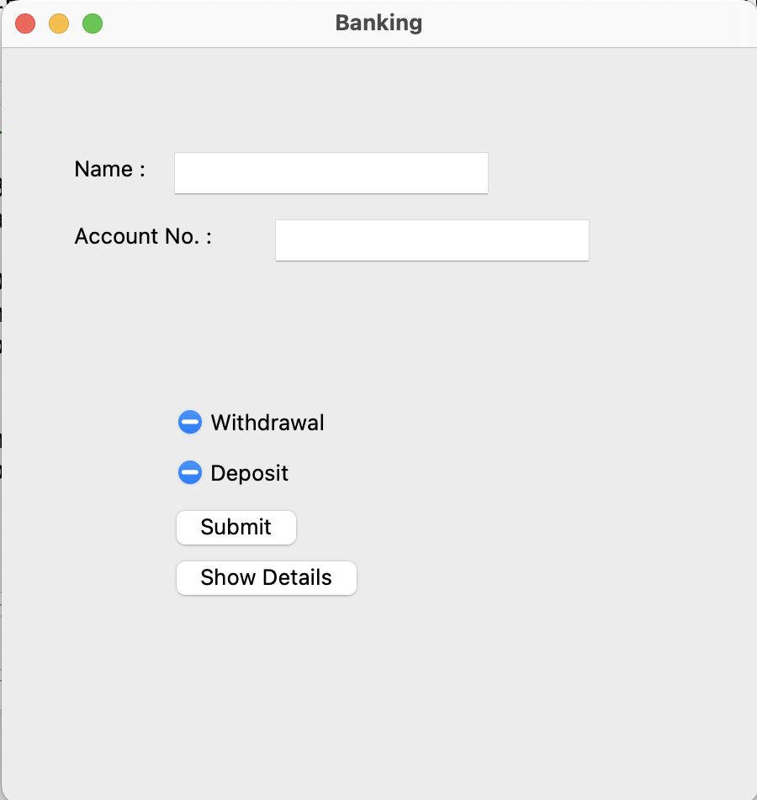
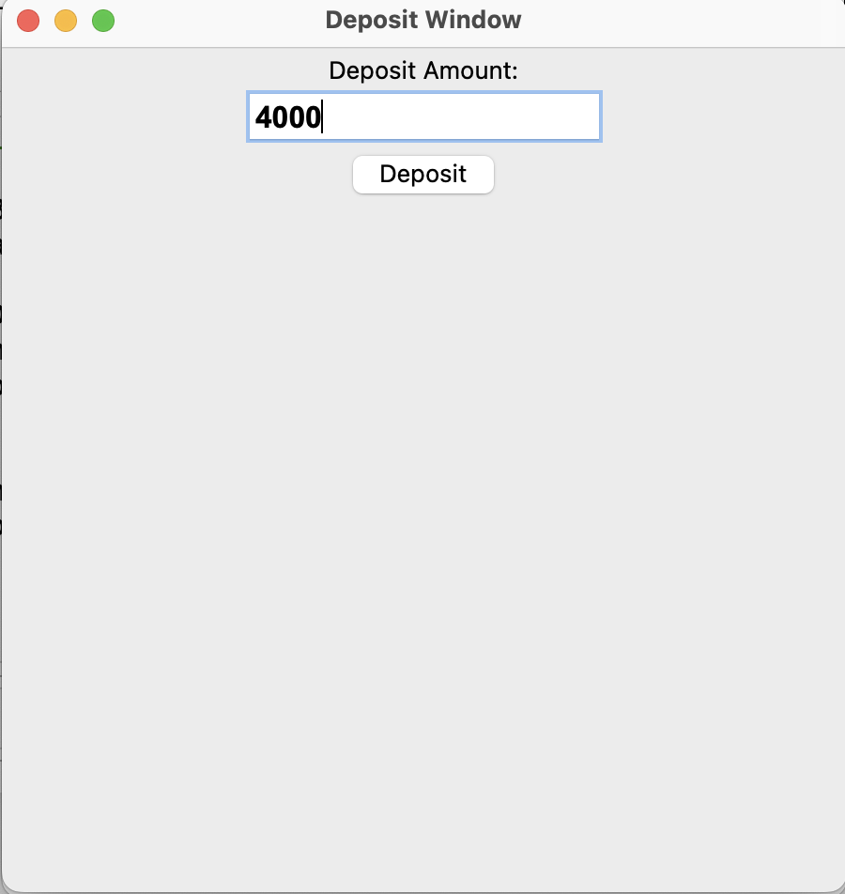
RESULT
Main Window
Deposit Window

Slide 7
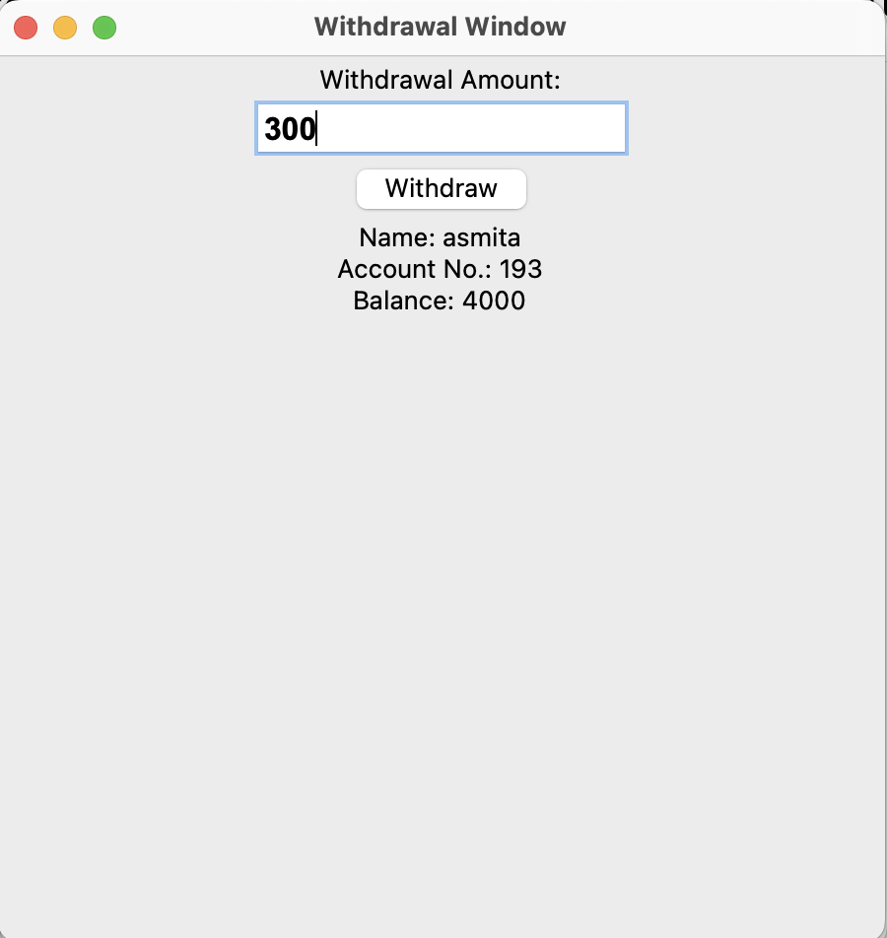
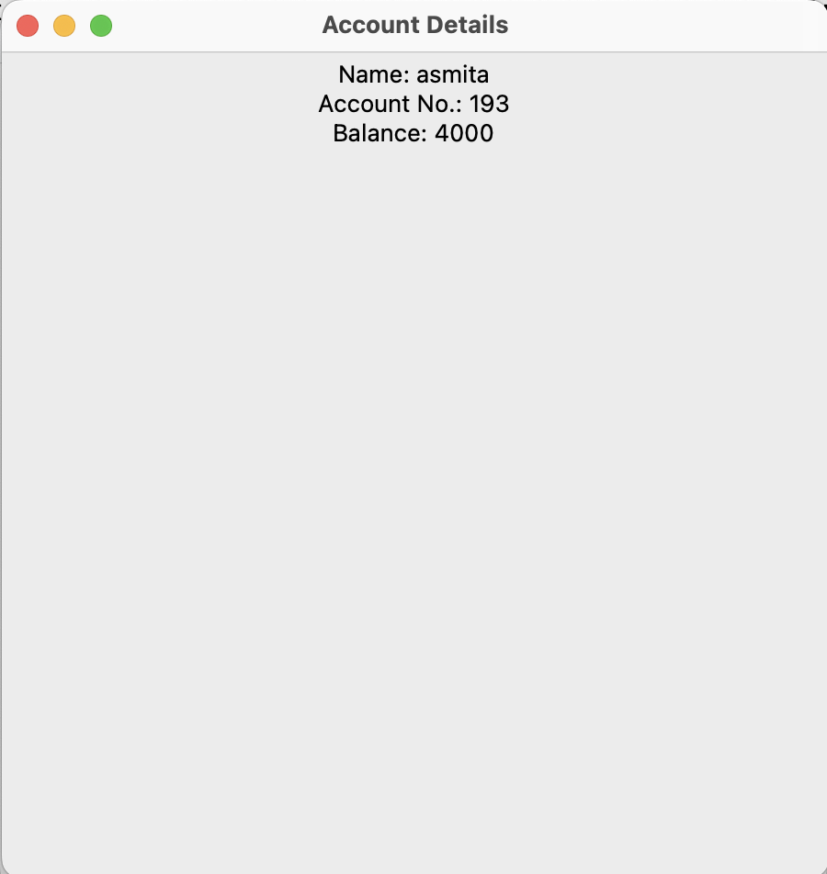
RESULT
Withdrawal Window
Account Details

Slide 8
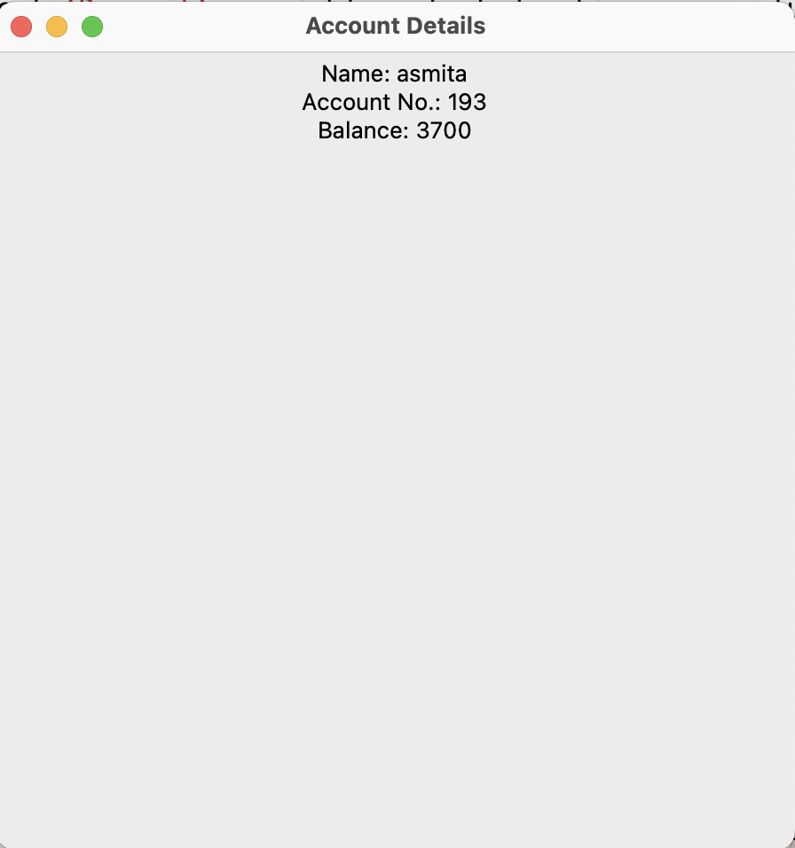
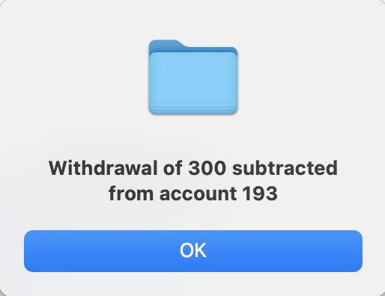
RESULT
Message box
Account Details after withdrawal

Slide 9
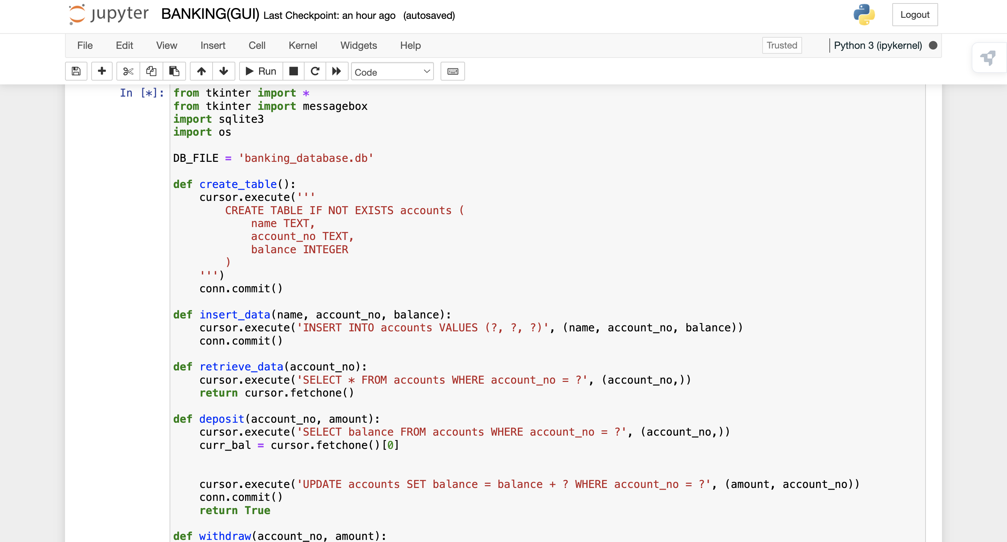
SOURCE CODE

Slide 10
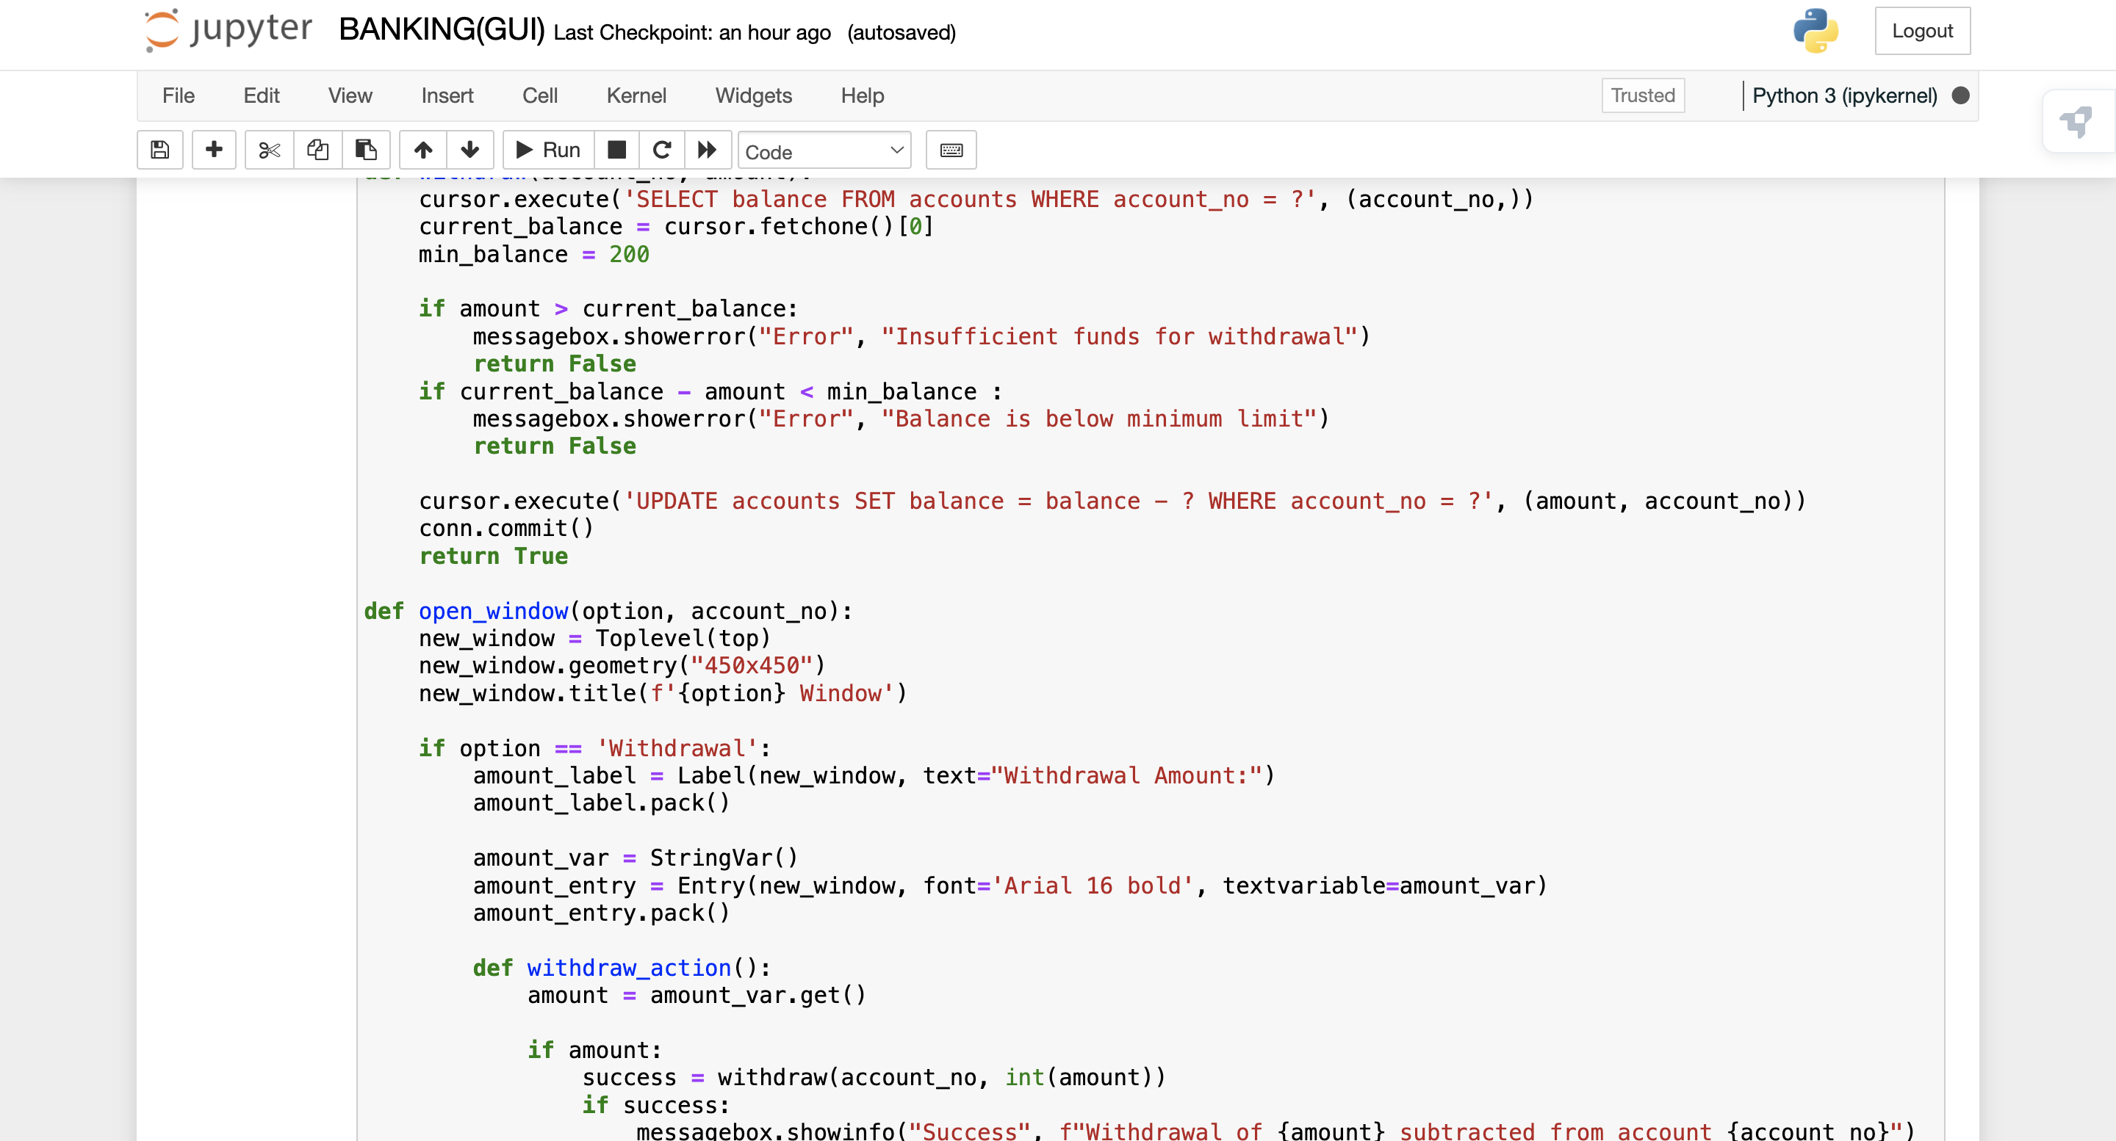
SOURCE CODE

Slide 11
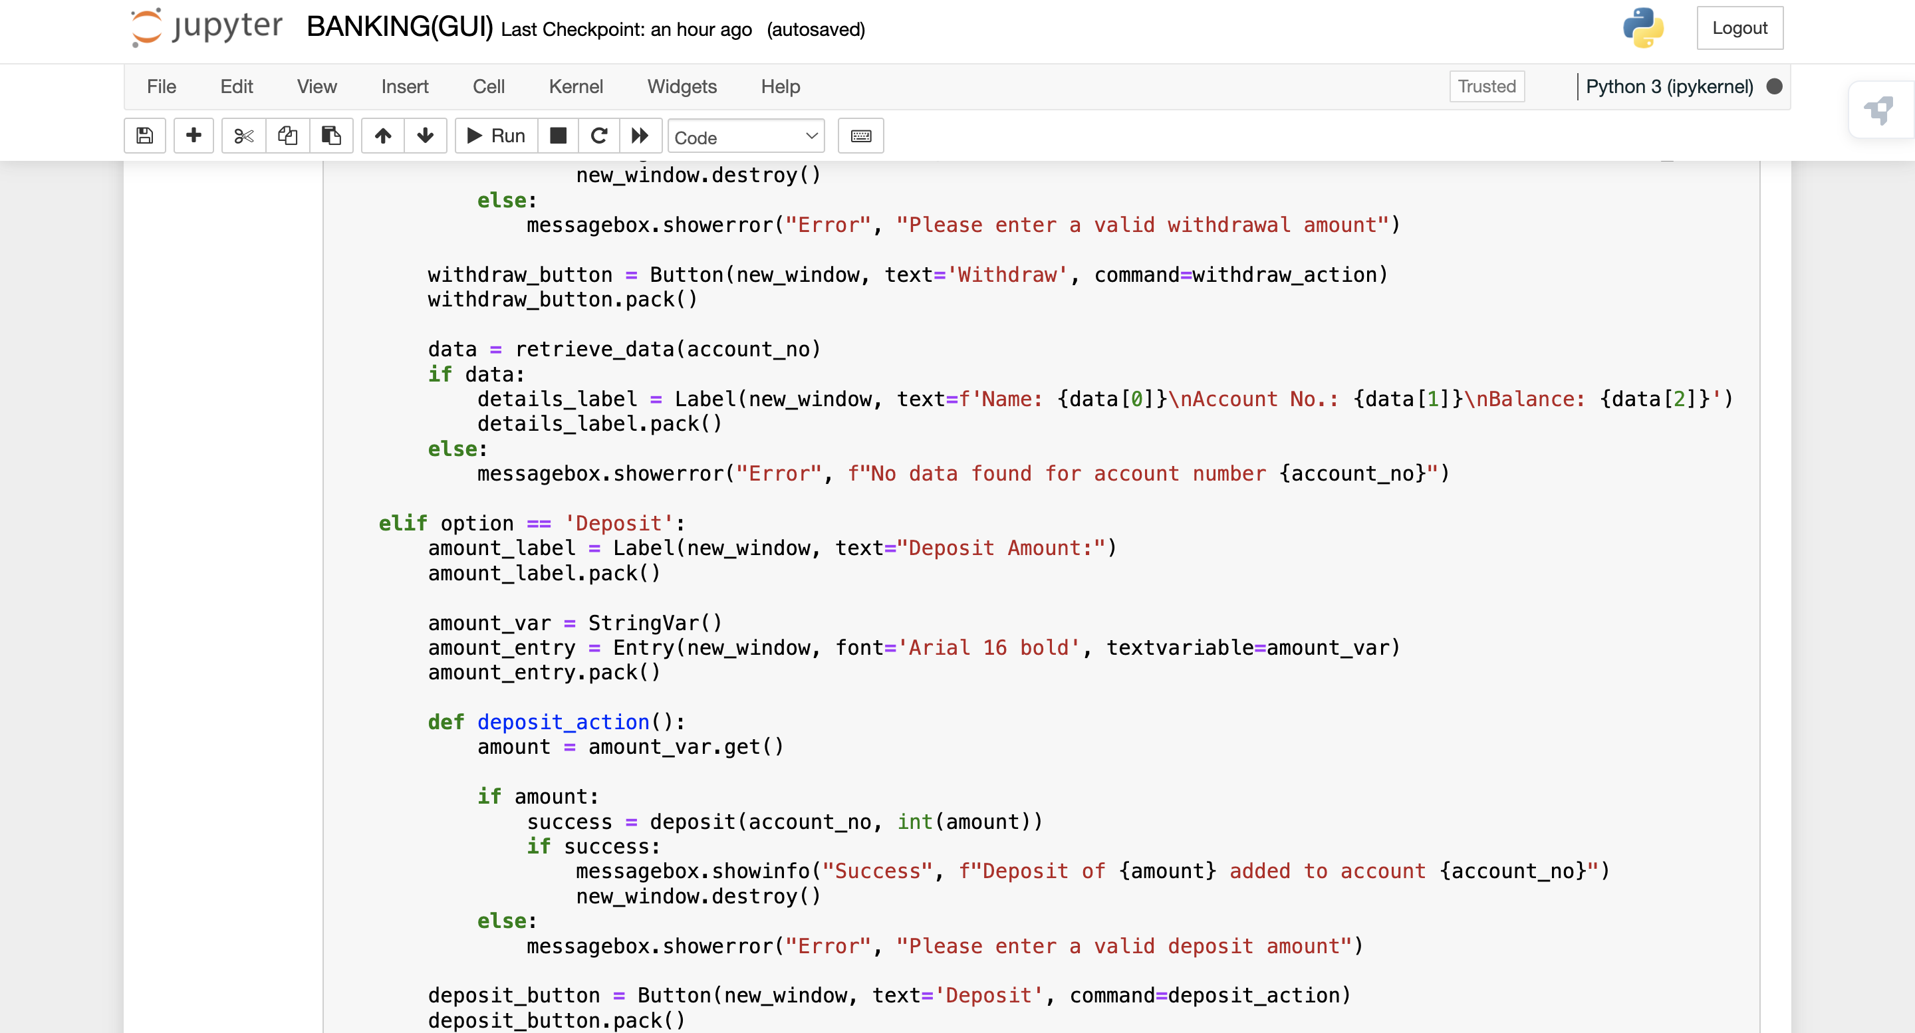
SOURCE CODE

Slide 12
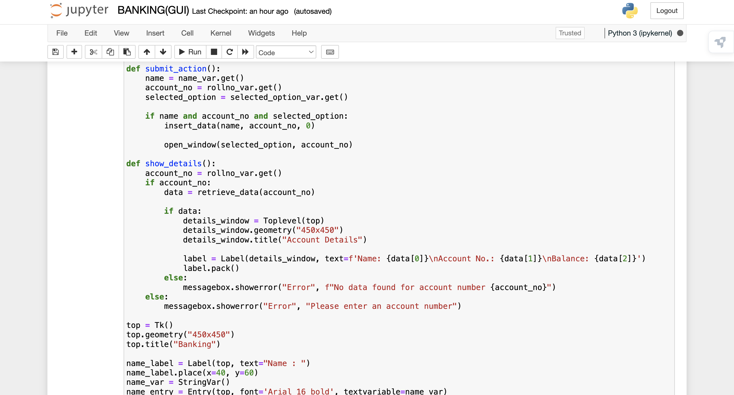
SOURCE CODE

Slide 13
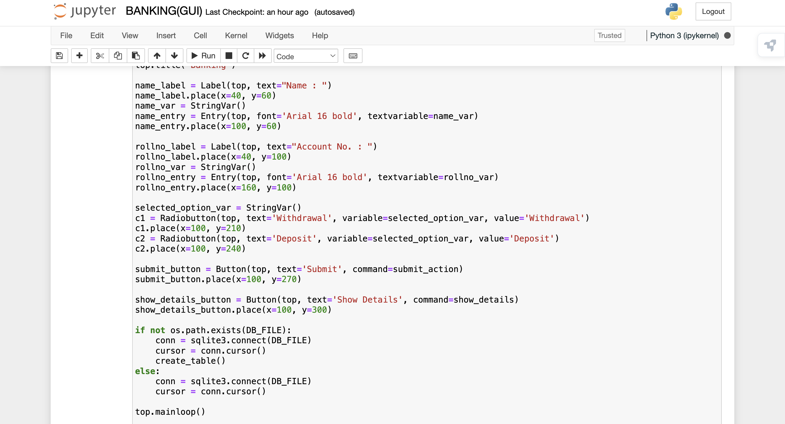
SOURCE CODE

Slide 14
CONCLUSION
Integration of Tkinter and SQLite: The project seamlessly integrates Tkinter for graphical interface development and SQLite for efficient database management.
Streamlined Banking Solution: Users experience a streamlined banking process, allowing them to perform various operations like depositing, withdrawing, and viewing account details effortlessly.
Robust Error Handling: The system incorporates robust error handling mechanisms to ensure smooth user interactions, handling invalid inputs and insufficient funds gracefully.
Data Persistence: Through SQLite, the system ensures data persistence, enabling users to access their account information reliably even after program restarts.

Slide 15
References
Stack Overflow, https://stackoverflow.com .
Tkinter Documentations ,https://docs.python.org/3/library/tkinter.html
SQLite Documentations , https://www.sqlite.org/docs.html
Learning SQLite for Python by Ian Howson

Slide 16
The End

