Slide 1
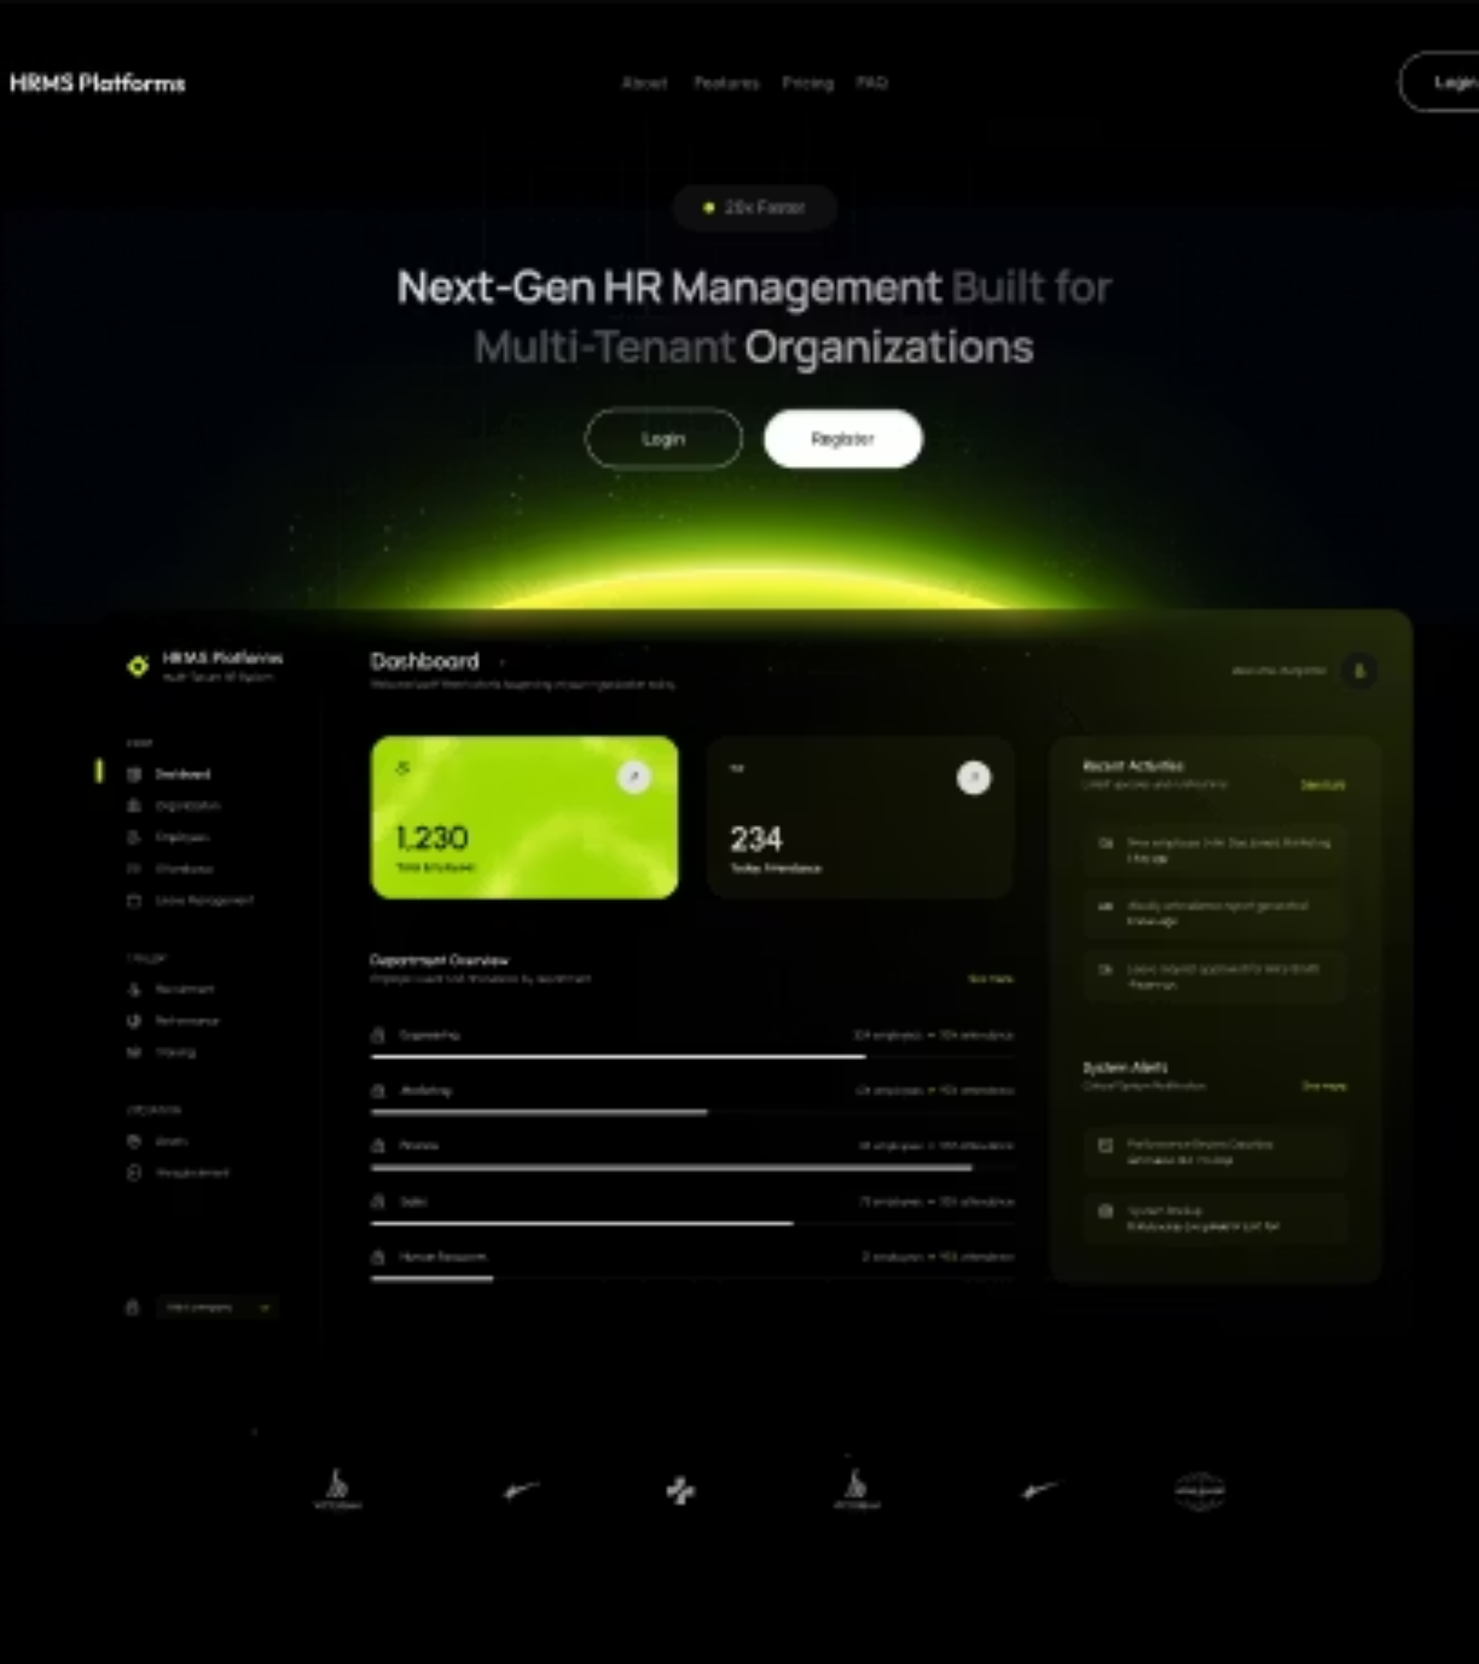
Internship Report
Human Resource Management System (HRMS) Development at AFRICOM PLC

Slide 2
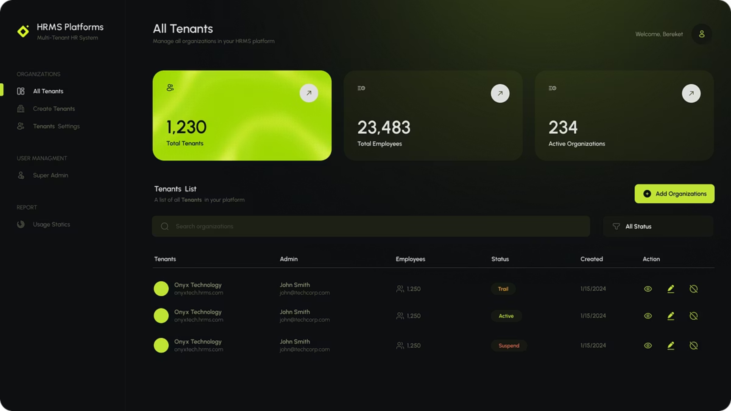
Development of a Multi-Tenant HRMS
Presented by: Salem Mesfin
ID: Ugr/25407/14
Department: Computer Science and Engineering
Adama Science and Technology University

Slide 3
Executive Summary
Internship Duration & Role
Project Focus
June 10, 2025 – September 22, 2025
Human Resource Management System (HRMS) with Multi-Tenancy Support.
Back-End Developer at AFRICOM PLC
Key Contributions
Skills Gained & Challenges
Gained practical experience in backend development, API design, database management, authentication, Git collaboration, and problem-solving.
Faced Git merge conflicts while collaborating in a multi-developer environment, which required careful coordination.
Weekly updates were not limited to planned tasks, demanding flexibility and strong time management.
User Interface Development
Multi-Tenant HRMS Support
Documentation and Knowledge Sharing
Authentication and Authorization

Slide 4
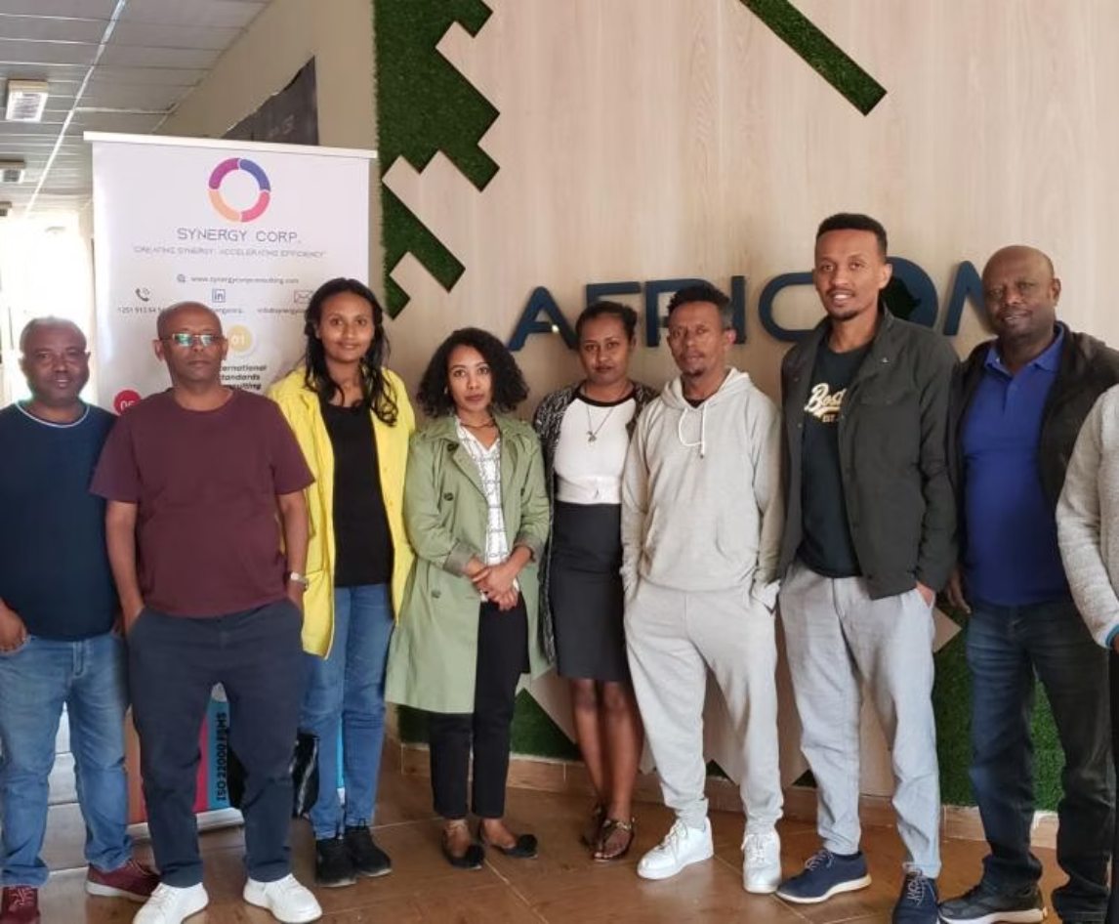
About AFRICOM PLC
Overview: Established in 2004, AFRICOM PLC is an ISO-certified IT solution provider based in Ethiopia, renowned for delivering innovative, secure, and high-quality IT solutions across the region.
Mission: Our core mission is to empower organizations by delivering reliable IT services, fostering digital transformation throughout Ethiopia and the wider African continent.
Products & Services
Software Development (MIS, ERP, HRMS)
Business Process Outsourcing (BPO)
IT Auditing
E-commerce Solutions
Single Window Projects

Slide 5


Internship Objectives
Specific Objectives
Design and implement database schemas to support multi-tenant HRMS functionality.
Develop and test RESTful APIs using .NET 8 for employee, role, and tenant management. Implement JWT authentication and Role-Based Access Control (RBAC) for system security.
Ensure smooth frontend-backend integration through well-structured API responses.

Slide 6
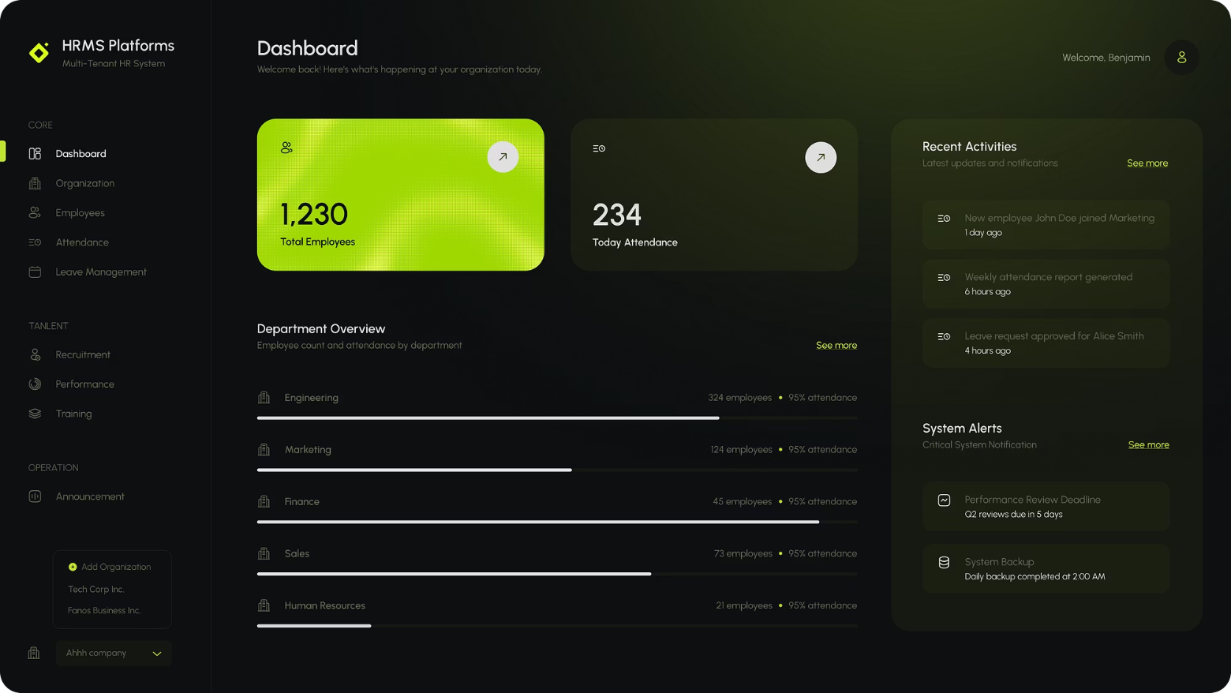
Project Overview – Multi-Tenant HRMS
Purpose: To significantly streamline and optimize human resource operations, covering key areas such as employee management, attendance tracking, and recruitment.
Key Features
Multi-tenancy for multiple organizations
Role-Based Access Control (RBAC)
Responsive dashboards and forms
Portals
Super Admin: Manage organizations, monitor usage
My Contributions
Admin User: Employee management, attendance, recruitment
Back-End Development
Employee Portal: Leave requests, performance reviews, announcements
I designed and optimized database schemas and developed RESTful APIs for HRMS modules.
Implemented JWT authentication and role-based access control (RBAC) for secure access.
Collaborated using Git, resolved merge conflicts, and ensured smooth frontend-backend integration.
Technologies Used
Front-End: React, Next.js, Tailwind CSS, React Hook Form, Zod
Back-End: Node.js, .NET 9, Next-Auth
Version Control: Git

Slide 7
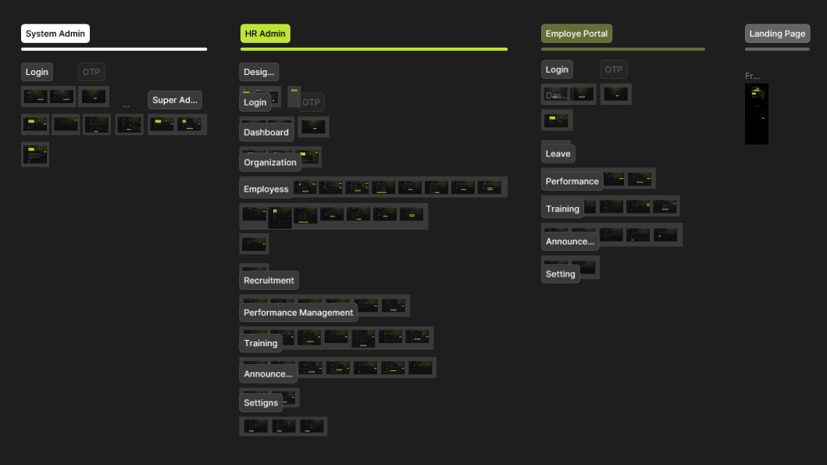
System Functionalities and Demonstration
Overall

Slide 8
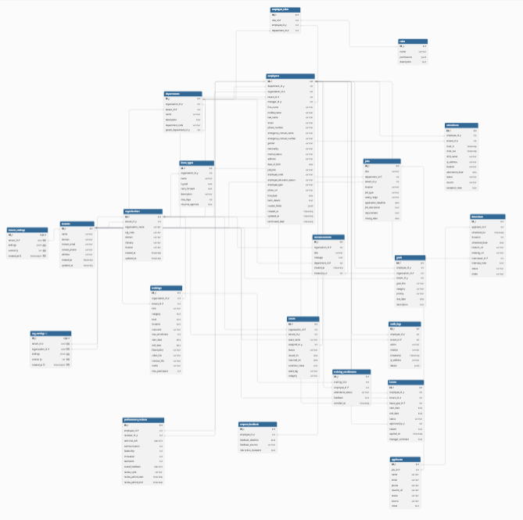
Design database

Slide 9
Create Models
using System;
using System.ComponentModel.DataAnnotations;
using System.ComponentModel.DataAnnotations.Schema;
namespace HRMS.Backend.Models
[Table("employees")]
public class Employee
{[Key]
[Column("id")]
public Guid EmployeeID { get; set; } = Guid.NewGuid();
// FKs
[Column("department_id")]
public Guid? DepartmentId { get; set; } // ← now nullable
[Required]
[Column("organization_id")]
public Guid OrganizationId { get; set; }
[Required]
[Column("tenant_id")]
public Guid TenantId { get; set; }
[Required]
[Column("role_id")]
public Guid RoleId { get; set; }
// Auth / access
[Required, MaxLength(100)]
[Column("username")]
public string Username { get; set; } = string.Empty; // ← required
// Auth / access
[Required, MaxLength(100)]
[Column("username")]
public string Username { get; set; } = string.Empty; // ← required
[Required][Column("password_hash")]
public string PasswordHash { get; set; } = string.Empty; // ← required (store a hash, not plain text)
// Personal info
[Required, MaxLength(100)] [Column("first_name")]
public string FirstName { get; set; } = string.Empty;
[Required, MaxLength(100)] [Column("last_name")]
public string LastName { get; set; } = string.Empty;
[Required, MaxLength(50)] [Column("gender")]
public string Gender { get; set; } = string.Empty;
[Required, MaxLength(100)] [Column("nationality")]
public string Nationality { get; set; } = string.Empty;
[Required, MaxLength(50)] [Column("marital_status")]
public string MaritalStatus { get; set; } = string.Empty;
[Required, MaxLength(500)] [Column("address")]
public string Address { get; set; } = string.Empty;
[Required] [Column("date_of_birth")]
public DateTime DateOfBirth { get; set; }
// Contact
[Required, MaxLength(255)] [Column("email")]
public string Email { get; set; } = string.Empty;
[Required, MaxLength(50)] [Column("phone_number")]
public string PhoneNumber { get; set; } = string.Empty;
[Required, MaxLength(200)] [Column("emergency_contact_name")]
public string EmergencyContactName { get; set; } = string.Empty;
[Required, MaxLength(50)] [Column("emergency_contact_number")]
public string EmergencyContactNumber { get; set; } = string.Empty;
[Required, MaxLength(150)] [Column("job_title")]
public string JobTitle { get; set; } = string.Empty;
[Required, MaxLength(100)] [Column("employee_education_status")]
public string EmployeeEducationStatus { get; set; } = string.Empty;
[Required, MaxLength(50)]
[Column("employee_type")]
public string EmploymentType { get; set; } = string.Empty;
[Required, MaxLength(2083)] [Column("photo_url")]
public string PhotoUrl { get; set; } = string.Empty;
[Required] [Column("hire_date")]
public DateTime HireDate { get; set; }
[MaxLength(50)] [Column("employee_code")]
public string? EmployeeCode { get; set; } // required via controller rule but will be auto-generated if missing
[Required] [Column("bank_details")]
public string BankDetails { get; set; } = "{}";
[Required] [Column("custom_fields")]
public string CustomFields { get; set; } = "{}";
[Column("benefits_enrollment")]
public string? BenefitsEnrollment { get; set; } // ← now nullable
[Column("shift_details")]
public string? ShiftDetails { get; set; } // ← now nullable
[Required] [Column("created_at")]
public DateTime CreatedAt { get; set; } = DateTime.UtcNow;
[Required] [Column("updated_at")]
public DateTime UpdatedAt { get; set; } = DateTime.UtcNow;
[Column("terminated_date")]
public DateTime? TerminatedDate { get; set; }
[Column("leave_credit")]
public decimal LeaveCredit { get; set; } = 20; // default 20 days
public DateTime LastCreditUpdate { get; set; } = DateTime.UtcNow;
public Tenant Tenant { get; set; } = null!;
public Organization Organization { get; set; } = null!;
public Department? Department { get; set; } // optional now
public Role Role { get; set; } = null!;
public ICollection<Attendance> Attendances { get; set; } = new List<Attendance>();
}
}

Slide 10
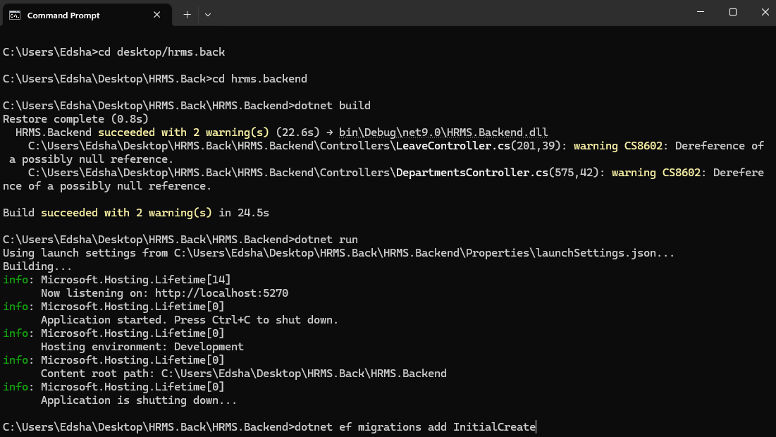
Migrate to database

Slide 11
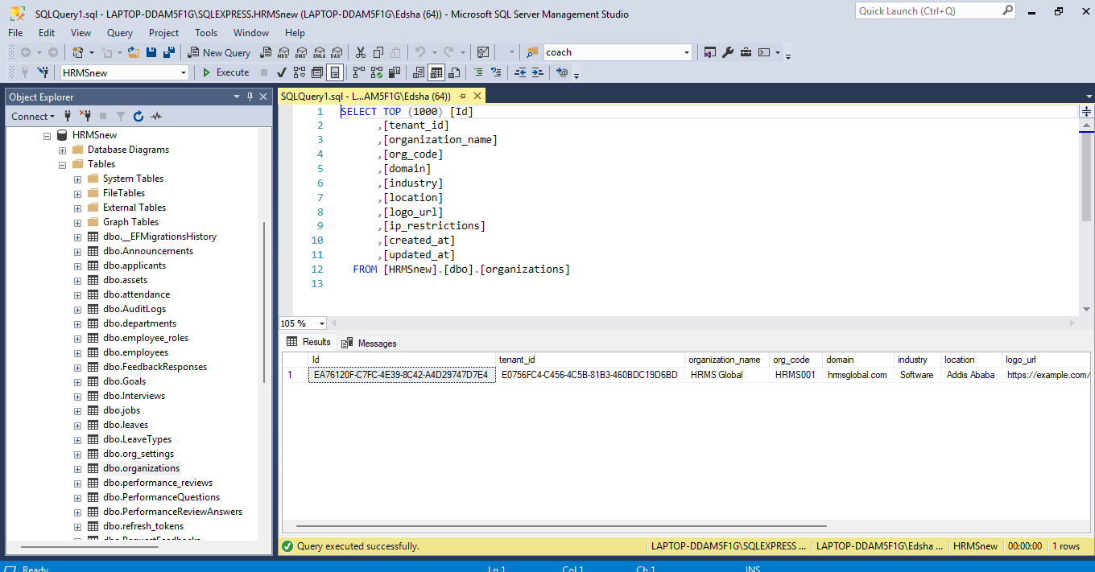
Database Tables (SQL Server) with sample records

Slide 12
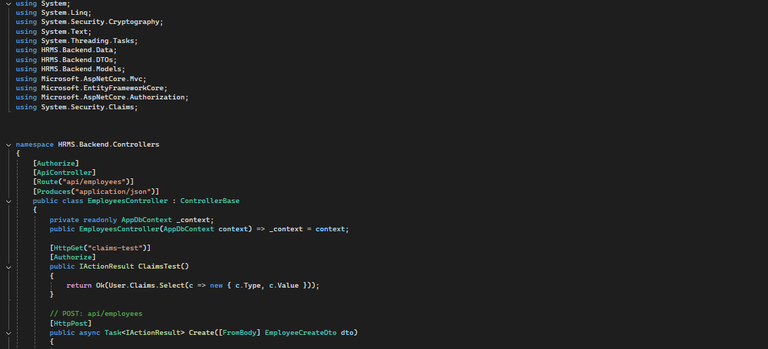
CRUD and Other Operations
Sample of Employee Controller Code

Slide 13
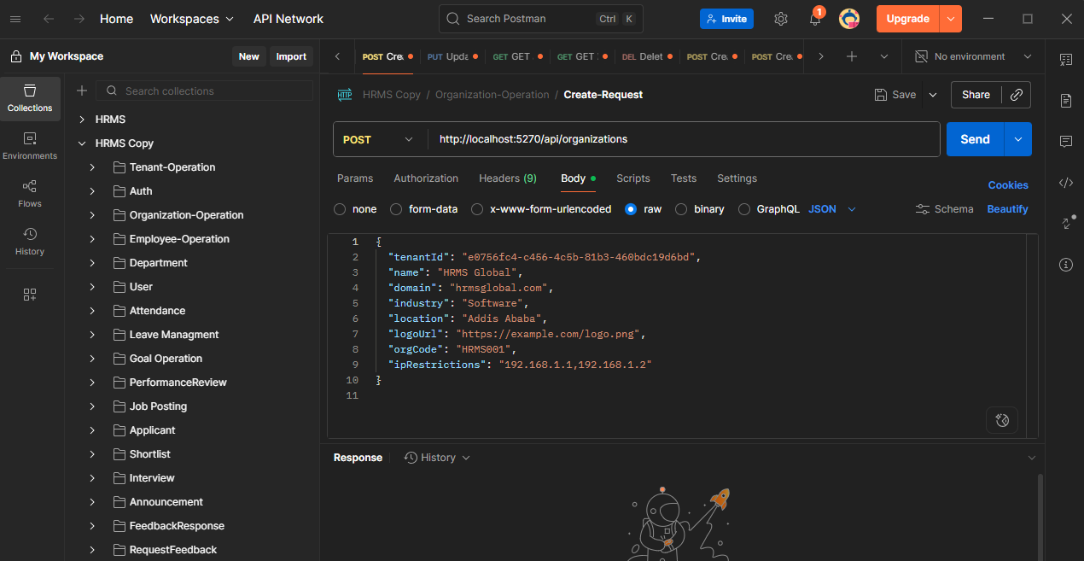
API Testing on Postman

Slide 14
Challenges & Solutions
Challenge 1: Handling Git merge conflicts while collaborating with multiple developers.
Solution: Regularly pulled updates, communicated effectively with teammates, and resolved conflicts systematically to maintain code integrity.
Challenge 2: Weekly updates were not limited to planned tasks, often requiring extra work beyond the schedule.
Solution: Prioritized tasks, managed time efficiently, and adapted to changing requirements to ensure timely delivery without compromising quality.

Slide 15
Conclusion
The internship at AFRICOM PLC provided invaluable hands-on experience in backend development and enterprise IT systems. I gained practical skills in database design, API development, authentication, and multi-tenant system implementation, while also improving problem-solving, teamwork, and professional communication. The challenges faced, such as managing Git merges and integrating complex modules, strengthened my technical and organizational abilities. Overall, this internship bridged the gap between academic learning and professional practice, preparing me for a successful career as a backend developer in real-world software environments.

Slide 16
Thank you !!
For Listening.

