Slide 1
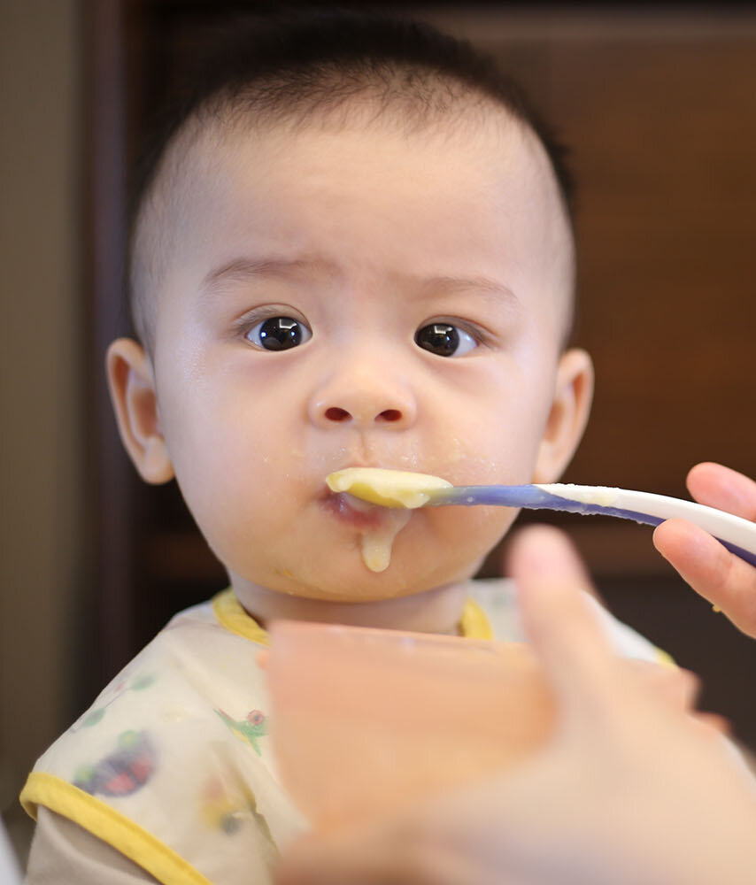

The Golden opportunity- An experiment to examine a connection between hygiene theory and utopian diseases in newborns
Shahar Shalom, Eden Anavim, Merav Pervil
Faculty Instructor: Prof. Micha Mandel
Counselee: Prof. Idit Lachover-Roth, Allergy & Clinical Immunology Unit, Meir Medical Center, Israel
Background
COVID-19 pandemic had consequences such as Social distancing, Masks and Lockdowns. Several studies were carried out in the world that resulted in the following findings: Social distancing reduced the prevalence of pediatric non-COVID-19 infections. Infants born in the first peek had significantly less respiratory morbidity in first year. Increased pediatric viral infections following the first and second lockdowns.
Results
Research Objective
These special circumstances created a Golden opportunity- To assess the influence of high hygienic environment incidence of atopic comorbidities on infants in their first and second year of life.
Data and its collection
Data was collected starting from November 2018. For the purpose of the study, Hebrew speaking parents from all sectors, 36 weeks pregnant and on, were recruited. Conditions were a baby with normal birth weight and without birth defects. Questionnaires were sent once a month during first year and once during the second year of baby's life. The babies were divided into 4 groups according to the date of birth and main landmarks during the pandemic ???
Experimental Design
Logistic Regression Model: Using the birth date as a categorial variable, we built a logistic regression and examined how different variables explain the probability of a baby getting sick with a utopic disease in the first/second year of life: Generalized Additive Model: Gam model provides us with an alternative to dividing into groups, instead of the date of birth acting as a categorical variable we made it continuous (every day is a category). We used a non-linear combination of variables, which create a smooth function. By connecting these smooth functions, we examined how the probability of a baby getting a utopic disease changes:
Conclusions

