Slide 1
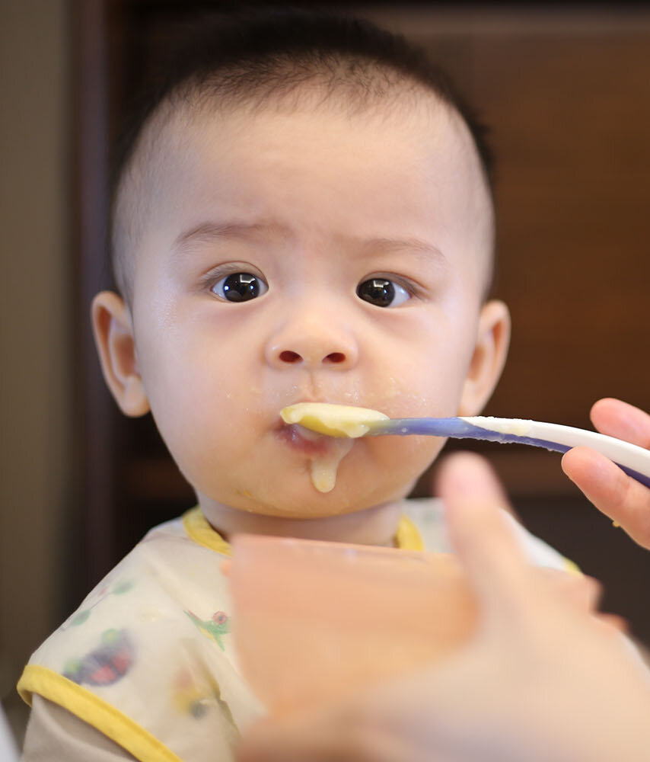

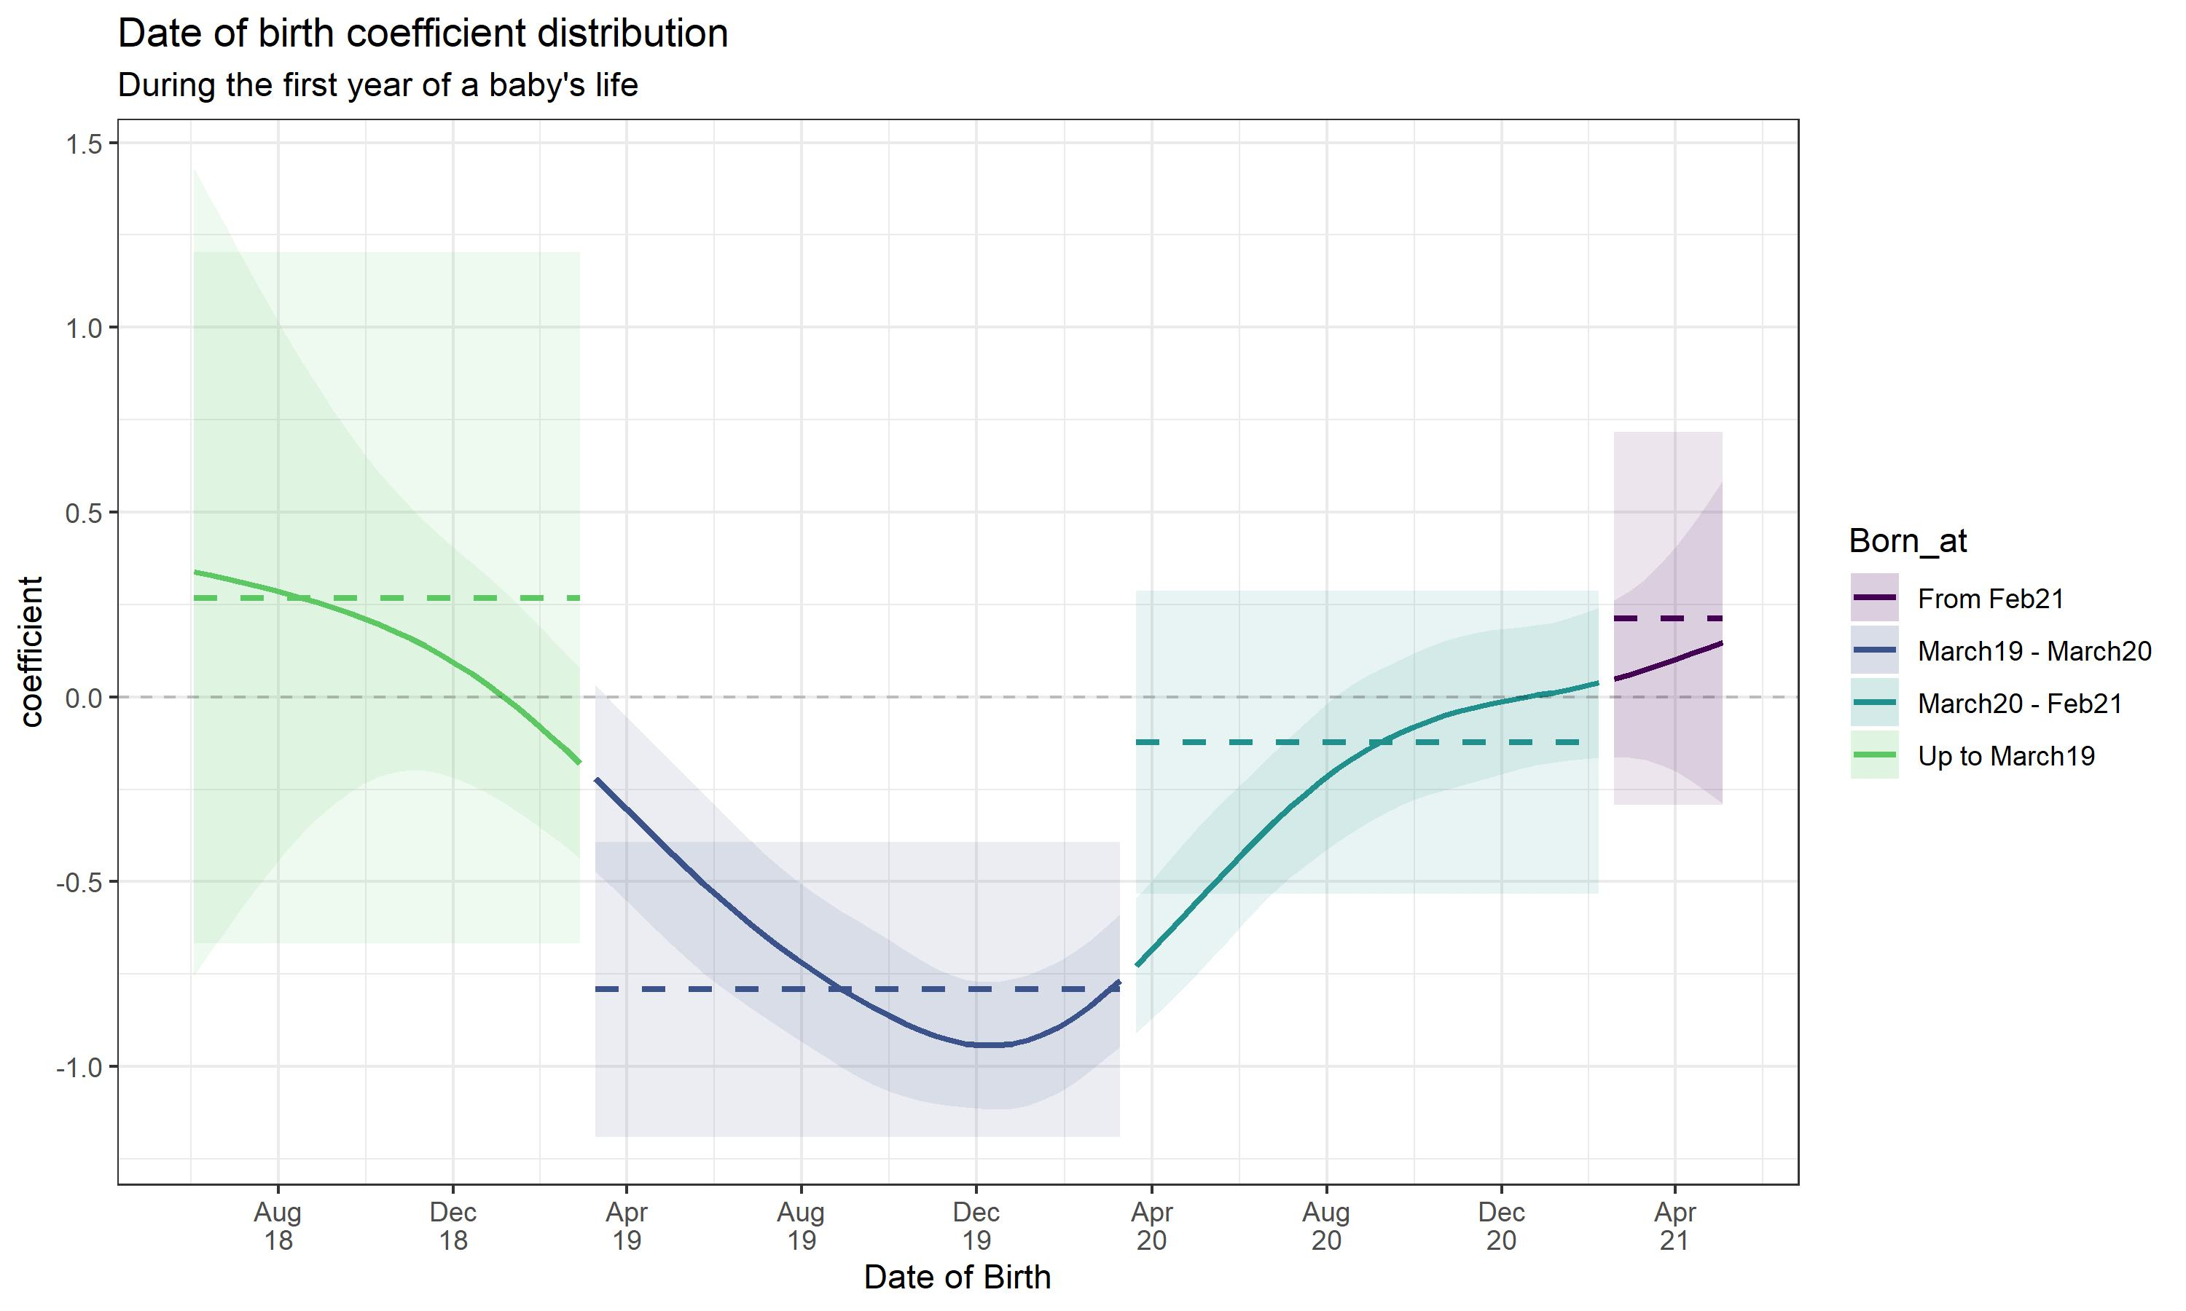
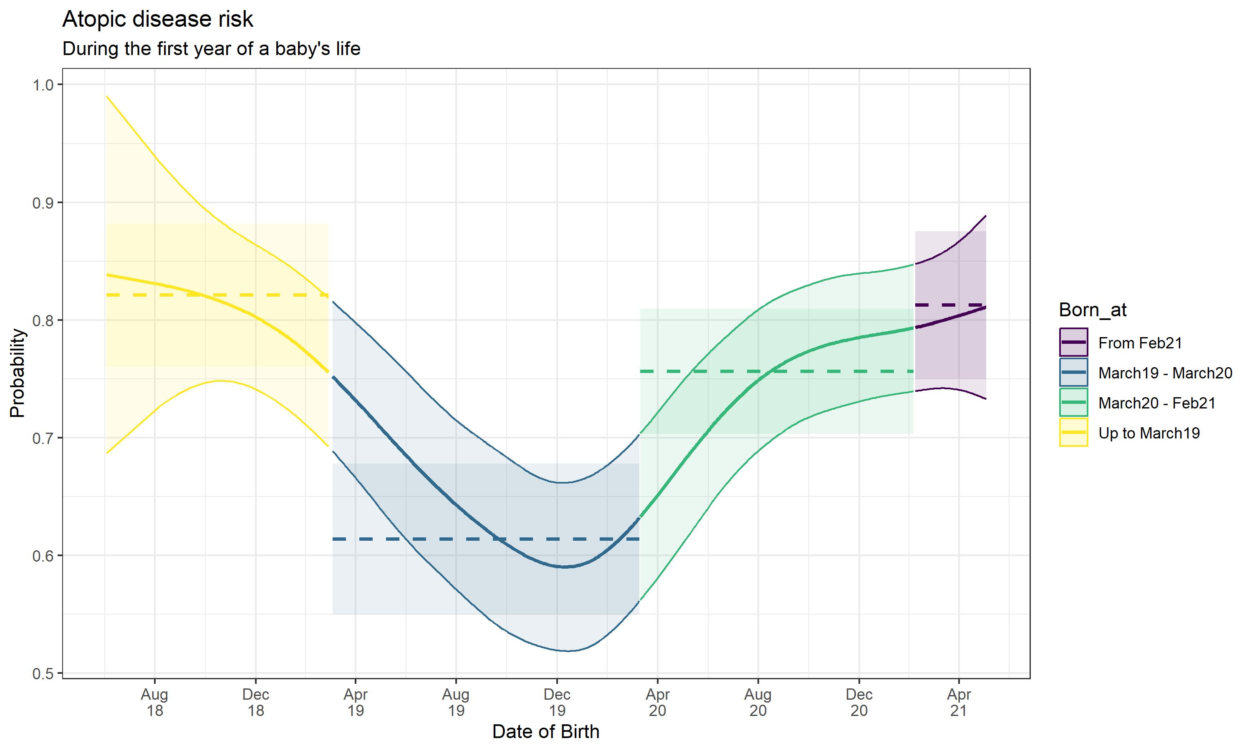
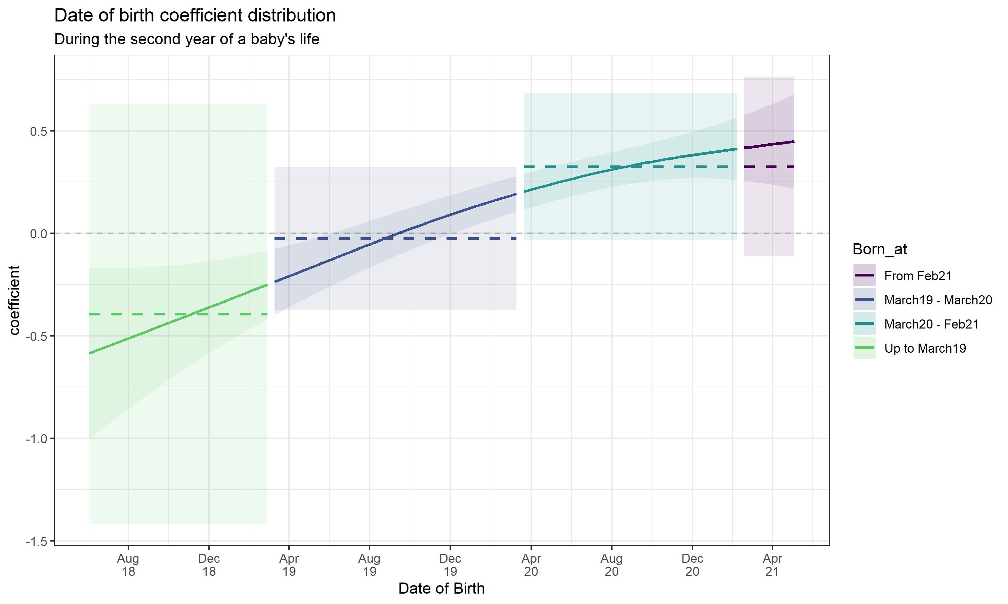
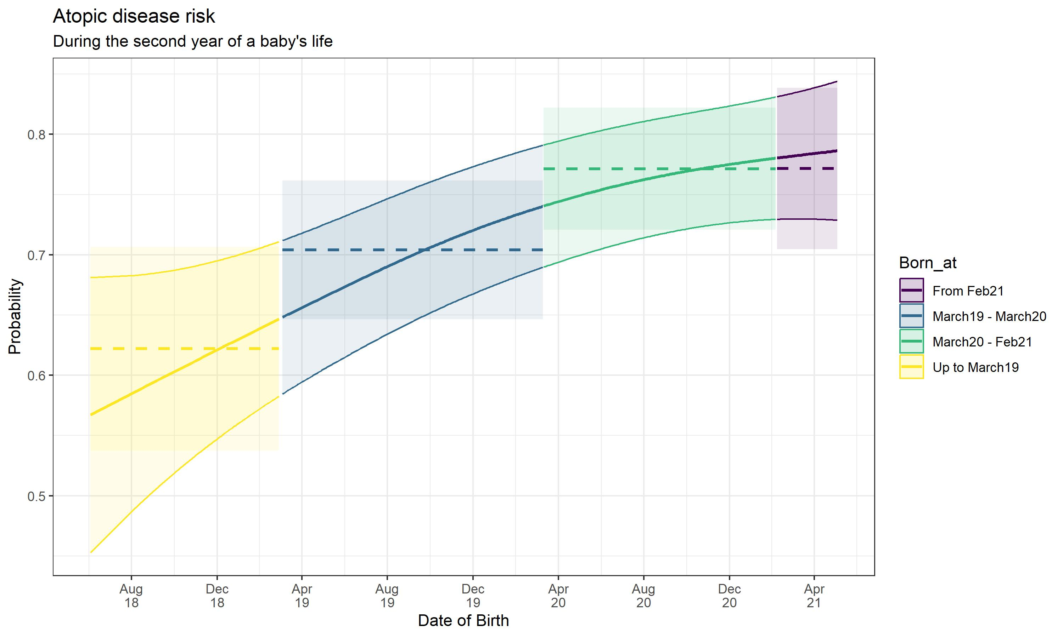
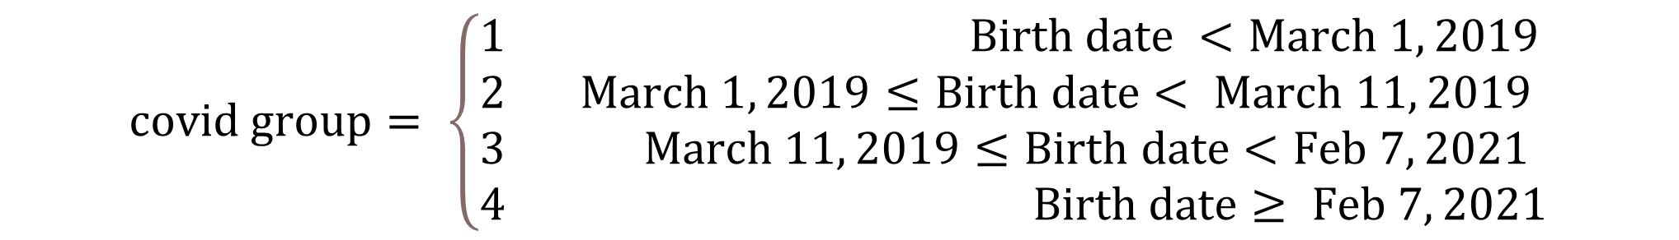
The Golden opportunity Examining the effect of hygiene theory on utopian diseases in newborns
Shahar Shalom, Eden Anavim, Merav Pervil | Faculty Instructor: Prof. Micha Mandel
Counselee: Prof. Idit Lachover-Roth, Allergy & Clinical Immunology Unit, Meir Medical Center, Israel
Background
COVID-19 had increased hygiene awareness. Following the pandemic, several studies led to the following findings: Social distancing reduced the prevalence of pediatric non-COVID-19 infections. Infants born in the first peek had significantly less respiratory morbidity in first year. Increased pediatric viral infections following the first and second lockdowns.
Results
Research Objective
It was therefore a golden opportunity to assess the influence of a highly hygienic environment on atopic comorbidities in infants.
Data and its collection
Data was collected starting from November 2018. Experiment participants: Hebrew speaking parents from all sectors, close to due date with normal birth weight and no defects. At predetermined intervals, parents were sent questionnaires to collect data. Characteristics of the babies, their families, and their environment were collected. Development of utopian diseases among babies was examined during experiment. The babies were divided into 4 groups according to the date of birth and main landmarks during the pandemic. ???
Group | First-year sickness rate (%) | Second-year sickness rate (%)
1 | 77 | 52
2 | 56 | 59
3 | 71 | 68
4 | 78 | 68
$$covid group= \left\{\begin{aligned}&1 Birth date <March 1, 2019 \\ &2 March 1, 2019≤Birth date< March 11, 2019 \\ &3 March 11, 2019≤Birth date<Feb 7, 2021 \\ &4 Birth date≥ Feb 7, 2021\end{aligned}\right.$$
Experimental Design
Logistic Regression Model was used to test the effect of explanatory characteristics on the probability of having an atopic disease using birth date group as the categorical variable. Generalized Additive Model: Gam model provides us with an alternative to dividing the birth date into groups, instead of the date of birth acting as a categorical variable we made it continuous (every day is a category). We used a non-linear combination of variables, which create a smooth function. By connecting these smooth functions, we examined how the probability of a baby getting a atopic disease changes:
Conclusions

Slide 2
The Golden opportunity Examining the effect of hygiene theory on utopian diseases in newborns
Shahar Shalom, Eden Anavim, Merav Pervil | Faculty Instructor: Prof. Micha Mandel
Counselee: Prof. Idit Lachover-Roth, Allergy & Clinical Immunology Unit, Meir Medical Center, Israel
Background
COVID-19 had increased hygiene awareness. Following the pandemic, several studies led to the following findings: Social distancing reduced the prevalence of pediatric non-COVID-19 infections. Infants born in the first peek had significantly less respiratory morbidity in first year. Increased pediatric viral infections following the first and second lockdowns.
Results
Research Objective
It was therefore a golden opportunity to assess the influence of a highly hygienic environment on atopic comorbidities in infants.
Data and its collection
Data was collected starting from November 2018. Experiment participants: Hebrew speaking parents from all sectors, close to due date with normal birth weight and no defects. At predetermined intervals, parents were sent questionnaires to collect data. Characteristics of the babies, their families, and their environment were collected. Development of utopian diseases among babies was examined during experiment. The babies were divided into 4 groups according to the date of birth and main landmarks during the pandemic. ???
Group | First-year sickness rate (%) | Second-year sickness rate (%)
1 | 77 | 52
2 | 56 | 59
3 | 71 | 68
4 | 78 | 68
$$covid group= \left\{\begin{aligned}&1 Birth date <March 1, 2019 \\ &2 March 1, 2019≤Birth date< March 11, 2019 \\ &3 March 11, 2019≤Birth date<Feb 7, 2021 \\ &4 Birth date≥ Feb 7, 2021\end{aligned}\right.$$
Experimental Design
Logistic Regression Model was used to test the effect of explanatory characteristics on the probability of having an atopic disease using birth date group as the categorical variable. Generalized Additive Model: Gam model provides us with an alternative to dividing the birth date into groups, instead of the date of birth acting as a categorical variable we made it continuous (every day is a category). We used a non-linear combination of variables, which create a smooth function. By connecting these smooth functions, we examined how the probability of a baby getting a atopic disease changes:
Conclusions

