Slide 1
Capstone Project: Event-driven Stock Prediction
Team: Xu Gao
Scott Edenbaum

Slide 2
Table of Content
Research
Reference papers
Our topic
Data scraping and cleaning
Model development
Prediction and trading result

Slide 3
Research
Reference Papers
1. Deep Learning for Event-Driven Stock Prediction
Xiao Ding, Yue Zhang, Ting Liu, Junwen Duan
They built a neural tensor network to transform word embeddings to event embeddings, then passed them to deep neural networks.
2. Deep Learning in Finance
J. B. Heaton , N. G. Polson ,J. H. Witte
They introduced main techniques in the deep learning and some applications in finance area.
Eg: Shallow Factor Models, Default Probabilities , Event Studies

Slide 4
Research
Our topic:
Event-driven Stock Prediction
Reasons:
Lack of researches
NLP
Our background

Slide 5
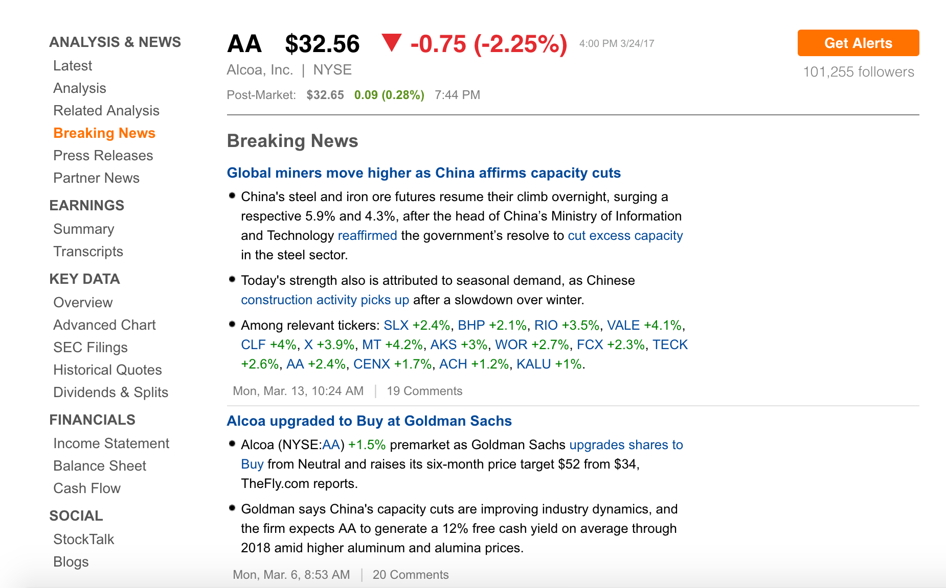
Data Scraping
Data Source:
Seekingalpha

Slide 6
Data Scraping and Cleaning
Difficulties:
Bot Test
Not well structured News and not consistent XPath
Solutions:

Slide 7
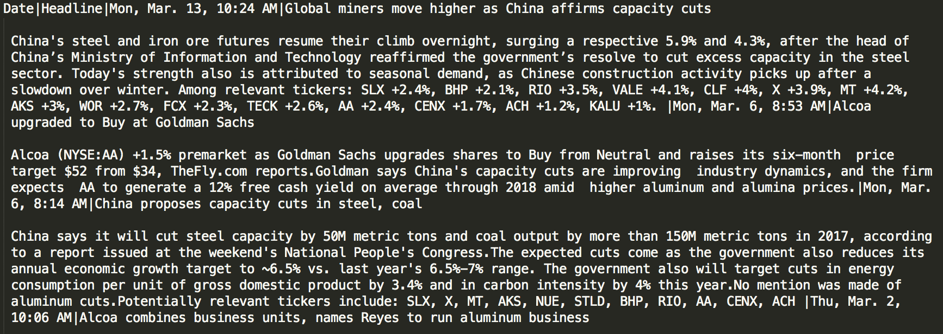
Data Cleaning

Slide 8
For news data some ways to transform to dataset:
1. Sentiment Analysis(textblob)
2. Word Embeddings
3. Doc2Vec
4. Event Embeddings

Slide 9
ReVerb:
ReVerb is a program that automatically identifies and extracts binary relationships from English sentences. ReVerb is designed for Web-scale information extraction, where the target relations cannot be specified in advance and speed is important.
Input: Paragraph

Slide 10
ReVerb Result:
/Users/gaoxu/DataSci/Event-Driven-FinModel/dev/single_news.txt 1 China ‘s steel and iron ore futures resumetheir climb 0 7 7 8 8 10 0.8225299076805256 China 's steel and iron ore futures resume their climb overnight , surging a respective 5.9 % and 4.3 % , after the head of China’s Ministry of Information and Technology reaffirmed the government’s resolve to cut excess capacity in the steel sector . NNP POS NN CC NN NN NNS VBP PRP$ NN RB , VBG DT JJ CD NN CC CD NN , IN DT NN IN NNP NNP NNP IN NNP CC NNP VBD DT NN VBD NN TO VB JJ NN IN DT NN NN . B-NP I-NP I-NP I-NP I-NP I-NP I-NP B-VP B-NP I-NP B-ADVP O B-VP B-NP I-NP I-NP I-NP O B-NP I-NP O B-PP B-NP I-NP I-NP I-NP I-NP I-NP I-NP I-NP I-NP I-NP B-VP B-NP I-NP B-VP B-NP B-VP I-VP B-NP I-NP B-PP B-NP I-NP I-NP O china 's steel and iron ore futures resume their

Slide 11
Model Development
Core model:
Neural Network with 2 hidden layers
1st hidden layer: 300 nodes, with tanh activation function
2nd hidden layer: 50 nodes, with tanh activation function
Output layer: 1 nodes, binary result with sigmoid activation function

Slide 12
Dataset development
I. Market Data:
5 day lag return data, S&P 500, NYSE Volume, Nasdaq Index
II. Add sentiment polarity
III. Word Embeddings
IV. Doc2vec, whole paragraph to 1 vector

Slide 13
Word Embeddings:
After ReVerb, get the sentence with the highest confidence level. And use subject, object, verb to get word embeddings.
Use average of those embeddings as input to Neural Network.
Doc2Vec
Transform all paragraph to 1 vector, pass it to Neural Network

Slide 14
Result

