Slide 1
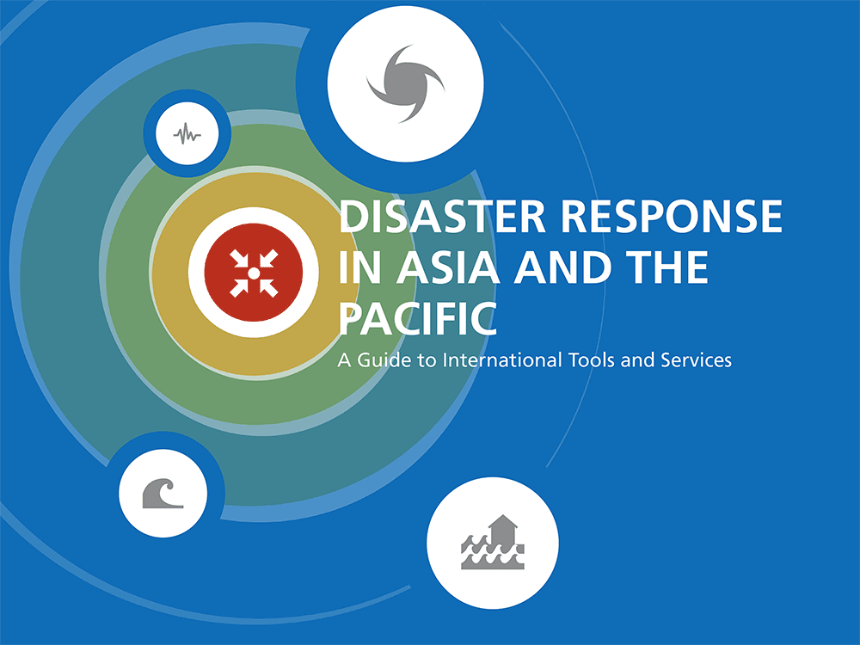

Slide 2
WHAT IS IT AND WHY WAS IT PRODUCED?
A guide of international tools and
services available for disaster response
and preparedness.
To help UN Member States and their
partners to understand the interaction
between national, regional, and
international response tools.

Slide 3


Slide 4
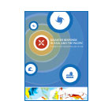
TIMELINE OF ACTIVITIES
August - October
2012
October - November
2012
November - March
2013
Desk Review
Field Testing
/ Workshop
Finalization
of Guide

Slide 5
SCOPE OF THE GUIDE:
RESPONSE & RESPONSE
PREPAREDNESS

Slide 6
WHAT IS IN IT?
International humanitarian architecture
Tools and services for disaster response
Tools and services for disaster preparedness

Slide 7
WHAT IS NOT
National government tools and services
Regional DRR efforts
Tools and services still being developed

Slide 8
WHAT THE GUIDE ANSWERS
For each entry, the Guide answers
the following questions:
WHAT IS IT?
WHO IS IT FOR?
HOW IS IT ACCESSED?
Where can one get further information.

Slide 9
WHAT THE GUIDE ANSWERS

Slide 10
TOTAL NUMBER OF ENTRIES IN THE GUIDE

Slide 11
PART 1:
INTERNATIONAL HUMANITARIAN ARCHITECTURE
REGULATION OF ACTION
• Binding agreements between States
• Non-binding agreements between States
• Voluntary guidelines
DIVERSITY OF ACTORS
• United Nations
• Red Cross Red Crescent Movement
• Regional intergovernmental organizations and forums
• NGOs
• Assisting governments
• Private sector
COORDINATION MECHANISMS
• Emergency Relief Coordinator
• Inter-Agency Standing Committee
• UN Resident Coordinator and Humanitarian Coordinator
• Humanitarian Country Teams
• Clusters
• OCHA

Slide 13
PART 2: DISASTER RESPONSE
TECHNICAL
TEAMS
• Bilateral teams
• Intergovernmental teams
• Teams of the RCRC movement
TECHNICAL
SERVICES
• Relief assets and stockpiles
• Technical networks
• Standby and surge rosters
FINANCIAL
RESOURCES
• “Fast money” mechanisms
• Strategic and fundraising tools
INFORMATION
MANAGEMENT
• Information management services
• Reporting tools
• Humanitarian websites
• Satellite imagery and mapping services
• Assessment tools

Slide 14
TIMELINE OF DISASTER RESPONSE TOOLS
AND SERVICES

Slide 15
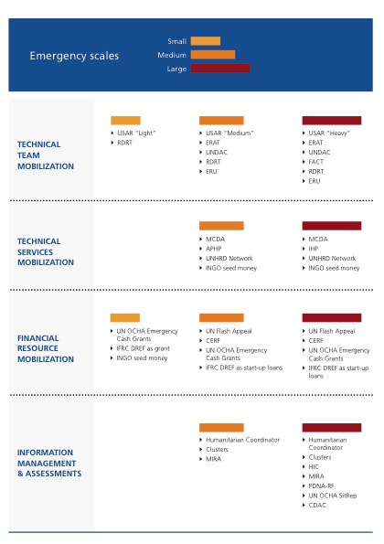
AVAILABLE TOOLS AND
SERVICES BY SCALE
OF DISASTER
(as requested by affected Government)

Slide 16
PART 3: DISASTER RESPONSE PREPAREDNESS
TECHNICAL
TEAMS
• International training
• Bilateral training
READINESS
PLANNING
• Legal preparedness
• Integrated preparedness packages/missions
• Support for national incident management systems
SIMULATION
EXERCISE
• International organization-led
• Regional organization-led
EARLY WARNING
SYSTEMS
• Weather forecasting
• Flood warning
• Tsunami warning
• Multi-hazard

Slide 17
TOOLS IN GUIDE BY ORGANIZATIONAL SOURCE

Slide 18
TOOLS DIRECTLY AVAILABLE TO GOVERNMENTS
VS. THROUGH OTHER HUMANITARIAN ENTITIES

