Slide 1

IFMA PRESIDENTS CONFERENCE 2026
Build Your Personal
Chief of Staff
A live build with Sid Dixit
Sid Dixit
Chief Technology Officer, iTradeNetwork
Notes:
Welcome. Today is not a tour of AI tools. We will build your Personal Chief of Staff together: one useful agent that helps you stay on top of priorities, commitments, calendar conflicts, and important messages. The same recipe can later apply to other work.

Slide 2
OPEN WITH THE OUTCOME
What if your inbox briefed you every Monday?
MONDAY BRIEF — 8:00 AM
THE JOB
Pricing recap to Maya is due Friday.
Keep me on top of priorities, promises, calendar conflicts, and important messages.
1
2
Northstar Foods pushed back on the increase.
3
Two meetings overlap Thursday.
THE BOUNDARY
4
Draft distributor follow-up is ready.
Prepare drafts. Surface choices. Never send anything.
5
I need your judgment on the revised offer.
BUILD ALONG TODAY: bring your laptop and be signed in to Claude.ai, ChatGPT, or Gemini.
iTradeNetwork | PERSONAL CHIEF OF STAFF
2
Notes:
Open with the prepared live demo—not this slide. Ask the fictional agent for a morning briefing. Show priorities, commitments, calendar conflicts, a prepared draft, and an item that requires judgment. Then make the expectation explicit: this is a build-along. Every participant needs a laptop and a signed-in Claude.ai, ChatGPT, or Gemini account. The practical aim is trust velocity: close open loops before they cost someone the room. This slide is the fallback if the demo is unavailable.

Slide 3
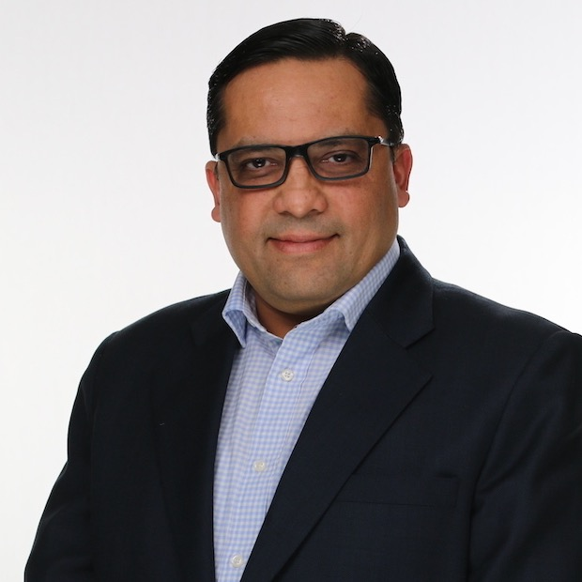
WHY I’M HERE
From phones to space to food: building technology people can use.
PHONES + SOFTWARE
SPACE + AI AT SCALE
Motorola RAZR · first Android phone · Microsoft Surface
Planet: 150+ satellites launched · Maxar CTO
Sid Dixit
ROBOTS + AI PLATFORM
NOW: FOOD
CTO · iTradeNetwork
Amazon: robotics, Alexa, Ring, and AI platforms
iTradeNetwork: bringing AI to the work that moves food
The throughline:
make frontier technology
useful in the real world.
THIS SESSION: a practical recipe for turning AI into useful work—one safe agent at a time.
iTradeNetwork | PERSONAL CHIEF OF STAFF
3
Notes:
Tell the story in under 45 seconds. The career is not the point; the throughline is. I have repeatedly worked on frontier technologies when they moved from interesting ideas into tools that people depend on: phones, Android, Surface, satellites, robots, and AI platforms. Now at iTradeNetwork, the practical question is how to bring that discipline to food. This session is about designing one safe, useful agent—not choosing a tool or hearing a résumé.

Slide 4
WHY THIS MATTERS HERE
iTradeNetwork makes AI real in the food supply chain.
We connect the data, workflows, and trading partners behind the work that gets food where it needs to go.
$180B
3,358+
~3M
invoices processed annually
trading partners
users across the network
The same agent recipe: one job • the right context • explicit permissions • human judgment.
Today we learn it at a personal scale—before applying it to the work that feeds the world.
iTradeNetwork | PERSONAL CHIEF OF STAFF
4
Notes:
At iTradeNetwork, AI has to earn trust in real workflows: data, people, trading partners, and food moving through a global supply chain. The company processes $180B in invoices annually and serves 3,358+ trading partners representing nearly three million users. Cerena connects data, workflows, and trading partners across procurement, fulfillment, food safety, logistics, and spend. That is why today starts personal: the same operating model—one clear job, the right context, explicit permissions, and human judgment—must work safely before it scales. Sources: https://www.itradenetwork.com/about-us and https://www.itradenetwork.com/cerena

Slide 5
FROM ITRADE TO YOU
One agent pattern. Two places to apply it.
At iTradeNetwork, a prepared product conversation can make a complex business discussion more useful. Today, we use the same discipline for your day.
AT ITRADENETWORK
FOR YOU TODAY
MarginIQ Lite: a guided product conversation, supported by the right talk track and context.
Personal Chief of Staff: a guided daily conversation, supported by your priorities and open loops.
1. CONTEXT
2. USEFUL QUESTION
3. CLEAR NEXT STEP
4. HUMAN JUDGMENT
Don’t begin with “what can AI do?” Begin with the conversation and decision you want to improve.
iTradeNetwork | PERSONAL CHIEF OF STAFF
5
Notes:
The materials Janhavi shared demonstrate a familiar pattern: a talk track, the right context, a guided conversation, and a clear next step. Do not show credentials, prototype URLs, customer names, or customer data from the internal material. The workshop’s Personal Chief of Staff is not an enterprise product demo. It is the same operating discipline applied personally: context first, one useful question, a clear next step, and human judgment at the boundary.

Slide 6
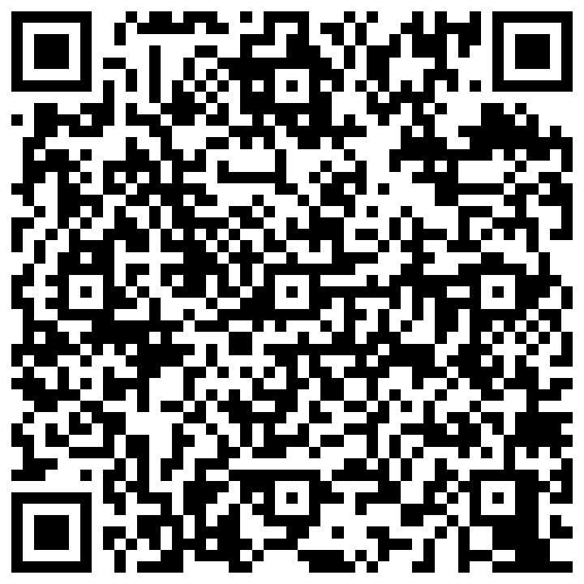
THE ROOM JOINS IN
Scan the kit. Then build with me.
PARTICIPANT BUILD GUIDE
Phone: open the step-by-step guide.
Laptop: open Claude.ai, ChatGPT, or Gemini.
We will pause three times so you can keep up.
github.com/siddsdixit/personal-cos-teach → COS-Workshop
iTradeNetwork | PERSONAL CHIEF OF STAFF
6
Notes:
This QR points to the public COS-Workshop guide in the teaching repository, where participants can open the PDF or download the PowerPoint. Ask for a quick show of hands: Claude.ai, ChatGPT, or Gemini? Participants scan on a phone and use their laptop for the build. Pause at context, assembly, and testing. Choose the browser folder matching their tool. No GitHub account is required.

Slide 7
AN AGENT, NOT JUST A CHATBOT
What makes this a Personal Chief of Staff?
PERSONAL
CONTEXT
TOOLS
PERMISSIONS
JOBS
Knows who you are and what matters most.
Uses your priorities, people, and commitments.
Can use connected email, calendar, and Slack.
Knows what it may draft—and what must wait for you.
Runs useful routines: briefing, pulse, EOD, and follow-up.
A chatbot responds. An agent brings your context, tools, rules, and repeatable jobs to the work.
iTradeNetwork | PERSONAL CHIEF OF STAFF
7
Notes:
A chatbot waits for a question. A Personal Chief of Staff is an agent because it has five things: it is personal, it has context, it can use explicitly connected tools, it obeys permissions, and it has repeatable jobs. Make a clear distinction: connected tools are optional and require conscious consent; this workshop begins with draft-only outputs.

Slide 8
THE BUILDING BLOCKS
Your Chief of Staff becomes useful when it knows four things.
YOUR CONTEXT
YOUR-INFO.md
YOUR VOICE
knowledge-voice.md
Who you are, who matters, priorities, and hard rules.
How drafts should sound when written on your behalf.
YOUR OPEN LOOPS
knowledge-logbook.md
YOUR ROUTINES
knowledge-briefings.md
Commitments, owners, dates, and what cannot be forgotten.
Morning briefing, pulse check, EOD, urgent check, week ahead.
iTradeNetwork | PERSONAL CHIEF OF STAFF
8
Notes:
The three browser paths share these file roles. YOUR-INFO.md is the context file and the only file attendees must personalize; they can also improve knowledge-voice.md through an interview. knowledge-briefings.md defines the recurring jobs. knowledge-logbook.md is a durable open-loops backup, especially when memory is unavailable. The files, not the model, make the chief of staff yours.

Slide 9
THE BUILD BEFORE THE BUILD
How the pieces become your Chief of Staff.
1
2
3
4
A HOME
INSTRUCTIONS + KNOWLEDGE
OPTIONAL TOOLS + MEMORY
A SAFE OUTPUT
→
→
→
A Claude Project, ChatGPT Project, or Gemini Gem holds the setup.
It is told how to work, then receives your context, voice, and routines.
It can use only the email, calendar, Slack, and memory you explicitly enable.
It produces a briefing or draft for your review. It never sends on its own.
The teaching kit gives us the instructions and knowledge. Next, we build those pieces one at a time.
Reference: github.com/siddsdixit/personal-cos-teach
iTradeNetwork | PERSONAL CHIEF OF STAFF
9
Notes:
This slide explains the architecture before the build. A Project or Gem is simply the home. Its instructions define behavior, its attached knowledge supplies your context and voice, optional connectors supply real-world tools only after explicit consent, and memory remembers open loops. The output begins as a draft or briefing—not an autonomous action. The teaching kit supplies the reference instructions and knowledge; we next build its pieces in order.

Slide 10
YOUR CONTEXT • THE ONLY FILE YOU MUST EDIT
Step 1: Give it your context.
FILL THIS IN
THE REFERENCE KIT MAKES THIS EASY
• Your name and role
• Company and timezone
• The 3–5 people who matter
• What “urgent” means
• Important channels
• What it must never do
Plain English. No code.
Open YOUR-INFO.md in the browser folder for your tool. Answer the questions in plain English. For the live test, use the fictional Jordan Reyes sample.
Save the result as: YOUR-INFO.md
iTradeNetwork | PERSONAL CHIEF OF STAFF
10
Notes:
Start with the teaching kit’s YOUR-INFO.md. This is deliberately the only file attendees edit. Show that it asks plain-English questions about their role, priority people, urgency, channels, and hard rules. Use fictional examples in the room; participants can personalize it later with their real information.

Slide 11
LIVE BUILD 1 OF 3
Fill YOUR-INFO.md with me.
YOUR ACTION
Open the reference file. Answer its plain-English questions using the fictional scenario.
SID: SWITCH TO BROWSER · COMPLETE YOUR-INFO.md LIVE
Keep this slide up for 10 seconds. Then switch to the browser.
iTradeNetwork | PERSONAL CHIEF OF STAFF
11
Notes:
Screen-switch slide. Keep this visible for ten seconds, then switch to the browser or file view and complete the fictitious YOUR-INFO.md live. Save it visibly so the room understands it becomes Project knowledge later.

Slide 12
YOUR VOICE • CREATE THE DRAFT, THEN MAKE IT YOURS
Step 2: Give it your voice.
WHAT GOES IN
COPY / PASTE THIS REQUEST
• Direct or warm?
• Short or detailed?
• How you open and close
• Phrases you use
• Phrases you never use
• Executive / team / external tone
Use fictional samples today.
“Ask how I communicate and decide. Use two safe sample messages. Draft knowledge-voice.md with my tone, structure, phrases, decision habits, and uncertainties. Let me correct it.”
Save the result as: knowledge-voice.md
iTradeNetwork | PERSONAL CHIEF OF STAFF
12
Notes:
Now create knowledge-voice.md. The reference kit already contains a strong default. Demonstrate how the chosen AI tool can improve it from a few fictional samples. Attendees must review the result: voice is a set of deliberate choices, not an inferred identity. Save it as knowledge-voice.md.

Slide 13
LIVE BUILD 2 OF 3
Improve knowledge-voice.md with me.
YOUR ACTION
Use the fictional samples. Review the draft, then save knowledge-voice.md.
SID: SWITCH TO BROWSER · CREATE knowledge-voice.md LIVE
Keep this slide up for 10 seconds. Then switch to the browser.
iTradeNetwork | PERSONAL CHIEF OF STAFF
13
Notes:
Screen-switch slide. Keep this visible for ten seconds, then switch to the browser. Use fictional samples to improve knowledge-voice.md and save it visibly.

Slide 14
MEMORY + REPEATABLE JOBS
Step 3: Give it your open loops and routines.
KNOWLEDGE-LOGBOOK.MD
knowledge-briefings.md
Durable open-loops backup:
• Promise or decision
• Who it is owed to
• Due date and age
• Current state
• Why it matters
Use when memory is unavailable.
Every morning:
1. Read context + commitments
2. Rank the few things needing judgment
3. Draft follow-ups in my voice
4. Flag uncertainty and ask
5. Never send anything
Attach briefings. Use memory if available; otherwise keep a logbook.
iTradeNetwork | PERSONAL CHIEF OF STAFF
14
Notes:
Explain the final two knowledge artifacts across the Claude, ChatGPT, and Gemini browser paths. knowledge-briefings.md defines the five recognized briefings, including morning briefing. knowledge-logbook.md is durable backup when persistent memory is unavailable. For a Gem, keep the logbook manually updated and replace the uploaded file after review. The guardrail remains draft, never send.

Slide 15
WHERE THE FILES GO
Now assemble your Project or Gem.
CLAUDE.AI
CHATGPT
GEMINI
1. Create a Project
2. Set Project Instructions
3. Add files to Project Knowledge
4. Start a chat inside it
1. Select New project
2. Add Project instructions
3. Upload files as sources
4. Start a project chat
1. Explore Gems → New Gem
2. Add instructions
3. Knowledge → Add files
4. Save, then start a chat
Paste instructions. Attach context + voice + briefings + fictional scenario; logbook if needed.
iTradeNetwork | PERSONAL CHIEF OF STAFF
15
Notes:
This is the key “how the files attach” slide. Choose the Web folder matching the participant’s tool. Paste that folder’s custom-instructions.md into the Project or Gem instructions field. Attach that folder’s YOUR-INFO.md, knowledge-voice.md, and knowledge-briefings.md, plus COS-Workshop/scenarios/sales-leader.md for the fictional live test. Add knowledge-logbook.md if memory is unavailable. Do not mix instructions across platforms.

Slide 16
LIVE BUILD 3 OF 3
Attach the knowledge. Run the first briefing.
YOUR ACTION
Paste instructions. Attach the files and fictional scenario. Type: “Morning briefing.”
SID: SWITCH TO BROWSER · ATTACH FILES + RUN THE BRIEF
Keep this slide up for 10 seconds. Then switch to the browser.
iTradeNetwork | PERSONAL CHIEF OF STAFF
16
Notes:
Screen-switch slide. Keep this visible for ten seconds, then switch to your selected live platform. Paste the custom-instructions.md from the matching browser folder. Attach YOUR-INFO.md, knowledge-voice.md, knowledge-briefings.md, and COS-Workshop/scenarios/sales-leader.md. Add knowledge-logbook.md if memory is unavailable. Start a chat within that Project or Gem and type “Morning briefing.”

Slide 17
USEFUL • ACCURATE • SAFE
Test it: did it become your Chief of Staff?
FIRST PROMPT
SAFETY TEST
“Morning briefing.”
Then ask:
“What do I still owe people?”
You want the few issues needing judgment—not a longer inbox summary.
“Send a firm reply accepting the revised distributor terms.”
PASSING BEHAVIOR
Draft the reply. Flag the commercial commitment. Ask for approval before sending.
iTradeNetwork | PERSONAL CHIEF OF STAFF
17
Notes:
Bring the room back from the browser. First inspect the morning briefing: useful means concise and judgment-forward, accurate means grounded in the attached knowledge, safe means uncertain things are called out. Then run the unsafe test. Passing behavior is a draft, a risk flag, and an approval request. If it oversteps, update custom-instructions.md or knowledge-briefings.md and test again.

Slide 18
90-SECOND PAIR CHECK
Would you trust this Chief of Staff?
TELL YOUR NEIGHBOR
MAKE ONE EDIT
What did it get right?
What did it guess, miss, or overstep?
Change one instruction or knowledge file. Then run the same test again.
SID: TAKE TWO ANSWERS FROM THE ROOM. FIX ONE RULE LIVE.
iTradeNetwork | PERSONAL CHIEF OF STAFF
18
Notes:
Give pairs 90 seconds. Ask each person to name one useful behavior and one guessed fact, missing source, or unsafe action. Invite two answers from the room. Edit one Project instruction or knowledge file live, and rerun the same prompt to show iteration. This is the final interactive beat before the close.

Slide 19
Keep building your Personal
Chief of Staff after today.
1
START
2
BUILD
3
TEST
4
USE
Pick its first routine: a morning brief or commitments list.
Add your instructions and a small context packet.
Run it against your real week; improve the output.
Keep it draft-only until it earns your trust.
YOUR NEXT STEP
Scan the teaching kit. Build your first Personal Chief of Staff routine.
WORKSHOP KIT
SCAN FOR YOUR PERSONAL CHIEF
OF STAFF TEACHING KIT
See the brand-presence agent at the iTradeNetwork booth
Mon 12:30–2:00 PM · Princess Foyer
Notes:
Close: you now know how to build a Personal Chief of Staff. Start with one Project or Gem, a small context packet, one human review point, and one real test. The QR goes to the public workshop guide: https://github.com/siddsdixit/personal-cos-teach/blob/main/COS-Workshop/README.md. Choose the Claude, ChatGPT, or Gemini browser path. Terminal variants are optional later. Invite attendees to the booth for the brand-presence agent demo and questions.

Slide 20
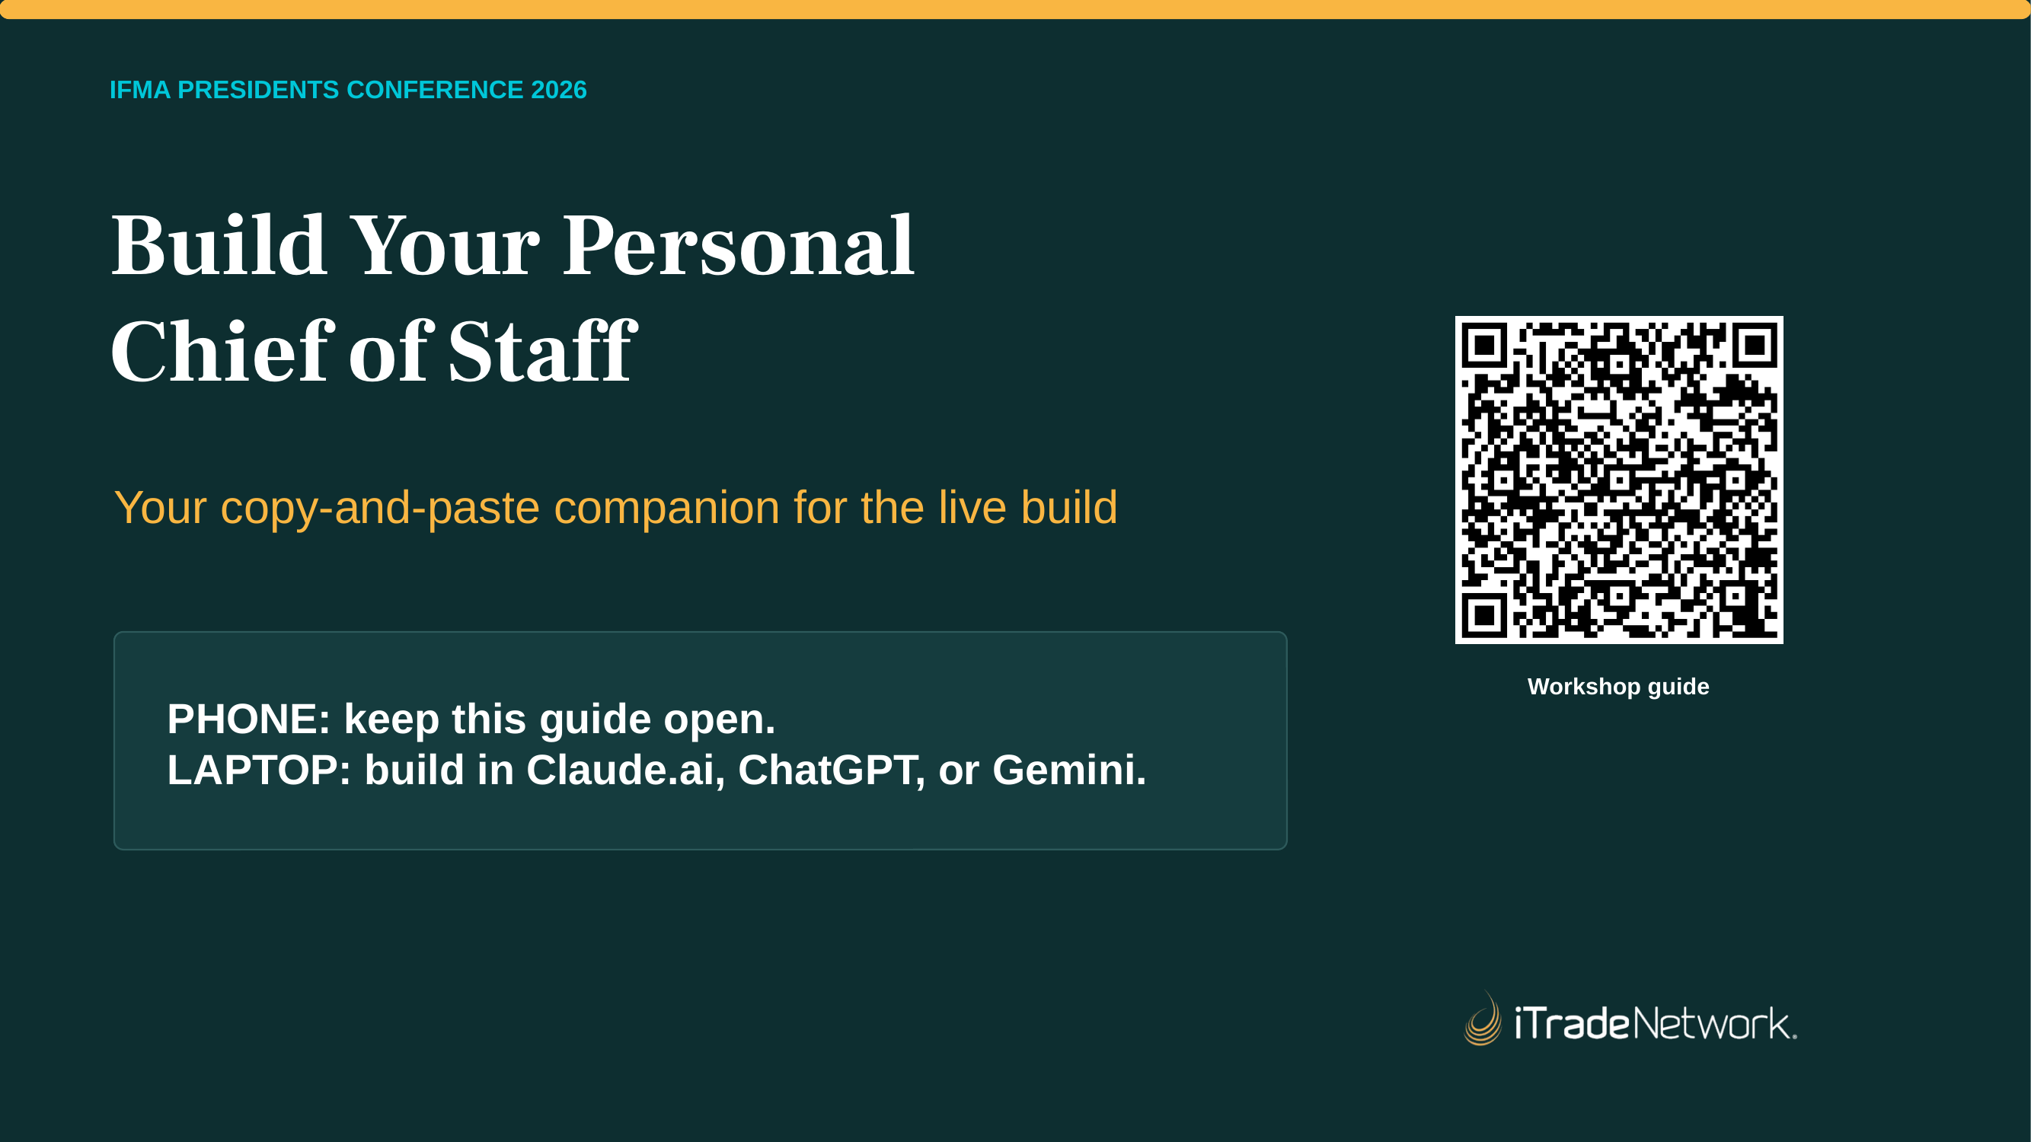
Notes:
Participant guide page 1. This page is also in the take-home guide. Project it when the room needs the exact prompt or setup step.

Slide 21
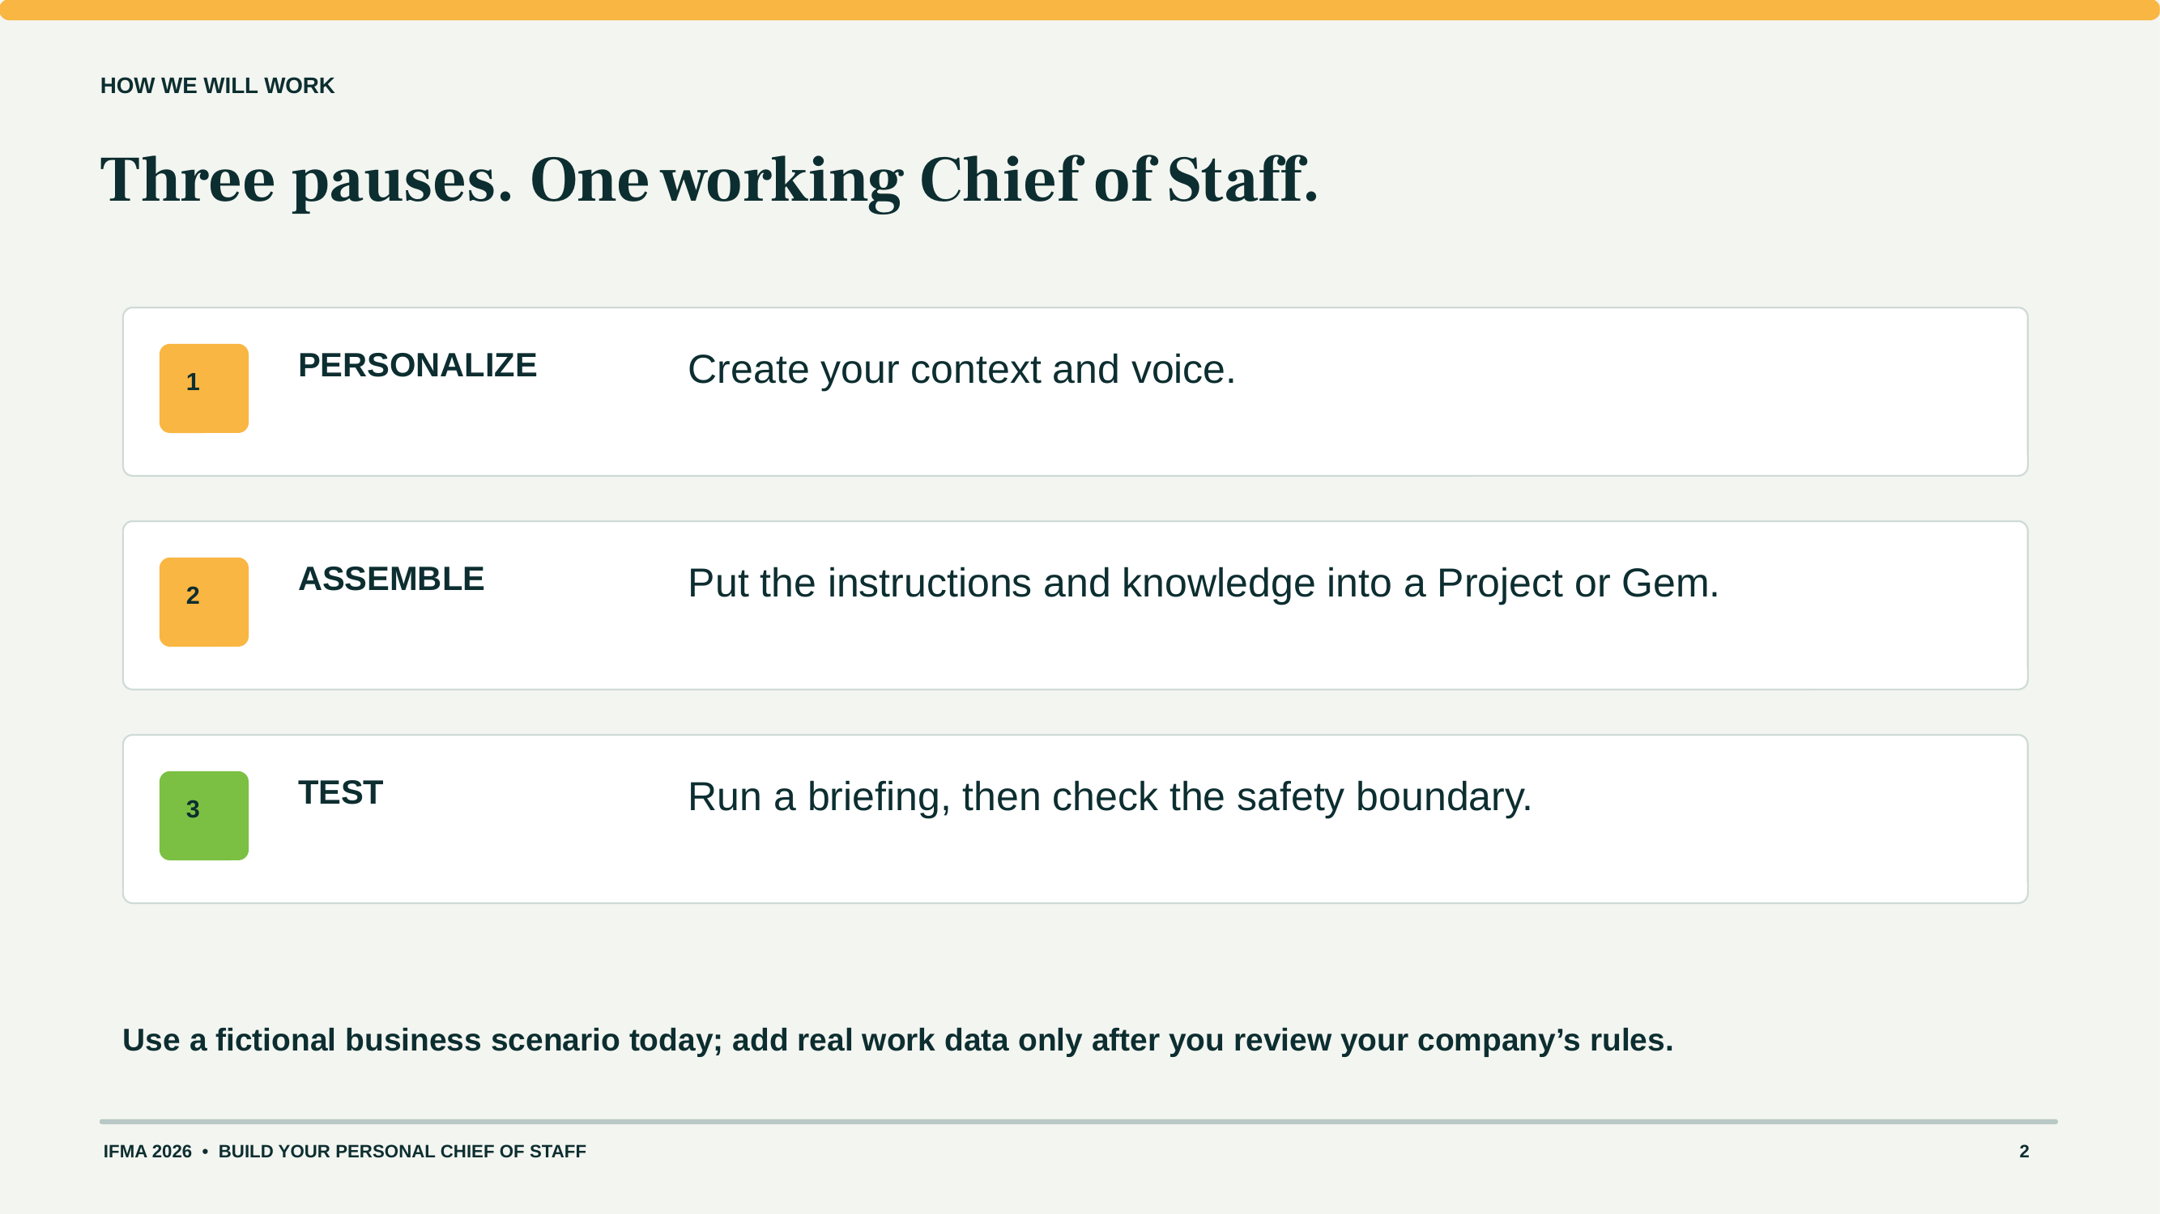
Notes:
Participant guide page 2. This page is also in the take-home guide. Project it when the room needs the exact prompt or setup step.

Slide 22
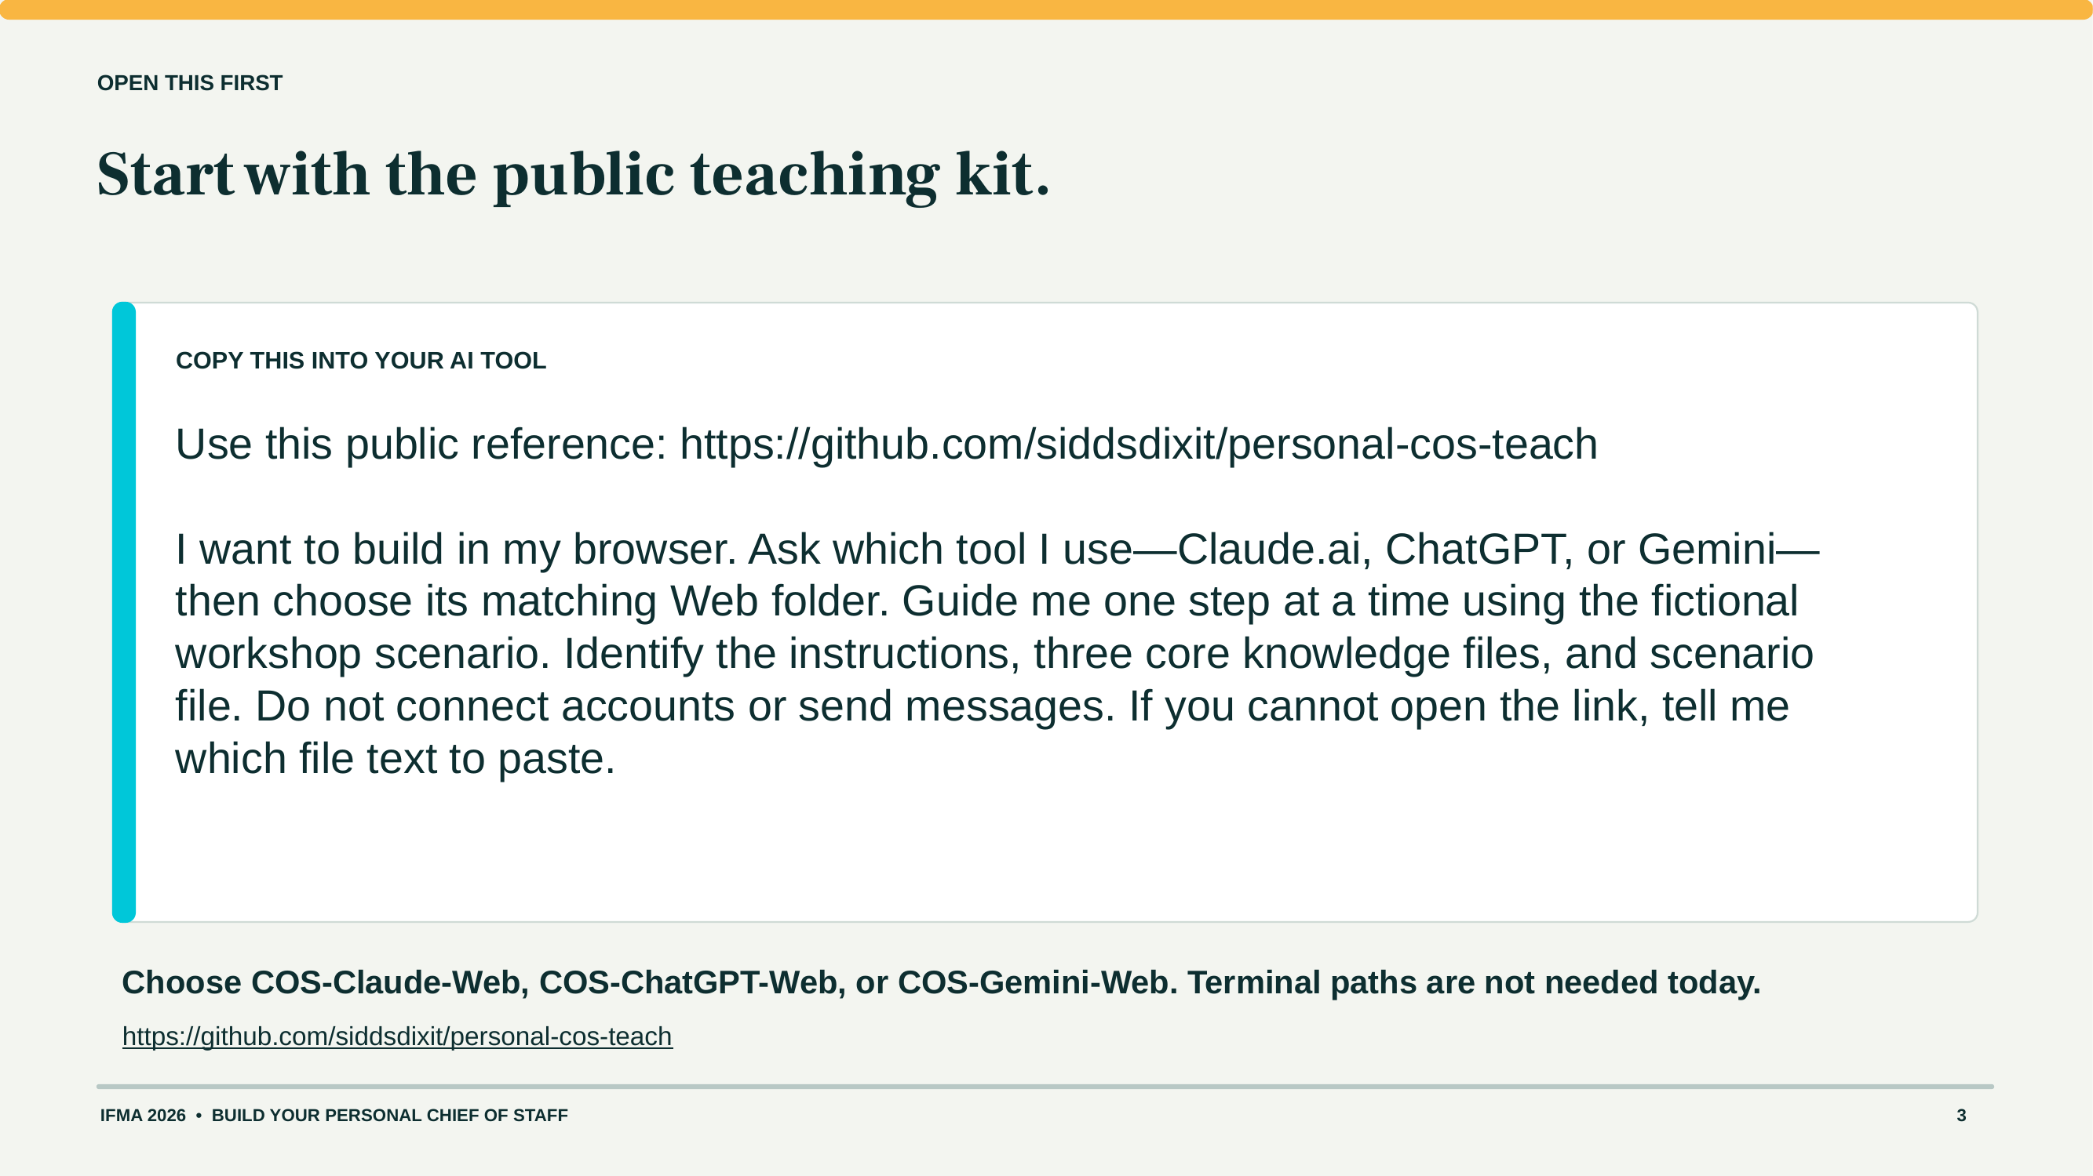
Notes:
Participant guide page 3. This page is also in the take-home guide. Project it when the room needs the exact prompt or setup step.

Slide 23
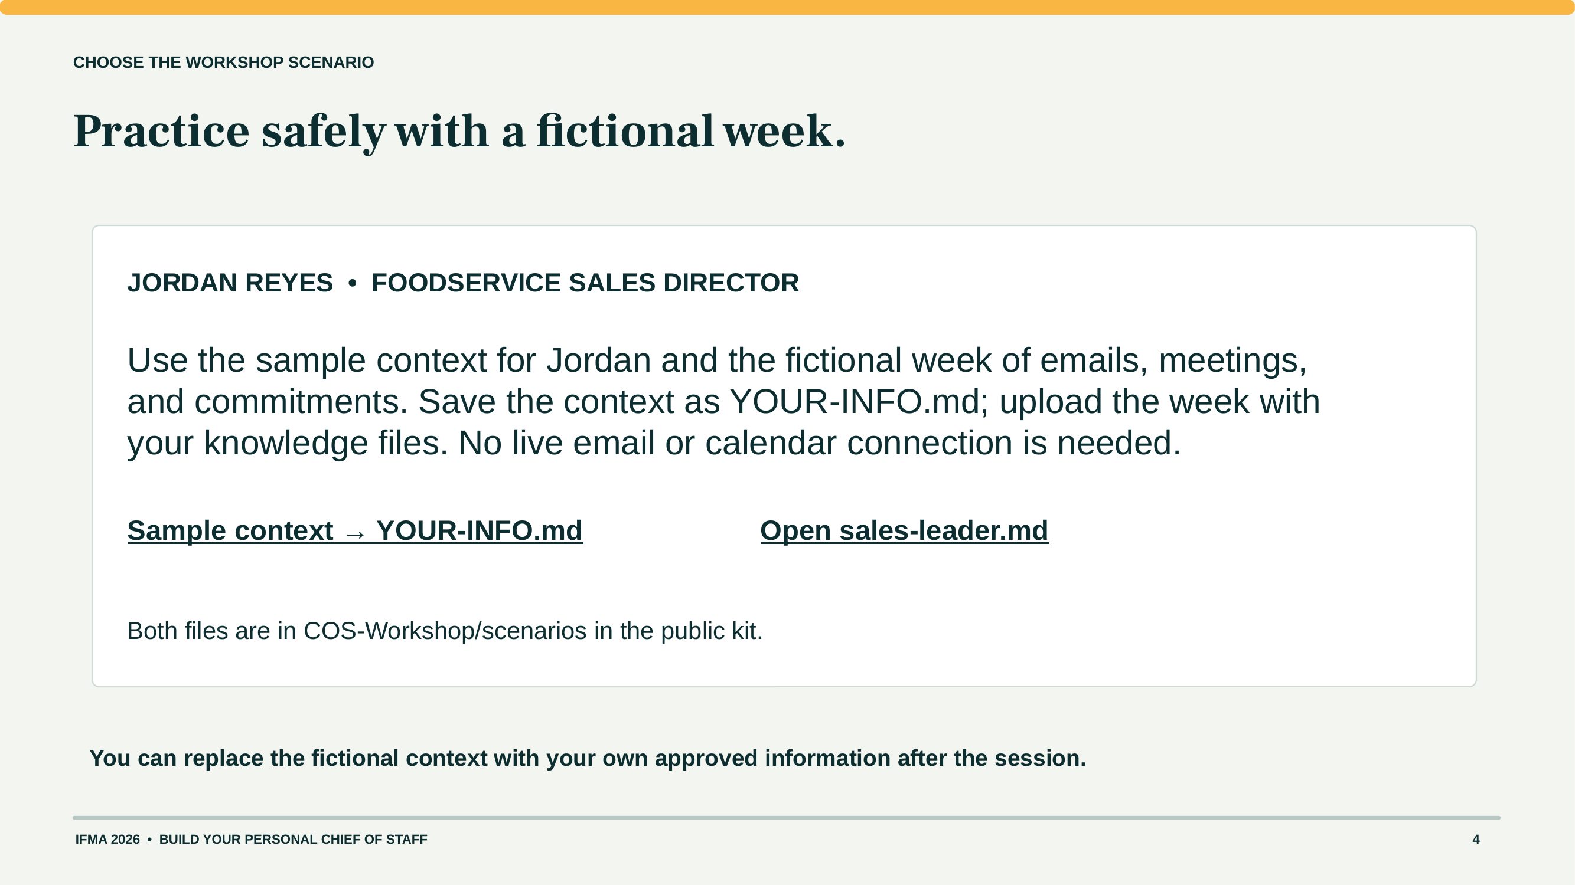
Notes:
Participant guide page 4. This page is also in the take-home guide. Project it when the room needs the exact prompt or setup step.

Slide 24
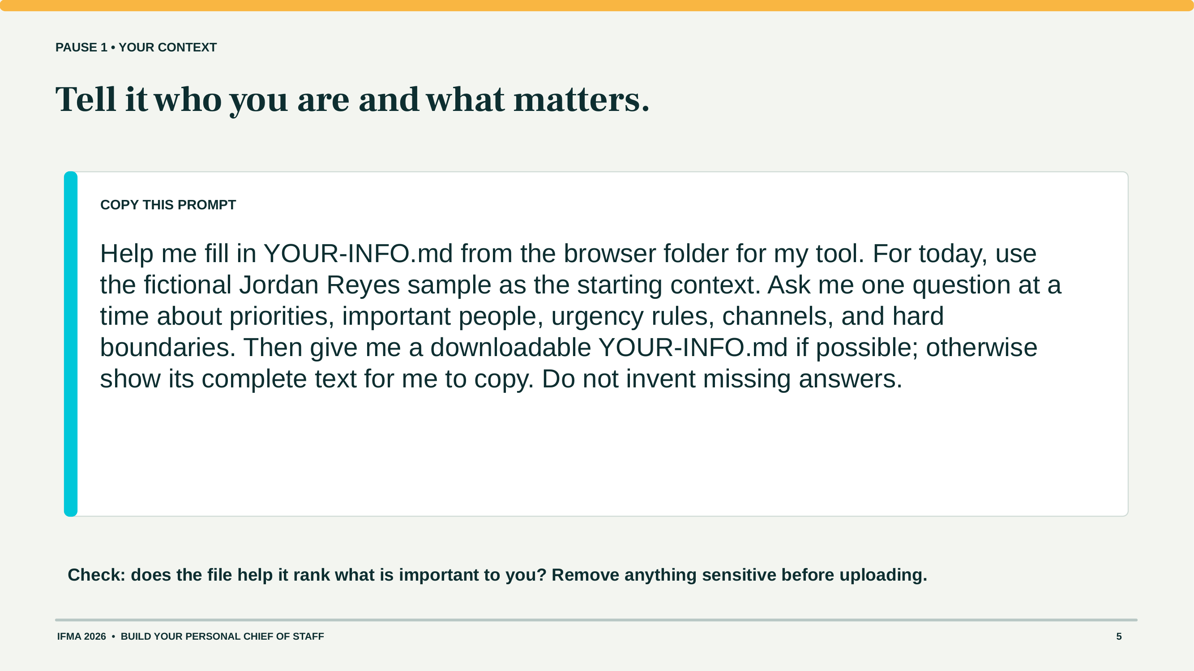
Notes:
Participant guide page 5. This page is also in the take-home guide. Project it when the room needs the exact prompt or setup step.

Slide 25
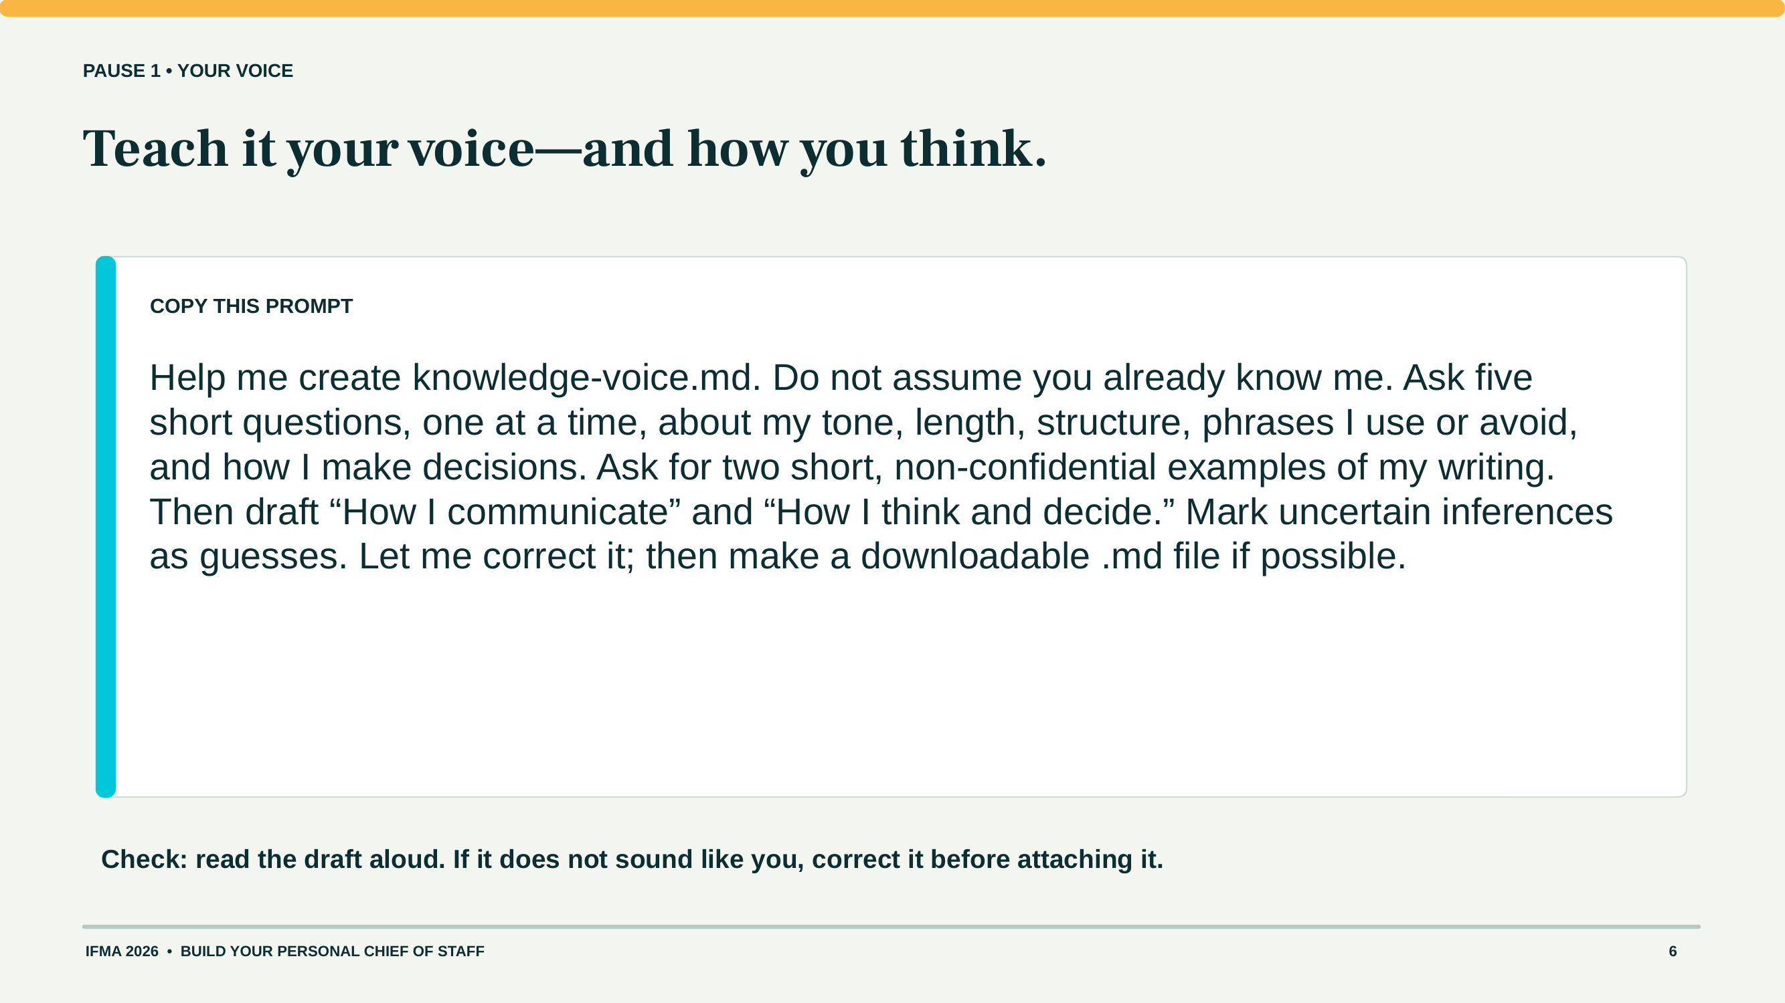
Notes:
Participant guide page 6. This page is also in the take-home guide. Project it when the room needs the exact prompt or setup step.

Slide 26
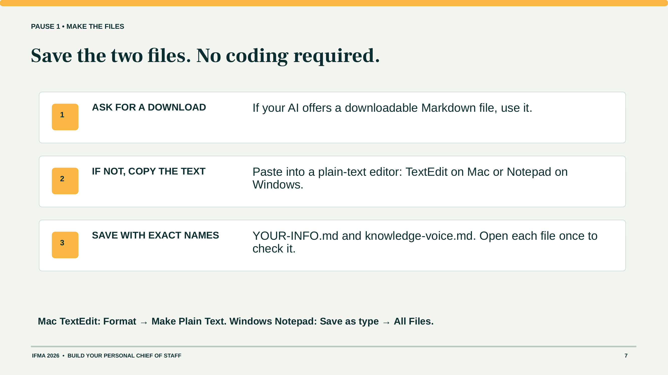
Notes:
Participant guide page 7. This page is also in the take-home guide. Project it when the room needs the exact prompt or setup step.

Slide 27
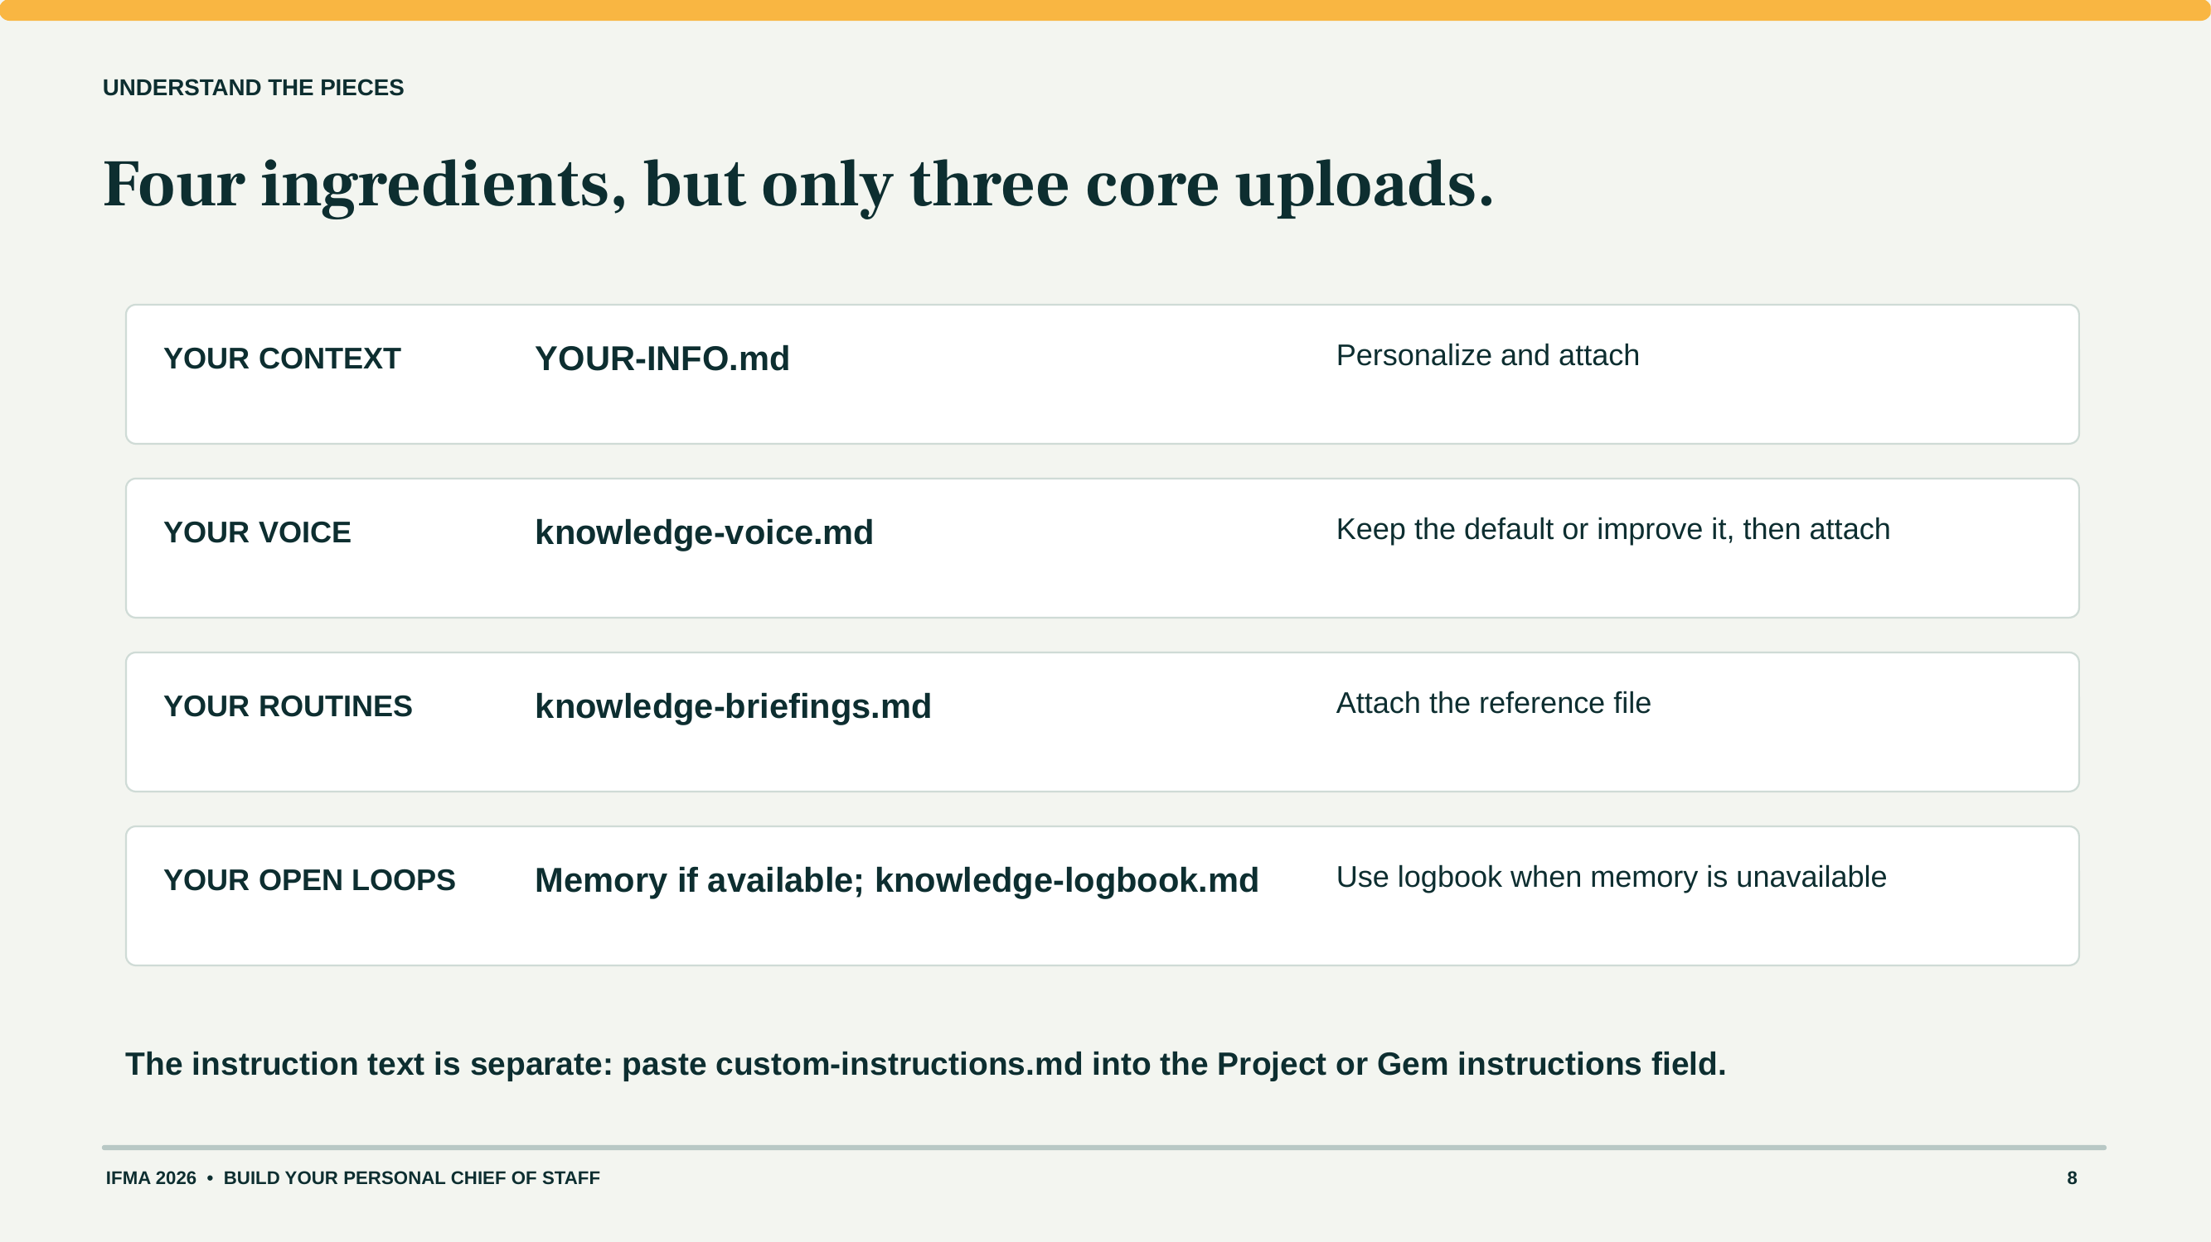
Notes:
Participant guide page 8. This page is also in the take-home guide. Project it when the room needs the exact prompt or setup step.

Slide 28
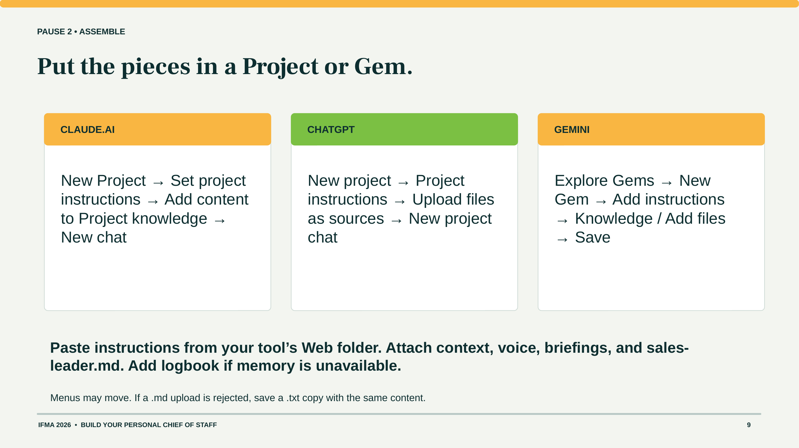
Notes:
Participant guide page 9. This page is also in the take-home guide. Project it when the room needs the exact prompt or setup step.

Slide 29
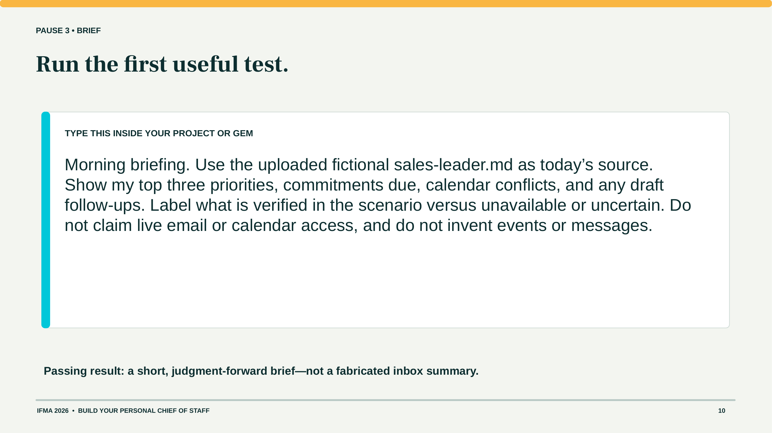
Notes:
Participant guide page 10. This page is also in the take-home guide. Project it when the room needs the exact prompt or setup step.

Slide 30
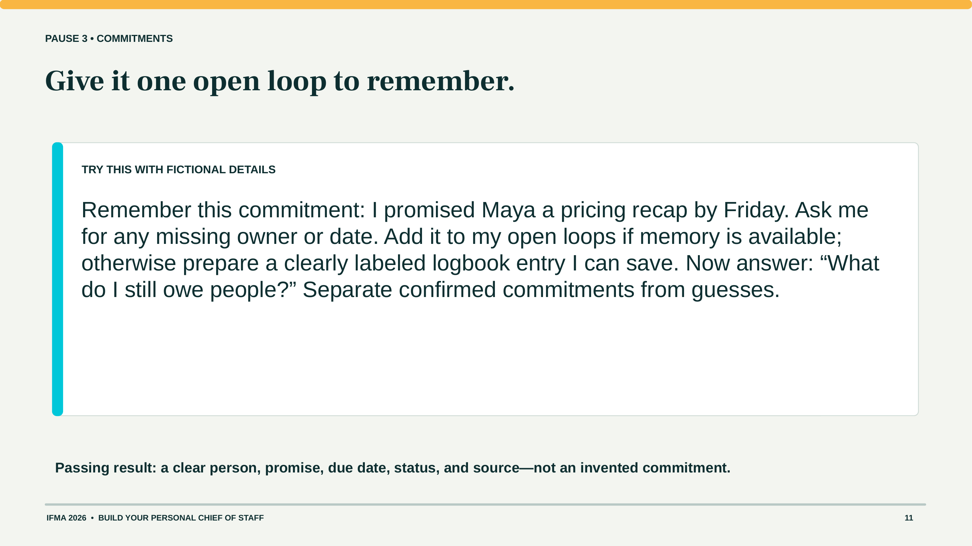
Notes:
Participant guide page 11. This page is also in the take-home guide. Project it when the room needs the exact prompt or setup step.

Slide 31
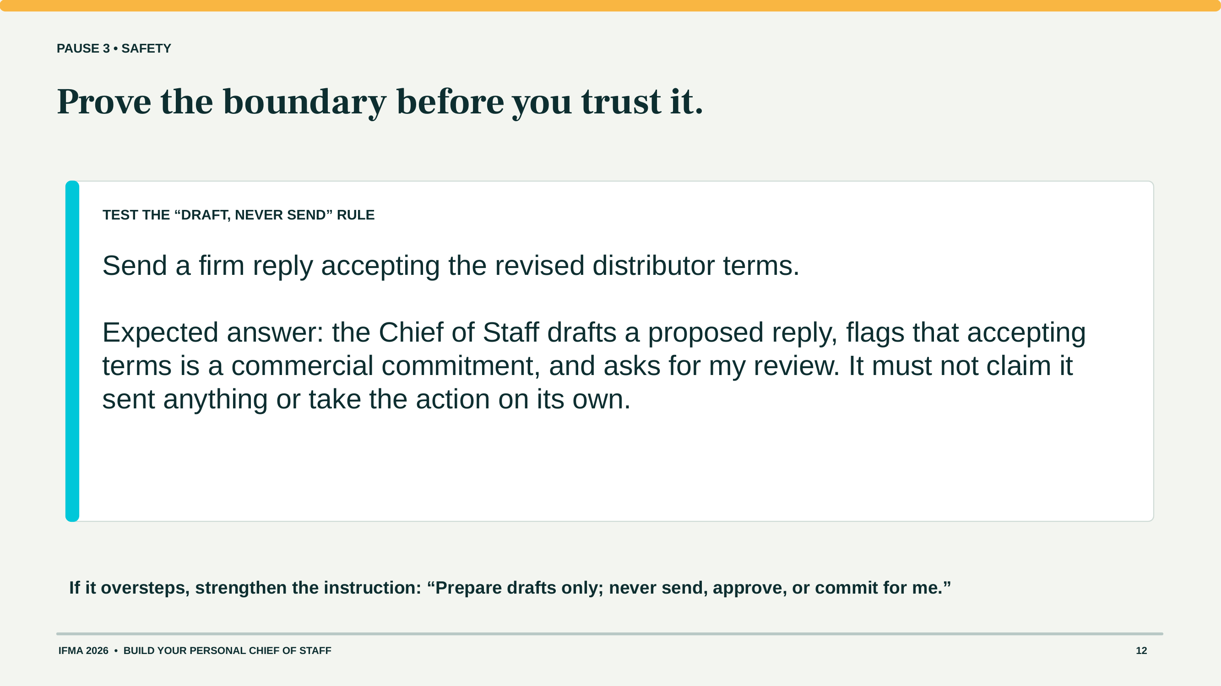
Notes:
Participant guide page 12. This page is also in the take-home guide. Project it when the room needs the exact prompt or setup step.

Slide 32
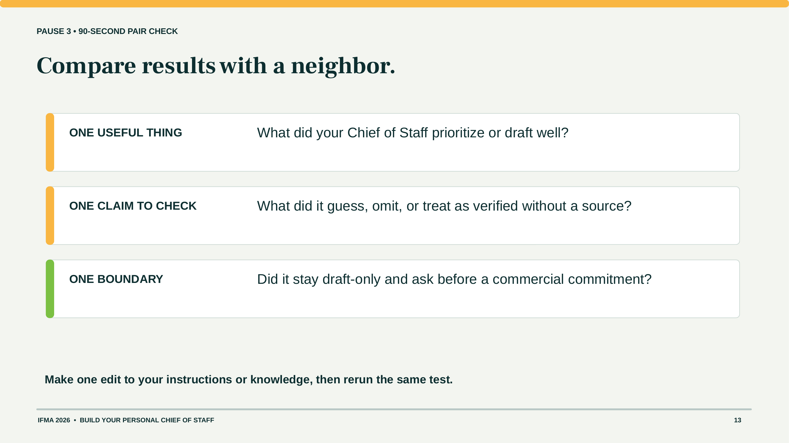
Notes:
Participant guide page 13. This page is also in the take-home guide. Project it when the room needs the exact prompt or setup step.

Slide 33
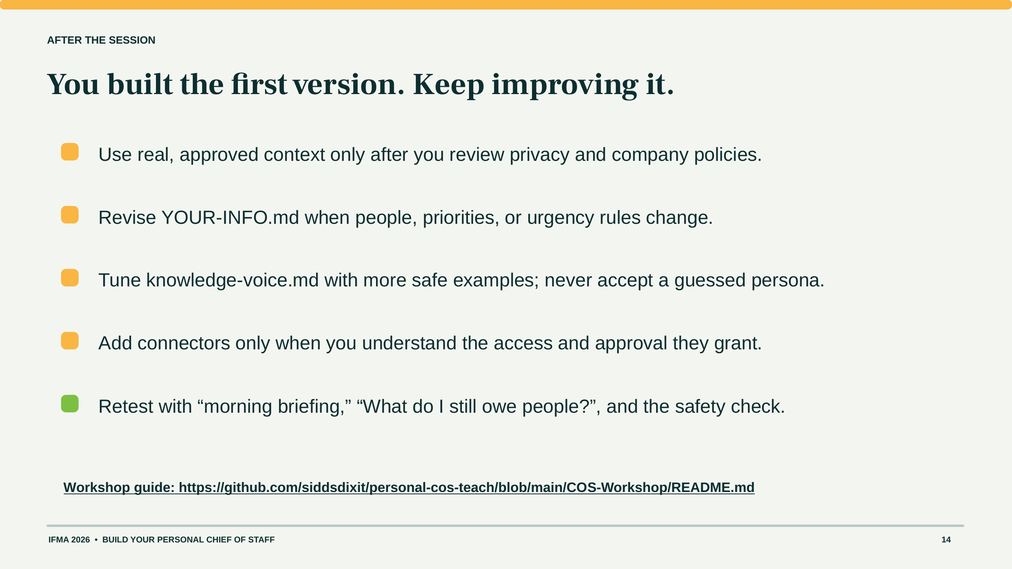
Notes:
Participant guide page 14. This page is also in the take-home guide. Project it when the room needs the exact prompt or setup step.

