Slide 2
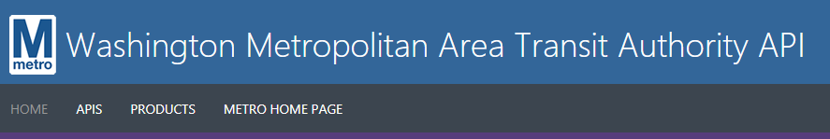




Slide 3
How it works
Api Returns train location
Mapped train location to led number in csv
(in my case, from Greenbelt to Columbia heights)
Turn API Json into Dataframe
Join location to led table
Pass which leds to turn on to Neopixel strip

Slide 4
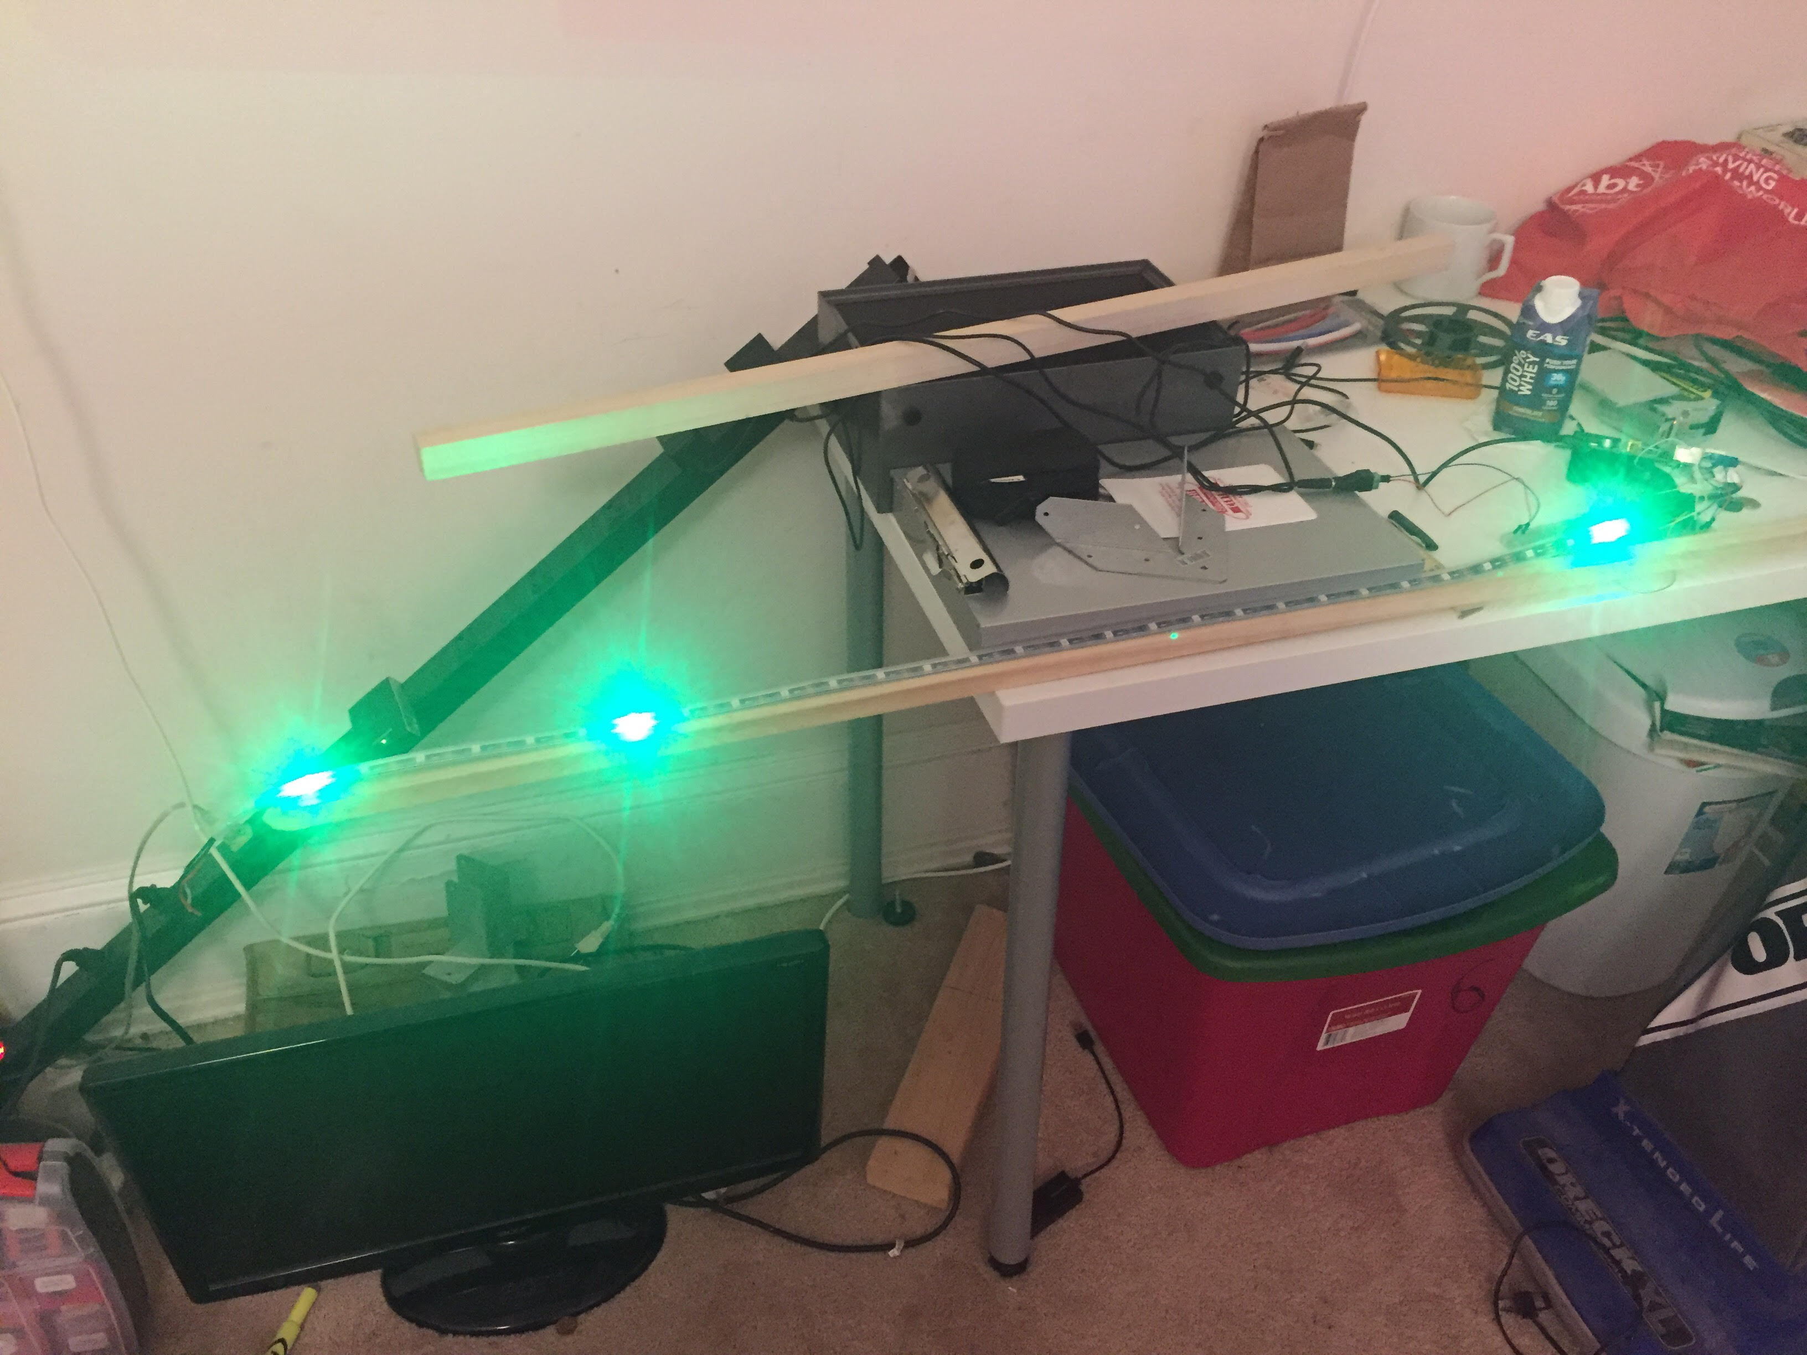

Slide 5

https://developer.wmata.com/
https://github.com/edeo/rpi_ws281x/blob/master/python/examples/wmataled.py
https://github.com/edeo/rpi_ws281x/blob/master/python/examples/led.csv
https://learn.adafruit.com/neopixels-on-raspberry-pi/overview
https://learn.adafruit.com/neopixels-on-raspberry-pi/overview

