Slide 1
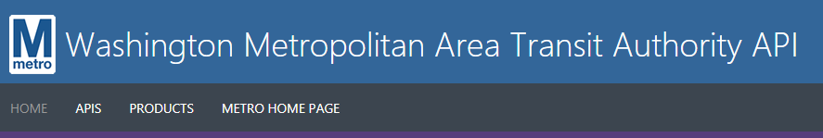



Ed O’Brien
@edeo
10/24/2017

Slide 2
How it works
Api Returns train location
Mapped train location to led number in csv
(in my case, from Greenbelt to Columbia heights)
Turn API Json into Dataframe
Join location to led table
Pass which leds to turn on to Neopixel strip

Slide 3
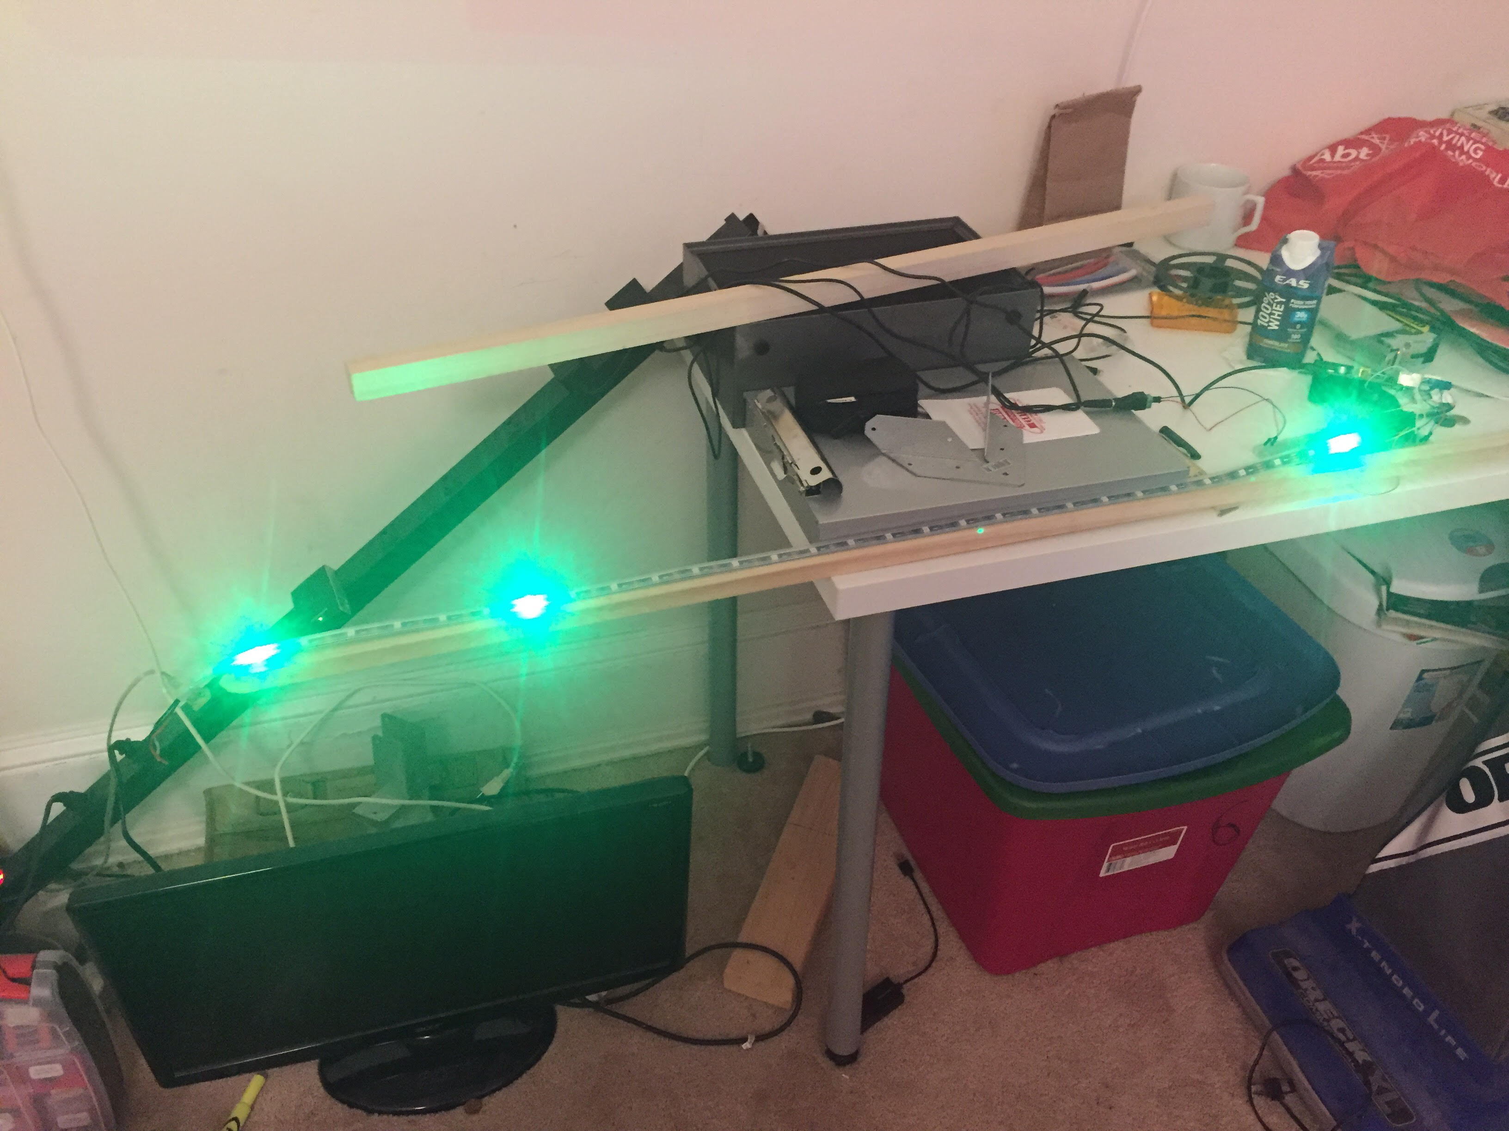

Slide 4
How to do it :
1.Build out the strip.
2. Wire it to the raspberry pi.
3.Config part
4.CircuitId – to light mapping.
5.While loop with requests

Slide 5

https://developer.wmata.com/
https://github.com/edeo/rpi_ws281x/blob/master/python/examples/wmataled.py
https://github.com/edeo/rpi_ws281x/blob/master/python/examples/led.csv
https://learn.adafruit.com/neopixels-on-raspberry-pi/overview
https://learn.adafruit.com/neopixels-on-raspberry-pi/overview

Slide 6
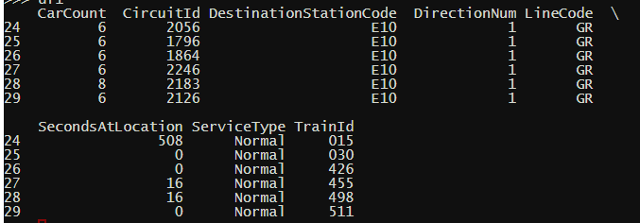
Wrangled Json output
Goal is to join CircuitId to Led on neopixel strip.

Slide 7
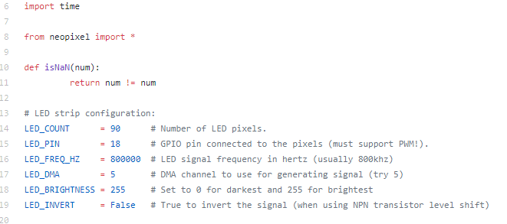
3.Config part
4.CircuitId – to light mapping.
5.While loop with requests

Slide 8
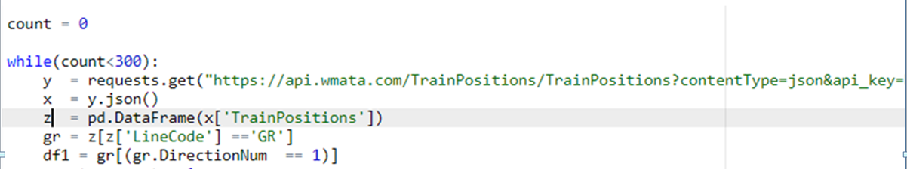
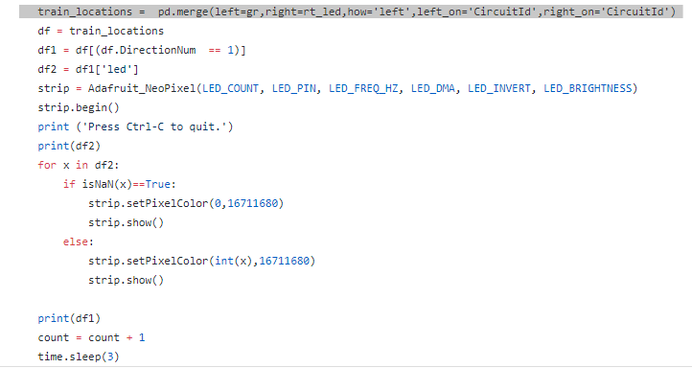
led = pd.read_csv('led.csv')

Slide 9
Ideas for the future :
1.Add yellow line trains.
2. Add both directions – maybe display train with a blinking light ahead of current
Position.
3. Show stations – maybe with white lights.
4. If trains are at one place for a long time – maybe have them blink red.
5. Get it to work on a raspberry pi W zero
6. Use numpy instead of pandas to wrangle the json api output.
API+Raspberry Pi + Neopixel – Lots of potential dashboards

Slide 10

@edeo
https://github.com/edeo/wmataledpresentation/

