Slide 1
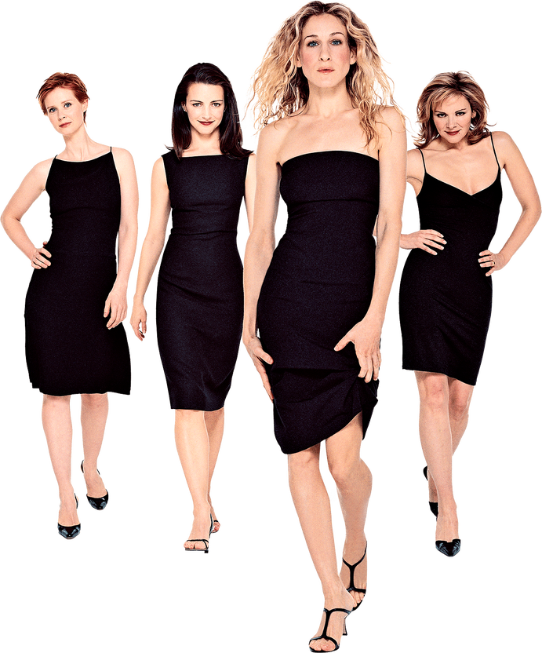

I couldn’t help but wonder...who said it?
Text Classification for Sex & The City Lines
By Emily Anne De Padua

Slide 2




Sex and the City
The Show
What is Sex and the City? Sex and the City is an American romantic comedy-drama television series by HBO starring Sarah Jessica Parker (Carrie), Cynthia Nixon (Miranda), Kim Cattrall (Samantha), and Kristen Davis (Charlotte). Broadcast from 1998 until 2004, the original run of the show had a total of 94 episodes. The show would eventually evolve into 2 feature film sequels released in 2008 and 2010.
What’s the plot of Sex and the City? The show follows the lives of a group of four women--three in their mid-thirties, one in her forties--who, despite their different natures, remain inseparable and confide in each other while navigating relationship & life in New York city.
Carrie Bradshaw
Miranda Hobbes
32, Writer
*Each episode is based on her Weekly Column
32, Lawyer
Samantha Jones
Charlotte York
40, Publicist
31, Art Dealer
Notes:
Add a video to explain the show to the class?

Slide 3
Defining Moments
Examples of each characters’ distinct dialogue
“Sometimes, it’s hard to walk in a single women’s shoes.”
“I’m looking for real love.”
“I’d like a cheeseburger, large fries, and a Cosmopolitan.”
“I started to wonder, in a city as cynical as New York, is it still possible to believe in love at first sight?”
"I want to enjoy my success, not apologize for it."
“How did it happen that four such smart women have nothing to talk about but boyfriends?”
“Why do we get stuck with old maid and spinster and men get to be bachelors and playboys?
Carrie Bradshaw
Miranda Hobbes
“If I worried what every b**** in New York was saying about me, I’d never leave the house.”
“Honey, before you buy the car, you take it for a test drive!”
“Nobody told me it was BYO man!”
“If you turn into one of those married a**holes, I’ll kill you.”
“I’m from Connecticut!”
“I’ve been dating since I was 15, I’m exhausted, where is he?”
“I can’t believe you took Ecstasy from a stranger!”
“Don't laugh at me, but maybe we could be each other's soulmates?”
Samantha Jones
Charlotte York
Notes:
If you don’t know or want a refresher on n-grams, don’t worry, I’ll get to that

Slide 4
A ‘Vogue’ Idea
Project Idea
The Question Can we predict if a line from Sex and the City was said by either Carrie, Miranda, Charlotte, or Samantha?
The Dataset Sourced from a Kaggle dataset that gives line by line every piece of dialogue spoken by every character on the show, there are 39K observations total. When broken to the core 4 (Carrie, Charlotte, Samantha, Miranda), observations move to 26.5K rows.

Slide 5
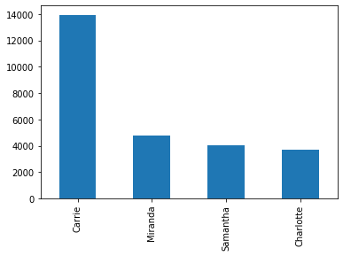
The Catch
Challenges
A case of Imbalanced Classes…
Carrie’s observations (~14K) is more than 2x Miranda, Samantha, or Charlotte
Notes:
What are reasons for this proportional differences besides Carrie being the main character?

Slide 6
The Domino Effect
Project Approach
Ran (3) iterations of the Text Classification model (using Naive Bayes):
Attempt 1 (Base) Ignore the class imbalance to see what happens ~54% accuracy score
Attempt 2 (Downsample) Downsample Carrie (from ~14K to ~5K) ~40% accuracy score
Attempt 3 (Upsample) Upsample Charlotte, Miranda, and Samantha’s observations Resulted in ~57% accuracy - yay!
*** initial scores did not include n-grams
Notes:
If you don’t know or want a refresher on n-grams, don’t worry, I’ll get to that

Slide 7
Pick-A-Little, Talk-A-Little
Train, Test, Pray, and Hope for the Best
What happened when we applied n-grams?
Here are some takeaways from including n-grams limited to 100K features:
Accuracy scores improved when we added up 1, 2, and 3-grams. Improved the accuracy (on the 3rd attempt) to ~68%. Including 2-grams landed at 66%.
However, there was a point of diminishing return when we began including 4 and 5-grams. When we included 4 and 5-grams, the accuracy dipped to 66% and 64% respectively.
Notes:
N-grams are features which consist of N (a specific number of) consecutive words. This is useful because this allows us to treat data scientist as a single feature, which has more meaning than having two independent features data and scientist!

Slide 8
Lights, Camera, Relationship!
Model Performance
So ultimately, where did I land?
Using Attempt 3 (Upsampling Charlotte, Miranda, and Samantha)...
Base Accuracy - ~58%
Using up to 3 n-grams - ~68%

Slide 9
Sex and Another City
Opportunities for Expansion
More scripts, more lines
Include dialogue from Sex and the City movies. Adding more character lines (especially for Miranda, Samantha, and Charlotte) could improve results.
Reframe the Question
Reframe the project to a binary classification -- Samantha’s Dialogue vs. Charlotte’s Dialogue
Try a different Algorithm?
Word2vec? Word Embed? Incorporate a Sentiment Analysis?
Notes:
LOL, Spencer, I tried, but my brain felt like it was going to melt trying to include it.

Slide 10
I Love New York
Additional Resources
Initial Dataset
Dataset
Sex and the City Analysis
Published on Ceros
Project Inspiration:
Celine or Jesse? Before Sunrise Text Classification

Slide 11
Thank you!
Questions?

