Slide 1
Arizona Accidents Analysis
Project 1
Michael Hennessy
Ethan Devey
Cassandra Clement
Pryia Balasubramanian

Slide 2
contents
Introduction
Analysis
Measures
Conclusion
Dataset & References

Slide 3
Introduction
Arizona Accidents Analysis for 2012 to 2016
We conducted research in the following topics to analyze the accidents that had higher fatality rates in the state of Arizona:
Counties
Roads/Intersections/Traffic Ways
Age
Weather Conditions
Car Types
Cause of crash
Funding of traffic
Conclusion found based on the research shows that there are many factors to consider on the who, what, when, why, and where accidents occur in the state of Arizona.

Slide 4
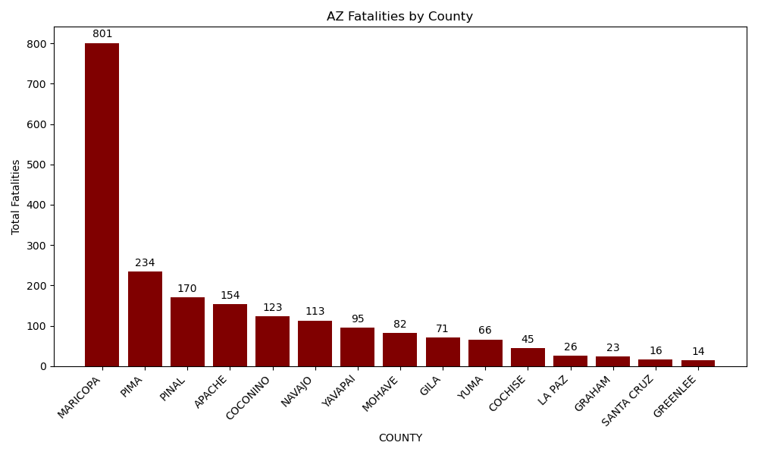
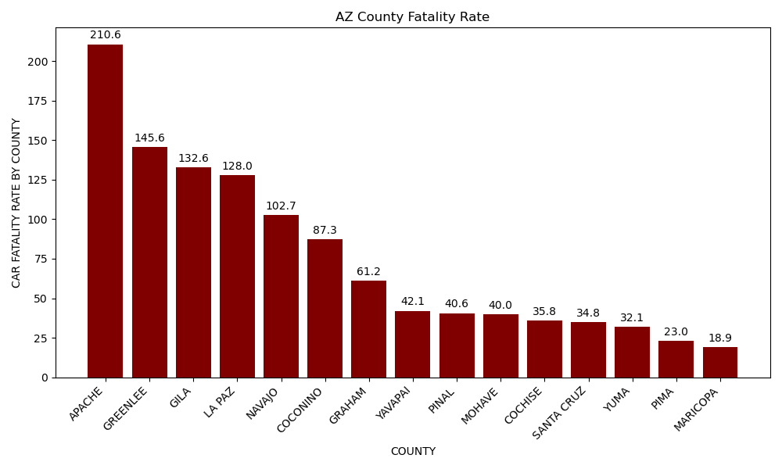
Analysis
Notes:
While it’s not a real surprise that Maricopa, Pima and Pinal had the most fatalities because they have the most people in those counties, what is surprising is the fatality rate per capita by county. Counties on the east side of state tended to have the higher fatality rate per capita. Apache greenlee and gila all are on the eastern side of the state, and have lower populaitons so the fatality rate of car accidents is higher there, although just because there was a fatality doesn’t mean that person was from that county. Greenlee and la Paz only had a total of 40 accidents combined, but because of low populations it made their fatality rate much higher

Slide 5
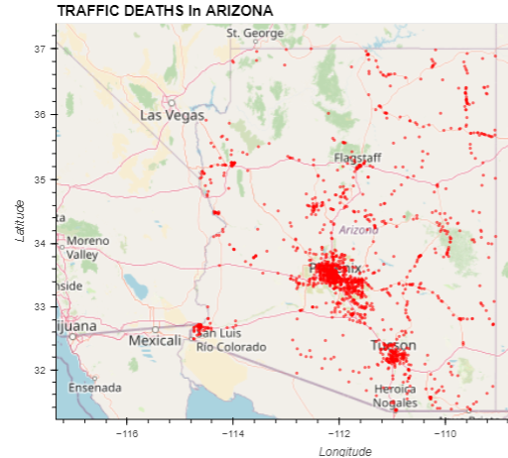
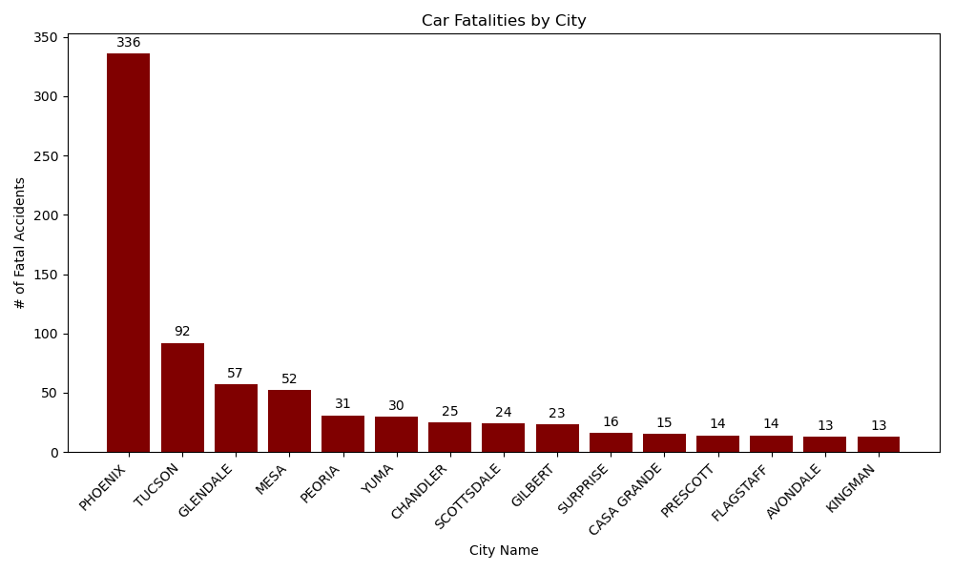
Notes:
No surprise that most of the accidents were found in the phoenix and surrounding area. What was interesting was the most dangerous Arizona roads for fatalities. US191 which runs north to south on the far east side of Arizona was the road with the most fatalities, this includes the counties that also had the highest fatality rates. SR 264, aand SR86 was the other major highway that doesn’t pass by the phoenix area that made the top 15 list.

Slide 6
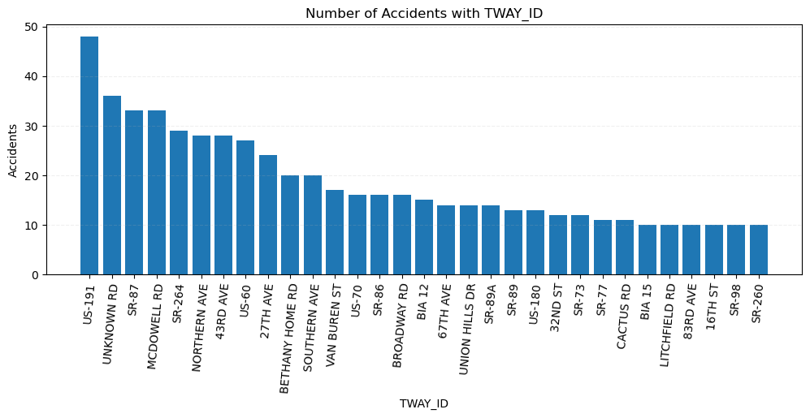
High Traffic Volume
Intersection Complexity
Poor Road Conditions
Implementing traffic calming measures, such as speed bumps, traffic signals, and pedestrian crossings, to reduce the risk of accidents in high-risk areas.
Enhancing road maintenance to address issues such as potholes, uneven surfaces, and poor lighting that contribute to accidents.
Enforcing traffic laws and speed limits to deter reckless driving behaviors.

Slide 7
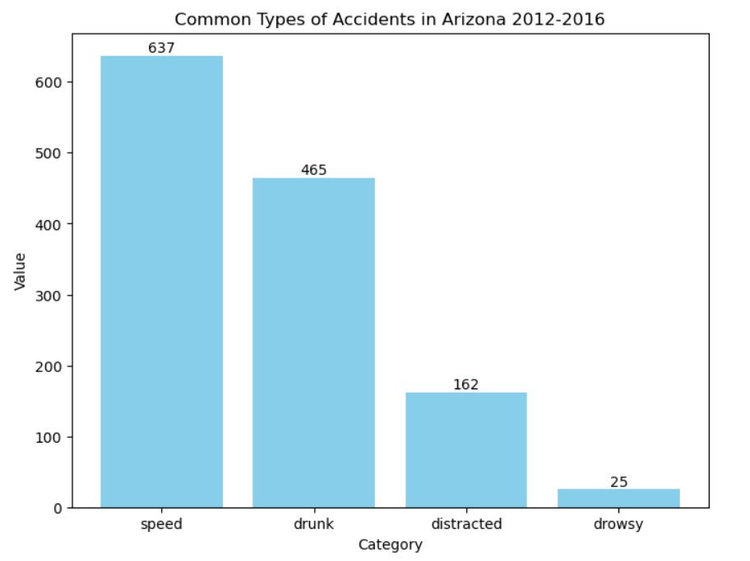
Common accidents in Arizona in 2012 to 2016
Speeding
Drunk Driving
Distracted Driving
Drowsy Driving

Slide 8
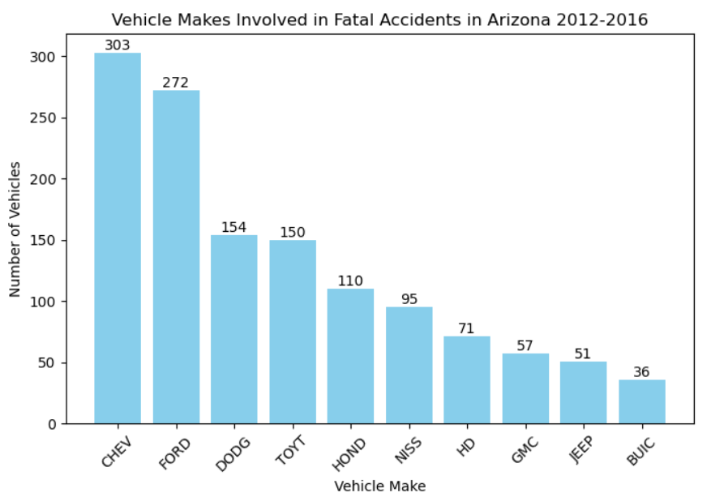
Vehicle Makes
Chevy
Ford
Dodge
Honda
Nissan
HD
GMC
Jeep
Buick

Slide 9
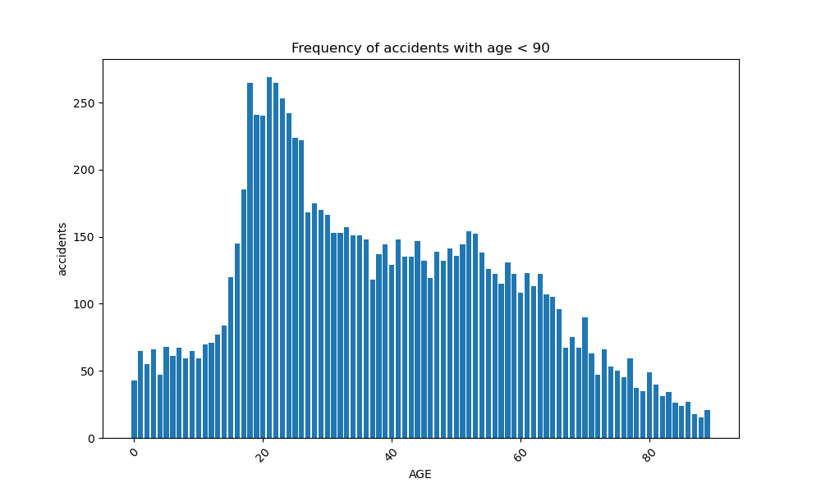
Younger drivers
Risk-Taking Behavior
Distractions
Graduated Driver Licensing (GDL) Programs: Enforce GDL programs that gradually introduce young drivers to more complex driving situations and restrictions, such as nighttime driving limitations and passenger restrictions.
Enforcement of Traffic Laws: Strict enforcement of traffic laws, including speed limits, seat belt usage, and zero-tolerance policies for impaired driving, can help deter risky behaviors among young drivers.
Peer-to-Peer Education: Promote peer-to-peer education initiatives where young drivers share experiences and encourage each other to adopt safe driving practices.

Slide 10
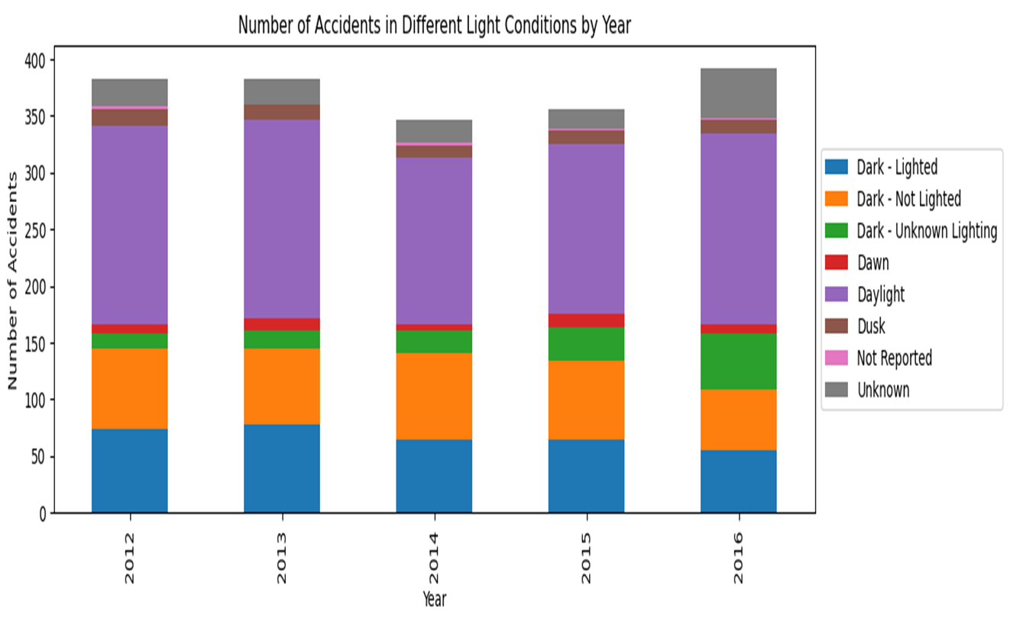
Pedestrian and Cyclist Activity
Weather Conditions
Fatigue and drowsiness
Stay Alert and Focused,
Obey Traffic Laws,--speed limits, traffic signals, road signs, avoid aggressive driving behaviors as tailgating , sudden lane changes
Ensure that your vehicle is properly maintained--checking the brakes, tires, lights, and other essential components.
Use turn signals--Indicate your intentions by using turn signals when changing lanes to alert other drivers

Slide 11
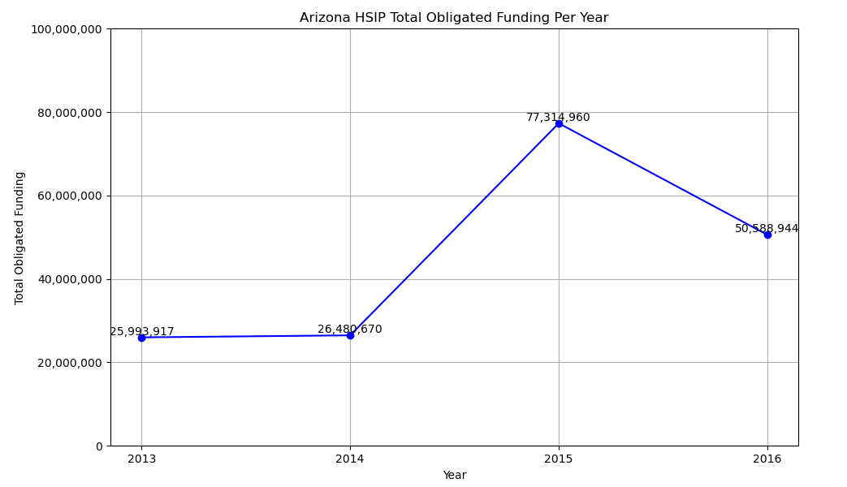
HSIP Funding
As shown in the graph, overall HSIP funding ranged from $25M-$77M per year.
The data shown reflects funding for 2013-2016 ranging from the year the program was put into place to the final year within the dataset of fatal accidents used to compare.

Slide 12
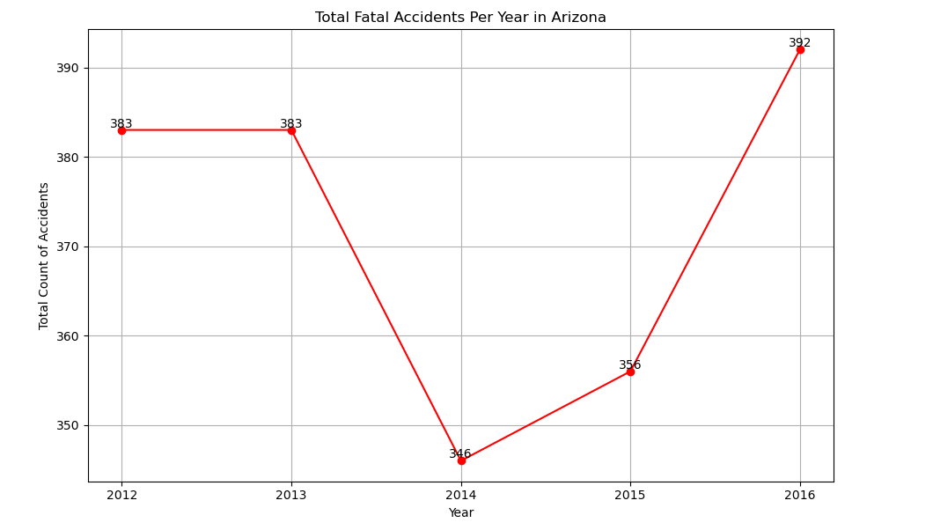
Total Fatal Accidents Per Year
The total # of fatal accidents per year took a dip between 2013-2014. This is the year that HSIP was put into place and received funding. When reviewing the two graphs, there’s an inverse relationship implying that the increases in funding might’ve played a part in the reduction of overall accidents.
Towards the end of the program’s initial term, the funding decreased. When the funding was reduced, the overall number of accidents began to rise again.

Slide 13
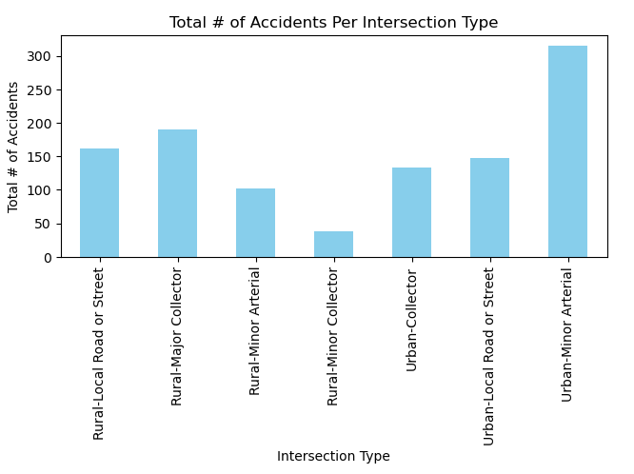
Intersection Review
When looking at the dataset of fatal accidents from 2012-2016, the most common type of roadway where accidents occurred were Urban-Minor Arterial roads. Urban-minor arterial intersections are roadways that are a step down from highways. These roads connect urban neighborhoods to the major highways.
There wouldn't be a way to limit this as these roadways are necessary for people living within a small urban area to navigate to other locations outside of their neighborhood.
For urban areas, collector streets have the least # of accidents within the dataset. It may be helpful to begin paving more collector streets that connect the arterials. This way, more people may avoid the arterials for a portion of their trip and only use it when necessary.

Slide 14
Dataset
References
Size of Dataset : 3.62 MB
Content: This dataset provides detailed information about fatal car accidents that occurred in the state of Arizona. Data points such as location, time, weather, contributing factors and demographic info of the motorists involved have been parsed out of the dataset.
Number of records: 18360 rows
Number of columns: 309 columns
Source: available on Kaggle
https://www.kaggle.com/datasets/thedevastator/fatal-traffic-accidents-in-arizona-2012-2016
HSIP – Highway Safety Improvement Program:
chrome-extension://efaidnbmnnnibpcajpcglclefindmkaj/https://highways.dot.gov/media/10071 chrome-extension://efaidnbmnnnibpcajpcglclefindmkaj/https://highways.dot.gov/media/10616 chrome-extension://efaidnbmnnnibpcajpcglclefindmkaj/https://safety.fhwa.dot.gov/hsip/reports/pdf/2015/az.pdf chrome-extension://efaidnbmnnnibpcajpcglclefindmkaj/https://highways.dot.gov/sites/fhwa.dot.gov/files/2022-06/hsip_reports_2016_az.pdf
Arizona County Population:
https://www.mapsofworld.com/usa/states/arizona/population.html#google_vignette

Slide 15
Thank you
Q&A

