Slide 1
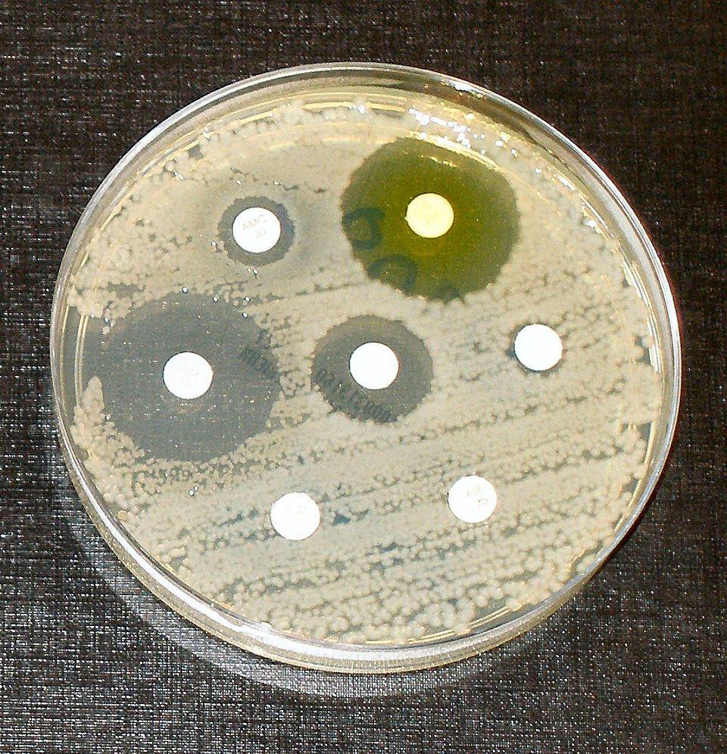
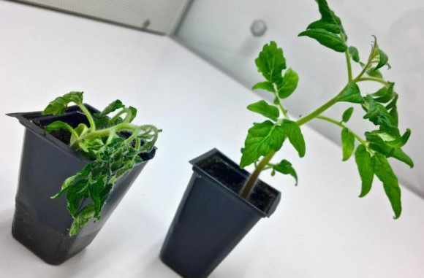
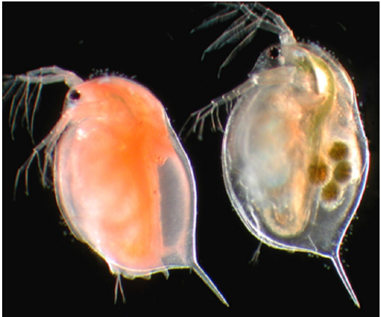
Evolutionary Genetics
Fall 2025
Eric Dexter, Julia Barth, Walter Salzberger

Slide 2
Organization of the course
Module I: Population Genetics (week 45-48)
Tuesday and Thursday afternoons 14:15 to 17:00
Kleiner Hörsaal (O1.13) Vesalianum Building
Module II: Molecular Evolution (week 49-51)
Tuesday and Thursday afternoons from 14:15 to 17:00
Seminar room E0.07 (ground floor) Vesalianum Building

Slide 3
Organization of the course
Intermediate grades for each module, written. Counts 1/3 of the final grade.
End-of-semester exam, written, 90 minutes. Counts 2/3 of the final grade.
Date final exam: Thursday, 18.12.2025, 14:15-15:45, Vesalianum, small lecture hall (O1.13)

Slide 4
Organization of the course
Important note for Module 1
For the duration of this 4-week module, there are no restrictions on the use of AI, and you are in fact strongly encouraged to use AI to help you understand the materials and complete the exercises
AI tools such as ChatGPT, google Gemini, Anthropic Claude, etc. are a great resource to help troubleshoot technical problems with software and tools that you will need to use. Professional bioinformaticians, statisticians, and programmers have adapted to using AI as part of their daily toolkit.
These tools are prone to errors, hallucinations, and mistakes. You must develop habits to know how to validate the output of these tools are work safely with them
Use AI as a tool to support your learning, not a substitute. Your final exam will be with a paper and pencil and the only tool that you will have available is your memory and understanding of the material
This AI policy applies only to this 4-week module! You will have stronger restrictions in other classes.

Slide 5
Structure for our 4-week course
Each 3-hour session will be divided into 2 roughly equal halves with a 15-minute break in the middle.
Part 1: Population genetics theory
Here we discuss the theory of population genetics, review important concepts, introduce and define new terminology, and work through hands-on exercises to better understand abstract concepts
Part 2: Bioinformatics
In part 1 we learn how to think about population genetics, but in part 2 we learn how to do population genetics. We learn in part 1 about the principles and mathematics behind the tools that we use, but here we learn how to use the tools. How to make reproducible results, how to backup our data and scripts securely, and how to write efficient code.

Slide 6
Structure for our 4-week course
Each 3-hour session will be divided into 2 roughly equal halves with a 15-minute break in the middle.
Part 1: Population genetics theory
Here we discuss the theory of population genetics, review important concepts, introduce and define new terminology, and work through hands-on exercises to better understand abstract concepts
Part 2: Bioinformatics
In part 1 we learn how to think about population genetics, but in part 2 we learn how to do population genetics. We learn in part 1 about the principles and mathematics behind the tools that we use, but here we learn how to use the tools. How to make reproducible results, how to backup our data and scripts securely, and how to write efficient code.

Slide 7
Who am I?
American but have lived and worked in many different countries
Originally interested in field biology but slowly moved to computational biology
Formerly a post-doc at the University of Basel from 2019-2025
Now an independent data science consultant
Specialist in Bioinformatics and statistics

Slide 8
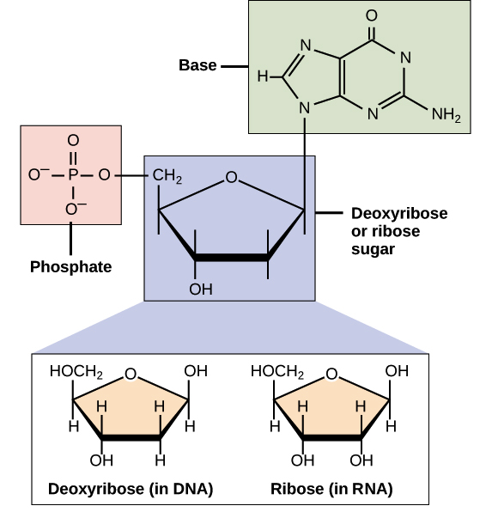
DNA and RNA
Less reactive - better for storage
More reactive - better for interactions

Slide 9
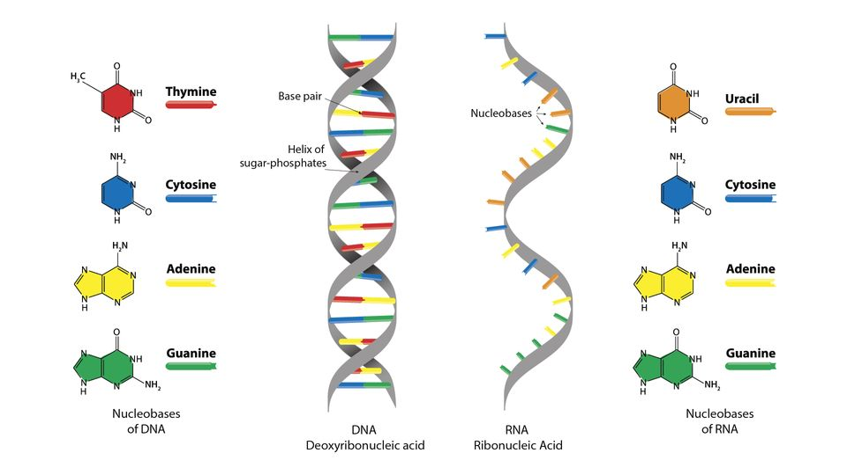
DNA and RNA

Slide 10
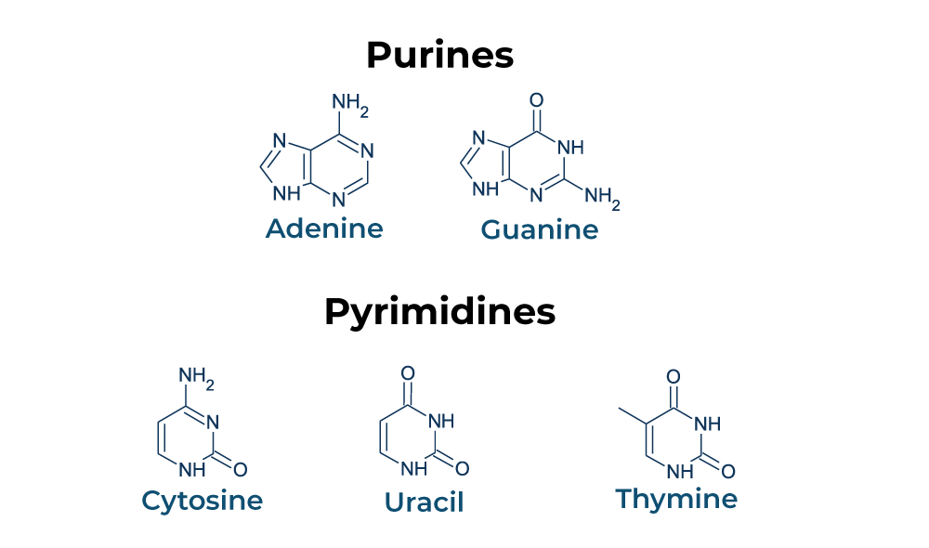
DNA and RNA
RNA only
DNA only

Slide 11
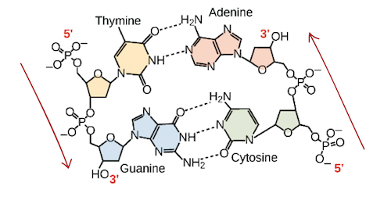
DNA and RNA

Slide 12

DNA and RNA

Slide 13
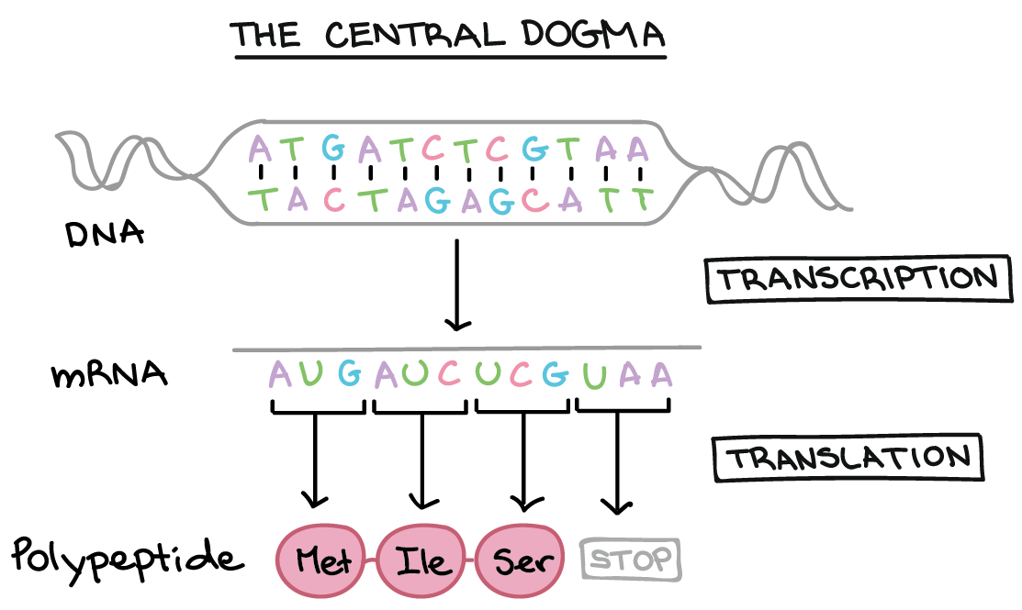
The central dogma

Slide 14
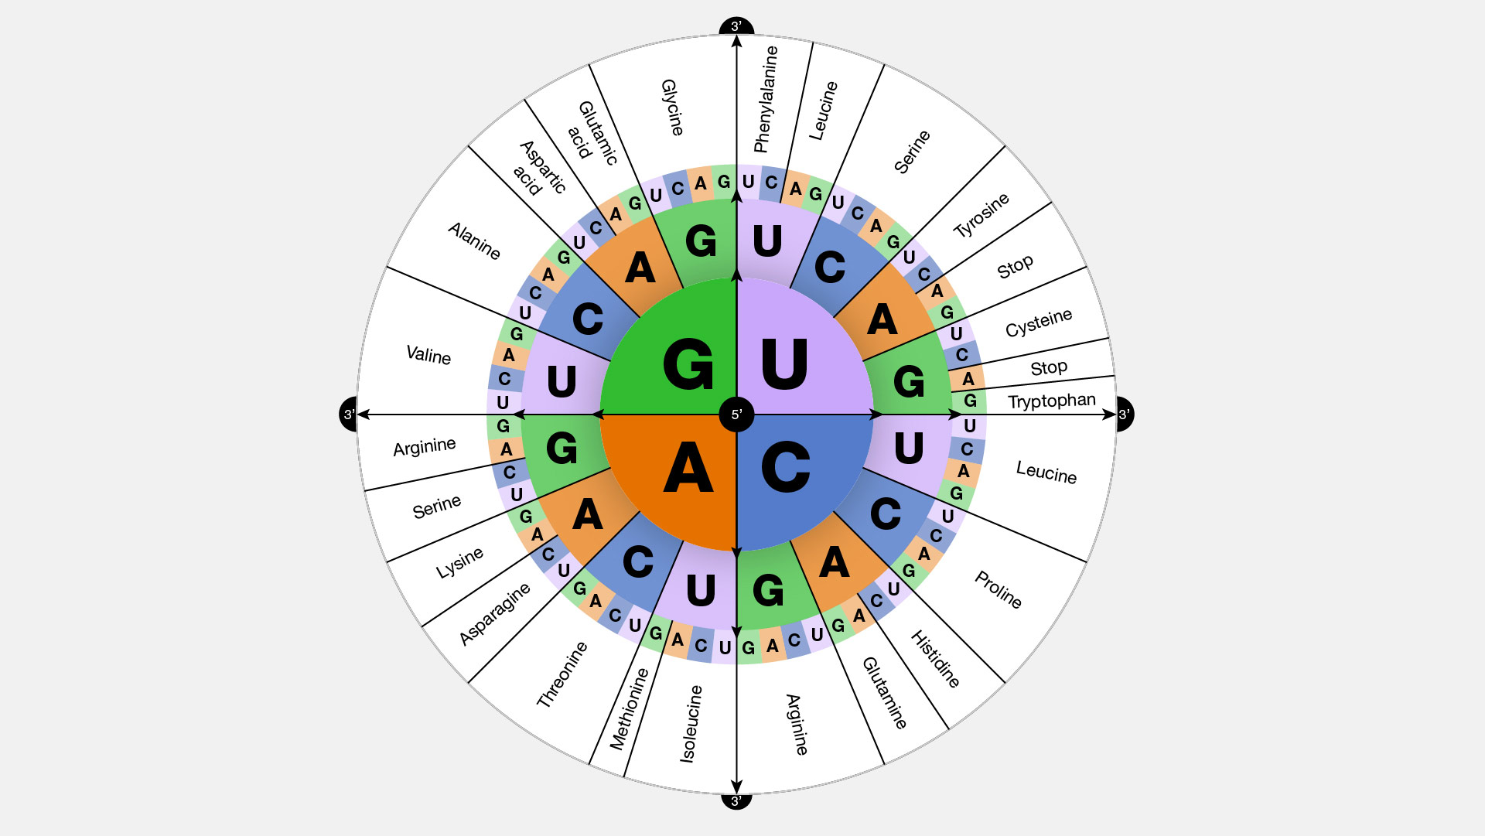
The central dogma

Slide 15
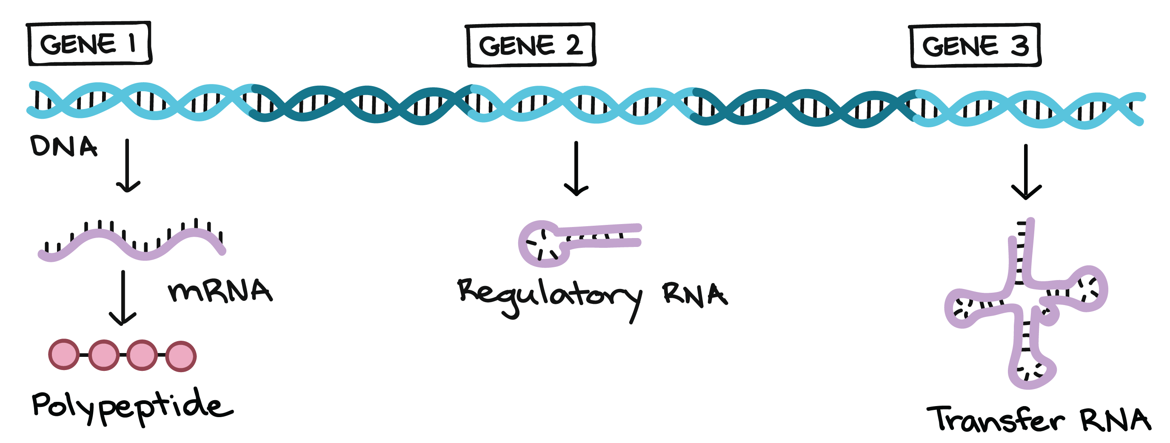
The central dogma

Slide 16

The central dogma

Slide 17
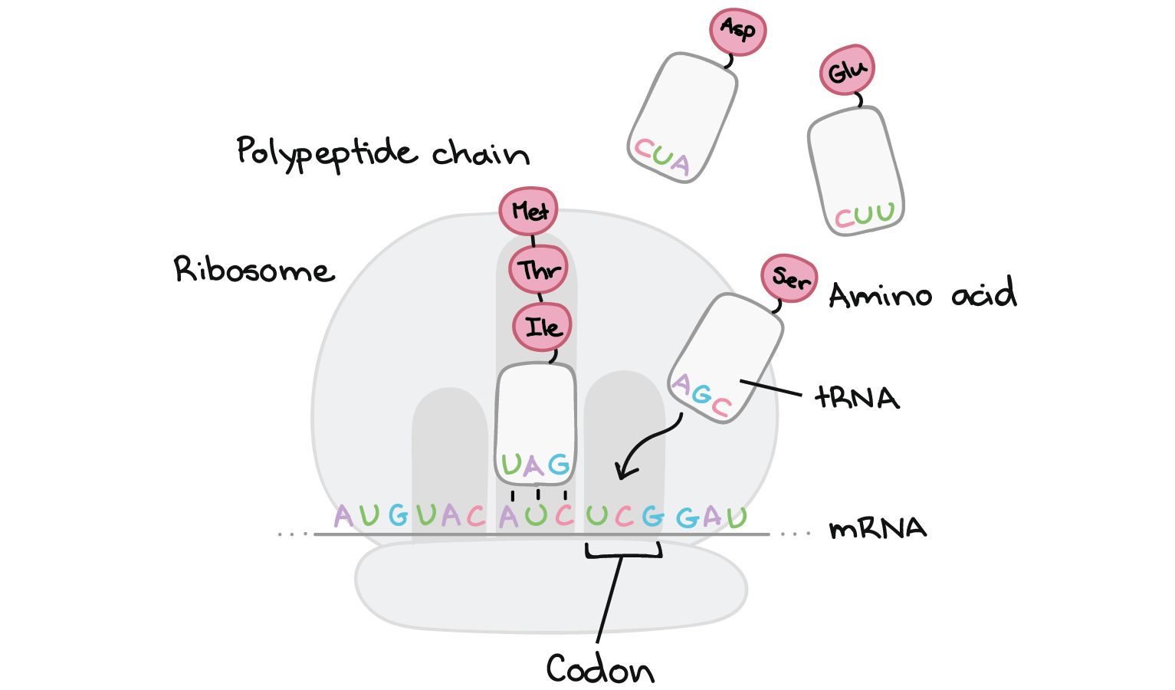
The central dogma

Slide 18
The central dogma
A visualization of the ribosome in action:
https://www.youtube.com/watch?v=5bLEDd-PSTQ

Slide 19
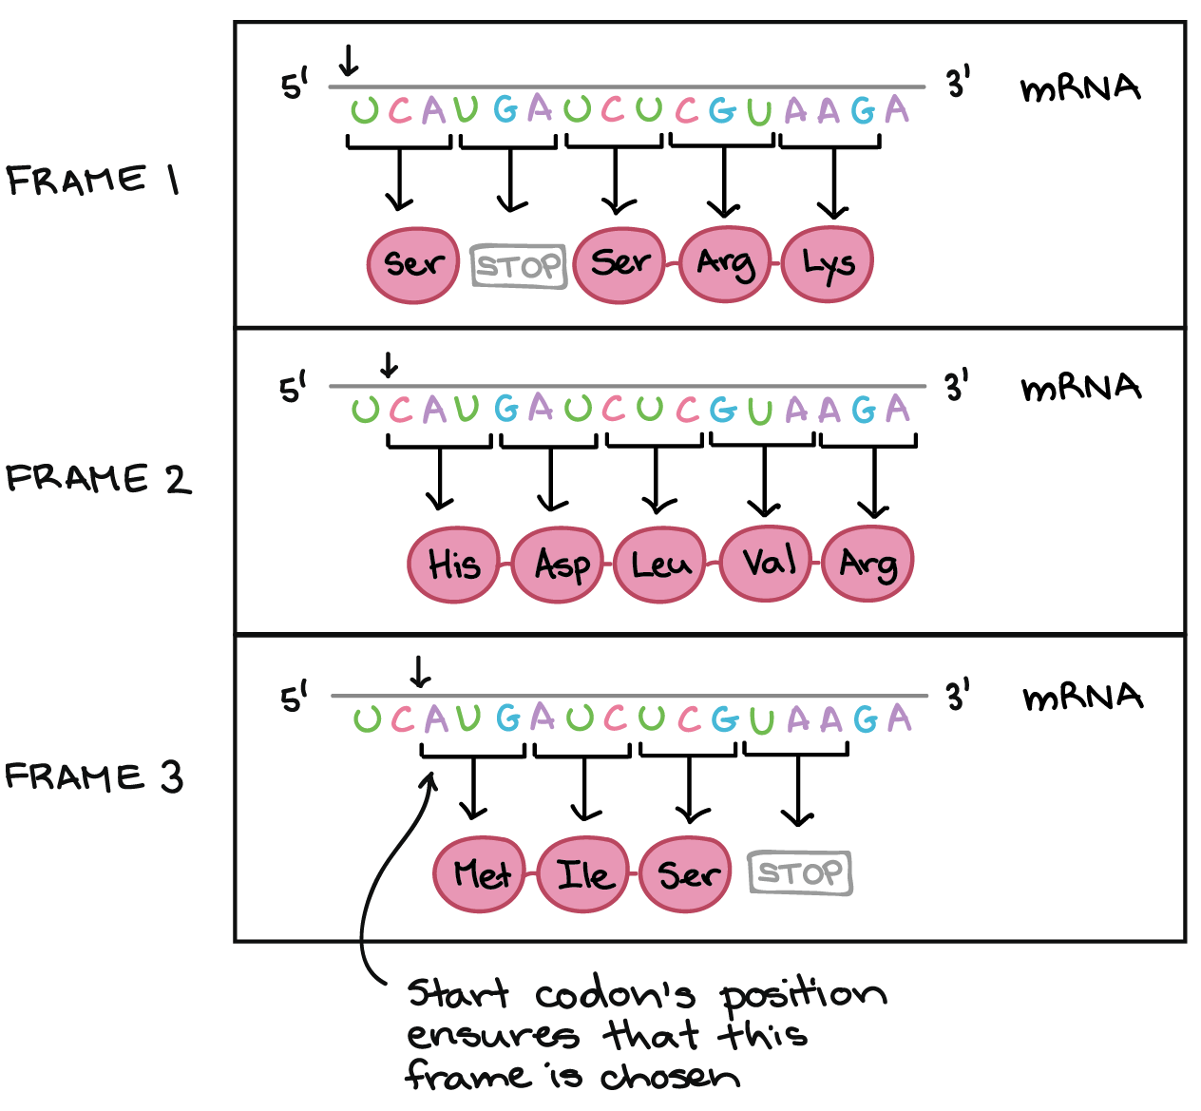
The central dogma

Slide 20
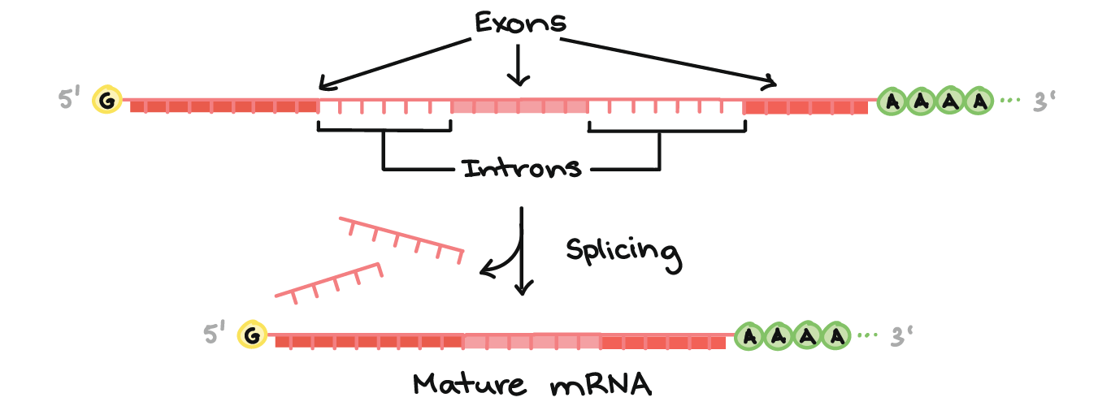
The central dogma

Slide 21
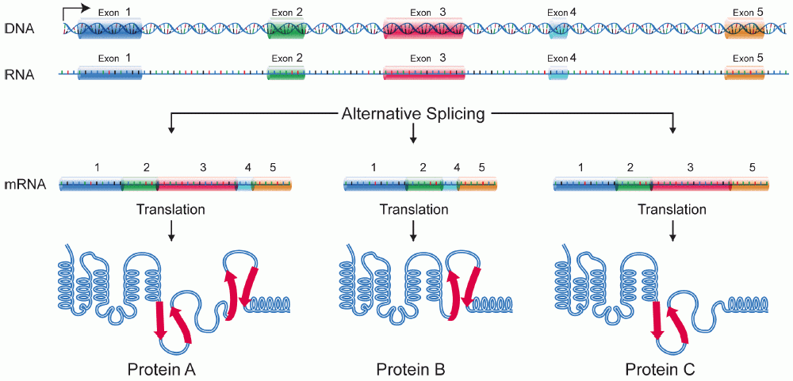
The central dogma

Slide 22
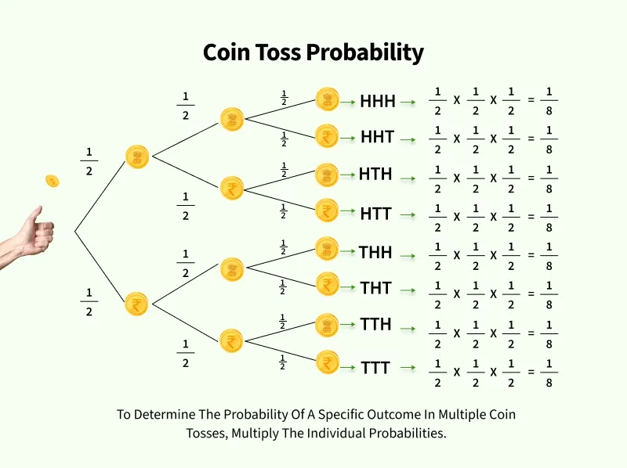
Probability: Addition and Multiplication rules
p(Heads) = 0.5; p(Tails) = 0.5
p(Success) = 0.5; p(Failure) = 0.5
p(1) = 0.5; p(0) = 0.5
p(H) = 0.5; p(T) = 1-p(H)

Slide 23
Probability
Four possible outcomes: (HH, HT, TT, TH)
Three possible combinations: (HH, TT, HT)
Some combinations are more likely that others!

Slide 24
Probability
Only one pathway to HH outcome:
Heads on the first flip with a 50% chance
Heads on the second flip with a 50% chance
50% of 50% is 25% so p(HH) = 0.25
We multiply the probabilities because both events need to happen to reach the final outcome. This is the multiplication rule.
This assumes that each event is independent, this means that the outcome of single events do not influence each other
Note that if the second flip used an unfair coin with a p(Heads)= 0.9, we multiply exactly as before to determine the probability of getting the HH outcome: 0.5 x 0.9 = 0.45. Although the events have unequal probabilities, they are still independent

Slide 25
Probability
If we change the question to ask what the probability of getting 1 head and 1 tail (in any order) when we flip a coin twice, we have to invoke an additional rule.
This is because there are two possible routes that will results in 1 head and 1 tail: HT or TH. All routes have an equal probability of 0.25, so we can add together the probabilities of the two routes that will meet our criteria. So we have a 0.25 + 0.25 = 0.5 chance of getting exactly one head and one tail.
This is the addition rule. It applies whenever events A OR B need to happen. Contrast this to the multiplication rule, which we apply whenever events A AND B need to happen.

Slide 26
Probability

Slide 27
Probability

Slide 28
Probability
probability(2 or more heads) = 1/8 + 1/8 + 1/8 + 1/8 = 1/2

Slide 29
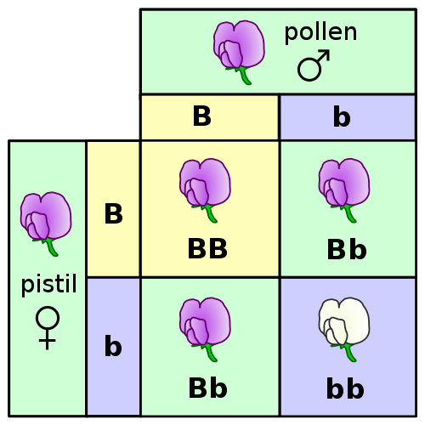
Probability
What is the probability that any given offspring will be a heterozygote? Demonstrate at least 2 different ways to solve this question.
What is the probability that any given offspring will express the dominant phenotype? Demonstrate at least 2 different ways to solve this question.
How would your answers to the above question change if the father were a BB homozygote?

Slide 30
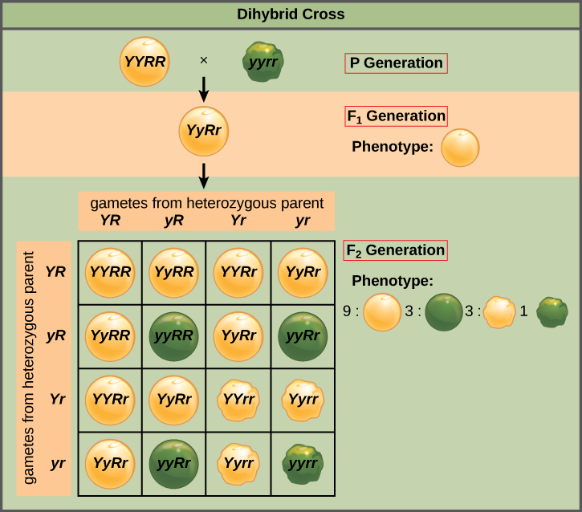
Probability

Slide 31
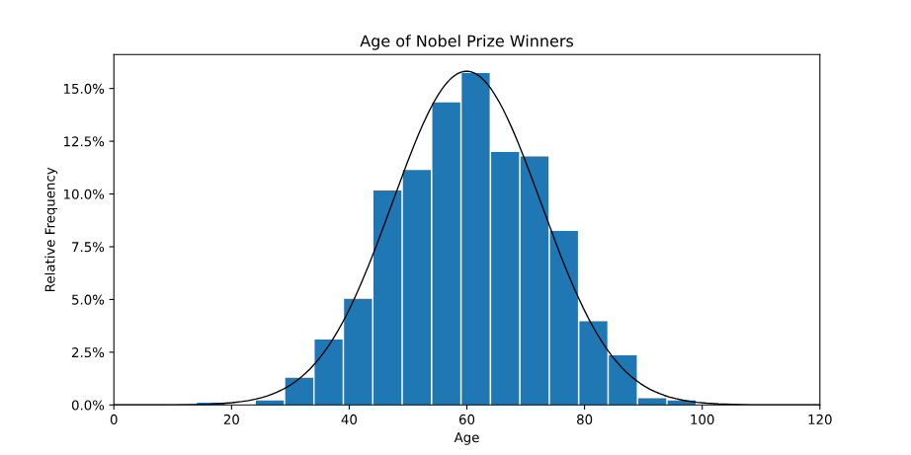
Probability – distributional thinking

Slide 32
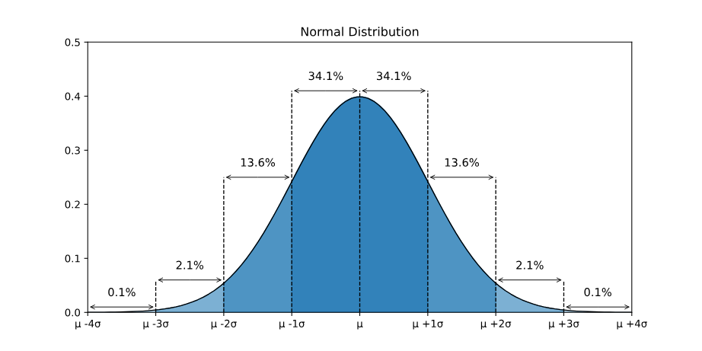
Probability

Slide 33
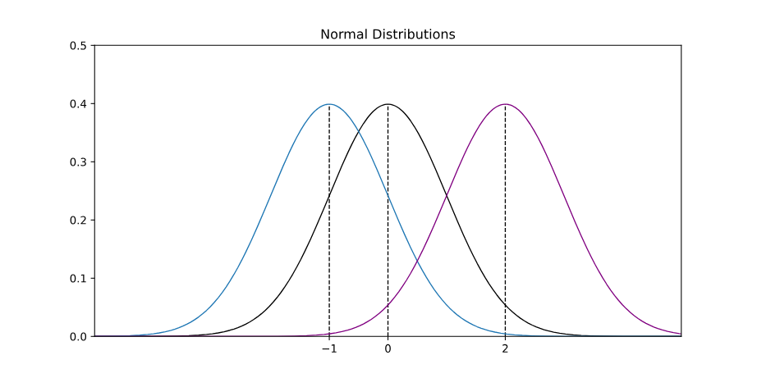
Probability
Parameter 1 = μ (mu) = mean =center of the distribution

Slide 34
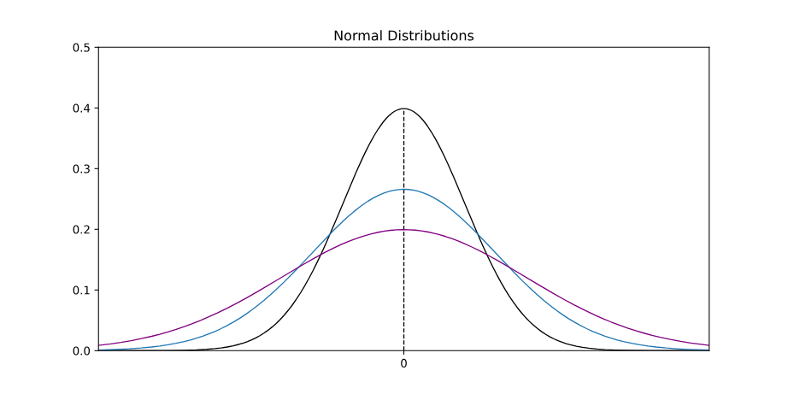
Probability
Parameter 2 = sigma = standard deviation = spread of distribution

Slide 35
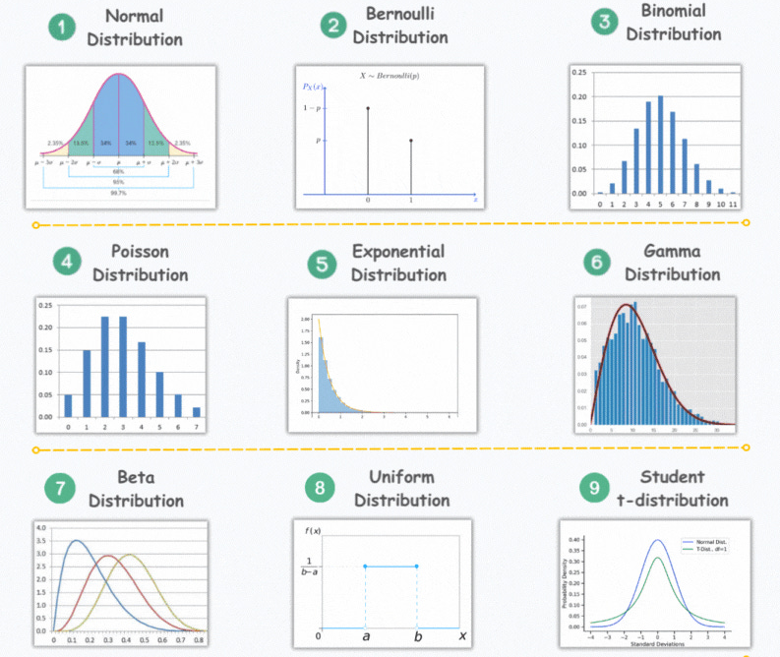
Data distributions

Slide 36
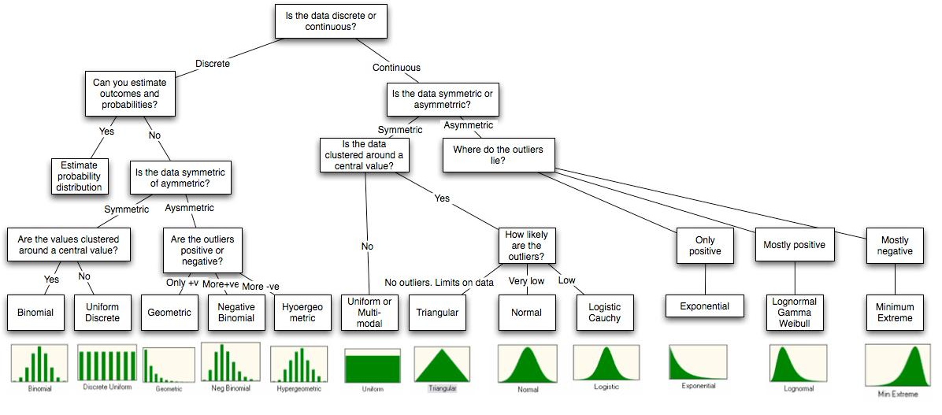
Data distributions

Slide 37
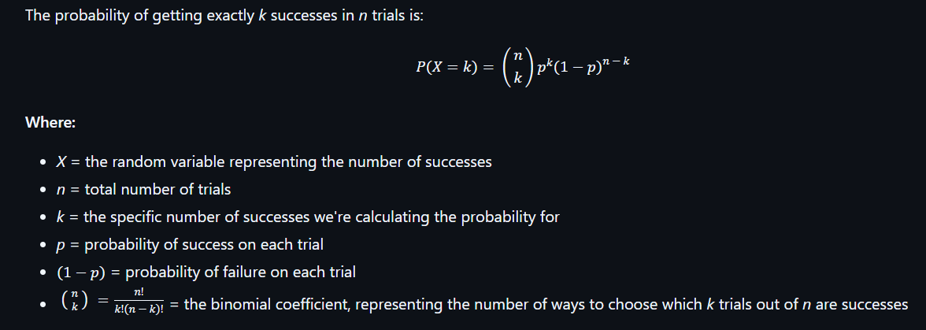
Probability

Slide 38
Data distributions – hands on exercises
Explore the virtual “Galton board” at the following page:
https://www.mathsisfun.com/data/quincunx.html
Make a Galton board with 2 levels. How many possible outcomes (resting place) exist for each ball? Calculate the probability that a random ball ends up in each of those bins.
Introduce a bias so that balls are more likely to go right than left. Now recalculate the probability for each bin.
Start adding levels to the Galton board. What equation would you use to calculate the number of balls going into to furthest right bin?
This is a binomial process, but what distribution shape does this also look like?
Another prettier but less customizable version here: https://www.maths.otago.ac.nz/~gregt/scifest/cascade.html

Slide 39
The binomial distribution
Start an R session on your personal computer (preferably inside R studio)
Go to the course github: https://github.com/edexter/population-genetics
Download the “binomial-distribution.r” script and open it in your R studio program. Alternatively, create a new R script and copy and paste the text into it
Work through the script line by line, exploring the code and answering questions. Feel free to change lines and experiment.

