Slide 1
Measuring Genetic Diversity
Population Genomics Statistics

Slide 2
Why measure genetic diversity?
Evolution - Population adaptation and change
Conservation - Risk assessment in populations
Health - Disease susceptibility patterns
Breeding - Agricultural trait selection

Slide 3
Common measurements of diversity
S
π
Segregating Sites
Nucleotide Diversity
He
θw
Heterozygosity
Watterson's Theta

Slide 4
Our example dataset
5 DNA sequences, 10 base pairs each
Seq1: A T G C A T G C A T
Seq2: A T G C G T G C A T
Seq3: A C G C A T G C A T
Seq4: A T G C A T A C A T
Seq5: A T G T A T G C A T

Slide 5
Common measurements of diversity
S
π
Segregating Sites
Nucleotide Diversity
He
θw
Heterozygosity
Watterson's Theta

Slide 6
Common measurements of diversity
S
Number of Segregating Sites

Slide 7
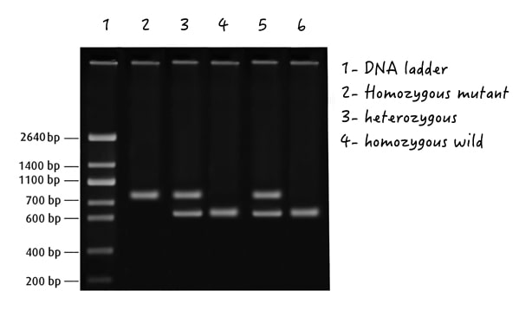
Segregating sites (S)
Definition: Count of polymorphic (variable) positions
A site is polymorphic if it has more than one nucleotide variant. “Segregating” is a historical term and comes from the fact that that different alleles will show as different bands when run on a gel.

Slide 8
Segregating sites (S)
Seq1: A T G C A T G C A T
Seq2: A T G C G T G C A T
Seq3: A C G C A T G C A T
Seq4: A T G C A T A C A T
Seq5: A T G T A T G C A T
Data set #1
Question: What is S for data set #1?

Slide 9
Segregating sites (S)
Seq1: A T G C A T G C A T
Seq2: A T G C G T G C A T
Seq3: A C G C A T G C A T
Seq4: A T G C A T A C A T
Seq5: A T G T A T G C A T
Data set #1
Seq1: A T G C A T A C A T
Seq2: A C G T G T G C A T
Seq3: A C G C G T G C A T
Seq4: A T G C G T A C A T
Seq5: A T G T A T A C A T
Data set #2
Question: What is S for data set #2? Which data set is more diverse?

Slide 10
Segregating sites (S)
Seq1: A T G C A T G C A T
Seq2: A T G C G T G C A T
Seq3: A C G C A T G C A T
Seq4: A T G C A T A C A T
Seq5: A T G T A T G C A T
Data set #1
Seq1: A T G C A T G C A T G C A
Seq2: A T G C G T G C A T G C A
Seq3: A C G C A T G C A T G C A
Seq4: A T G C A T A C A T A C A
Seq5: A T G T A T G C A T G C A
Data set #3
Question: What is S for data set #3? Which data set is more diverse?

Slide 11
Segregating sites (S)
Seq1: A T G C A T G C A T
Seq2: A T G C G T G C A T
Seq3: A C G C A T G C A T
Seq4: A T G C A T A C A T
Seq5: A T G T A T G C A T
Data set #1
Seq1: A T G C A T G C A T
Seq2: A T G C G T G C A T
Seq3: A C G C A T G C A T
Seq4: A T G C A T A C A T
Seq5: A T G T A T G C A T
Seq6: G T G T A T G C A T
Data set #4
Question: What is S for data set #4? Which is more diverse?

Slide 12
Segregating sites (S)
Simplest measure of variation
Counts the number of polymorphisms, but does not consider rarity
Dependent on sample size (length of sequence, number of individuals, number of chromosomes, etc.)
Most reliable for comparisons within the same data set

Slide 13
Common measurements of diversity
S
π
Segregating Sites
Nucleotide Diversity
He
θw
Heterozygosity
Watterson's Theta

Slide 14
Nucleotide Diversity (π)
Definition: Average pairwise differences per site
Accounts for allele frequencies, which S does not.
Σ (pairwise differences)
(num. possible comparisons) × (sequence length)

Slide 15
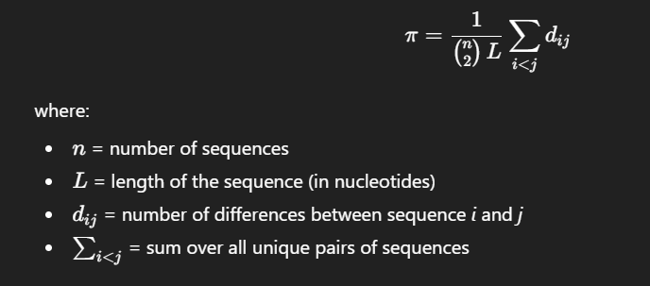
Nucleotide Diversity (π)

Slide 16
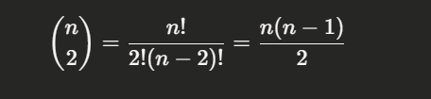
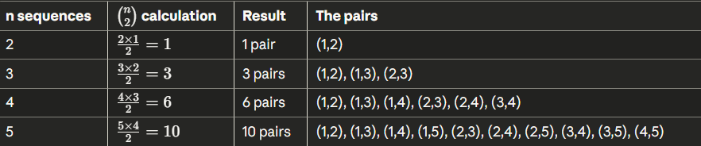
Nucleotide Diversity (π)

Slide 17
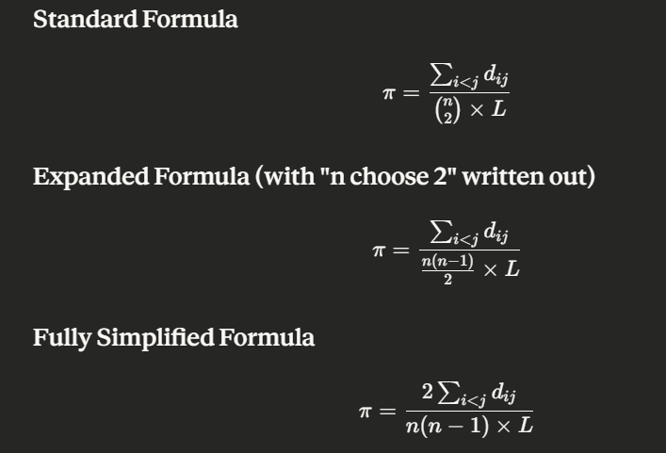
Nucleotide Diversity (π)

Slide 18
Segregating sites (S)
Seq1: A T G C A T G C A T
Seq2: A T G C G T G C A T
Seq3: A C G C A T G C A T
Seq4: A T G C A T A C A T
Data set #1
Question: What is pi for data set #1?

Slide 19
Nucleotide Diversity (π)
Seq1: A T G C A T G C A T
Seq2: A T G C G T G C A T
Seq3: A C G C A T G C A T
Seq4: A T G C A T A C A T
Data set #1
Seq1: A T G C A T G C A T
Seq2: A T G C G T A C A T
Seq3: A C G C A T A C A T
Seq4: A C G C G T A C A T
Data set #2
Question: Calculate pi and S for data sets 1 and 2. Which data set is more diverse?

Slide 20
Nucleotide Diversity (π)
Seq1: A T G C A T G C A T
Seq2: A T G C G T A C A T
Seq3: A C G C A T A C A T
Seq4: A C G C G T A C A T
Data set #2
Seq1: A T G C A T G C A T
Seq2: A T G C G T A C A T
Seq3: A C G C A T C C A T
Seq4: A A G C G T A C A T
Data set #3
Question: Calculate pi and S for data sets 2 and 3. Which data set is more diverse?

Slide 21
Nucleotide Diversity (π)
More sophisticated measure of diversity than S
Describes the average percent base differences between 2 random samples
Corrects for sample size (length of sequence, number of individuals, number of chromosomes, etc.)
Small numbers of individuals will underestimate diversity because rare alleles are likely to be missed
Can be used to compare diversity across different data sets

Slide 22
Nucleotide Diversity (π)
π represents the per-site diversity
π = 0.16 means that, on average, 16% of nucleotide positions differ between two random sequences
Under neutrality, π is an estimate of θ = 4Neμ, where:
Ne = effective population size
μ = mutation rate per site per generation
π weights by allele frequency: common variants contribute more than rare variants

Slide 23
Common measurements of diversity
S
π
Segregating Sites
Nucleotide Diversity
He
θw
Heterozygosity
Watterson's Theta

Slide 24
Expected Heterozygosity (He)
Expected heterozygosity (He), also called gene diversity, is the probability that two randomly chosen alleles at a locus are different. It's calculated based on allele frequencies and represents the expected proportion of heterozygotes under Hardy-Weinberg equilibrium.

Slide 25
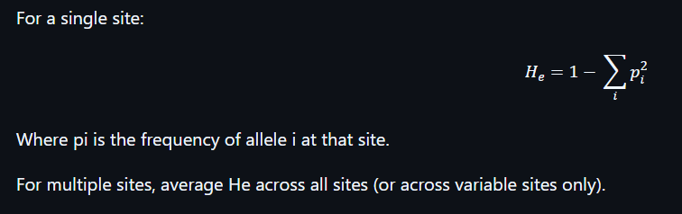
Expected Heterozygosity (He)

Slide 26
Expected Heterozygosity (He)
Seq1: A T G C A T G C A T
Seq2: A T G C G T G C A T
Seq3: A C G C G T A C A T
Seq4: A T G C G T A C A T
Data set #1
Question: What is He for each of the polymorphic sites in the alignment?

Slide 27
Expected Heterozygosity (He)
Seq1: A T G C A T G C A T
Seq2: A T G C G T G C A T
Seq3: A C G C G T A C A T
Seq4: A T G C G T A C A T
Data set #1
Question: What is He for each of the polymorphic sites in the alignment? What is the average He across the sequence (exclude fixed sites)

Slide 28
Expected Heterozygosity (He)
Seq1: A T G C A T G C A T
Seq2: A T G C G T G C A T
Seq3: A C G C G T A C A T
Seq4: A T G C G T A C A T
Data set #1
Question: What is He for each of the polymorphic sites in the alignment? What is the average He across the sequence (exclude fixed sites)

Slide 29
Expected Heterozygosity (He)
Seq1: A T G C A T G C A T
Seq2: A T G C G T G C A T
Seq3: A C G C G T A C A T
Seq4: A T G C G T A C A T
Data set #1
Seq1: A T - - A T G - - T
Seq2: A T - - G T G - - T
Seq3: A C - - G T A - - T
Seq4: A T - - G T A - - T
Data set #2
Question: Calculate pi and He for data sets 1 and 2. Does missing data change your estimates?

Slide 30
Expected Heterozygosity (He)
Seq1: A T G C A T G C A T
Seq2: A T G C G T G C A T
Seq3: A C G C G T A C A T
Seq4: A T G C G T A C A T
Data set #1
Seq1: A T - - A T G - - T
Seq2: A T - - G T G - - T
Seq3: A C - - G T A - - T
Seq4: A T - - G T A - - T
Data set #2
Question: He considers information site-by-site

Slide 31
Expected Heterozygosity (He)
Seq1: A T G C A T G C A T
Seq2: A T G C G T G C A T
Seq3: A C G C G T A C A T
Seq4: A T G C G T A C A T
Data set #1
Seq1: A T - - A T G - - T
Seq2: A T - - G T G - - T
Seq3: A C - - G T A - - T
Seq4: A T - - G T A - - T
Data set #2
Question: Pi considers information sequence-by-sequence

Slide 32
Expected Heterozygosity (He)
He measures the expected genetic diversity at a locus
Higher He indicates more balanced allele frequencies
He = 0: No variation (all individuals have the same allele)
He = 0.5: Maximum diversity for a biallelic locus (both alleles at 50%)
Related to π, but calculated per-site then averaged
Both weight by allele frequency
Note on Observed Heterozygosity (Ho)
If working with diploid genotype data, you can also calculate:
Ho (observed heterozygosity): The actual proportion of heterozygotes in the sample
Comparing Ho and He can reveal inbreeding or population structure

Slide 33
Common measurements of diversity
S
π
Segregating Sites
Nucleotide Diversity
He
θw
Heterozygosity
Watterson's Theta

Slide 34
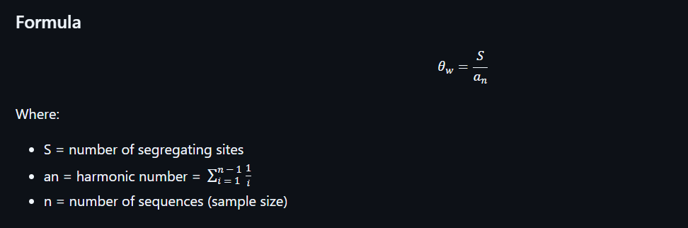
Expected Heterozygosity (He)

Slide 35
Watterson's Theta (θw)
Watterson's theta (θw) is an estimate of the population mutation parameter θ = 4Neμ based on the number of segregating sites (S). Unlike π, it treats all mutations equally regardless of their frequency.
The harmonic number correction (an) accounts for the fact that larger sample sizes will detect more rare variants. This makes θw comparable across studies with different sample sizes.

Slide 36
Watterson's Theta (θw)
θw is another estimator of θ = 4Neμ
Under neutrality and constant population size, θw and π should be similar
θw is based only on the number of segregating sites, not their frequencies
More sensitive to rare variants than π
Used in neutrality tests (e.g., Tajima's D)

