Slide 1

COW VS ALIENS
By Ethan Frank

Slide 2
Description
It’s a game where you shoot different aliens. It has levels and buttons and everything. It can be played with a controller.

Slide 3
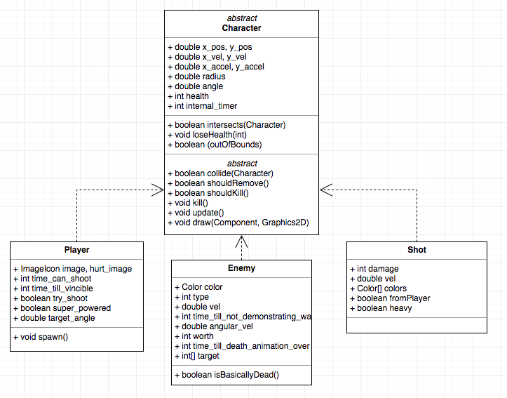
Architecture Overview (The game)

Slide 4
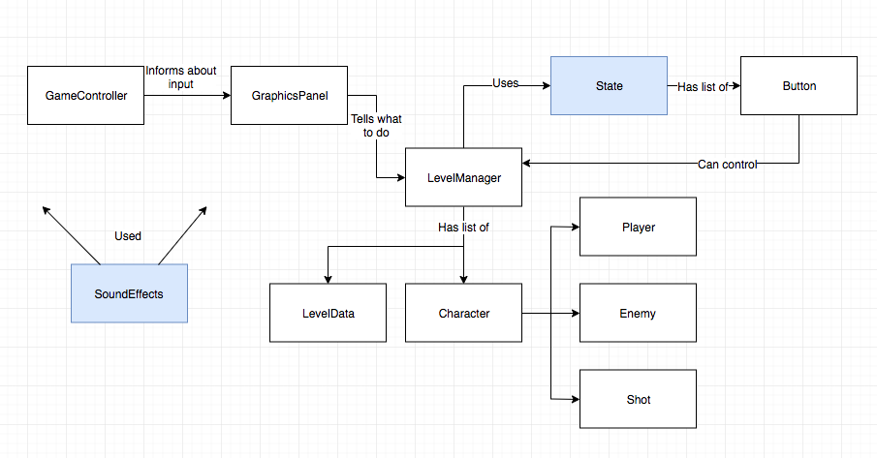
Architecture Overview (The whole thing)

Slide 5
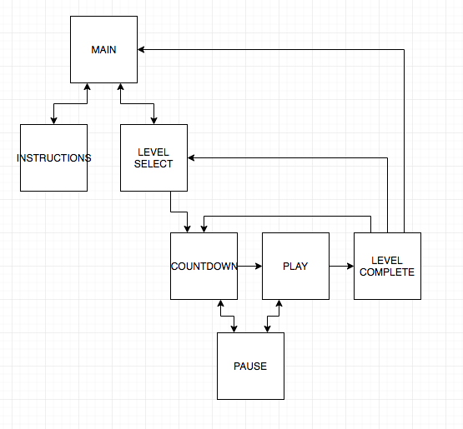
State Flowchart

Slide 6
The annoyance of sounds clipping
The most challenging part was getting the sounds to work.
The first implementation was great, except sometimes the sound of a bullet would clip off the sound of an explosion
Then I had to experiment for 3 days to find another solution that worked, which I did.
It’s called AudioCue, I found it on github.
Now the sounds don’t interrupt each other.

Slide 7
The awesomeness of enums
Enums let you create many different types of the same thing and call methods on them.
The State enum represents which state the game is in (PLAY, INSTRUCTIONS, etc.) .
The State constructor takes in an array of buttons: private State(Button[] buttons)
What screen is displayed is controlled by the gameState. It’s then easy to call gameState.showButtons()and the buttons for the state gameState currently is will be drawn.

Slide 8
Demo
It’s a demo

