Slide 1

KYANOS
When Voters Ask, What Will AI Say?
AI Monitoring for Progressive Campaigns
Ed Forman, Founder • For Thanasi Dilos, Investing In US • January 2026
Notes:
SPEAKER NOTES:
"Thanasi, thank you for your time. When voters want to learn about a candidate, they don't visit campaign websites anymore—they ask AI.
Kyanos ensures AI gives them the right answer."
TRANSITION: "Let me start with a lesson we should have learned in 2024..."

Slide 2
We Missed Podcasts. AI Is Next.
2020-2024: PODCASTS
2024-2028: AI
14M
Google AI • ChatGPT • Meta AI
Three companies control
most AI information access
viewers saw Rogan's
Trump endorsement
Progressives arrived late
We can lead this time
History doesn't repeat, but it rhymes — we have one chance to get ahead.
Notes:
SPEAKER NOTES:
"You watched this happen. Joe Rogan's endorsement reached 14 million people. Progressives had no equivalent infrastructure.
The same pattern is emerging with AI. Three companies—Google, OpenAI, Meta—control most AI information access.
History doesn't repeat, but it rhymes. We have one chance to get ahead."
TRANSITION: "But AI isn't just another podcast moment. The data shows it's more consequential..."

Slide 3
AI Controls the Answers
58%
50%
100M+
45-60%
of searches end
without a click
show AI
Overviews
weekly ChatGPT
users in US
voter queries
by AI in 2028
When AI controls the answers, controlling what AI learns becomes critical.
Google AI
ChatGPT
Meta AI / WhatsApp
Appears before all links
100M+ active researchers
Critical for Hispanic voters
Notes:
SPEAKER NOTES:
"58% of Google searches end without a click—voters get their answer from AI and never visit a campaign website.
When AI controls the answers, controlling what AI learns becomes critical. That's what Kyanos does.
Three platforms matter now: Google AI Overviews, ChatGPT, and Meta AI—especially WhatsApp for Hispanic communities."
TRANSITION: "And here's what makes this urgent: AI isn't just reaching voters. It's moving them..."

Slide 4
4x More Persuasive at 1/60th the Cost
Nature & Science, Dec 2025
"A shockingly large effect" — David Rand, MIT
TV Advertising
1x
AI Chatbots
4x MORE PERSUASIVE
$100-600
$1-10
per voter influenced (TV)
per voter influenced (AI)
Notes:
SPEAKER NOTES:
"MIT research published in Nature confirms AI chatbots are 4x more persuasive than TV advertising. David Rand called it 'a shockingly large effect.'
And the cost? $1-10 per voter influenced vs $100-600 for TV. That's 4x the persuasion at 1/60th the cost.
This makes AI the dominant battleground for 2026 and beyond."
TRANSITION: "But there's another dimension to this..."

Slide 5
Three Pressure Points on AI Platforms
$9B+
230
⚠
Government
Contracts
Section 230
Exposure
Political
Pressure
DoD, Intelligence Community
Liability, antitrust, mergers
Administration demands loyalty
Without independent monitoring,
progressive voices become invisible by design.
Notes:
SPEAKER NOTES:
"Three pressure points: $9B+ in government contracts. Section 230 liability exposure. And an administration that demands loyalty.
I'm not suggesting bad faith. But responsible corporate governance requires managing political risk. In this environment, that risk runs one direction.
Without independent monitoring, progressive voices become invisible by design. That's why Kyanos exists."
TRANSITION: "So what exactly are we building?"

Slide 6
Kyanos: Monitor → Trace → Diagnose → Fix
🔍
🔗
📊
✓
MONITOR
TRACE
DIAGNOSE
FIX
See what AI
says about you
Find where it
got that info
Rank issues
by impact
CMS-specific
action steps
What Makes Us Different
🔔 Early Warning System
✓ Campaign-focused, not generic SEO
If AI models shift against progressives, we detect it first and sound the alarm.
✓ AI-native, not search rankings
✓ Root causes, not just reports
✓ Ready-to-execute fixes
Notes:
SPEAKER NOTES:
"Four steps: Monitor what AI says. Trace where it got that information. Diagnose root causes and rank by impact. Then provide specific fixes campaigns can execute immediately.
We're not generic SEO—we're campaign-focused. We don't just generate reports—we provide ready-to-execute action items.
And if AI models shift against progressives, we detect it first and sound the alarm."
TRANSITION: "Let me show you how this works in practice..."

Slide 7
From AI Confusion to Clear Messaging in 48 Hours
💬 "What does [Candidate] think about abortion?"
✓ THE FIX
1. Add structured FAQ to issues page
❌ AI Response:
"The candidate has not stated a clear position..."
2. Include clear position statement
3. Add schema.org markup
4. Submit to Google Search Console
🔍 Root Cause:
Issues page missing structured data markup
✓ AI now shows correct position
Notes:
SPEAKER NOTES:
"Here's a concrete example. Voter asks AI about a candidate's abortion position. AI says 'no clear position stated'—but the candidate has a clear position.
We trace it: the issues page exists but lacks structured data AI can parse.
The fix: Add structured FAQ, clear position statement, schema.org markup, submit to Google.
Result: From confusion to clarity in 48 hours."
TRANSITION: "Beyond Panopticon, we have a complete product suite..."

Slide 8
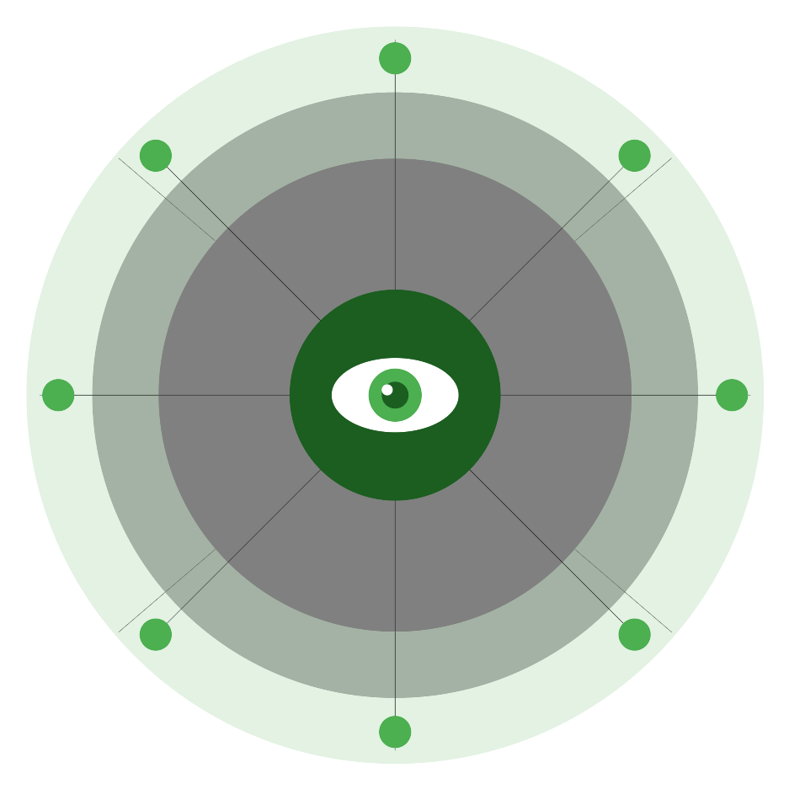
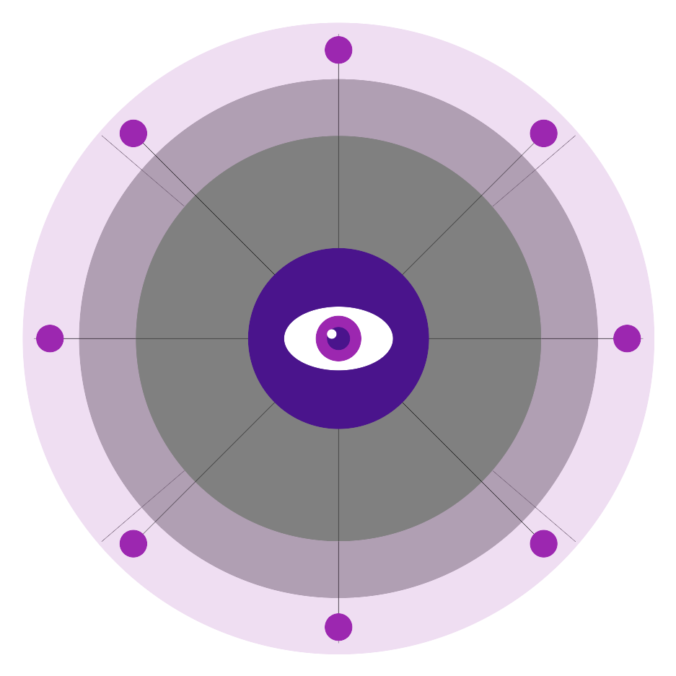

The Kyanos Product Suite
PANOPTICON
MVP+
GOODINK
MVP
AI Monitoring & Remediation
Positive Press Discovery
Core product • Launching Q2 2026
Surface coverage worth featuring
ADWATCH
MVP
TRIPWIRE
MVP
Ad Monitoring
Opponent Monitoring
Track opponent ads across platforms
Know when competitors shift messaging
🗼 WATCHTOWER: Geographic monitoring detects regional AI variation
Notes:
SPEAKER NOTES:
"Panopticon is the flagship—MVP+, launching Q2 2026. It's where campaigns see what AI says and get fixes.
GoodInk surfaces positive press coverage. Adwatch monitors opponent advertising. TripWire detects when competitors change messaging.
Watchtower is our geographic monitoring network—it detects regional AI variation, critical for statewide and national campaigns."
TRANSITION: "Now let me explain how we've structured this to be permanent and accountable..."

Slide 9
First Mover in Progressive AI Monitoring
Political
Context
AI Bias
Detection
Root
Causes
Actionable
Fixes
Progressive
Only
SEMrush / Ahrefs
❌
❌
❌
❌
❌
AI Monitoring Tools
❌
❌
❌
❌
❌
NGP VAN / Catalist
✓
❌
❌
❌
✓
KYANOS
✓
✓
✓
✓
✓
NETWORK EFFECTS
More campaigns → Better intelligence → Stronger platform accountability
Notes:
SPEAKER NOTES:
"There's no direct competitor because the category doesn't exist yet.
SEO tools aren't built for AI or politics. AI monitoring tools don't understand campaigns. Political tech focuses on voter data, not AI presence.
We're first mover, and our trust structure means we can't be acquired by opponents.
Network effects matter: more campaigns means better intelligence means stronger accountability."
TRANSITION: "Let me explain our governance structure..."

Slide 10
Trust-Owned. Mission-Locked. Permanent.
✓ Mission locked to progressives
KYANOS TRUST
Board of progressive leaders
Major funders get board seats
✓ Cannot be sold to opponents
Transparent governance
✓ No equity, no hostile exits
Permanent infrastructure
KYANOS LLC (100% trust-owned)
THE CATALIST PRECEDENT — Trusted by Democratic campaigns since 2006
2006
$5M+
Trust LLC
Every major
Dem campaign
Founded
Initial funding
Structure
Today serves
Notes:
SPEAKER NOTES:
"We're following the Catalist model—trusted by Democratic campaigns since 2006.
Trust owns 100% of the LLC. Mission is locked to progressives. Cannot be sold to opponents.
Major funders get board seats—that's part of the value proposition. You're not buying equity. You're building permanent infrastructure."
TRANSITION: "Let me introduce the team..."

Slide 11
Built for Long-Term Impact, Not Quick Exits
LAUNCH TEAM (Q2 2026)
Ed Forman
Founder & Architect
CEO
Tech Lead
Research Dir
EF
• 35 years Silicon Valley
Strategy & fundraising
Bentham infrastructure
Methodology & quality
• 11 startups (early employee)
• Stanford MBA, taught there
Ops Manager
Marketing
Client delivery
Partnerships & sales
BOARD OF TRUSTEES
Progressive
Leaders
Foundation
Reps
Labor
Reps
Independent
Expert
Mission fidelity
Major funder seats
Union alignment
Tech/political
Notes:
SPEAKER NOTES:
"I'm the architect, not the operator. 35 years in Silicon Valley, 11 startups, Stanford MBA.
We're hiring a CEO with deep progressive foundation relationships. Technical lead builds Bentham. Research director ensures quality.
Board includes progressive leaders, foundation reps, labor reps, and independent experts. Major funders get board seats."
TRANSITION: "Here's the growth trajectory..."

Slide 12
2026 Free Year Builds Reference Base and Proves ROI
2026
2027
2028
FREE YEAR
LAUNCH
SCALE
200
150
466
campaigns
clients
clients
$0
$1.2M
$2.8M
2026 Free Year Breakdown:
15
50
110
25
Statewide
Congressional
Local
Other orgs
Notes:
SPEAKER NOTES:
"2026 is a free year—we serve 200 campaigns at no cost. 15 statewide, 50 Congressional, 110 local, plus organizations.
Why free? To build reference base and prove ROI. Case studies and testimonials for 2027 sales.
By 2027 we launch paid subscriptions and reach breakeven. By 2028—presidential cycle—466 clients, $2.8M revenue, $850K surplus."
TRANSITION: "Here's what we're asking for..."

Slide 13
$1M to Build Progressive AI Infrastructure
$1,000,000
USE OF FUNDS
Personnel (5 FTEs): $650K
65%
Min: $750K • Target: $1M • Reach: $1.25M
Contractors: $150K
15%
📅 Commitments by March 15, 2026
Infrastructure: $48K
5%
Marketing: $40K
4%
Other: $112K
11%
WHAT $1M ENABLES
200
5
4
$850K
campaigns
served free
FTEs
hired
products
launched
surplus
by 2028
Notes:
SPEAKER NOTES:
"We're asking for $1 million. Min $750K, reach $1.25M. Commitments needed by March 15.
65% goes to personnel—5 FTEs. 15% contractors. Rest is infrastructure, marketing, operations.
What does $1M enable? 200 campaigns served free. 5 FTEs hired. 4 products launched. $850K annual surplus by 2028."
TRANSITION: "Let me tell you why I'm in this room specifically..."

Slide 14
Kyanos Completes Your Portfolio
"Technology is changing politics faster than politics is adapting."
— Investing In US founding principle
Vote.org
→ We ensure they find accurate info
Voter registration
News for Democracy
→ We ensure AI surfaces accurate news
Media ecosystem
Run for Something
→ We help them compete in AI
Candidate pipeline
Help keep progressives visible
when information access determines outcomes.
Notes:
SPEAKER NOTES:
"Investing In US was founded on this observation: technology changes politics faster than politics adapts.
You've invested in voter registration, candidate pipelines, media ecosystems. Kyanos is the AI layer that makes all of those more effective.
Vote.org registers voters—we ensure they find accurate info when they research. Run for Something builds candidates—we help them compete in AI environments.
Here's my ask: bring this to Reid and Dmitri. If it resonates, I'll give you everything you need to make the case internally.
Help keep progressives visible when information access determines outcomes."
FINAL: "What questions do you have? What would they need to see?"

