Slide 1
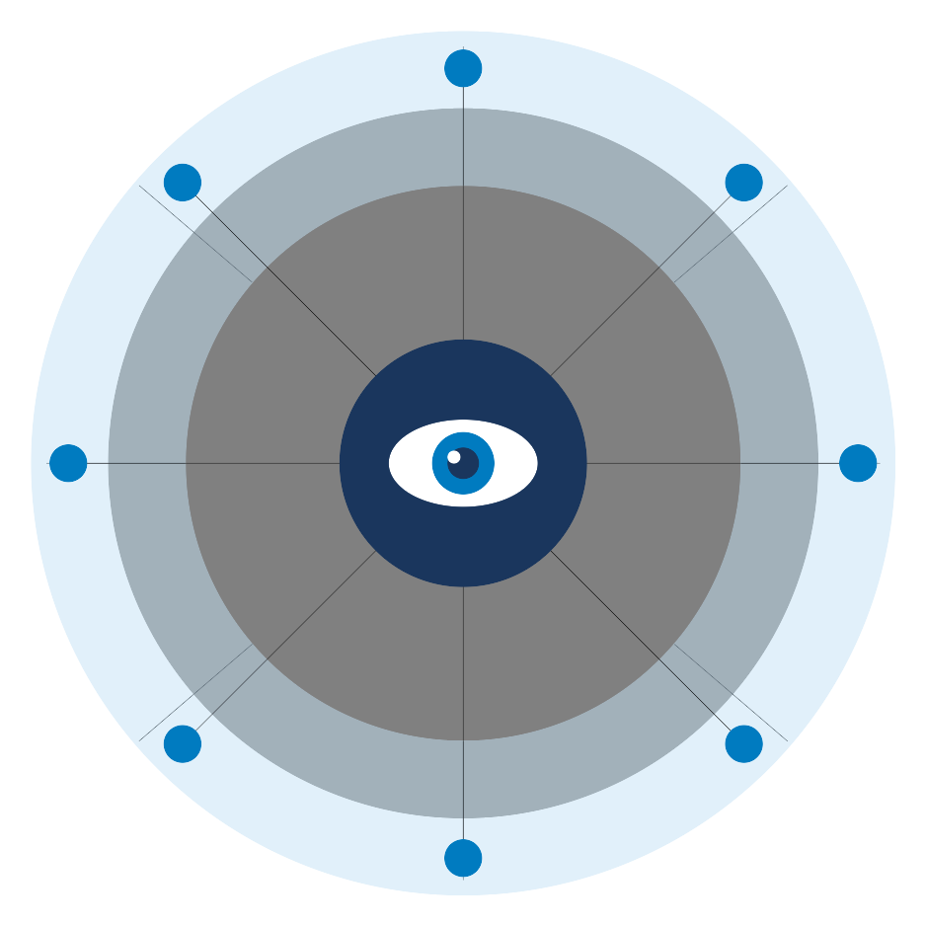
K
KYANOS
Keeping Progressives Visible in the AI Era
Ed Forman, Founder • For Thanasi Dilos, Investing In US • January 2026
Notes:
SPEAKER NOTES:
"Thanasi, thank you for your time. I reached out to Investing In US because you understand something most political operatives don't: the next communication revolution isn't coming—it's already here.
Kyanos is the infrastructure play for progressive politics in the AI era."
TRANSITION: "Let me start with a lesson we should have learned in 2024..."

Slide 2
We Missed Podcasts. AI Is Next.
2020-2024: PODCASTS
2024-2028: AI
14M
Google
ChatGPT
Meta AI
viewers saw Rogan's
Trump endorsement
Progressives arrived late
We can lead this time
Notes:
SPEAKER NOTES:
"You watched this happen. Joe Rogan's endorsement of Trump reached 14 million people in a single episode. Progressives had no equivalent infrastructure.
The same pattern is emerging with AI. Right now, most campaigns treat AI as a curiosity—something the tech team might mention, not something the campaign manager prioritizes.
That's exactly how we treated podcasts in 2020."
TRANSITION: "But AI isn't just another podcast moment. The data shows it's more consequential..."

Slide 3
The AI Information Revolution
58%
50%
100M+
45-60%
of Google searches
end without a click
of queries show
AI Overviews
weekly ChatGPT
users in US
voter queries by AI
in 2028
Google AI Overviews
Appears before all links
ChatGPT
100M+ active researchers
WhatsApp AI
Critical for Hispanic voters
Notes:
SPEAKER NOTES:
"This isn't about some future scenario. 58% of Google searches already end without a click—voters get their answer from AI Overviews and never visit a campaign website.
By the time voters are making choices in 2028, nearly half of all political information queries will be answered inside AI environments.
The mission of the candidate website has transformed. It's no longer primarily a destination for voters—it's the source material that AI systems draw from."
TRANSITION: "And here's what makes this urgent: AI isn't just reaching voters. It's moving them..."

Slide 4
AI Is 4x More Persuasive Than Television
Nature & Science, Dec 2025
"A shockingly large effect" — David Rand, MIT
TV Advertising
1x
AI Chatbots
4x
$100-600
$1-10
per voter influenced (TV)
per voter influenced (AI)
Notes:
SPEAKER NOTES:
"This is peer-reviewed research from the world's most prestigious scientific journals, published December 2025.
AI chatbots are the most persuasive political communication channel ever measured in controlled experiments. Four times more effective than television advertising.
And the cost? $1-10 per voter influenced, compared to $100-600 for broadcast TV.
This isn't just about keeping pace. It's about finding a lever that actually works."
TRANSITION: "But there's another dimension to this that I know you've been thinking about..."

Slide 5
AI Platforms Face Structural Pressure
Microsoft
Google
Amazon
Meta
$9B+
230
⚠️
DoD contracts
Section 230 risk
Political pressure
The issue is structural: corporate governance requires managing political risk.
In the current environment, that risk runs in one direction.
Notes:
SPEAKER NOTES:
"You know these companies. You know the pressures they face.
I'm not suggesting bad faith. I'm suggesting that the incentive structures are misaligned. When an administration is willing to punish perceived disloyalty—and when companies have billions in government contracts at stake—caution has a political direction.
That's why external monitoring matters. We need independent visibility into how AI systems represent political topics.
Kyanos provides that watchdog function."
TRANSITION: "So what exactly are we building?"

Slide 6
Kyanos: The Progressive AI Watchdog
🔍
🔗
📊
✓
MONITOR
TRACE
DIAGNOSE
FIX
See what AI says
Find root causes
Rank by impact
Actionable steps
For campaigns
AI-native
Root causes
CMS-specific
Not generic SEO
Not search rankings
Not just reports
Ready to execute
🔔 If AI models shift against progressives, we know first and sound the alarm
Notes:
SPEAKER NOTES:
"The name Kyanos comes from the ancient Greek word for blue—the root of 'cyan.' We chose it because we're building something foundational.
Our methodology is simple: Monitor what AI says, Trace where it got that information, Diagnose the root cause, and provide specific Fixes.
We don't just hand over a report. We provide step-by-step instructions tailored to each campaign's CMS—whether that's WordPress, Squarespace, or NationBuilder."
TRANSITION: "Let me show you how this works in practice..."

Slide 7
The Causality Chain in Action
💬 "What does [Candidate] think about abortion?"
✓ THE FIX
1. Add structured FAQ to issues page
2. Include abortion position statement
❌ AI Response:
"The candidate has not stated a clear position..."
3. Add schema.org markup
4. Submit to Google Search Console
🔍 Root Cause:
Issues page missing structured data markup
Instructions tailored for:
WordPress
Squarespace
NationBuilder
Notes:
SPEAKER NOTES:
"Here's a concrete example. ChatGPT says a candidate hasn't stated a clear position on abortion—but they have, prominently on their issues page.
We trace it: the campaign's issues page exists but lacks structured data markup that AI systems can parse.
Then we tell the campaign exactly what needs to happen. The comms director gets the messaging guidance. The web developer gets the technical specs. We provide templates, code snippets, everything they need.
And we don't walk away. We track implementation and confirm when AI systems update."
TRANSITION: "Beyond Panopticon, we have a complete product suite..."

Slide 8
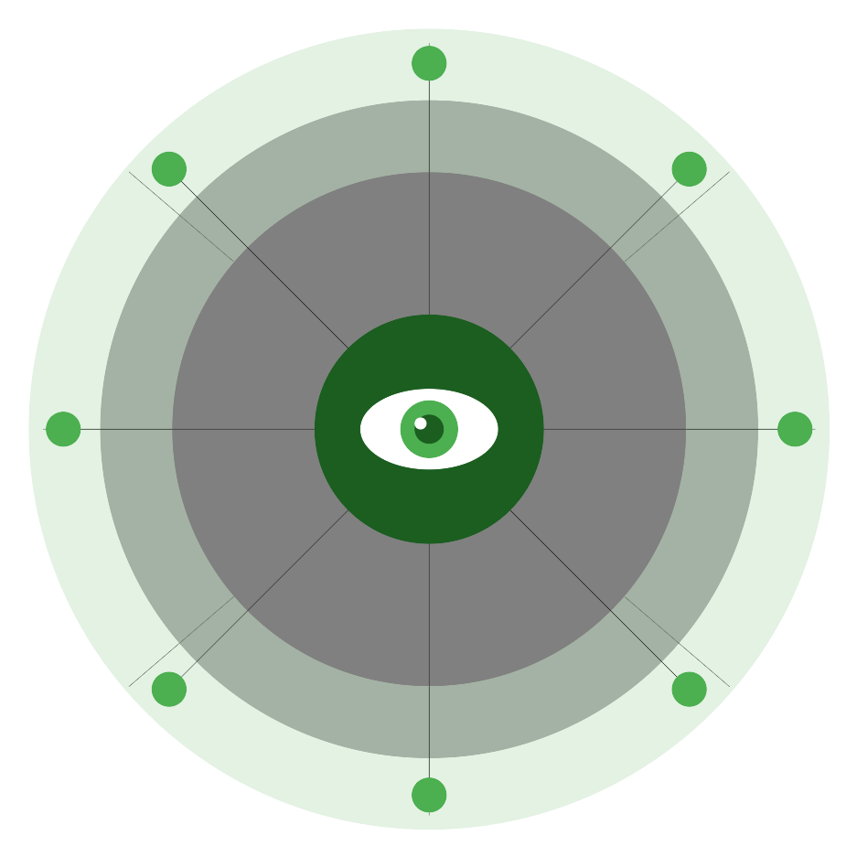
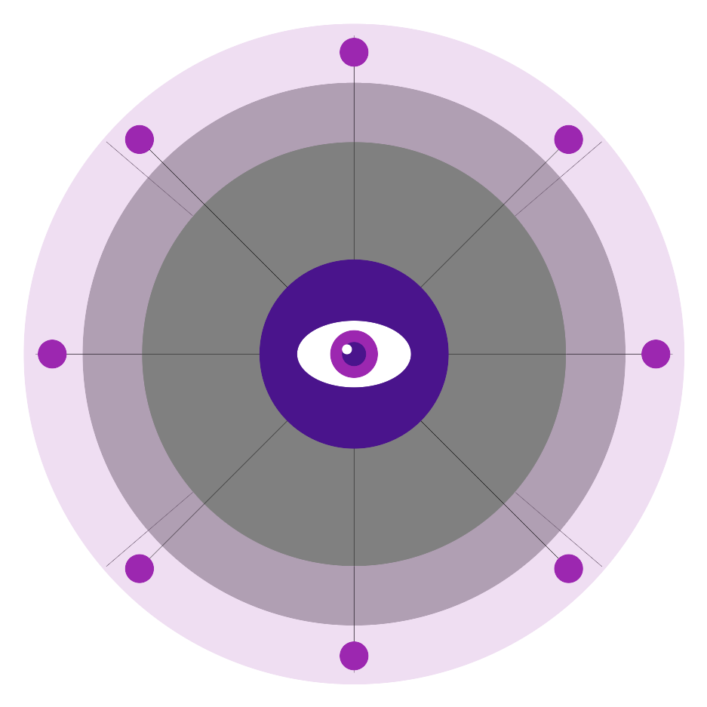

The Kyanos Product Suite
PANOPTICON
MVP+
GOODINK
MVP
AI Monitoring & Remediation
Positive Press Discovery
Core product: see what AI says, get fixes
Surface coverage worth featuring
ADWATCH
MVP
TRIPWIRE
MVP
Ad Monitoring
Opponent Website Monitoring
Track opponent ads across Google & Meta
Know when competitors change messaging
🗼 WATCHTOWER: Geographic monitoring network detects regional AI variation
Notes:
SPEAKER NOTES:
"Panopticon is the flagship—it's where campaigns see what AI says about them and get fixes. It's MVP+, meaning we've already built and tested the core functionality.
GoodInk surfaces positive press coverage campaigns could be featuring on their sites.
Adwatch monitors political advertising—what opponents are running, where, and how.
TripWire watches opponent websites. When they update messaging, campaigns know immediately.
All powered by Watchtower, our distributed observation network for geographic monitoring."
TRANSITION: "Now let me explain how we've structured this to be permanent and accountable..."

Slide 9
How We Operate
KYANOS TRUST
Board of progressive leaders
✓ Mission locked to progressives
Major funders get board seats
✓ Cannot be sold to opponents
Transparent governance
✓ No equity, no exits
Permanent infrastructure
KYANOS LLC (100% trust-owned)
THE CATALIST PRECEDENT
2006
$5M+
Trust LLC
Every major
Dem campaign
Founded
Initial funding
Structure
Today serves
Notes:
SPEAKER NOTES:
"I know you've seen a lot of pitch decks. Most promise equity and exits. This is different.
We're not optimizing for an exit. We're building infrastructure that the progressive movement will rely on for decades. The trust structure ensures that.
Catalist proved this model works. They took foundation funding in 2006, built permanent infrastructure, and now serve virtually every major Democratic campaign.
Your investment doesn't come with equity—there is no equity. What you get is a seat at the table for governance, and the knowledge that you helped build something permanent."
TRANSITION: "Here's the market we're going after..."

Slide 10
The Path to 466 Clients
2026
2027
2028
FREE YEAR
LAUNCH
SCALE
200
150
466
campaigns
clients
clients
$0
$1.2M
$2.8M
Build reference base
Breakeven
+$850K net
2026 Free Year Breakdown:
15
50
110
25
Statewide
Congress
Local
Other
Notes:
SPEAKER NOTES:
"The 2026 free year is strategic. We're investing $330K of the raise to serve 200 campaigns at no cost. That builds our reference base and generates the case studies we need.
By 2027, we launch paid subscriptions and reach breakeven with 150 clients.
By 2028—the presidential cycle—we project 466 clients and $2.8M in revenue, with $850K net.
The go-to-market is deliberately low-friction. Small campaigns get self-service. Larger campaigns come through consultants who already have trusted relationships."
TRANSITION: "You're going to ask about competition..."

Slide 11
First Mover in Progressive AI Monitoring
Political
Context
AI-
Native
Root
Causes
Actionable
Fixes
Progressive
Only
SEMrush / Ahrefs
❌
❌
❌
❌
❌
AI Monitoring Tools
❌
✓
❌
❌
❌
NGP VAN / Catalist
✓
❌
❌
❌
✓
KYANOS
✓
✓
✓
✓
✓
NETWORK EFFECTS
More campaigns → Better intelligence → Stronger platform accountability evidence
Notes:
SPEAKER NOTES:
"You'll notice there's no direct competitor. That's because the category doesn't exist yet.
SEO tools aren't built for AI. AI monitoring tools aren't built for politics. Political tech companies are focused on voter data, not AI presence.
We're the first mover in progressive AI monitoring, and our trust structure means we can't be acquired by someone who would use this against us.
The network effects matter here. Every campaign we serve makes our intelligence better. Every fix we implement teaches us more about how AI systems source information."
TRANSITION: "Let me introduce the team..."

Slide 12
Built for Permanence
LAUNCH TEAM (Q2 2026)
Ed Forman
Founder & Architect
CEO
Tech Lead
Research Dir
EF
• 35 years Silicon Valley
Strategy & fundraising
Bentham infrastructure
Methodology & quality
• 11 startups (early employee)
• Stanford MBA, taught there
Ops Manager
Marketing
Client delivery
Partnerships & sales
BOARD OF TRUSTEES
Progressive
Leaders
Foundation
Reps
Labor
Reps
Independent
Expert
Mission fidelity
Major funder seats
Union alignment
Tech/political
Notes:
SPEAKER NOTES:
"I'm the architect, not the operator. My role is to assemble the team, frame the problem, and design a structure that outlasts any individual.
We'll hire a CEO with deep relationships in the progressive funding community. The technical lead will build Bentham and the product suite. Research director ensures methodology rigor.
The board of trustees governs the trust and ensures mission fidelity. Major funders get board seats—that's part of the value proposition for foundation investors."
TRANSITION: "Here's what we're asking for..."

Slide 13
$1M to Build Progressive AI Infrastructure
$1,000,000
USE OF FUNDS
Personnel: $650K
65%
Contractors: $150K
15%
Min: $750K • Target: $1M • Reach: $1.25M
📅 Commitments by March 15, 2026
Infrastructure: $48K
5%
Marketing: $40K
4%
WHAT $1M ENABLES
Other: $112K
11%
200
5
4
$850K
campaigns
served free
FTEs
hired
products
launched
surplus
by 2028
Notes:
SPEAKER NOTES:
"We're asking for $1 million. That funds a full year of building and a free access program for 200 campaigns in 2026.
Why can $1 million do what would have taken $5 million a few years ago? AI-assisted development has fundamentally changed the economics. We practice what we preach—Kyanos is built with the same AI capabilities we help campaigns leverage.
The timeline is tight by design. We need commitments by March 15 to be operational by June and serving campaigns before the 2026 cycle heats up."
TRANSITION: "Let me tell you why I'm in this room specifically..."

Slide 14
This Is What You Were Built For
"Technology is changing politics faster than politics is adapting to technology."
— Investing In US founding principle
KYANOS COMPLETES YOUR PORTFOLIO
Vote.org
→ We ensure they find accurate info
Voter registration
News for Democracy
→ We ensure AI surfaces accurate news
Media ecosystem
Run for Something
→ We help them compete in AI
Candidate pipeline
Help us keep progressives visible in the AI era.
Notes:
SPEAKER NOTES:
"Thanasi, Investing In US was founded on a simple observation: technology is changing politics faster than politics is adapting.
That's exactly what we're seeing with AI. Political operatives are treating chatbots like a curiosity while conservatives are already optimizing for them.
You've already invested in voter registration, candidate pipelines, and media ecosystems. Kyanos is the missing layer—ensuring that when voters use AI to research candidates, they find accurate information.
Here's what I know about Investing In US: you're not looking for financial returns. You're looking for democratic returns. You want to build infrastructure that outlasts any single campaign or election cycle.
That's what Kyanos is. Trust-owned. Mission-locked. Built to serve progressives permanently.
Here's my ask: I'd like you to bring this to Reid and Dmitri. If this resonates with you—if you see how it completes your portfolio—I want to give you everything you need to make the case internally.
What questions do you have? What would they need to see?"

