Slide 1

H&M Group – Senior Data Scientist Product Markdown Forecast
Unrestricted

Slide 2
The data: a hierarchical set from October 2017
Index Group Name
6 elements
Department Name
155 elements
Department ID
215 elements
Predict Uplift
For October 2018
Product Type
83 elements
Product Code
681 elements
Article
702 elements
Variant
3244 elements

Slide 3
Question 1: Trends per week and product
Unrestricted

Slide 4
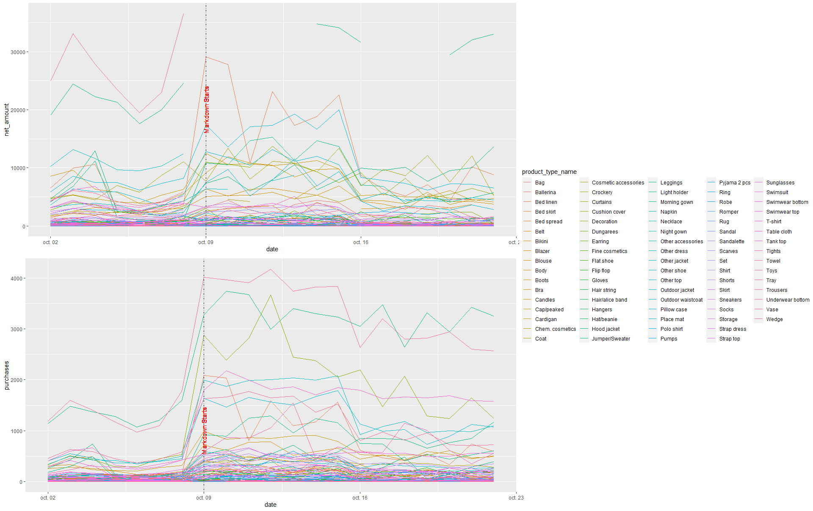
Discount effects by product type: temporal evolution

Slide 5
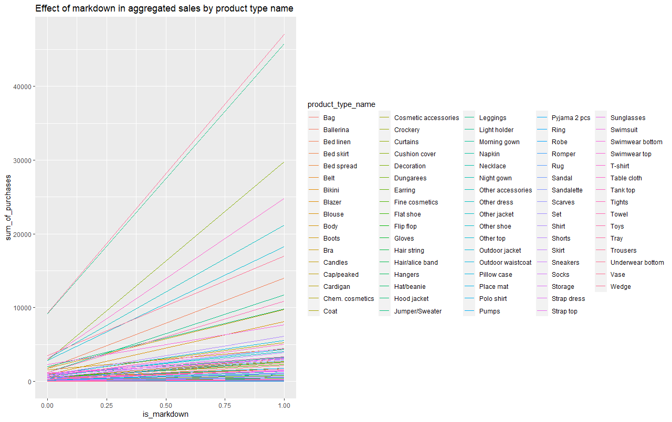
Discount effects by product type: markdown impact

Slide 6
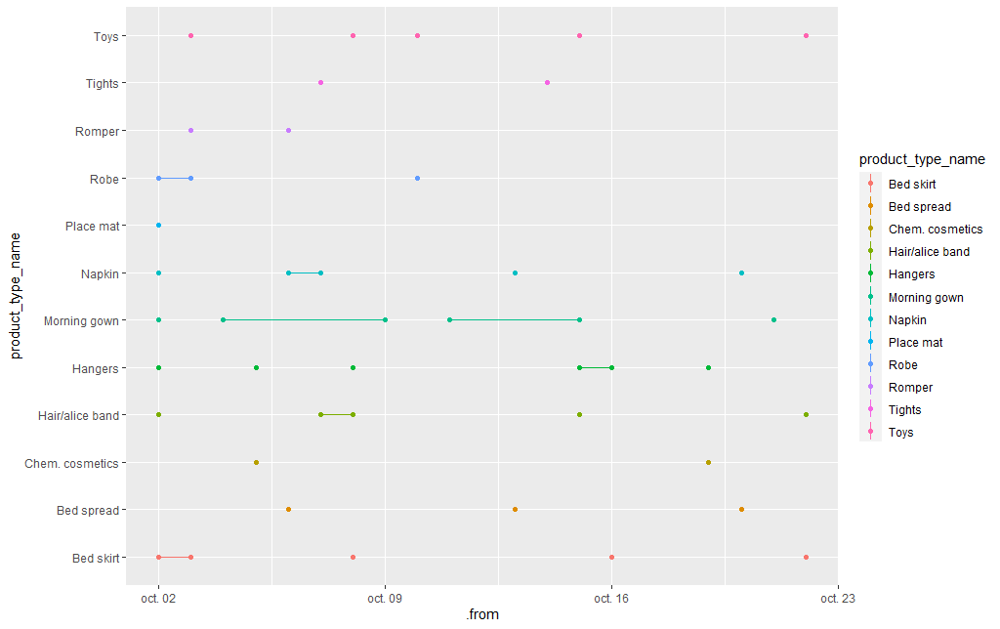
Gap analysis for product type:

Slide 7
Question 2: Uplift prediction
Unrestricted

Slide 8
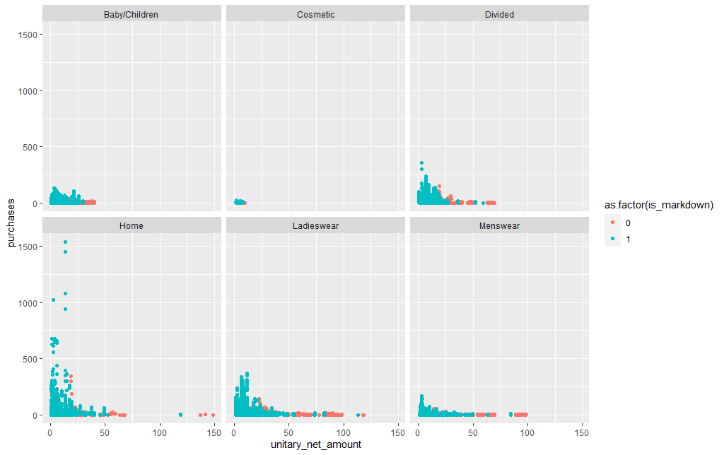
Markdown effect on purchases vs unitary net amount

Slide 9
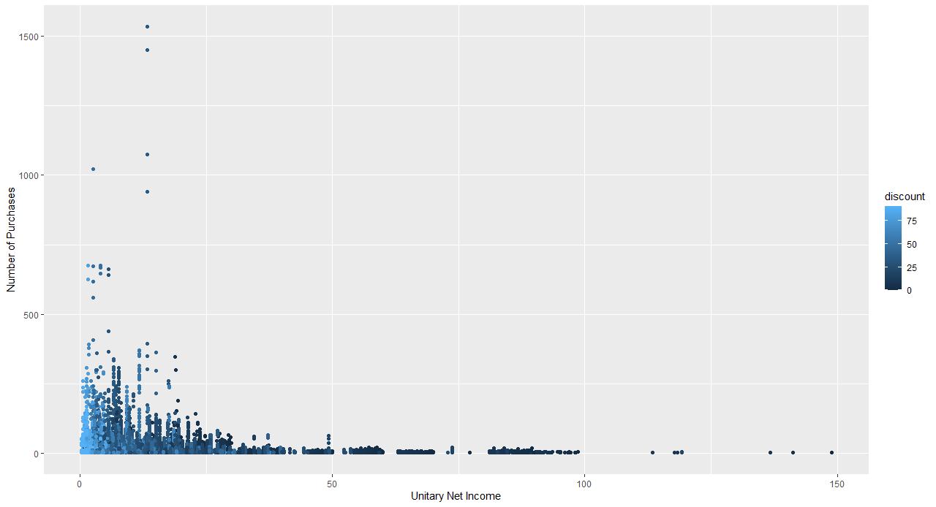
Discount global effect in purchase vs net income

Slide 10
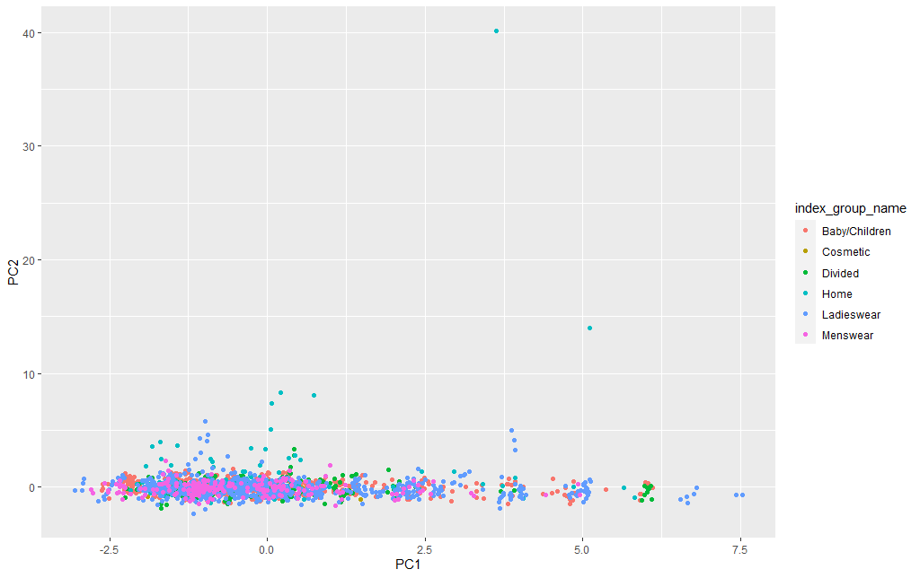

Does the internal features of the time series tell us something?
Trend Strength
Seasonal strength
Spikiness
…

Slide 11
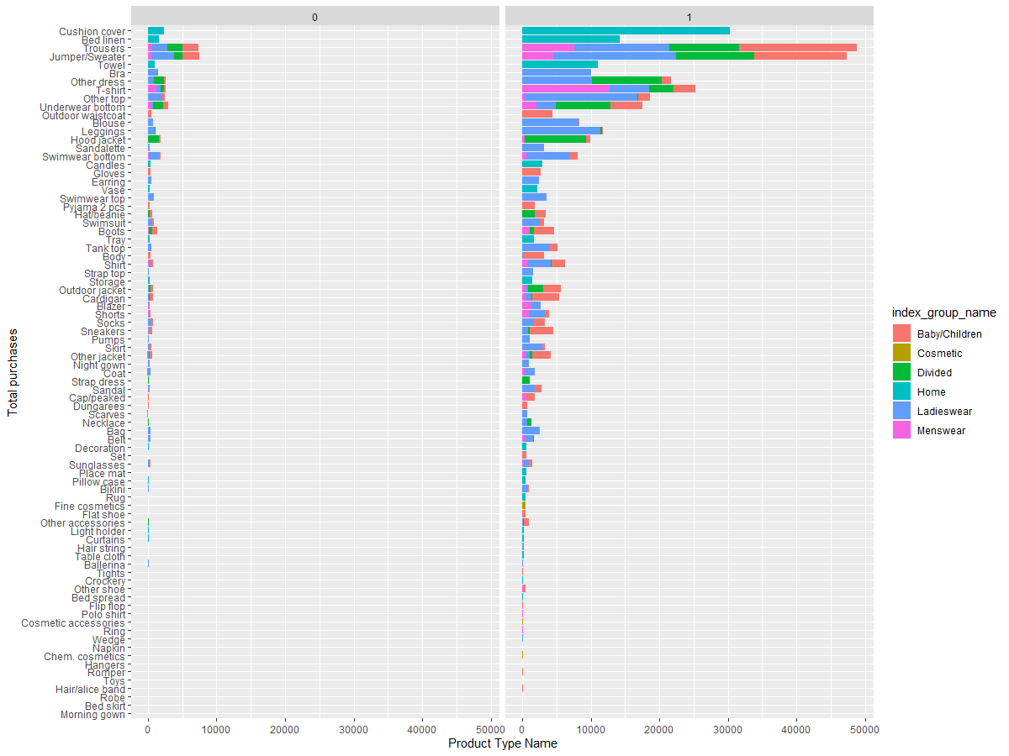
What are the more popular before/after markdown season?
As expected an increase in clothes for cold period

Slide 12
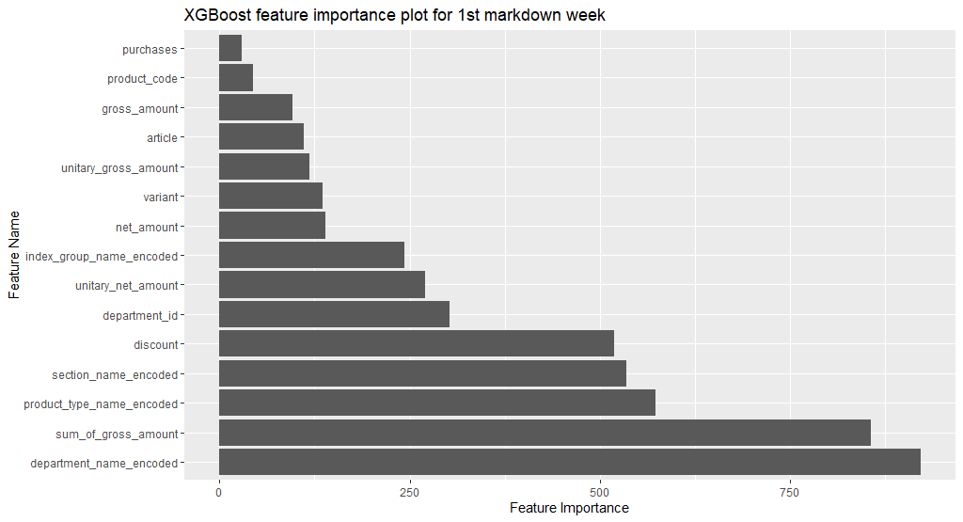
Uplift prediction feature importance:
MAPE=26%
No HPO
(Baseline)

Slide 13
Question 3: Stock leveraging
Unrestricted

Slide 14
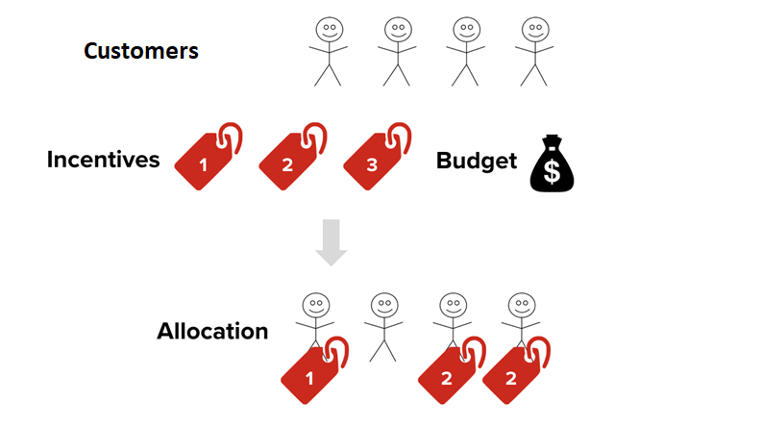
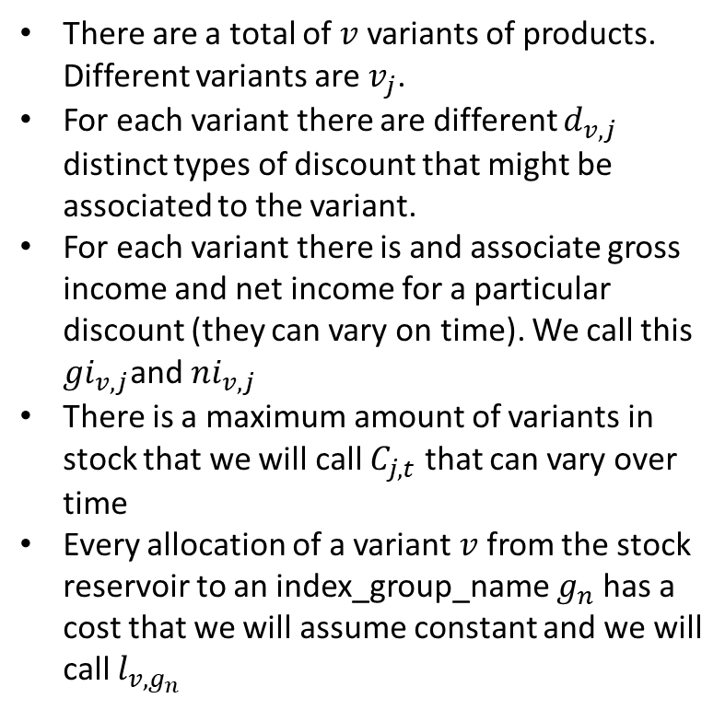
Optimization objective
There are a total of $v$ variants of products. Different variants are $v_{j}$.
For each variant there are different $d_{v,j}$ distinct types of discount that might be associated to the variant.
For each variant there is and associate gross income and net income for a particular discount (they can vary on time). We call this $gi_{v,j}$and $ni_{v,j}$
There is a maximum amount of variants in stock that we will call $C_{j,t}$ that can vary over time
Every allocation of a variant $v$ from the stock reservoir to an index_group_name $g_{n}$ has a cost that we will assume constant and we will call $l_{v,g_{n}}$

Slide 15
What we know about this problem?
General guidelines
Unknown stock levels
Get weather temperature data to understand if the popularity of Jumper of Sweaters will increase again or products sensitive to temperature changes.
Sell the products with highest unitary net income in the first week of markdown as it is most likely the that discounts will increase in the last one.
Forget about cosmetics at it seem that they are not popular this season of the year same also with swim suits.
Unknown allocation cost
Some missing discounts
Because gaps

Slide 16
Extra point question: Uplift prediction
Unrestricted

Slide 17
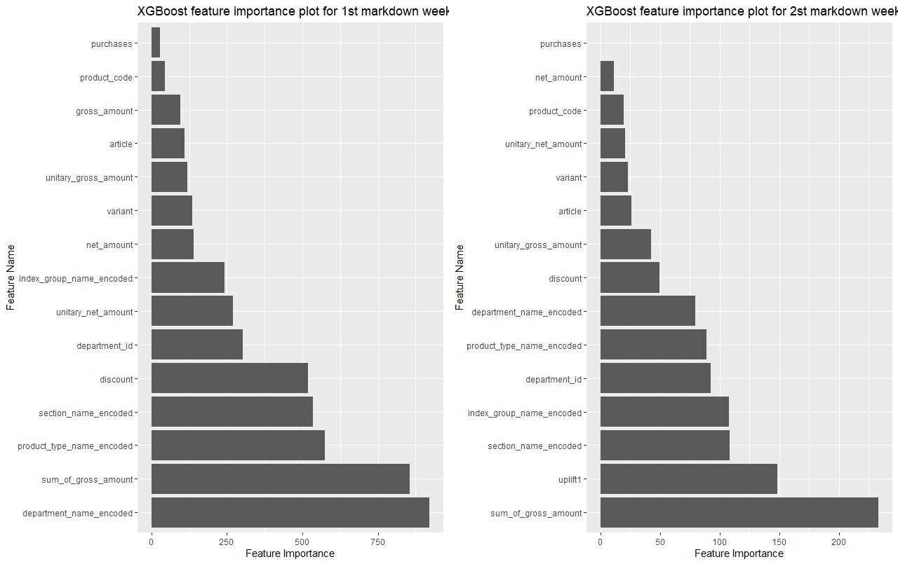
Uplift prediction feature importance:
The previous week uplift seems to be very relevant in the prediction of the uplift for week 2.
The discount seems to fall positions as most likely the most interested products were purchased in the first ware.
It seems that the department_id moved some positions so it might be worth it to relocate some of the products there in order to sale more.

