Slide 1
VPN and Connecting to VM
CSCE 3600 Major Assignment 2

Slide 2
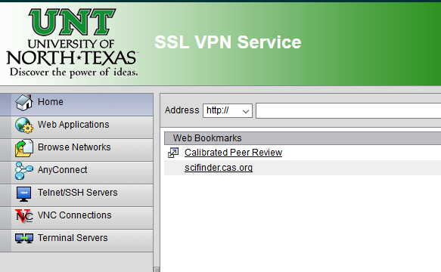
Download and Install VPN
CONNECT TO VPN
Connect to “vpn.unt.edu” in your browser
Enter your UNT EUID and password
Select “AnyConnect” from the list
Click “Start AnyConnect”
Download the software by clicking
“AnyConnect VPN” from Manual
Installation Popup window
(Make sure you have JAVA installed in
your system)

Slide 3
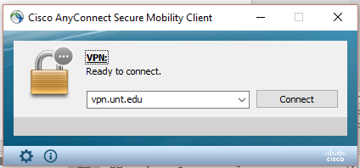
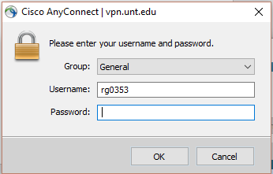
Connecting your machine through VPN
Once it is downloaded and installed in your machine, Open the software and
Connect to “vpn.unt.edu” and login with your UNT EUID and password.

Slide 4
Connecting to your group’s VM
Connect to VPN
If you are using Windows: You can connect through Putty
IP address: 129.120.60.29 (same for all groups)
Enter your group’s port number. Port numbers are specific to your group.
Enter the credentials given to you for logging to your VMs.
For Ubuntu/MAC: use the command below
“ssh –p portno username@ipaddress”
IP address: 129.120.60.29 (same for all groups)
Port numbers are specific to your group.

Slide 5
Example
Username: group31
port numbers: 54175, 54210
command to connect to VM1:
ssh –p 54175 group31@129.120.60.29
Enter your group’s password when prompted
command to connect to VM2:
ssh –p 54210 group31@129.120.60.29
Enter your group’s password when prompted

Slide 6
Change password of your Account in the VM
Command: “ssh -t -p portnumber username@129.120.60.29 passwd”
If you are using Windows machines
Connect through WinSCP to one of your VMs.
Use the command given above to ssh to another VM and change password and vice versa.

Slide 7
For Questions or Issues for connecting to VMs
Help Lab hours
Monday, Wednesday : 10:30 AM to 12:00 PM
Email: rg0353@unt.edu

