Slide 1
Video Steganography using Motion Vectors
Edgar Liberis

Slide 2
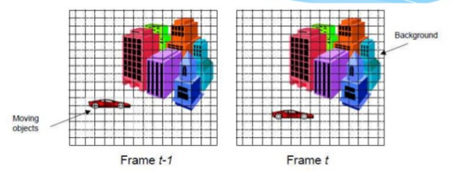
Motion Vectors (MVs)?
Frames of a video have temporal correlation, i.e. the current frame is similar to the previous one, maybe just a few things have moved...
Modern video encoders use this property to achieve high compression rates.

Slide 3
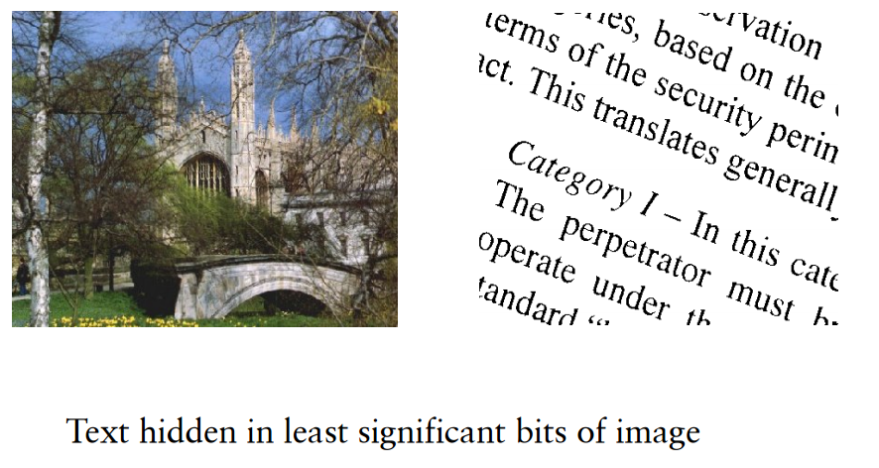
Steganography?
Techniques to embed a secret payload into a seemingly innocent file.
From Security II notes, (c) Frank Stajano

Slide 4

MVs as embedding space
Motion vectors are insensitive to small changes.
From FFmpeg wiki, (c) FFmpeg team

Slide 5
What's the project about?
Explore steganographic techniques and their applicability to motion vectors. Implement known methods and try to break them.
As a result:
  Usable end-user tool to embed data
  Matlab suite to perform steganalysis

Slide 6
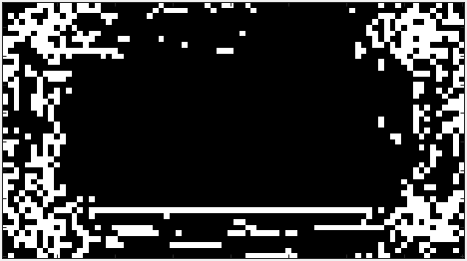
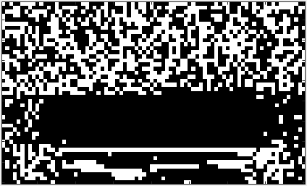
An example
Embed message in LSB of MVs:
LSB plane of the original frame
LSB plane of the modified video's frame, embedding ~50%
Too random? Steganalysis can tell...

Slide 7
Project progress
Implemented numerous embedding schemes in an end-user tool
Implemented steganalysis routines in Matlab
Carrying out experiment to see whether videos are visually distinguishable
Evaluating usefulness & other criteria of each embedding scheme

Slide 8
Thank you!

