Slide 1
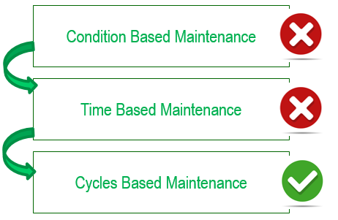
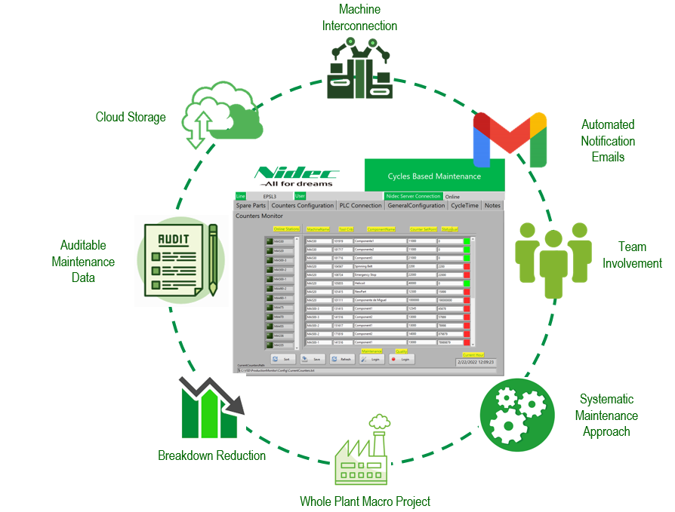
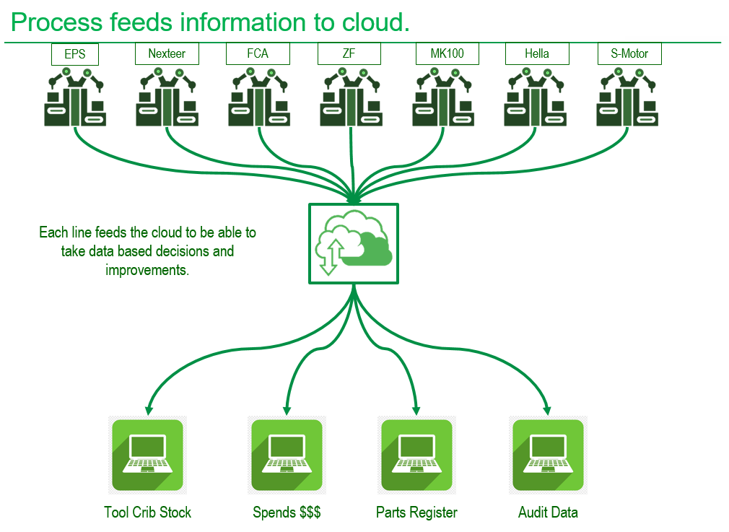
Automated maintenance execution
Why:
There are a lot of opportunities with the maintenance routines since their activities are ambiguous and they don’t ensure reliability..
Why
How:
Through a systematic approach of the maintenance execution to be able to change from condition based maintenance to cycle based maintenance.
How
What
Internal development of a new software able to connect to all the machines in the plant to count cycles to measure the real wear of the consumable parts.
What
Be
-Breakdown reduction..
-Close collaboration between maintenance and quality teams.
-Saving projects derived from the data generated from the system.
-Automated emails
-Automated stoppages to force replacements.
Benefits

Slide 2
Implementation plan.
It takes one week per subassembly due to the time needed to install the required software to run the application and the network installation to communicate with all the machines.

