Slide 1

NIDEC CORPORATION
Cycle Based Maintenance
NAMM: Bermudez
Date: February 4th 2022
Ref. P103.02X
F103.18B
Notes:
Enfoque en Capacity Improvement y recalcar Mexico

Slide 2



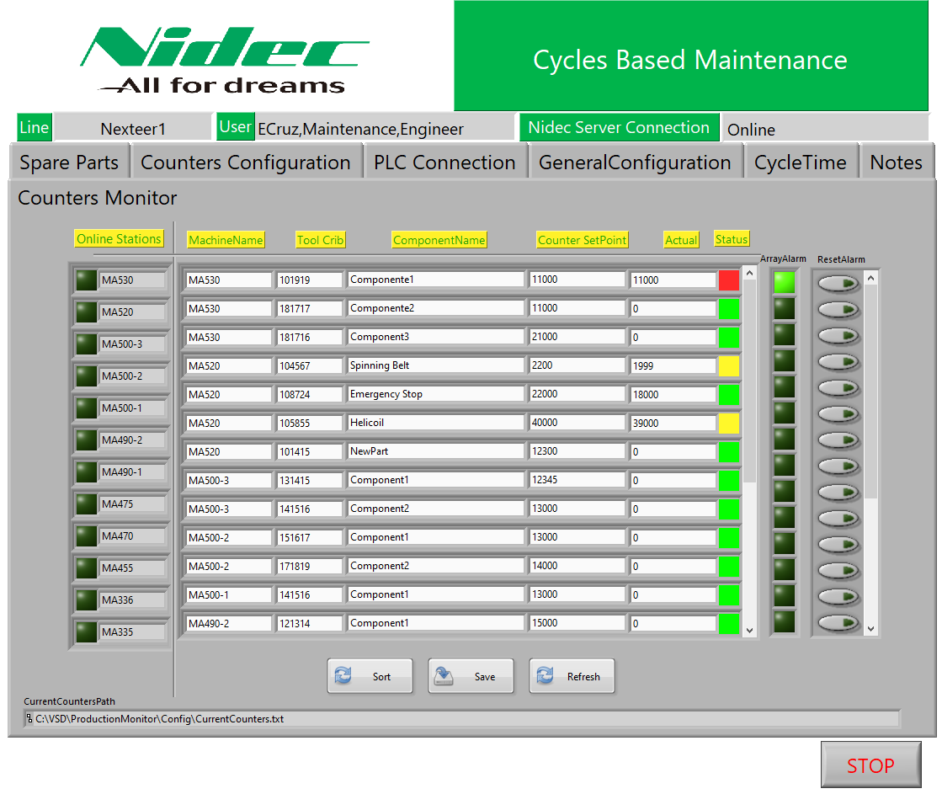





Concept
Machine Interconnection
Cloud Storage
Automated Notification Emails
Auditable Maintenance Data
Team Involvement
Systematic Maintenance Approach
Breakdown Reduction
Whole Plant Macro Project

Slide 3
Introduction
Objective
Automate and standardize the timely maintenance to prevent breakdown related to worn parts.
Implement a software based solution to enable the cycles based maintenance as the best practice for real preventive maintenance.
Proposal
Internal Software Development able to:
Register and connect to several machines.
Register and monitor parts replacement through cycles count with online connection to the machines.
Send Email Alerts to notify when a part needs to be replaced before it causes breakdown.
Send Email Alerts when a part is not replaced in time, to carry out the appropriate escalation process.
Register auditable records in a cloud database of the interventions performed to the machines.
Ensure the appropriate execution of the maintenance routines through the involvement of the multifunctional team.(Maint,PE,QA,Prod.)
Report spare parts spends per line and per machine $$.
Automate the amount of downtime register per intervention by counting the IDLE Time directly from the machine.
Resources
Computers to run the application in strategic locations of the lines.
IT Support for Database Servers in order to store the cloud data.
Network Installation to interconnect all the application instances.

Slide 4

Process feeds information to cloud.
EPS
Nexteer
FCA
ZF
MK100
Hella
S-Motor
Each line feeds the cloud to be able to take data based decisions and improvements.
Tool Crib Stock
Spends $$$
Parts Register
Audit Data

Slide 5
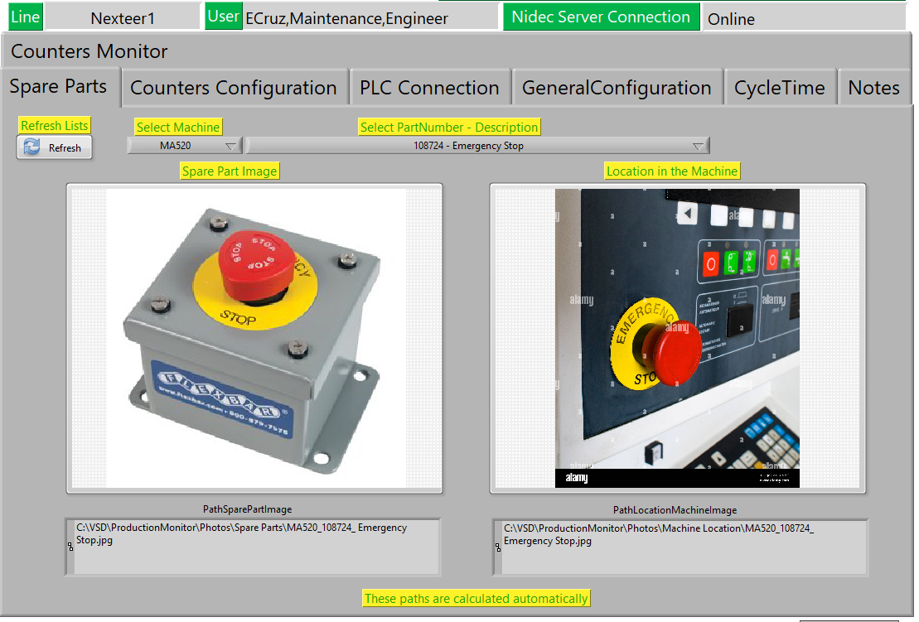
Visual Identification
Visual Identification of component and its location.

Slide 6
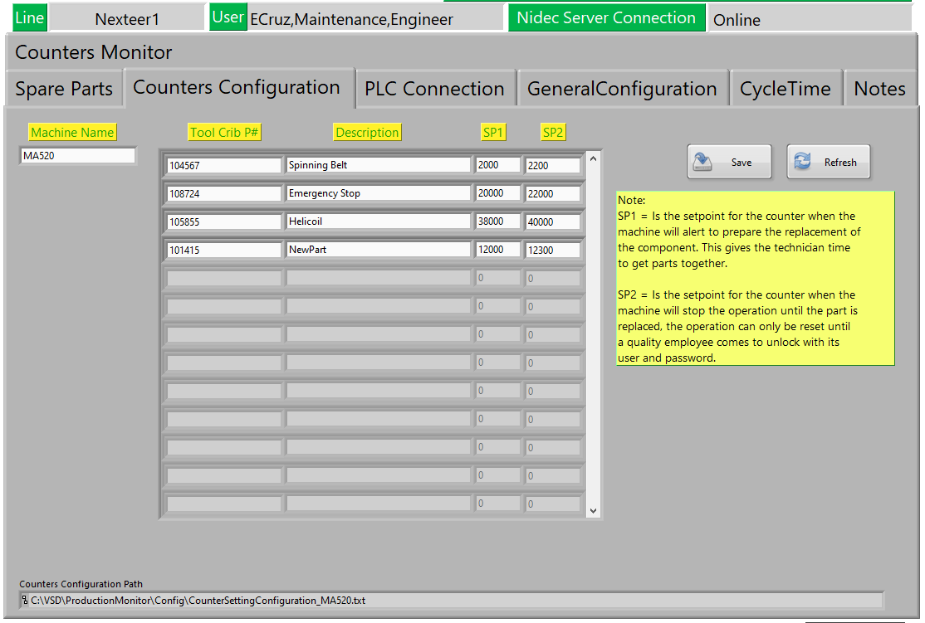
Spare Parts Register
The spare parts can be added specifying the Tool Crib Part Number for easy Identification and access.

Slide 7
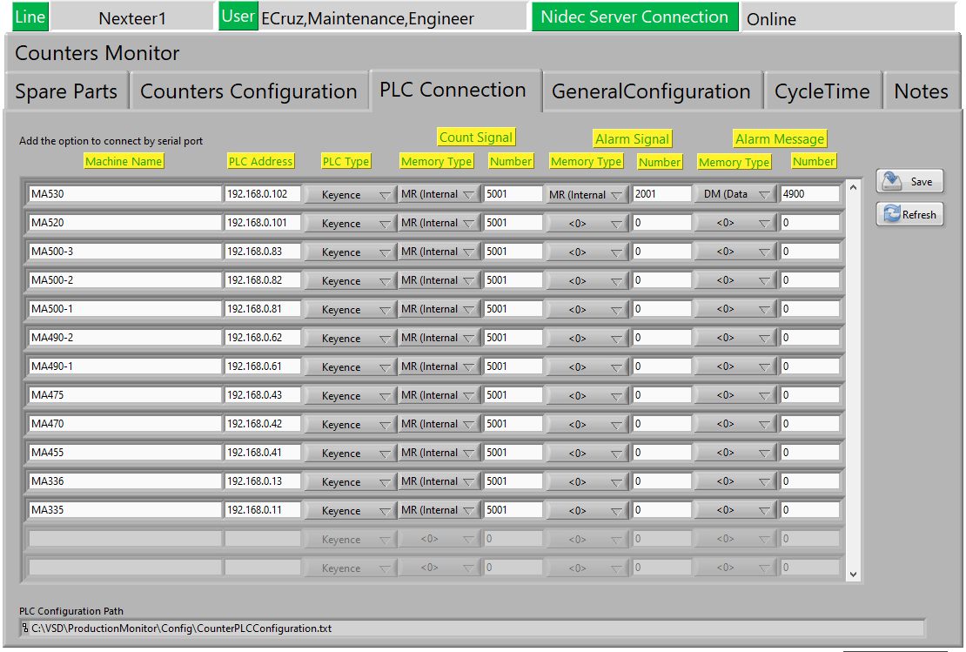
Machine Register
Machine register configurable to ease the implementation in the whole plant.

Slide 8
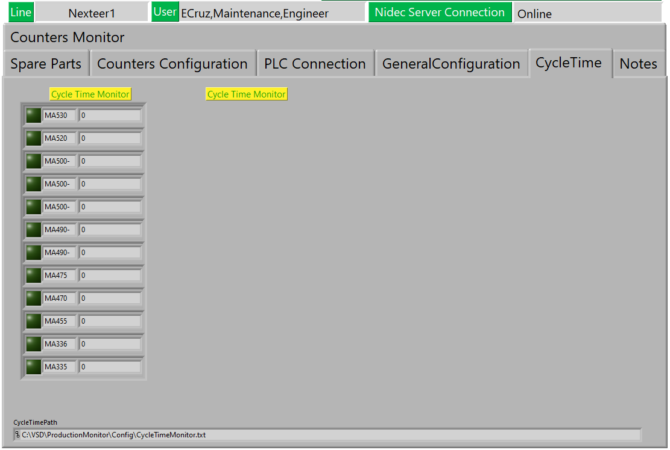
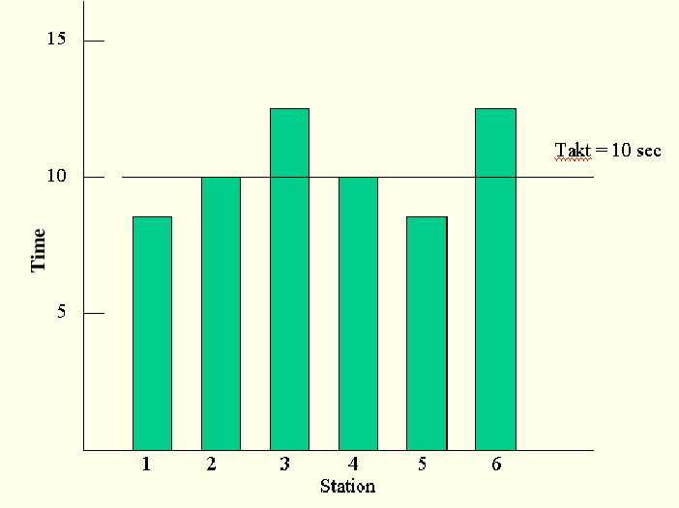

Cycle Time Monitor
System will record the cycle time of each machine.

Slide 9
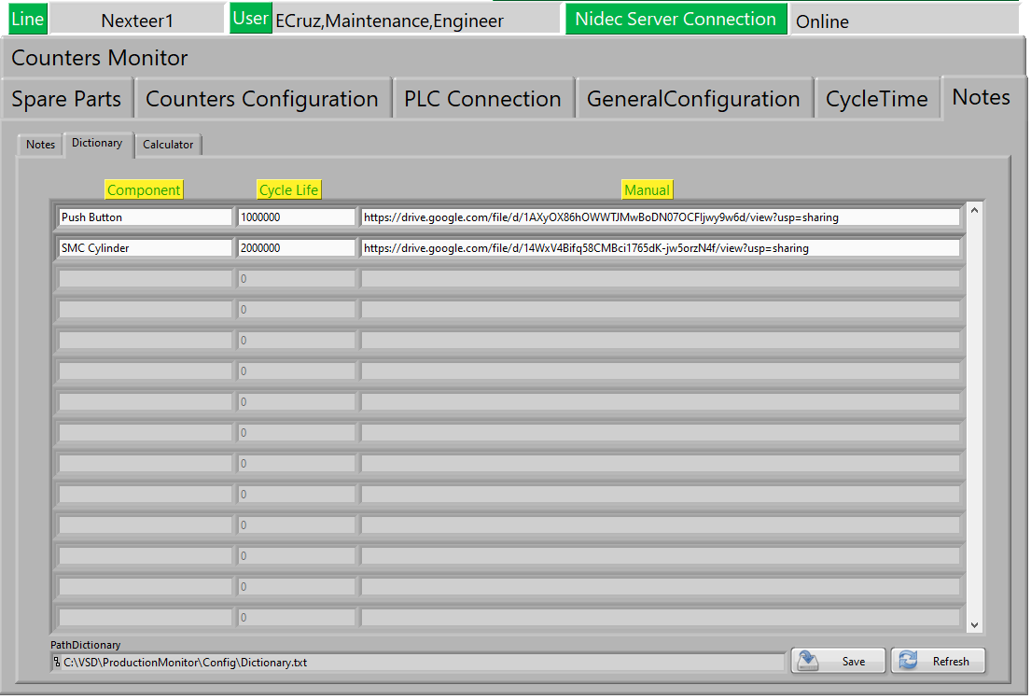
Digital Manuals Availability
Dictionary of common parts with their Cycle Life and Manual in PDF Format for easy view.

Slide 10
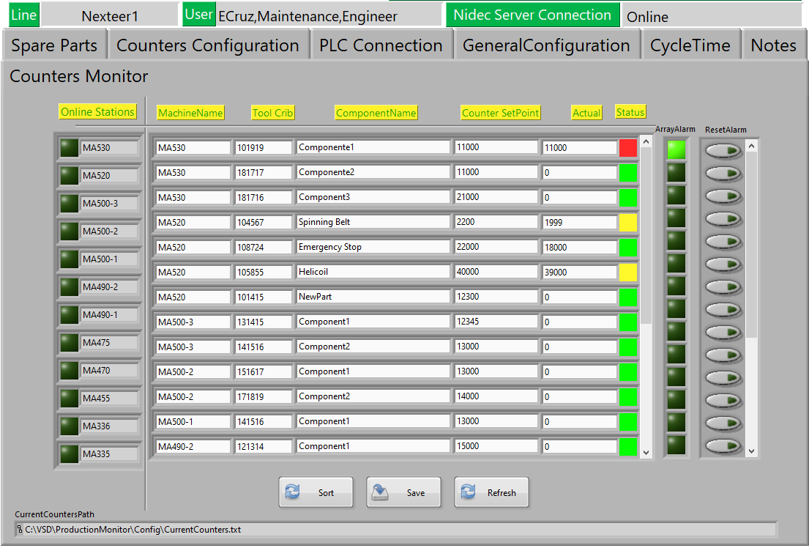
Counters Monitor
Counter of each component per machine with color visible status

Slide 11
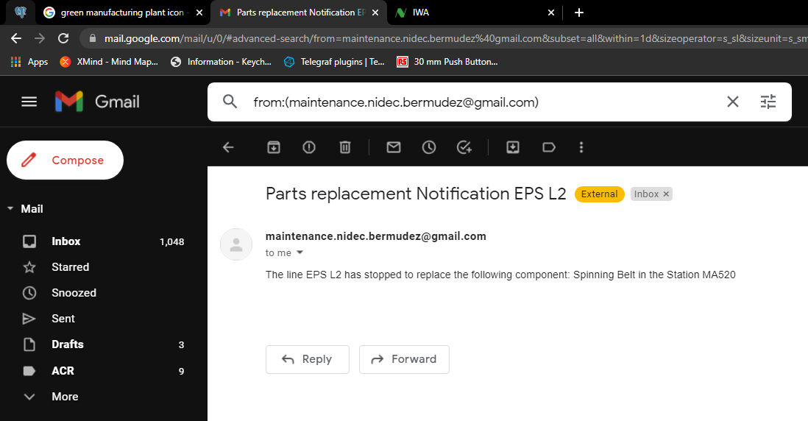
Automated Emails
Automated Emails to Notify the need for replace a component.

Slide 12
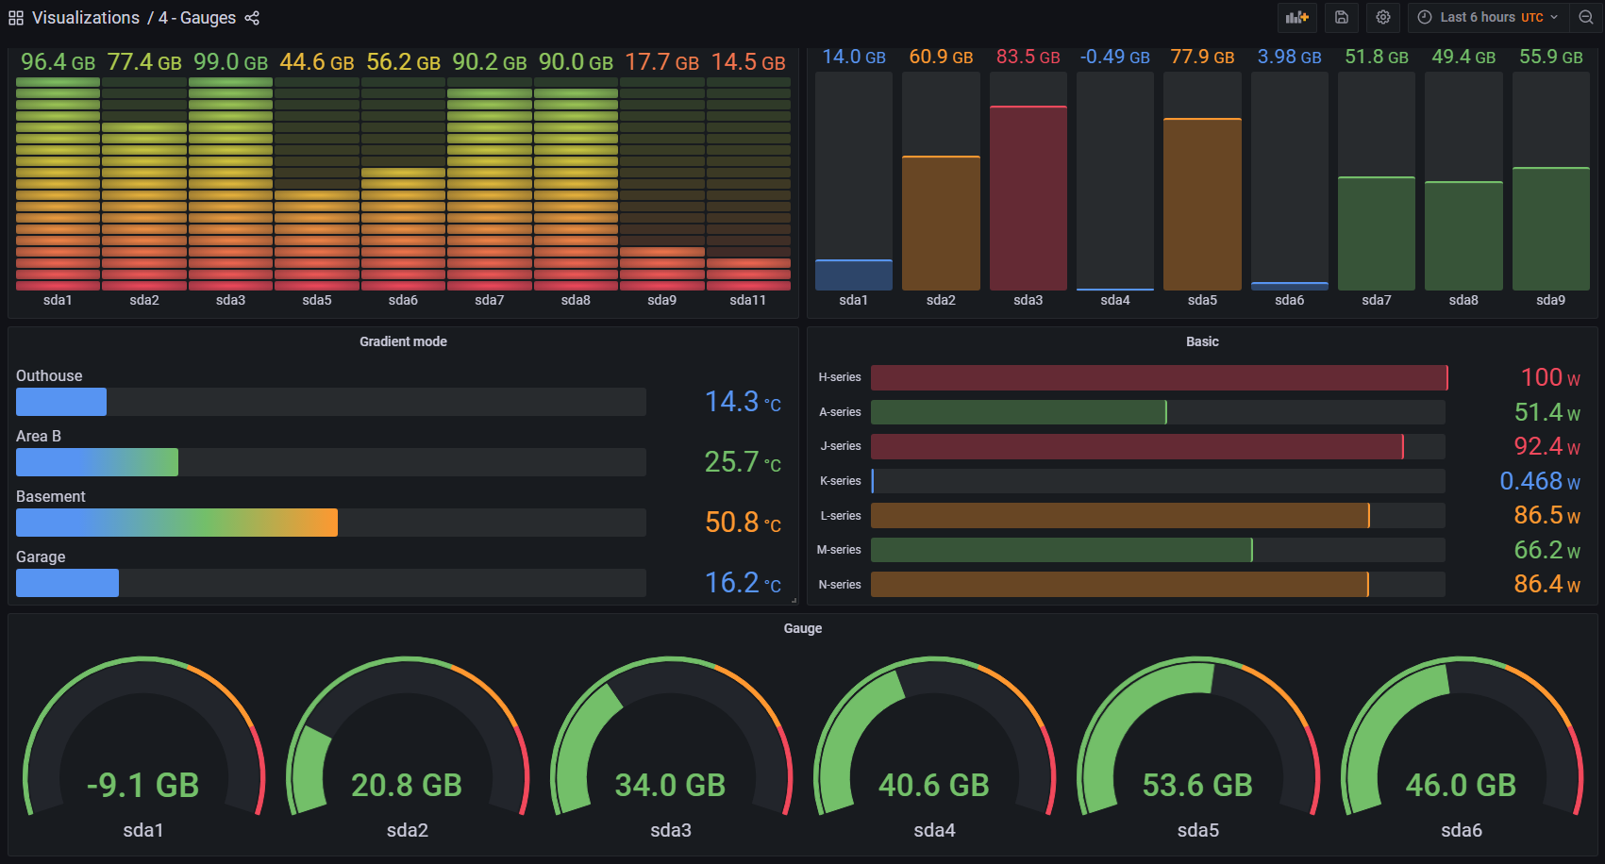
Spare part cost monitor
$0
$100
$210
$250
$302
$296
EPS L1
EPS L2
EPS L3
FCA
ZF
MK100

Slide 13
Implementation plan.
It takes one week per subassembly due to the time needed to install the required software to run the application and the network installation to communicate with all the machines.

Slide 14

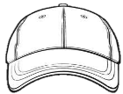




Nidec Juarez Team
Ref. P103.02X
F103.18B

