Slide 1
Pentaho Big Data Test Harness
Proposal
Joe Rice
Hitachi Vantara – Pentaho Engineering 3/13/2018

Slide 2
Agenda
Overview
Problem – Lack of Large-Scale Real-World Test Capabilities
Solution – Pentaho Big Data Test Harness (Proposal)
Work Complete So Far – Prototype & Proof of Concept
The Ask – Time & Money to Complete this Effort

Slide 3
Overview
This presentation is a pitch to build a Big Data Test Harness
It will describe some challenges and gaps in Pentaho’s testing capabilities
Then, it will present a solution to solve those challenges.
Finally, it will pull out a tin cup and politely ask for money.

Slide 4
Problem Statement

Slide 5
Problem 1 – Lack of Ability to test at Scale
Pentaho builds an amazing set of Big Data products.
But we only test our solutions with tiny data on small infrastructure before releasing to wild.
Meanwhile, our customers run our products on large clusters against TB and PB-sized data sets.
How do we know how our code will hold up against those workloads??
Do we want our customers to be our QA?
Currently, we have no data-driven way to test & optimize our products at scale before we ship.

Slide 6
Problem 2 – Lack of Empirical Data
We spend time & resources to make Pentaho steps run natively on Spark.
The assumption is that by utilizing spark native code, we should see performance & resource improvements. Right?
But do we?? How do we know? Can we quantify the difference?
How does AEL on Spark compare with running vanilla spark? How does it compare with running same on Pentaho Server?
Are we sure we have optimized our AEL code to fullest? How do we quantify how much impact code improvements have?

Slide 7
Problem 3 – Lack of Ability to Experiment
How do our products perform on 5-node cluster? -Vs- 100-node cluster? –Vs- 1,000 node cluster?
How do they perform against GB of data, TB, PB? What’s the breaking point?
Ideally, we want to test and measure to answer those questions.
But manually building out such infrastructure is costly – time, money, and resources.
Manual infra buildouts are not practical ☹.

Slide 8
Problems – Anecdotes from Engineering - 8.1
Spark Native / AEL
In BB8, we are building GroupBy, UniqueRows, and SubTrans as Spark Native steps.
Testing against 5MB datasets on laptops & 3-node Pentaho Hadoop clusters.
We are utilizing SparkSql. Code is speedy running against tiny data on a small cluster.
How will it perform on 100 Node cluster against 1TB data set? Have I made the right design / code decisions? I need to test to validate. I need hard data to guide decisions.
Big Data Formats
Avro, Orc, and Parquet support is being added by Mos Eisley in 8.1
Same small test data & test clusters. How will they perform at scale?
Are we confident customers won’t face problems we could have caught earlier?

Slide 9
Solution

Slide 10
Solution – Requirements
Before we describe the proposed solution, let’s look at requirements.
Given the problems described earlier, the solution must:
Allow us to test real-world large data sets (1TB+).
Allow us to test using real-world large-scale Hadoop clusters (100 – 1,000 node clusters. 16+ GB RAM, tons of CPU cores)
Allow us to monitor tests, record metrics, gather data that give insights to how our products perform.
Allow us to compare results of different tests.
Allow us to quickly experiment with different configurations with little effort.
Not cost the size of a small government or army.

Slide 11
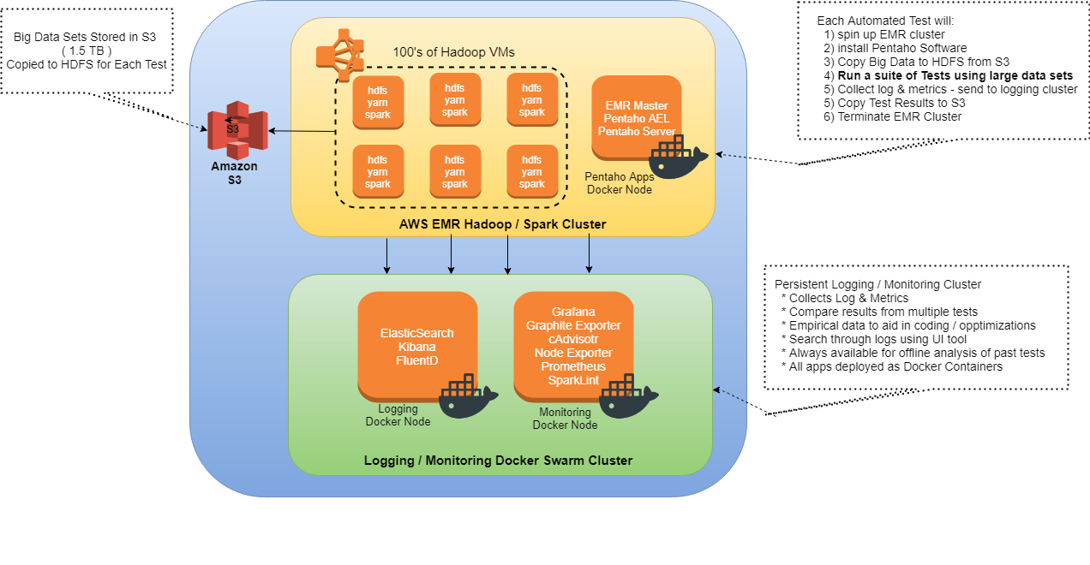
Solution – Big Data Test Harness
© Hitachi, Ltd. 2017. All Rights Reserved

Slide 12
Solution – Big Data Test Harness
The key to being able to quickly experiment with different infra buildouts at low cost are:
1) Automation
2) Infrastructure as Code
3) Low-cost cloud solutions
4) Instrumentation & Metrics

Slide 13
Solution – Key Components
AWS EMR Hadoop Cluster
Completely automated. 1 script builds out entire infrastructure including VMs
# of VMs, CPU, Mem, Disk Size are all configurable. Quickly experiment.
Spin up, run test, then spin down. Only pay for the few hours the test runs.
Running 1,000 node cluster for 4 hours is not cost-prohibitive.
Logging & Monitoring Cluster
Records metrics and data across tests.
Can view test results even after test cluster is terminated.
Big Data Sets stored in S3 – Real-World large data sets to test against.

Slide 14
Solution – Monitoring & Metrics
Spark exposes metrics we will graph using Open Source (free) tools.
Hadoop, HDFS, and Yarn also expose metrics we will graph.
We will copy Spark Events to S3 so we can pull into Spark History Server for offline analysis.
All Spark, Hadoop, Yarn, and Pentaho app logs are stored in ElasticSearch / Kibana for offline searching (Splunk would be super).
We can get OS (disk, cpu, mem) and JVM (cpu, mem, garbage collection, threading) metrics along with Spark / Hadoop metrics.
The test harness will also collect metrics from our apps (AEL, Pentaho Server) so we get full insight.

Slide 15
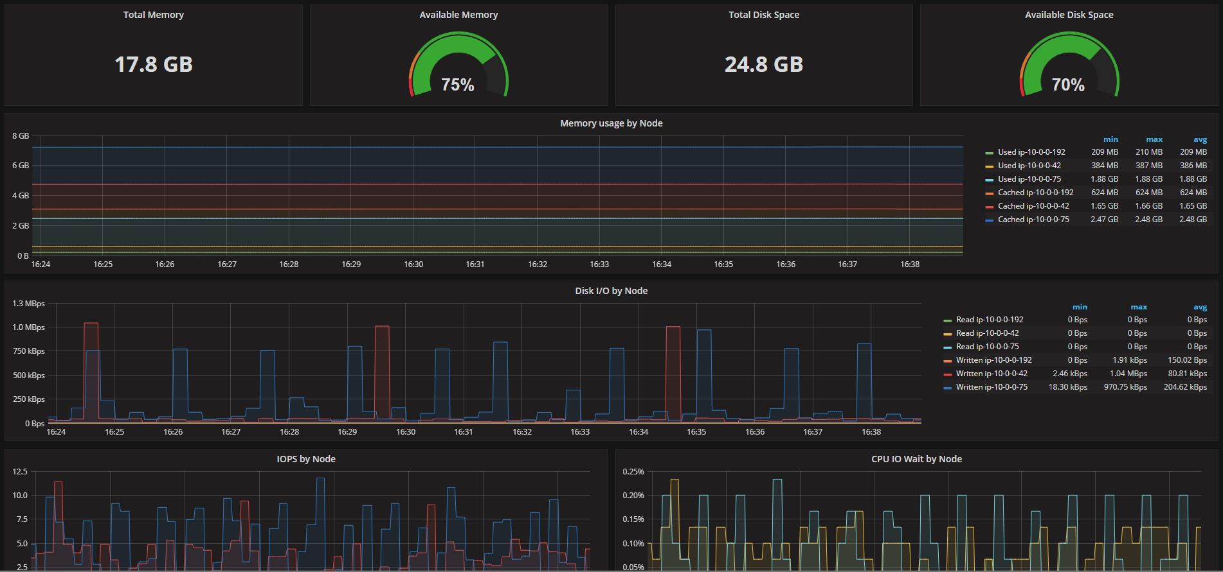
Solution – Monitoring & Metrics - Grafana

Slide 16
Solution – Use Cases
Test Pentaho Products at Scale
AEL / Spark
Pentaho Server
Worker Nodes, etc
QA - Regression testing at scale before release
Scrum teams - steps to doneness for new Pentaho Big Data features
Test at scale, find bottlenecks, optimize code
Performance benchmarks to share with sales, customers, and external parties
Support, Enterprise Arch, and Field Engineers - validate cust. recommendations

Slide 17
Work Complete So Far

Slide 18
Work Completed So Far
Working Prototype
Automation script to build out EMR cluster
Can set # of VMs to spin up & VM size (CPU cores, RAM, & Disk size)
Automation script to build out Logging / Monitoring Cluster
Creates all AWS resources
Provisions & configures a Docker Swarm cluster
Deploys 12 Logging & Monitoring apps as docker containers.
Working Spark app sending metrics & logs to Logging / Monitoring Cluster
Working dashboards to view Spark metrics live and offline.
https://github.com/pentaho-jrice/jrice-big-data-test-harness

Slide 19
Work Completed So Far
Big Data Set stored on S3
Stack Exchange Data Dump – anonymized dump of all user posts on several sites in the Stack Exchange Network (eg https://stackoverflow.com/, etc)
Compressed – ~48GB of data
Uncompressed – ~300GB of data
Pain in the butt to download from slow source site.
But now it’s in S3 for all Pentaho to use. Fast to download from S3.
Chosen because it is a simple schema and does not require domain knowledge.
https://s3.console.aws.amazon.com/s3/buckets/big-dataset-stackexchange/?region=us-east-1&tab=overview

Slide 20
The Big Ask

Slide 21
Remaining – Next Steps
Work with EngOps & DevOps to vet solution & refine it together.
Gain AWS privileges so I can script / create resources using Hitachi $$
Cost Testing – I Have cost estimates. Want to validate those estimates.
More Automation
Pentaho Server cluster buildout
AEL on EMR
Dockerization of Pentaho Server & AEL
Add metrics gathering capabilities to AEL
Add code to use Codehale to export to many different sinks so we can graph
Backups & all the other official EngOps-y stuff that needs to happen

Slide 22
Remaining – Next Steps
Support for cost tracking & protection
Billing Tag standards – tag resources into billing groups
Cost reports so we know exactly how much each EMR Cluster test costs. Can adjust over time.
Putting in spending alerts & guardrails to avoid accidental cost overruns. For example:
Tests that run longer than expected automatically terminated when reach certain $ limit.
Can set spending limits per group. i.e. Each scrum team can have certain monthly $ limits on how much testing they can do. No more testing once limit is reached until next month.
Makes it easy to plan monthly spending budgets spread across teams and enforce.

Slide 23

The Ask – Time & Money
3 Asks:
Approval to proceed further
Time & Resources
Would like to add official stories to work on this after code freeze. 2 sprints of work.
Would also need some of EngOps and DevOps time to collaborate on it together.
Time to socialize it and work with QA, Support & Architecture teams.
Money (see cost estimates next slide)
Short-Term – the cost to script the spin up and automation of cluster buildout
Long-Term – the costs of hosting big data sets in S3, spinning up EMR clusters for testing, and hosting the Logging / Monitoring Docker cluster.

Slide 24
Cost Estimates – Short Term
Costs to script
Involves repeated spinning up clusters & tearing down. Testing different configs few hours at a time
In prototype phase, it cost me $180.00 for 2 weeks of scripting work
I estimate roughly same costs for scripting on Pentaho resources –
2 sprints = $400.00

Slide 25
Cost Estimates – Long-Term
*Disclaimer – These estimates are based on my assumptions before review with EngOps.
EngOps may have their own requirements / standards. Subject to change based on review.
Monthly / yearly cost to operate Monitoring cluster & host Big Data sets in S3. Assume:
1.5 TB data stored in S3
3 VMs – 1 Docker Swarm Manager. 1 Logging Docker Node. 1 Monitoring Docker Node.
Cluster is persistent – VMs remain up 750 hours per month.
Service | Monthly Cost | Yearly Cost
S3 | $35.00 | $420.00
EC2 Instances (VMs) | $287.00 | $3,445.00
Total | $322.00 | $3,865.00

Slide 26
Cost Estimates – Long-Term
Per-Test Cost for EMR Cluster. Assume: :
100 VMs (m4.xlarge spot instances – 4 vCPUs, 16 GB RAM)
20GB Disk per VM – 2TB Total
1.5 TB data transferred from S3 to HDFS.
Cluster is ephemeral – VMs and resources are terminated after test completes.
Service | Per Test Cost 2 Hour Test | Per Test Cost 5 Hour Test
S3 Transfer | $15.00 | $15.00
EMR Instances (VMs) | $78.00 | $193.00
Disk | $8.00 | $20.00
Total | $101.00 | $228.00

Slide 27
Thank You

Slide 29
Appendix I – Behind the Curtain Technologies Used

Slide 30
Technologies Used
Technology | Description | Alternatives
Amazon EMR | Cloud-based Hadoop Cluster | Cloudera, Hortonworks, MapR. Google Cloud DataProc, Azure HDInsight EMR chosen because it is simplest to script and set up. Recommend exploring what majority Pentaho customers use.
Amazon EC2 | Cloud-based Virtual Machines for Logging and Monitoring | CloudStack, Internal Pentaho Hardware, Google Cloud, Azure

Slide 31
Technologies Used
Technology | Description | Alternatives
Terraform | Automate creatiton of AWS Resources such as: VMs, Networking (VPC, subnets), Load Balancers, DNS records, etc. | AWS CloudFormation. Terraform chosen because it is vendor-neutral and industry standard.
Ansible | Automate provisioning, installing, and configuring software on VMs. | Chef, Puppet. Ansible chosen because it is simplest. But can use whatever standard Pentaho has.

Slide 32
Technologies Used
Technology | Description | Alternatives
Docker Swarm | Docker Container management and orchestration technology. Makes it super easy to deploy docker containers across many VMs / nodes. | Kubernetes, Mesos / Marathon. Swarm chosen because it is simplest to use. Get a lot of features with little setup. Kubernetes and Mesos worth exploring. More powerful / flexible / complex
Spark Lint | Spark Performance Debugger and a tool for monitoring and tuning Spark jobs for efficiency. Valuable insight into details of how Spark jobs behave. | N/A

Slide 33
Technologies Used
Technology | Description | Alternatives
Prometheus | Monitoring / time-series database. Used to track & store metrics across different applications. | Graphite, InfluxDB Chosen because it is most powerful. Query Language support super flexible. Simplest to setup and use.
Grafana | UI Tool for analytics, monitoring, graphing, and dashboards. Used as tool to consolidate and show all metrics collected from different sources (graphs metrics stored in Prometheus) | DataDog, NuRelic, AppDynamics, Kibana. Chosen because it is best free option. Supports many data sources

Slide 34
Technologies Used
Technology | Description | Alternatives
ElasticSearch | Store log data written from different data sources (Pentaho Apps, Spark, Yarn, Docker Containers, etc) | Splunk ElasticSearch chosen because it is free. Splunk is best choice. But expensive.
Kibana | UI Tool that allows searching log data stored in ElasticSearch. Can also build graphs and other visualizations off log data. | Splunk Kibana chosen because it is free. Splunk is best choice. But expensive.

Slide 35
Technologies Used
Technology | Description | Alternatives
FluentD | Data collector for unified logging layer. Basically, collects log data from many different data sources and delivers it many different data consumers. In our case, fluentD collects logs from Docker, Spark, Yarn, Pentaho and writes to ElasticSearch. | Logstash, Flume FluentD chosen because it is industry standard and because of its retry and reliability features.

