Slide 1
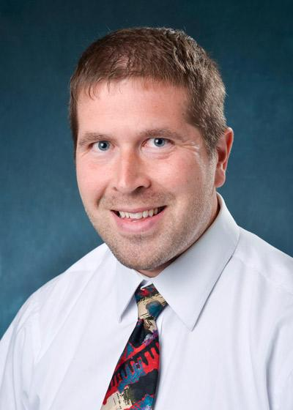
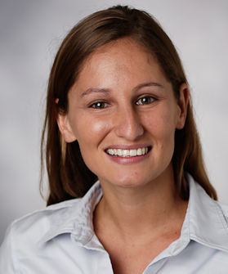
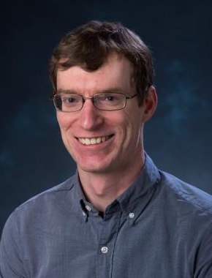
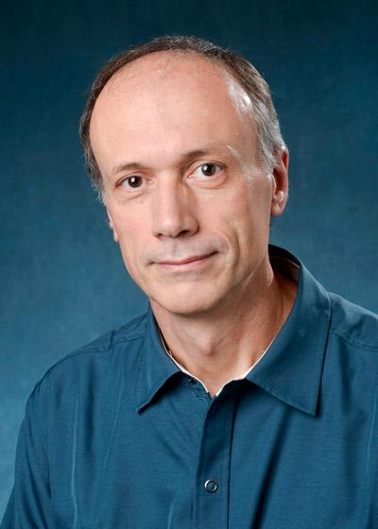
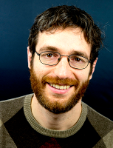
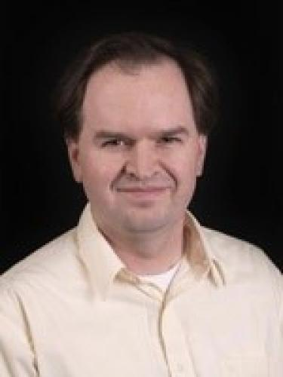
Computer Engineering Faculty
- Network Systems
- Computer Security
- Computer Architecture
- Computer Security
- Computer and Network Security
Eric Keller
Tamara Lehman
Eric Wustrow
- Formal Verification
- Model Checking
- Software Systems
- Distributed Computing
- Synthetic Biology
- Biological Inspired Computing
Fabio Somenzi
Joe Izraelevitz
Chris Myers
(dept. chair)
Notes:
One way you can tailor your studies is by partnering with a faculty member or taking their classes to dig deeper in a particular field. Here are all the permanent faculty that you may encounter in Computer Engineering
Eric Keller, PhD from Princeton, Postdoc at University of Pennsylvania, research in systems and networks
Fabio Somenzi, phd politecnico di Torino. Formal verification and model checking
Joe Izraelevitz, PhD University of Rochester, research in system software and distributed computing theory
Eric Wustrow, phd university of Michigan, research in computer and network security
Chris Myers, PhD Stanford, biologically inspired computing
Tamara Lehman, PhD Duke, Secure memory and architectures

