Slide 1
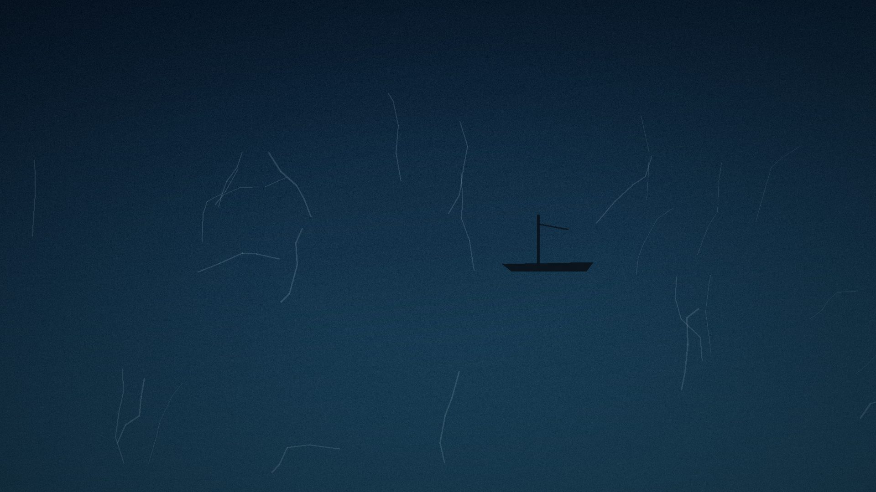
1915.
Notes:
Open cold, no framing, no logo, no title slide in the corporate sense. "This is the Endurance. Twenty-eight men. One of the most ambitious expeditions of its time: the first crossing of Antarctica on foot. They had trained for the cold. They had trained for the ice. They had a plan." Pause. Let the image hold before speaking again.

Slide 2
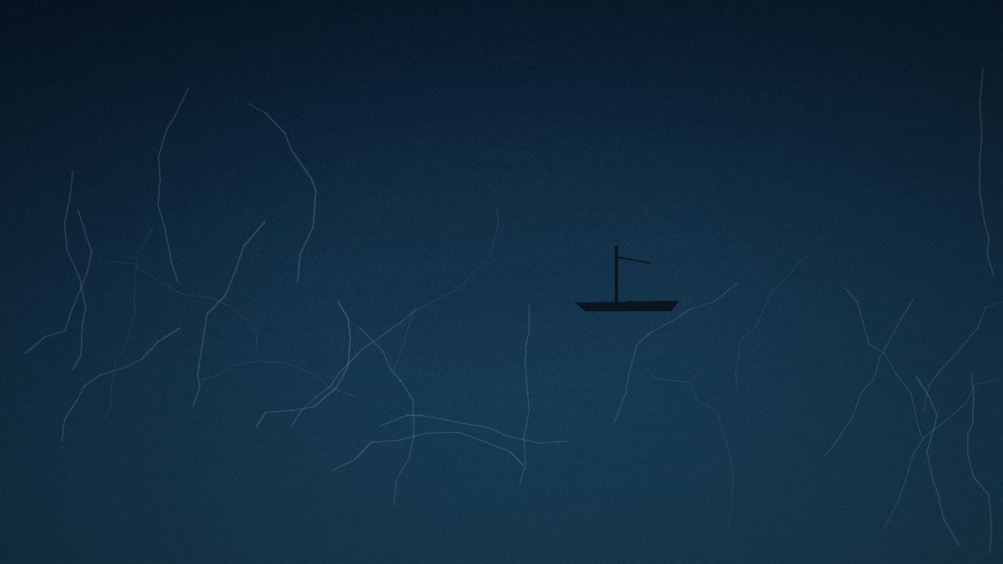
The ice had other plans.
Notes:
"In January 1915, still short of land, the ship stopped. Not damaged — stopped. Frozen into the pack ice of the Weddell Sea. For months, it didn't move. Neither did they." Source: History.com, "The Stunning Survival Story of Ernest Shackleton and His Endurance Crew"; Frank Hurley photograph, 1915 (public domain).

Slide 3
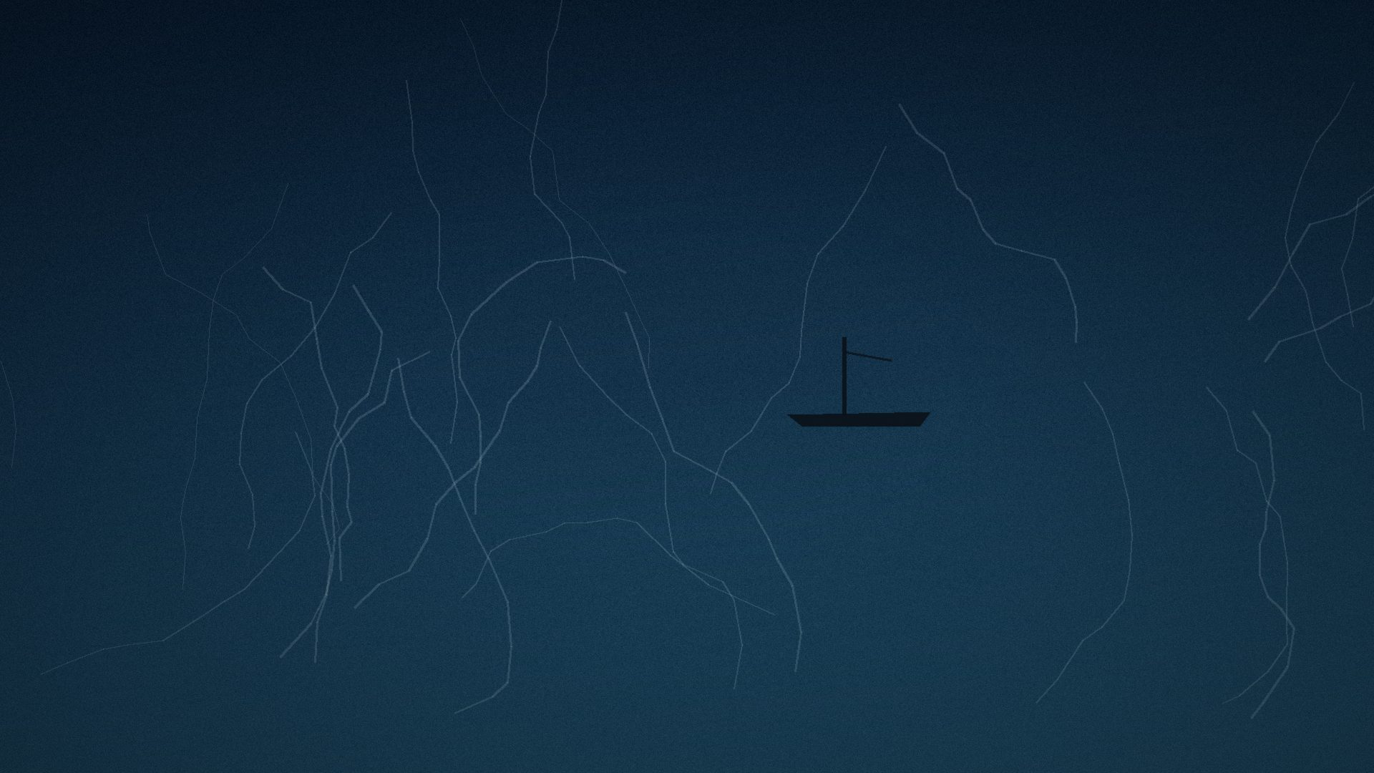
Then the ice began to close.
Notes:
"By October, the pressure of a thousand square miles of ice found the ship's hull. It didn't sink. It was crushed — slowly, over weeks — while the men watched from tents on the ice beside her. Every plan they had sailed south with died with that ship." Land the thread: this is not a talk about Antarctica. GOOSEBUMPS SETUP — do not resolve yet.

Slide 4

We have gotten extraordinarily good at
predicting, planning, and controlling.
Notes:
Turn from the ice to the room. We build five-year strategies, OKRs, forecasts, roadmaps — extraordinary machinery for turning uncertainty into a plan. Image: aerial center-pivot irrigation, evoking engineered, perfect order (placeholder — see Image_Sources workbook for the real USGS/Landsat asset).

Slide 5
But what happens when the environment
changes faster than the plan?
Notes:
The turn of Act I. Ask it plainly and let it sit — do not answer yet. Same image family as S4, alternate crop in final production.

Slide 6

ACT II
The Illusion of Control
Notes:
Organizations respond to uncertainty with more planning, more process, more prediction, more reporting. Introduce Act II by name — the only act title spoken aloud as a title in the whole talk, because it names the trap the audience is about to recognize in itself.

Slide 7
The more precisely we plan for one future,
the less ready we are for the ones we didn't plan for.
Notes:
PARADOX 1. State it and let it breathe — this is its own beat, not a subpoint. This is the hinge into Act III.

Slide 8

What if we looked at systems that have been
adapting for a billion years?
Notes:
Pivot into 'Look at Life.' Not a biology lecture — a change of witnesses. Signal explicitly: we are not here to learn biology, we are here to borrow judgment from things that have survived longer than any company.

Slide 9
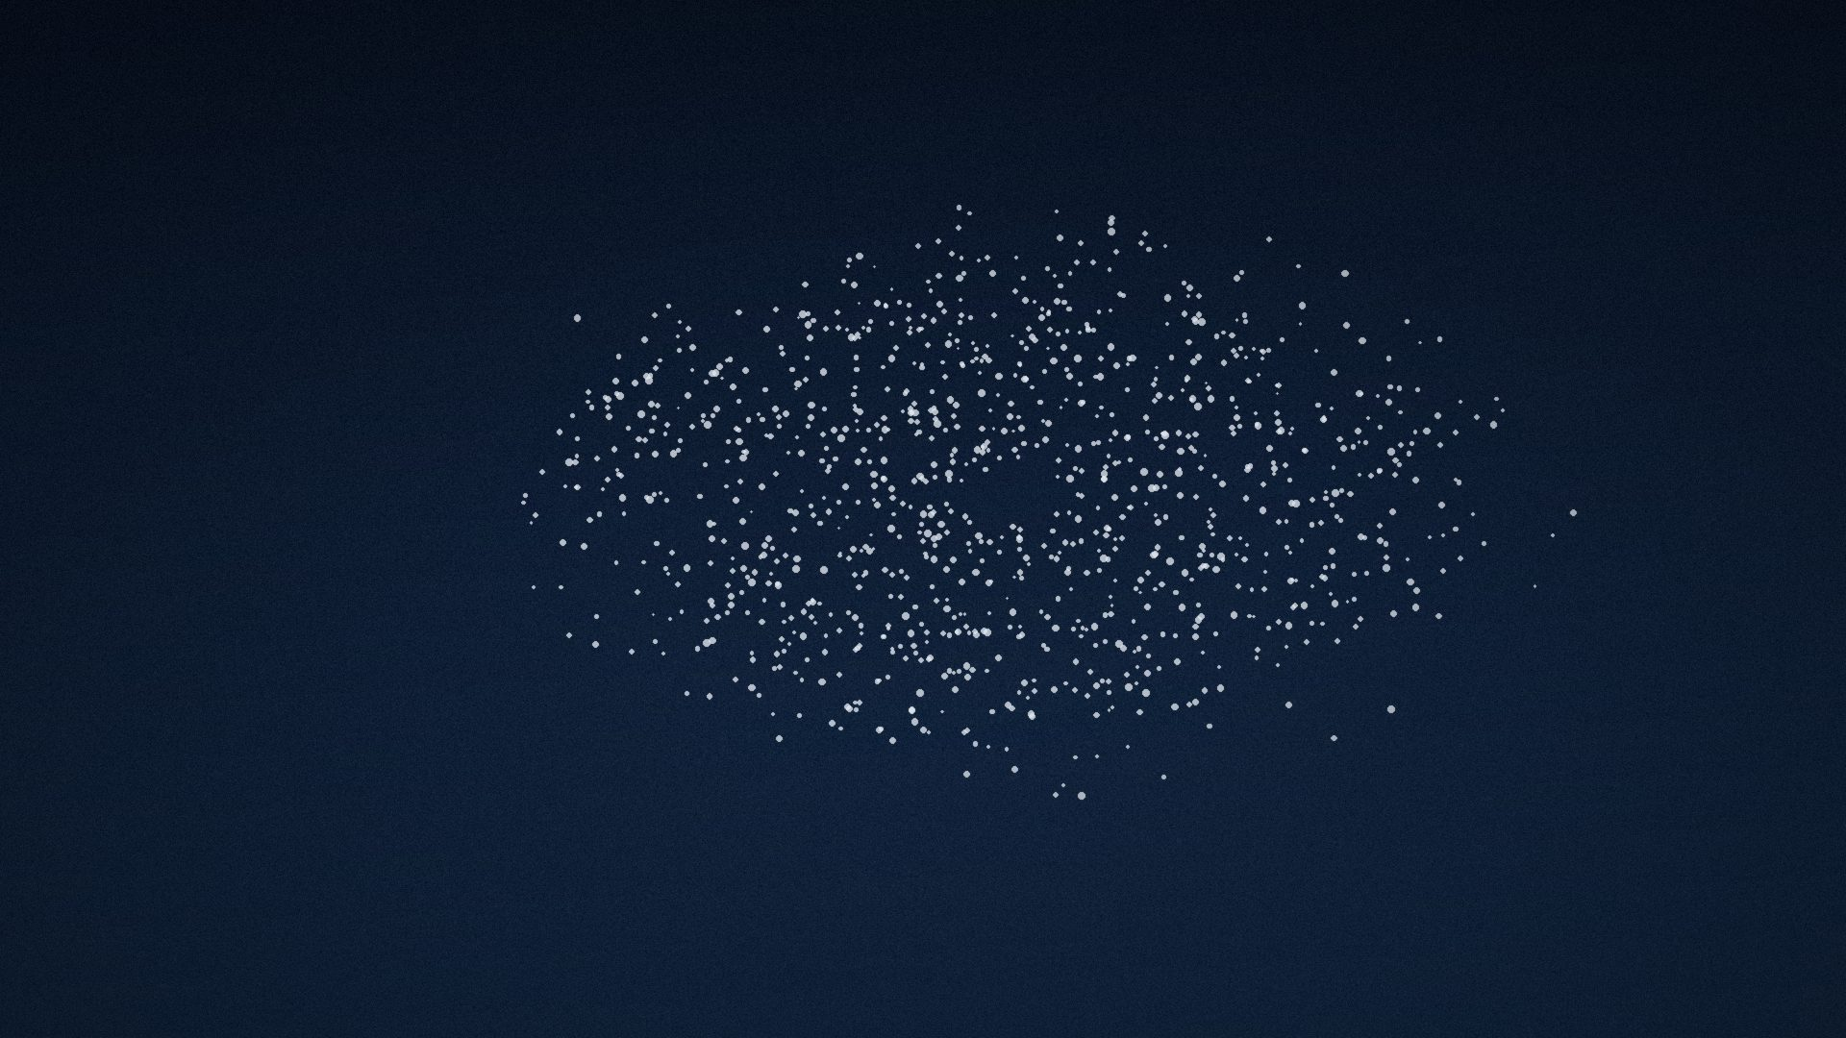
No leader.
No plan.
Every wingbeat carries information.
Notes:
WOW #2. Starling murmurations show scale-free correlation (Cavagna et al., PNAS 2010): a turn at one edge of a flock of thousands reaches the far edge in under a second, with no leader initiating it. Land: 'Information doesn't need a hierarchy to travel fast. It needs connection.'

Slide 10
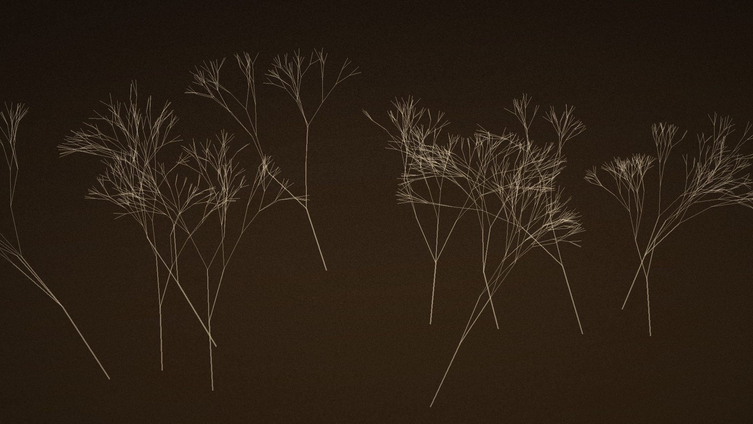
A forest is not a group of trees
that succeeded alone.
Notes:
Suzanne Simard's mother-tree research (UBC): trees share carbon, warnings, nutrients through fungal networks below ground. MEMORABLE LINE #3 delivered here in full: 'It is a network that agreed to fail together less often' (say the second half now or hold it — director's choice).

Slide 11
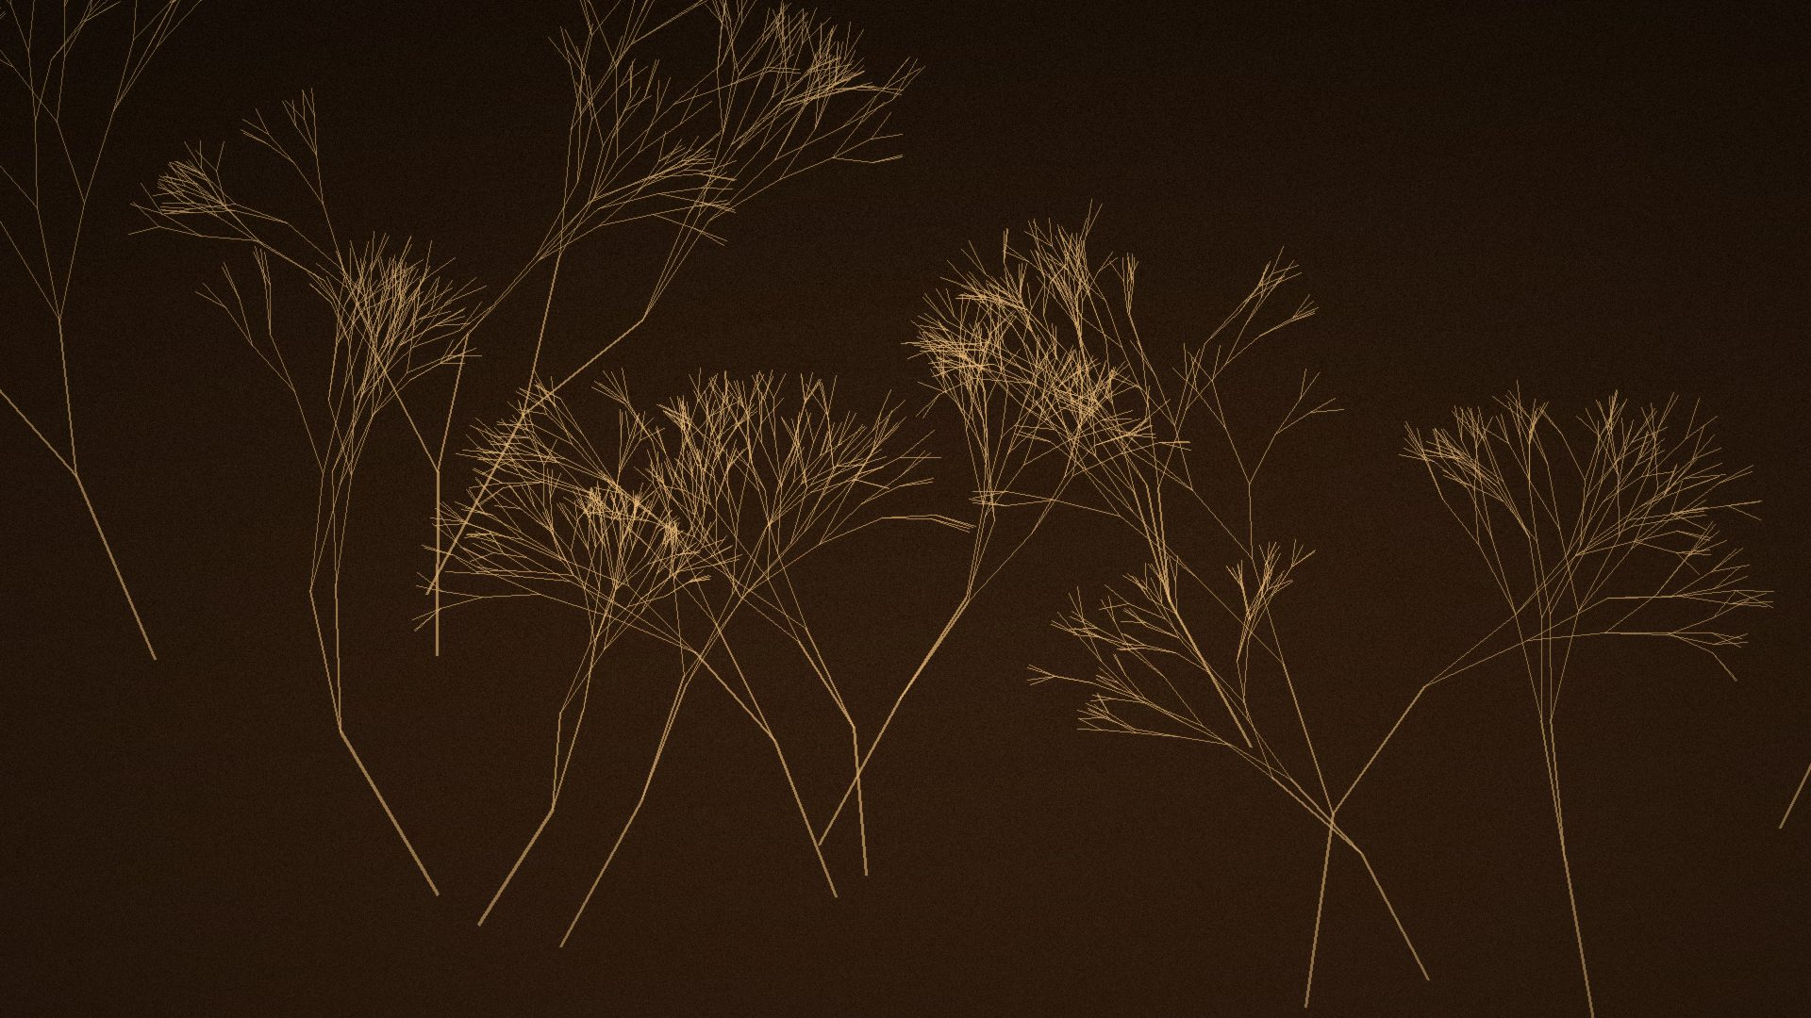
No brain solved this.
Feedback did.
Notes:
WOW #3. Physarum slime mold recreated Tokyo's rail network from scattered oat flakes — no central plan, pure local reinforcement (stigmergy) (Tero/Nakagaki et al., Science 2010). Ants solve shortest-path foraging problems the same way. Land: 'You don't need a strategy meeting to be intelligent. You need feedback loops everyone can read.'

Slide 12

The fast, 'dumb' system
learns too.
Notes:
WOW #5. 'Trained immunity': the innate immune system, assumed purely reflexive, was shown to also learn from past exposure — encoded via chromatin/epigenetic change rather than genetic recombination (Netea et al.; Cell Host & Microbe, 2018 review). Adaptability doesn't only live in the slow, deliberate system.

Slide 13

None of these systems have a plan.
All of them have a capacity.
Notes:
Bridge slide. This line is the pivot from nature to the three human planes. Say it slowly — it is doing the structural work of the whole middle third of the talk.

Slide 14
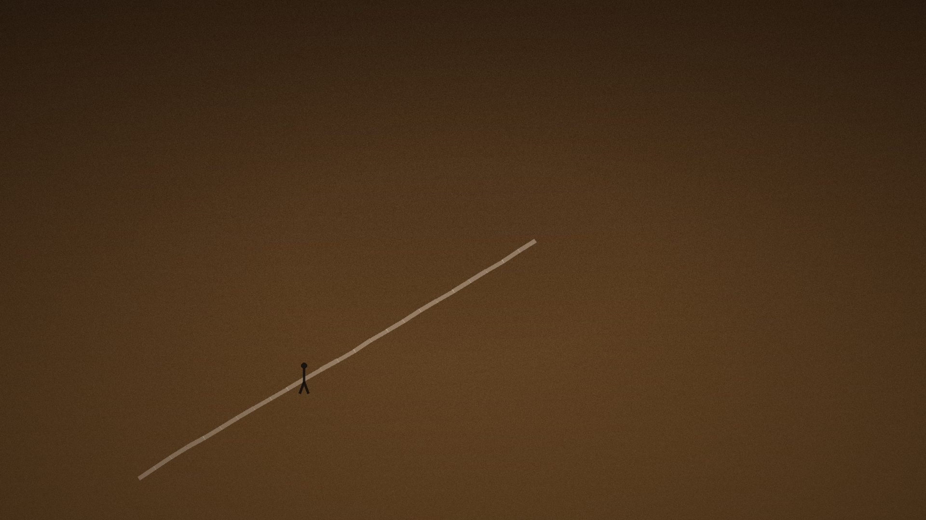
Before an organization can adapt,
a person has to.
Notes:
ACT IV — SELF. Introduce the personal plane: identity, unlearning, tolerance for ambiguity.

Slide 15
Ali Mahlodji
Notes:
Tell the story: school dropout, refugee family background, rebuilt an identity and a career repeatedly, eventually founded a career-guidance company (whatchado). Source: SAP BrandVoice / Forbes profile, 2018. The self that adapts is not the self staying the same — it is the self that can be rewritten.

Slide 16
A system that cannot change its mind
cannot change its outcome.
Notes:
MEMORABLE LINE #2. Lands the personal-plane idea: unlearning as a skill, not a failure. Closes Act IV.

Slide 17
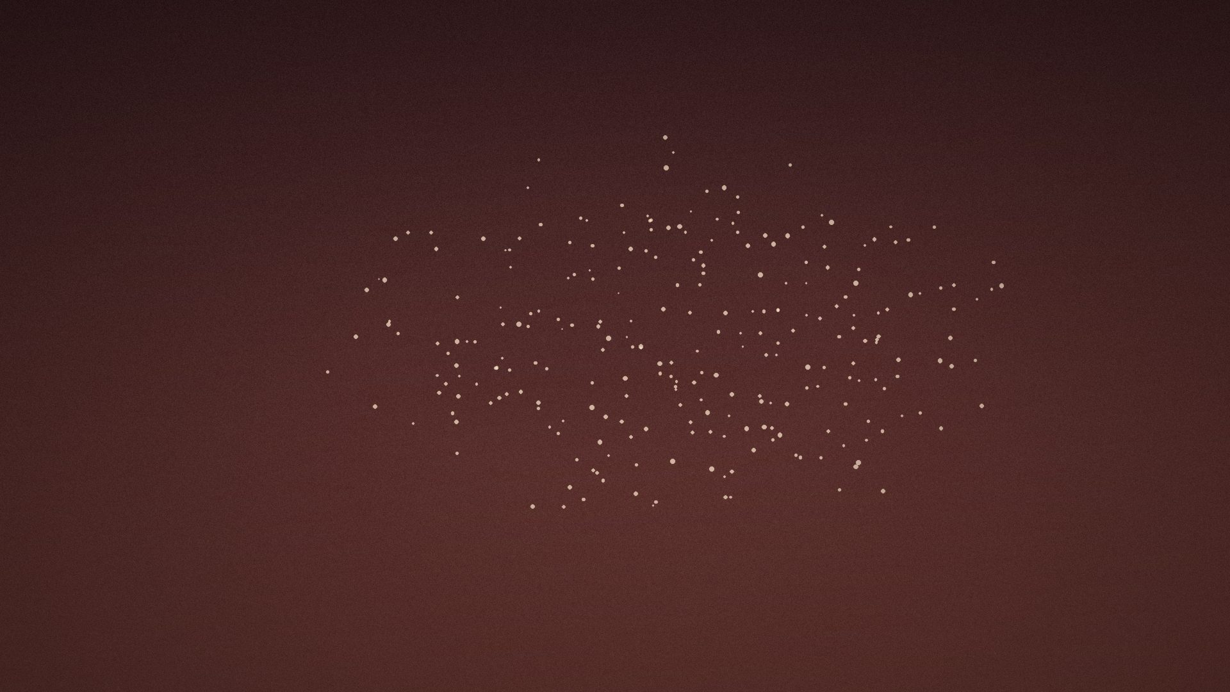
Humans don't adapt alone.
Notes:
ACT V — TOGETHER. Turn to the team plane.

Slide 18
The smartest room is not the room
with the smartest people in it.
Notes:
WOW #1 — the keynote's central WOW. Woolley et al. (Science, 2010): the collective intelligence factor 'c' correlates with average social sensitivity and equality of speaking turns — not average or maximum individual IQ (699 participants, two studies). 'It's the room where everyone gets to speak.'

Slide 19

The smartest individuals in a room
can build the least intelligent room.
Notes:
PARADOX 3. Janis 1972 / Bay of Pigs: groupthink among some of the most credentialed people in the U.S. government. Diversity and dissent are not friction — they are signal.

Slide 20
69 days.
700 meters down.
Notes:
The 2010 San Jose mine collapse, Chile: 33 miners trapped roughly 700m underground for 69 days. Self-organized roles and rationing below ground; distributed problem-solving with engineers and family above ground. Team-level adaptability under total uncertainty. Source: Britannica, 'Chile mine rescue of 2010.'

Slide 21
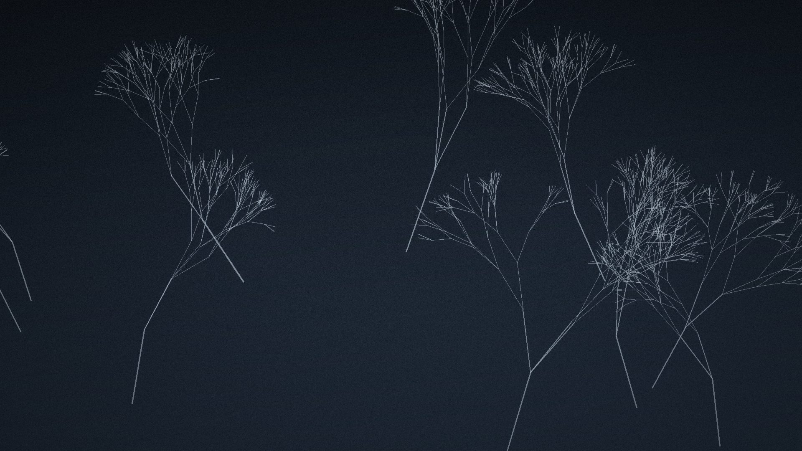
A person can adapt.
A team can adapt.
And the system can still say no.
Notes:
ACT VI — THE SYSTEM. Introduce the organizational plane: structure, incentives, information flow, power, speed of decision.

Slide 22

Kodak didn't fail
to see the future.
Notes:
WOW #4. Kodak's own engineer, Steven Sasson, built the first digital camera in 1975, inside Kodak. Management's recorded reaction: 'cute — but don't tell anyone about it.' Kodak filed for bankruptcy in 2012. 'It built a system that couldn't afford to.'

Slide 23
Some systems reinvent
before they're forced to.
Notes:
Netflix: DVD-by-mail to streaming (2007) to originals to ad-supported/gaming — reinvented its own model repeatedly, ahead of being forced. Blockbuster, which didn't, filed for bankruptcy in 2010.

Slide 24
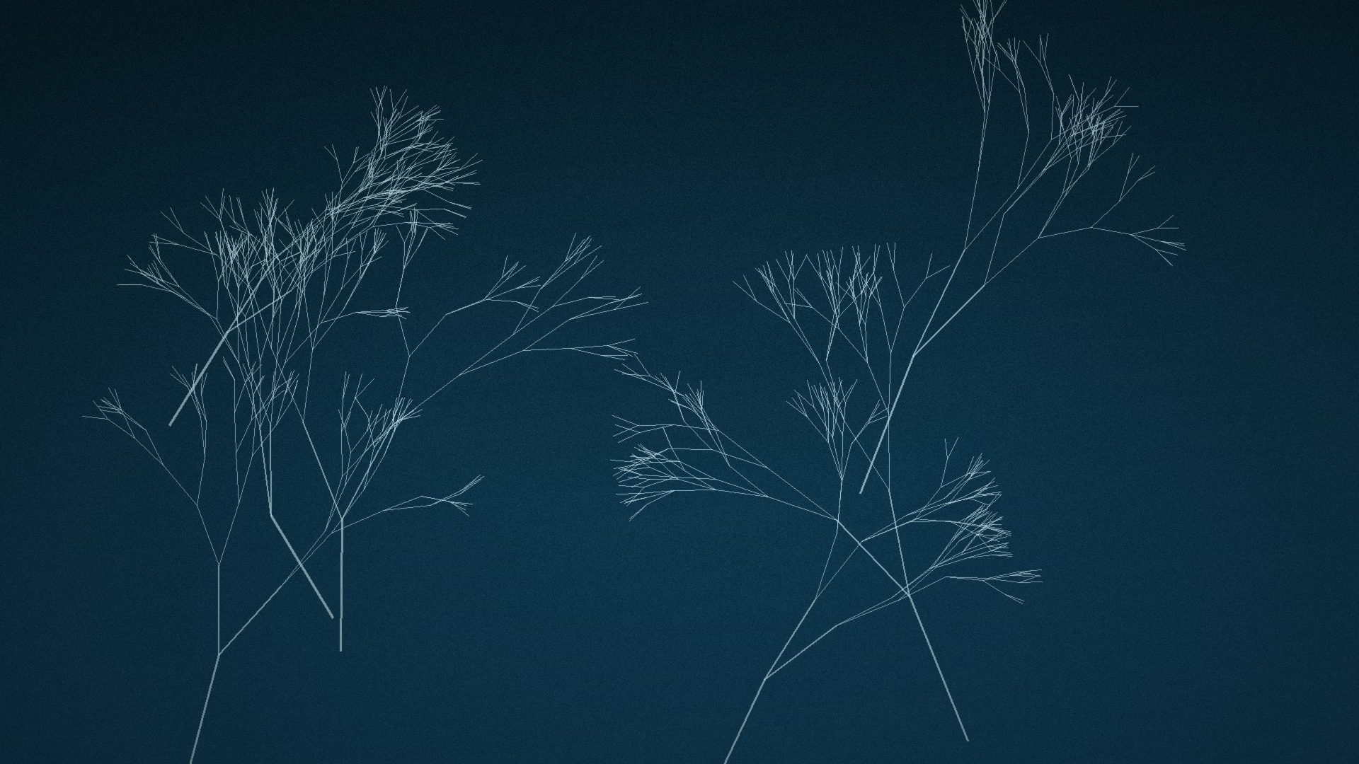
Resilience brings you back.
Adaptability takes you somewhere
you haven't been.
Notes:
MEMORABLE LINE #4, delivered as the slide itself. ACT VII. Distinguish resilience (return to prior state) from adaptability (become a new one). Image: braided river channels finding new paths (placeholder for NASA Earth Observatory, Yarlung Zangbo, Tibet).

Slide 25
A resilient system survives by returning
to what it was. An adaptable one survives
by refusing to.
Notes:
PARADOX 2. Let it breathe — this is the hinge into synthesis (Act VIII).

Slide 26
sense
Notes:
ACT VIII begins. Introduce Sense -> Interpret -> Experiment -> Learn -> Reconfigure -> Adapt as the pattern already seen in every story told tonight, not a new framework. Say each word once, quietly, mapping it back to Shackleton's own choices: sensing the ice reports, interpreting that the crossing was over, experimenting with camps and small boats, learning and adjusting roles, reconfiguring from march to boat journey, adapting the goal itself.

Slide 27
This isn't a framework.
It's what every story tonight already showed you.
Notes:
Explicitly refuse to let Sense-Interpret-Experiment-Learn-Reconfigure-Adapt calcify into a bullet-point framework slide. Name how Shackleton's own decisions trace the same six-word arc, in one sentence each, spoken — not itemized on screen.

Slide 28
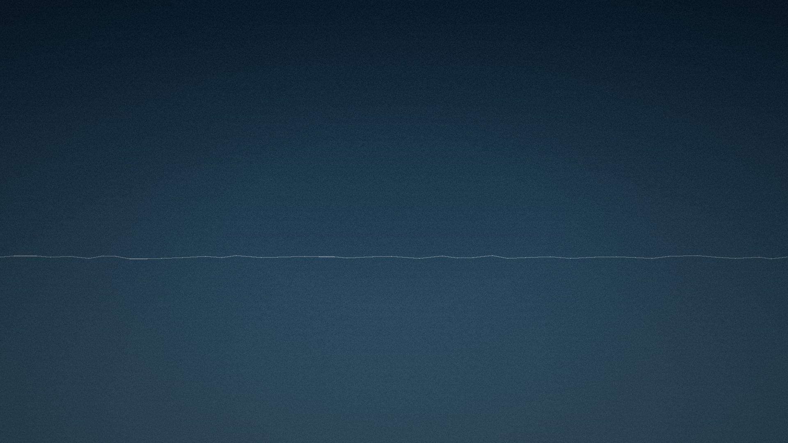
ACT IX
Not one page of the plan survived.
Notes:
Return to Shackleton: the 800-mile open-boat journey in the James Caird to South Georgia, then the unmapped crossing of South Georgia's mountains on foot to reach the whaling station.

Slide 29
Every single man came home.
Notes:
GOOSEBUMPS MOMENT. No version of the original plan survived. All twenty-eight men did. Let it land in full silence for a breath before continuing — do not talk over the image.

Slide 30
We could not choose the ice.
We can still choose who we become on it.
Notes:
FINAL THESIS LINE, spoken last, after this: 'We cannot decide what the future will bring. We can decide who will be standing there to meet it.' Hold the image. No further text, no logo, no call-to-action slide. Close in silence.

