Slide 1
Final Report Capstone Project

Slide 2
Introduction
The purpose of this Project is to help people in exploring better facilities around their neighbourhood. It will help people making smart and efficient decision on selecting great neighbourhood out of numbers of other neighbourhoods in Scarborough, Toronto.
This Project aim to create an analysis of features for a people migrating to Canada to search a best neighbourhood as a comparative analysis between neighbourhoods. The features include median housing price and better school according to ratings, crime rates of that particular area, road connectivity, weather conditions, good management for emergency, water resources both fresh and waste water and excrement conveyed in sewers and recreational facilities.
It will help people to get awareness of the area and neighbourhood before moving to a new city, state, country or place for their work or to start a new fresh life.

Slide 3
Data Description
Data Link (wikipedia) : https://en.wikipedia.org/wiki/List_of_postal_codes_of_Canada:_M
Data Link (foursquare): https://foursquare.com/explore?mode=url&ne=43.53262%2C1.611042&sw=43.395818%2C1.375866

Slide 4
Foursquare API Data:
We will need data about different venues in different neighbourhoods of that specific borough.
In order to gain that information we will use "Foursquare" locational information. Foursquare is a location data provider with information about all manner of venues and events within an area of interest. Such information includes venue names, locations, menus and even photos. As such, the foursquare location platform will be used as the sole data source since all the stated required information can be obtained through the API.
After finding the list of neighbourhoods, we then connect to the Foursquare API to gather information about venues inside each and every neighbourhood. For each neighbourhood, we have chosen the radius to be 100 meter.
The data retrieved from Foursquare contained information of venues within a specified distance of the longitude and latitude of the postcodes. The information obtained per venue as follows:
1. Neighborhood
2. Neighbourhood Latitude
3. Neighbourhood Longitude
4. Venue
5. Name of the venue e.g. the name of a store or restaurant
6. Venue Latitude
7. Venue Longitude
8. Venue Category

Slide 5
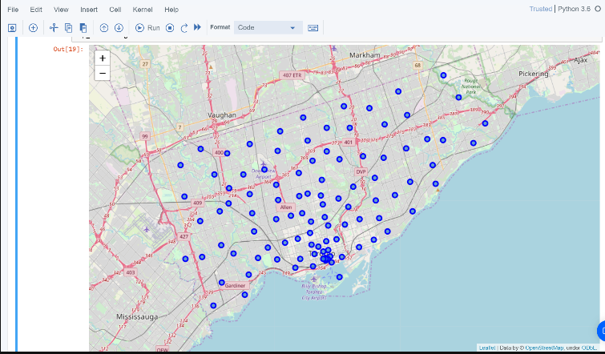
Map of Scarborough

Slide 6
Methodology Section
Clustering Approach:
To compare the similarities of two cities, we decided to explore neighbourhoods, segment them, and group them into clusters to find similar neighbourhoods in a big city like New York and Toronto. To be able to do that, we need to cluster data which is a form of unsupervised machine learning: k-means clustering algorithm.

Slide 7
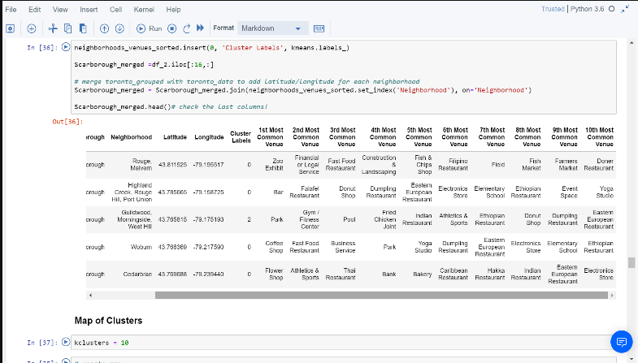
Using K-Means Clustering Approach

Slide 8
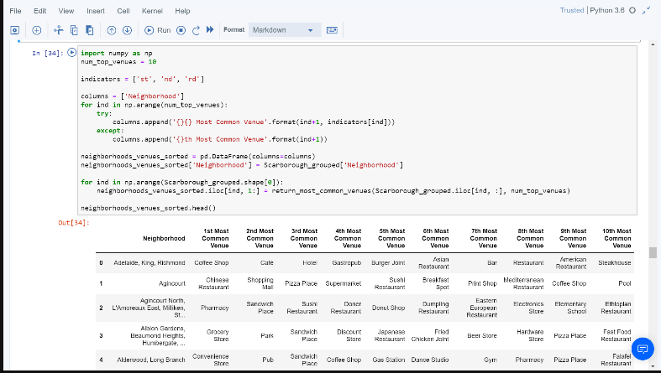
Most Common venues near Neighborhood
Work Flow:
Using credentials of Foursquare API features of near-by places of the neighbourhoods would be mined. Due to http request limitations the number of places per neighbourhood parameter would reasonably be set to 100 and the radius parameter would be set to 500.

Slide 9
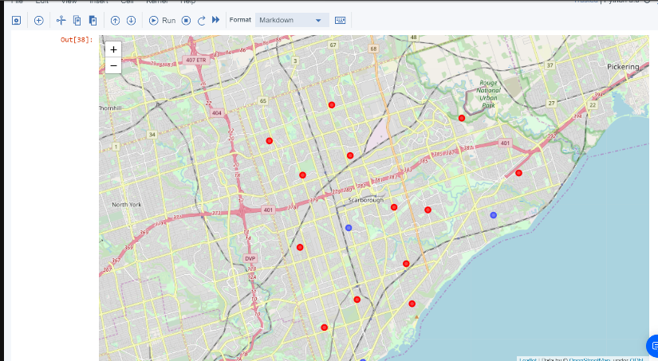
Results Section
Map of Clusters in Scarborough

Slide 10
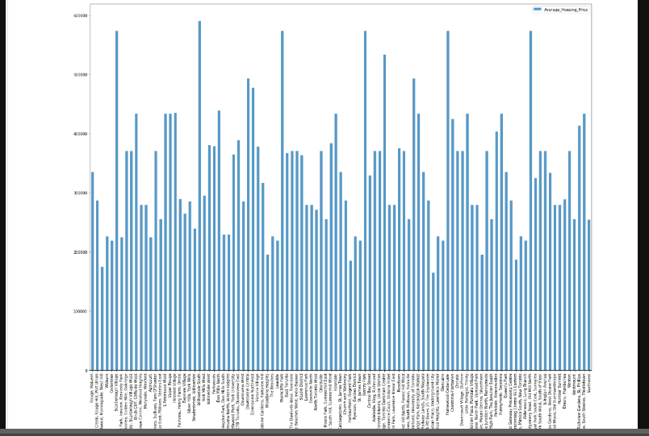
Average Housing Price by Clusters in Scarborough

Slide 11
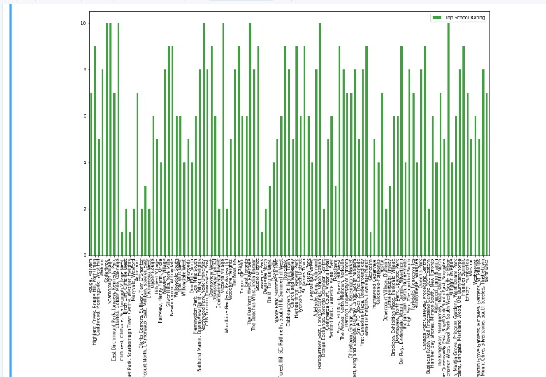
School Ratings by Clusters in Scarborough

Slide 12
The Location:
Scarborough is a popular destination for new immigrants in Canada to reside. As a result, it is one of the most diverse and multicultural areas in the Greater Toronto Area, being home to various religious groups and places of worship. Although immigration has become a hot topic over the past few years with more governments seeking more restrictions on immigrants and refugees, the general trend of immigration into Canada has been one of on the rise.
Foursquare API:
This project have used Four-square API as its prime data gathering source as it has a database of millions of places, especially their places API which provides the ability to perform location search, location sharing and details about a business.

Slide 13
Discussion Section
Problem Which Tried to Solve
The major purpose of this project, is to suggest a better neighbourhood in a new city for the person who are shifting there. Social presence in society in terms of like minded people. Connectivity to the airport, bus stand, city center, markets and other daily needs things nearby.
1. Sorted list of house in terms of housing prices in a ascending or descending order
2. Sorted list of schools in terms of location, fees, rating and reviews

Slide 14
Conclusion Section
In this project, using k-means cluster algorithm I separated the neighbourhood into 10(Ten) different clusters and for 103 different latitude and longitude from dataset, which have very-similar neighbourhoods around them. Using the charts above results presented to a particular neighbourhood based on average house prices and school rating have been made.

