Slide 1


Find My Artisan
Demo Day • Team 1 • Group C
Notes:
Say your team name, who you are, and one sentence on what your API does.

Slide 2
Our App and Why It Exists
⏱ 0:00–0:30
Weeks 1–2: Plan
ONE NEEDS STATEMENT (your strongest)
Meditrac needs our API to vet artisans in order to determine who can carry out tasks at their pharmacies.
WHAT IT DOES AND WHO IT IS FOR
Find My Artisan connects clients in Kenya with electricians, plumbers, carpenters and painters: search, view a profile and free times, book, then review the work. Our API lets Meditrac (Team 2) find and vet artisans for pharmacy maintenance, and artisans price jobs with scrap materials from Kanairo-Klean (Team 13).
Notes:
Time 0:00 to 0:30. Plan (Weeks 1-2). Read your best needs statement aloud.

Slide 3
Our Ring
⏱ 0:15
Weeks 1 and 10: who depends on whom
UPSTREAM PARTNER
US
DOWNSTREAM PARTNER
Team 13
Kanairo-Klean
Team 1
Find My Artisan
Team 2
Meditrac
WE CALL THEM
THEY CALL US
GET /materials: scrap stock and price per kg, shown on our Materials page and used to price artisans' quotes.
Drop-offs: artisans report leftover scrap after a job.
GET /artisans, /artisans/{id}: Meditrac finds and vets artisans (verified badge, busy times, phone).
POST …/reviews: they rate an artisan after a job.
Notes:
About 15 seconds. Say who you consume from and who consumes you.

Slide 4
Live Demo: Our Run Sheet
⏱ 0:30–2:30
Weeks 5, 6, 9, 10, 12: this is the heart of it
TERMINAL 1: SERVER AND LIVE LOG
cd server && npm start (each request logs one JSON line: path, status, ms, caller)
BASE=https://find-my-artisan.onrender.com
1
READ
curl -H "X-API-Key: $API_KEY" $BASE/artisans/1 → 200, Wanjiru Kamau
2
WRITE
POST $BASE/artisans/3/reviews {"author":"Demo Day","rating":5} → 201 + id; PATCH it → 200
3
FAIL
curl $BASE/artisans/1 (no key) → 401 {"code":"unauthorized"}
4
PARTNER
Meditrac → GET /artisans → log: "path":"/artisans","status":200,"caller":"key-…"
Notes:
Time 0:30 to 2:30. Switch to the terminal. Narrate what you do and why. Do not show keys.

Slide 5
Design: Endpoints and Contract
⏱ evidence / Q&A
Weeks 3–4: Design
Method
Path
Idempotent?
Safe to retry?
GET
/artisans?trade=&county=
Yes
Yes
POST
/artisans/{id}/reviews
No
No
PATCH
/artisans/{id}/reviews/{reviewId}
Yes
Yes
OUR CONTRACT AND ONE DESIGN DECISION
Contract: openapi.yaml in the repo root, browsable at edgarnguyo.github.io/Find-My-Artisan.
Decision: our peer review said to make availability a "slots" resource. In Week 6 we gave each artisan one busy list instead: the times they are booked in the next 14 days. Any time not listed is free, so Meditrac can plan a job without a having to directly use our system, they use our data instead.
Notes:
Evidence slide for Q&A. Design (Weeks 3-4). Be ready to explain one idempotency answer.

Slide 6
Build and Test
⏱ evidence / Q&A
Weeks 5–7: Build and Test
WHAT WE BUILT
WHAT OUR TESTS PROVE
Read: GET /artisans (filter by trade, county), GET /artisans/{id}
Write: POST, PATCH, DELETE reviews; POST, PATCH, DELETE availability
Status codes: 200, 201, 204, 400, 401, 404, 413, 429
Validation: in each route, before any SQL. Rating 1–5, a real Kenyan county, extra fields ignored → 400
215 of 215 tests pass (11 Jest + Supertest files, run 6 Nov). What they check is on the next slide.
Bug found in our audit: when a client's booking is accepted, we save that time as a "busy block" so the artisan shows as booked. Anyone with an API key (a key we issued to a partner team, such as Meditrac's) could delete that block by its id, and the website's own route let anyone do it without signing in. The artisan would then look free and could be double-booked.
Fix: a booked block now answers 404 to any change or delete. bookings.test.js checks it, and it passes.
Notes:
Evidence slide for Q&A. Build and Test (Weeks 5-7).

Slide 7
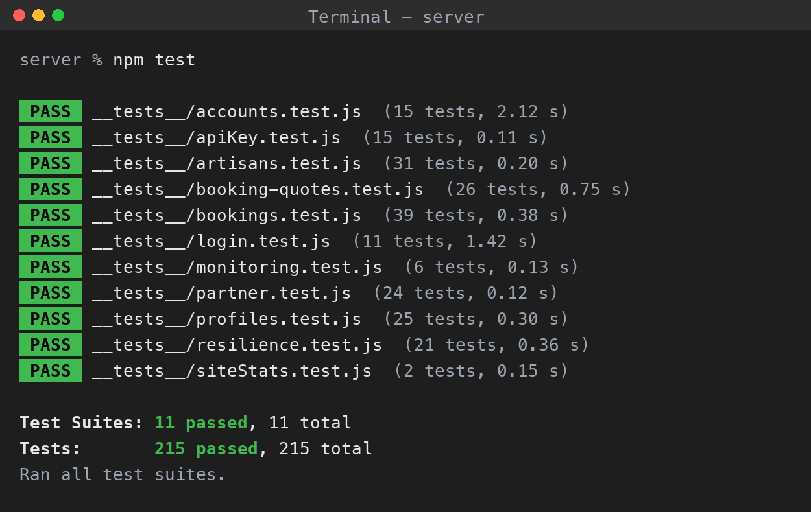
Tests: What They Check
⏱ evidence / Q&A
Weeks 5–7: Build and Test
WHAT THE TESTS CHECK
THE PASSING RUN (npm test)
Happy path: GET /artisans gives 200 in the agreed shape; a new review gives 201
Bad input: a rating outside 1–5, a missing time, or a made-up county gives 400
Not found: an unknown or non-numeric artisan id gives 404, never a crash
Edge cases: overlapping busy times are refused; the verified badge goes when the average drops below 4.3
Security: no key or a wrong key gives 401; over the limit gives 429 with Retry-After; no email or password is displayed in a profile
Resilience: a slow Kanairo times out; a 503 is retried at most twice; then the saved list comes back with stale: true
Run on 6 Nov against our database

Slide 8
Documentation
⏱ evidence / Q&A
Week 8: Document
README QUICKSTART
API REFERENCE
Nothing to install: set API_KEY, then one curl to https://find-my-artisan.onrender.com/artisans/1 returns an artisan.
[TODO: Week 8 blind test. A team outside our ring used only the README, with no help. Expected: their first curl returns 200. Write who tried it, what worked, what failed, what we fixed]
Swagger UI: edgarnguyo.github.io/Find-My-Artisan (every endpoint, Authorize, Try it out)
GET /artisans/1 → 200
{"id": 1, "name": "Wanjiru Kamau", "trade": "electrical", "county": "Nairobi", "verified": true, "busy": [], …}
Notes:
Evidence slide for Q&A. Document (Week 8). Report the blind-test outcome honestly.

Slide 9
Security
⏱ evidence / Q&A
Week 9: Secure
API KEY REQUIRED
RATE LIMIT
SECRETS STAY OUT
curl -i https://find-my-artisan.onrender.com/artisans
HTTP/1.1 401 Unauthorized
{"code": "unauthorized", "message": "Send your API key in the X-API-Key header."}
60 requests a minute per key.
Request 61: 429 Too Many Requests, Retry-After: 57, {"code":"rate_limited"}
Keys live in server/.env and in Render's settings, never in the code.
$ git check-ignore -v server/.env
server/.gitignore:6:.env server/.env
$ git log --all -- server/.env
(no output: never committed)
Logs show key names, never keys.
Notes:
Evidence slide for Q&A. Secure (Week 9). Never show a real key.

Slide 10
Integration and Resilience
⏱ 1:45–2:30
Weeks 10–11: Integrate and Harden
OUR INTEGRATION
WHEN THE PARTNER FAILS
We call: Kanairo-Klean GET /materials, from our server (Bearer token in .env)
Feature: the Materials page lists scrap stock and price per kg; artisans' quotes are priced from it
Timeout: 2000 ms. Retries: 2 (200 ms, then 400 ms), GETs only
Fallback: the last good list, with "Showing saved prices from 12:09:47. Kanairo-Klean is not responding…"
Failure drill: we made the partner fail on purpose and watched what a user sees:
1) Kanairo stopped : saved list and banner in 0.6 s. Back up: live list again, no code change.
→ An outage doesn’t break our page.
2) Fails twice, then works (our stand-in): the retries hide it, live list in 0.6 s.
→ Short blips are invisible to users.
3) Too slow (10 s, our stand-in): gives up after 3 tries, saved list in 6.6 s.
→ Worst case: a 6.6 s wait, never an error.
Notes:
Time 1:45 to 2:30 (live partner call). Integrate and Harden (Weeks 10-11).

Slide 11
Monitoring
⏱ evidence / 2:30
Week 12: Monitor
OUR LOG (no keys in it)
OUR /stats NUMBERS
{"method": "GET", "path": "/artisans", "status": 200, "ms": 26.4, "caller": "key-68284d"}
{"method": "GET", "path": "/artisans", "status": 401, "ms": 0.6, "caller": "none"}
No query string or body is logged. Zero key matches in 343 records.
342 requests, 255 client errors, 1 server error, 0.3% error rate
Slowest read: GET /artisans, 2.7 ms average, 26.4 ms max
Burst: 200 requests → 153 × 429, no server errors
Pattern: the artisan list usually answers in about 3 ms, but the very first request took 26 ms, about 10 times slower.
Reason: the first request also has to open the database connection; later requests reuse it. Measured on a local run.
Notes:
Evidence slide. Monitor (Week 12). One real pattern with figures.

Slide 12
Versioning
⏱ evidence / 2:30
Week 13: Version
v1
v2
PARTNER
Still works
The new shape
Migrated to v2
THE CHANGE WE SHIPPED
OUR MIGRATION
[TODO: what changed in v2, and why it was worth a break]
[Week 13 isn't in the repo yet: no /v2 routes or Deprecation headers]
[Notice sent on ___. Sunset date: ___]
[Proof we moved to our partner’s v2: stale is false, their /stats row]
[What it was like to receive it]
Notes:
Evidence slide. Version (Week 13). Show curl -i on v1 for the Deprecation headers.

Slide 13
What Is Not Finished
⏱ 2:45–3:00
Week 14: honesty is graded
OUR HONEST LIMITS
WHAT WE WOULD DO NEXT
Rate-limit counts and saved prices live in memory, so a Render restart clears them. The first request after a sleep takes about a minute.
Meditrac can only review an artisan once the artisan has logged the job as a Meditrac job. If the artisan forgets, Meditrac's real review is refused.
Hold a refused review as “waiting” and ask the artisan to confirm the Meditrac job, instead of turning the review away.
Keep rate-limit counts and saved prices in a shared store such as Redis, so a restart no longer clears them.
Notes:
Time 2:45 to 3:00. Say one honest sentence about limits, then take questions.

Slide 14
Thank you!
Any Questions?
Notes:
Two minutes of Q&A. If you do not know an answer, say so, and say how you would find out.

