Slide 1


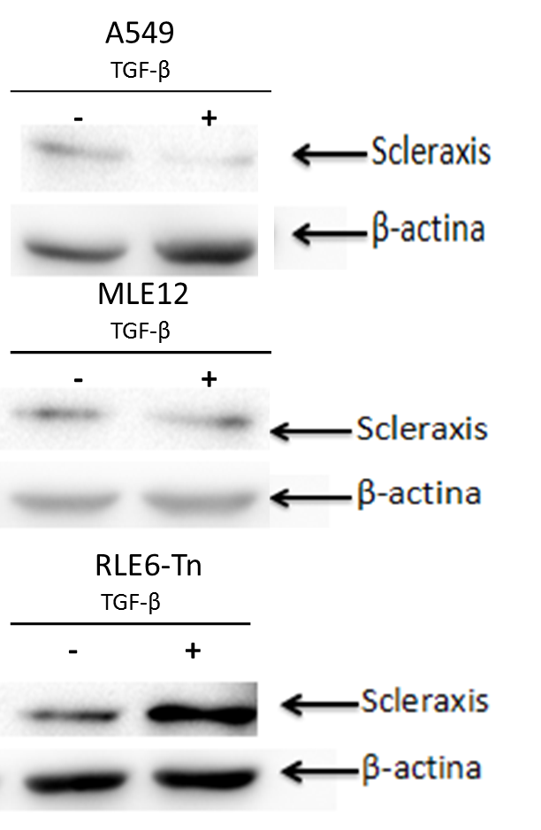
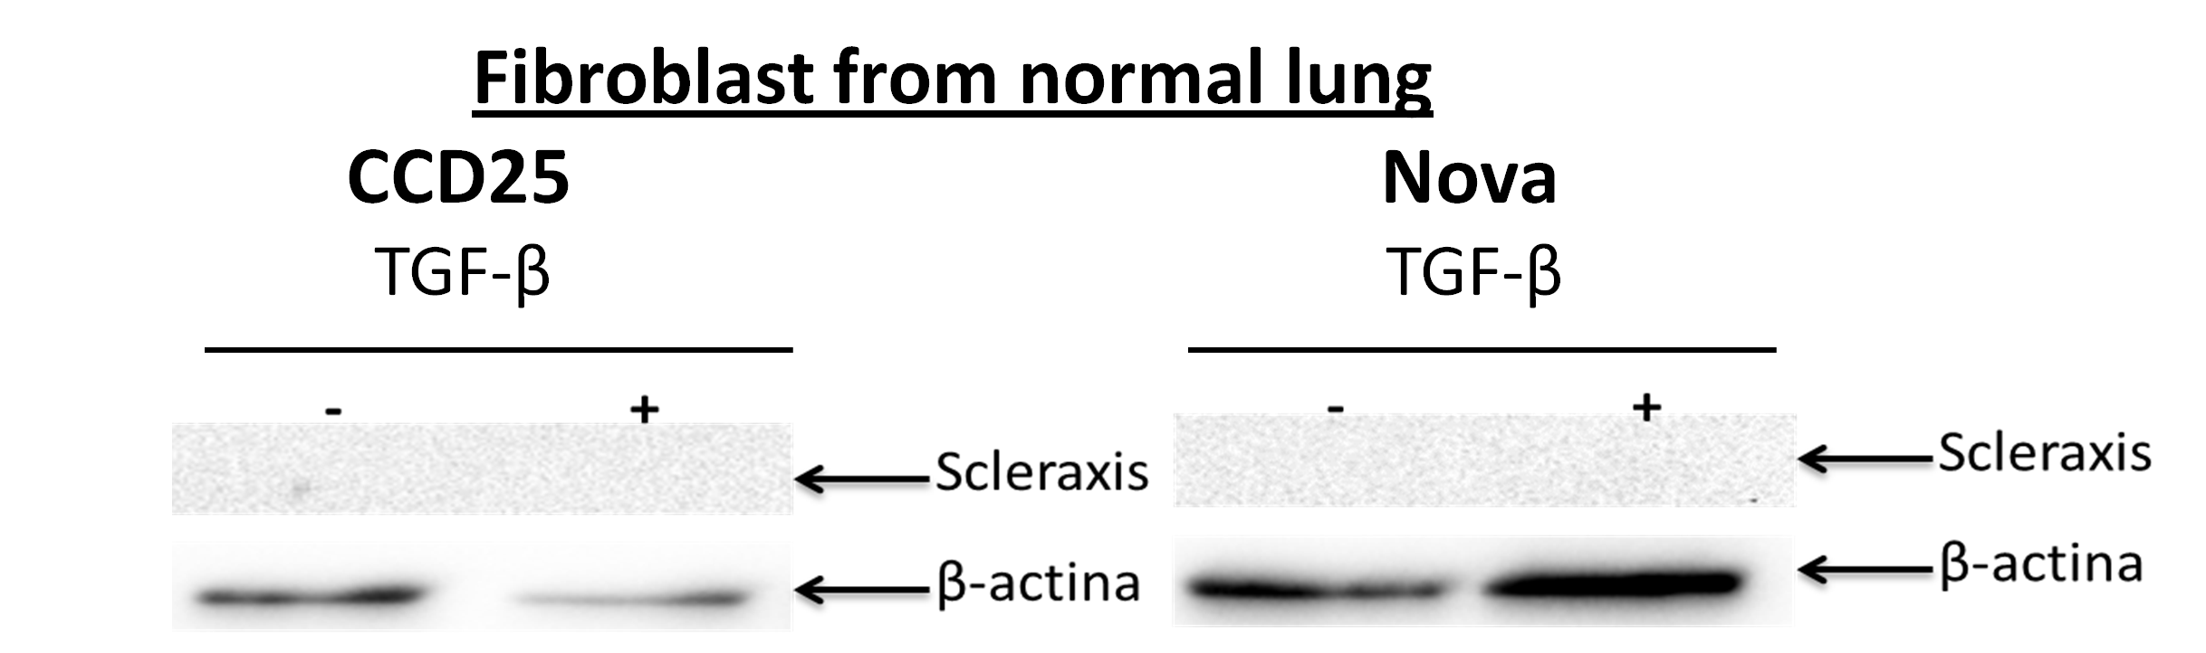
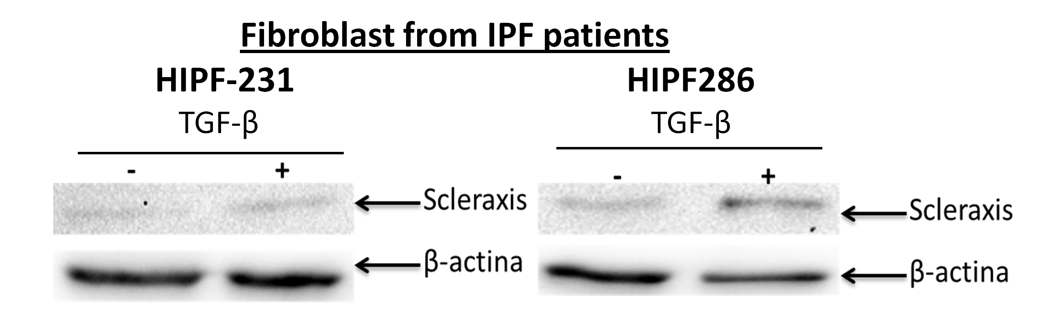
TGF-BETA INDUCES THE EXPRESSION OF SCLERAXIS IN LUNG FIBROBLASTS FROM
IDIOPATHIC PULMONARY FIBROSIS
Miguel Ramirez Aragon^{1,2}, Manuel Alejandro Blancas Oropeza², Fernando Hernandez Sanchez², Alfredo Cruz Lagunas², Michael P. Czubryt³, Criselda Mendoza Milla².
¹Posgrado en Ciencias Biologicas, Universidad Nacional Autonoma de Mexico, Mexico City, Mexico,
²Instituto Nacional de Enfermedades Respiratorias Ismael Cosío Villegas (INER), Mexico City, Mexico,
³Institute of Cardiovascular Sciences, Winnipeg, MB, Canada
Introduction
Idiopathic pulmonary fibrosis (IPF) is a chronic, progressive and lethal lung disease. Its pathogenesis is not totally understood but is characterized by the expansion of the fibroblast population and excessive extracellular matrix accumulation with the subsequent destruction of the lung architecture (1). The latter processes are regulated by TGF-β through the activation of various transcription factors such as SMAD2/3 or bHLH family members (2). Scleraxis (SCX) is a transcription factor of the bHLH family, that it is responsive to TGF-β. It is active during early stages of embryonic development. However, recent evidence demonstrate that SCX participates in fibrotic processes in adults organs such as heart and kidneys. It promoting Collagen I synthesis (3, 4), one of the most abundant matrix proteins in IPF . Nevertheless the role of SCX in IPF is unknown. Therefore, taking into account recent evidence, we hypothesize that SCX participates in the pathogenesis of IPF.
Aim
Determine Scleraxis role in IPF.
Methods
We examined the effect of TGF-beta on scleraxis RNA and protein levels. Normal (NOVA, CCD25) and IPF (HIPF 231, 286) human lung fibroblasts, and human (A549) and murine (MLE12) epithelial cells were used in this study.
Results
TGF-β INDUCES AN INCREASE IN SCX EXPRESSION IN LUNG FIBROBLASTS FROM IPF BUT NOT IN THOSE FROM HEALTHY LUNG
Figure 1. Fibroblasts from normal lung and IPF patients were stimulated 24 hours with TGF-β. RNA was extracted and converted to cDNA by RT-PCR. The cDNA was used to analyze SCX expression by qPCR. The POLR2A gene was used as endogenous control for ΔΔCt analysis.
SCX PROTEIN LEVELS INCREASED IN TGF-β-TREATED LUNG FIBROBLASTS FROM IPF, WHEREAS IT WAS NOT DETECTED
IN HEALTHY LUNG
Figure 2. Fibroblasts from normal lung and IPF patients were stimulated 48 hours with TGF-β. Then proteins were extracted with RIPA buffer. This protein extract was analyzed by immunoblot using an anti-SCX antibody.
TGF-β INDUCES AN INCREASE IN SCX EXPRESSION IN EPITHELIAL CELLS
Figure 3. A549 and MLE12 cells were stimulated 24 hours with TGF-β. SCX expression was measured by qPCR. POLR2A and GAPDH genes were used as endogenous controls for ΔΔCt analysis in A549 cells and MLE12 cells respectively.
SCX PROTEIN WAS NOT INCREASED BY TGF-β IN EPITHELIAL CELLS
Figure 4. Proteins extracted from A549 and MLE12 cells after TGF-β stimulus for 48 hours were used to measure SCX protein levels as in Figure 2.
Conclusions
Scleraxis protein levels are increased by TGF-β in pulmonary fibroblasts with IPF but not in normal fibroblasts and epithelial cells. Thus, it suggests that SCX could have an important role in the fibrotic process. However, more studies are needed.
References
Selman M. et al. PLoS ONE, 2: e482, (2007).
Biernacka A. et al. Growth Factors, 29 (5): 196–202, (2011).
Espira L. et al. J Mol Cell Cardiol, 47:188–95, (2009).
Rushita A. et al. Biochimica et Biophysica Acta (BBA) - Molecular Cell Research, 1823 (10):1936-1944,(2012)
Cell Culture (IPF fibroblasts, normal lung fibroblasts, A549, MLE12)
Control
TGF-β (10ng/µl)
SCX RNA expression and Protein levels
RNA extraction (24 hours)
RT-PCR for convert RNA to cDNA
qPCR for SCX and analysis
Protein extraction (48 hours)
Western Blot for SCX and analysis
Email: mira0989@hotmail.com, criselda.mendoza@gmail.com
This project has been supported by CONACYT scholarship 262580 and CONACYT-SALUD S0008-2015-1261961

