Slide 1
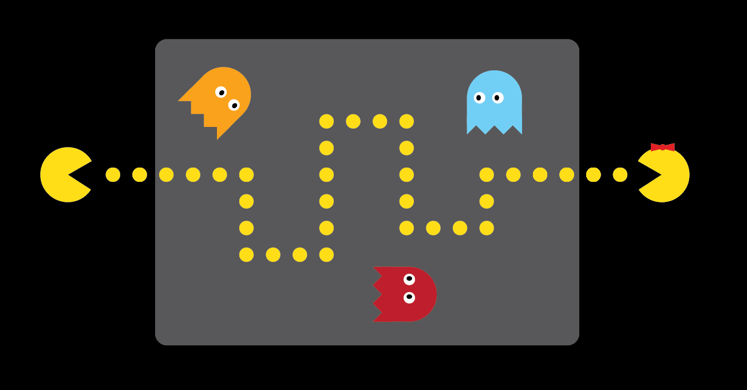
How HTTPS Works
J. David Giese

Slide 2
Hyper Text Transfer Protocol
Request
GET / HTTP/1.1
HOST: edge-effect.github.io
HEADERS
BODY
Browser
HTTP Server
edge-effect.github.io
Response
HTTP/1.1 200 OK
HEADERS
BODY
Fielding, R., Gettys, J., Mogul, J., Frystyk, H., Masinter, L., Leach, P., and T. Berners-Lee, "Hypertext Transfer Protocol -- HTTP/1.1", RFC 2616, June 1999.

Slide 3
Hyper Text Transfer Protocol
Browser
HTTP Server
edge-effect.github.io
HTTPS == HTTP + TLS
Visiting a webpage …
Application Layer | HTTP
Transport Layer | TCP
Internet Layer | IP
Link Layer | Ethernet, etc.
Visiting a webpage …
Application Layer | HTTP
TLS – Transport Layer Security
Transport Layer | TCP
Internet Layer | IP
Link Layer | Ethernet, etc.

Slide 4
Transport Layer Security
Developed by Netscape in early 1990s.
Used to be called secure socket layer (SSL)
Can be used with other application layer protocols
Provides:
Privacy: Can anyone overhear “us”?
Authentication: Do I know who sent the message?
Non-repudiation: Can I prove who the sender was?
Integrity: Was the message tampered with?
Dierks, T. and E. Rescorla, "The Transport Layer Security (TLS) Protocol Version 1.2", RFC 5246, August 2008.

Slide 5
Cryptographic Primitives the building blocks of TLS

Slide 6
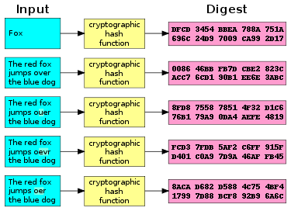
Cryptographic Primitives: Cryptographic Hash Function
A normal hash function with extra requirements:
infeasible to generate a message with a given digest
infeasible to change a message without modifying the digest
find two messages with the same digest

Slide 7
Cryptographic Primitives: Symmetric Cryptography
Also know as “conventional cryptography”
Same key used for encryption and decryption
Simplistic example:
SERVER
CLIENT
KEY
A → Q
E → _
H → M
L → P
O → A
_ → H
…
HELLO ALL
KEY
A → Q
E → _
H → M
L → P
O → A
_ → H
…
HELLO ALL
encrypt
decrypt
send across internet
M PPAHQPP
M PPAHQPP
Problem: How to share the key?

Slide 8
Cryptographic Primitives: Asymmetric Cryptography
Also know as “public key cryptography”
Two keys; Each decrypts what the other encrypts
SERVER
CLIENT
HELLO ALL
Server’s Private KEY
Server’s Public KEY
HELLO ALL
Encrypt
With
Server’s Public Key
Decrypt
With
Server’s Private Key
send across internet
125134223
125134223
Notes:
You can do the same thing going in the other direction…
Its obvious that it is possible to brute force open the message since the private key is known!

Slide 9
Example of Asymmetric Encryption: RSA
Generate special numbers e, d, and n
Represent message as a series of integers between 0 and n – 1
Encrypt each integer, M, using: C = Encrypt(M) = Me mod n
Decrypt each integer using: M = Decrypt(C) = M^{d} mod n
R. Rivest, A. Shamir, and L. M. Adleman, ”A Method for Obtaining Digital Signatures and Public-Key Cryptosystems",
Communications of the ACM, v. 21, n. 2, Feb 1978, pp. 120-126.
Notes:
What is the private key? What is the public key?
Notice that you can go both ways with this.

Slide 10
You can’t just pick any e, d, and n
Let d = 39, e = 11, n = 35
M |  | C = Me mod n
0 |  | 0
1 |  | 1
2 |  | 8
3 |  | 27
4 |  | 29
… |  | …
32 |  | 8
33 |  | 27
34 |  | 34

Slide 11
How to pick d, e, and n
Pick two large primes, p and q
Let n = p*q 100 = 2*2*5*5
Pick d such that: GCD(d, (p – 1)*(q – 1)) = 1
Pick e such that: e*d = 1 mod (p – 1)*(q – 1)
Notes:
What is the private key? What is the public key?
Notice that you can go both ways with this.

Slide 12
Simplistic example of RSA keys
Let d = 157, e = 17, n = 2773
H^{e} mod n |  | H = M^{d} mod n |  | M |  | C = Me mod n |  | C^{d} mod n
0 |  | 0 |  | 0 |  | 0 |  | 0
1 |  | 1 |  | 1 |  | 1 |  | 1
2 |  | 1037 |  | 2 |  | 741 |  | 2
3 |  | 441 |  | 3 |  | 1553 |  | 3
4 |  | 2218 |  | 4 |  | 27 |  | 4
… |  | … |  | … |  | … |  | …
2770 |  | 2332 |  | 2770 |  | 2332 |  | 2770
2771 |  | 1736 |  | 2771 |  | 1736 |  | 2771
2772 |  | 2772 |  | 2772 |  | 2772 |  | 2772

Slide 13
Cryptographic Primitives:
Problem with Asymmetric Cryptography
SERVER
CLIENT
HELLO ALL
Server’s Private KEY
Server’s Public KEY
HELLO ALL
Encrypt
With
Server’s Public Key
Decrypt
With
Server’s Private Key
send across internet
125134223
125134223
Problem: How can the server know who sent the message?
Notes:
You can do the same thing going in the other direction…
Its obvious that it is possible to brute force open the message since the private key is known!

Slide 14
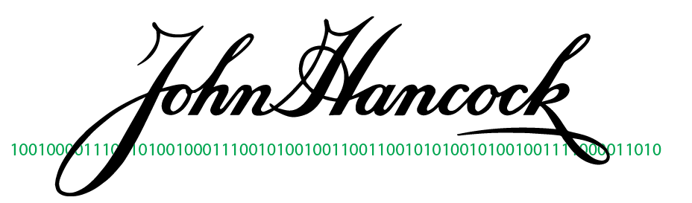
Cryptographic Primitives: Digital Signature
Hash the message
Encrypt hash with your private key
Attach to message
Ensures that you, and only you, could have sent the message (assuming your private key is secure)
Anyone can verify the signature

Slide 15
Review of Cryptographic Primitives
Cryptographic hash function arbitrary length data → fixed length hash
Symmetric (or conventional) cryptography one key is used for encryption and decryption
Asymmetric (or “public key”) cryptography two keys: each key decrypts the what the other encrypts
Digital Signature hash of a message encrypted with a private key

Slide 16
Certificate Authority
A “trusted” third party that associates a public key with an identity.
Public keys of common CAs are distributed with browsers.
Need to register with a CA to setup HTTPS for your website.

Slide 17
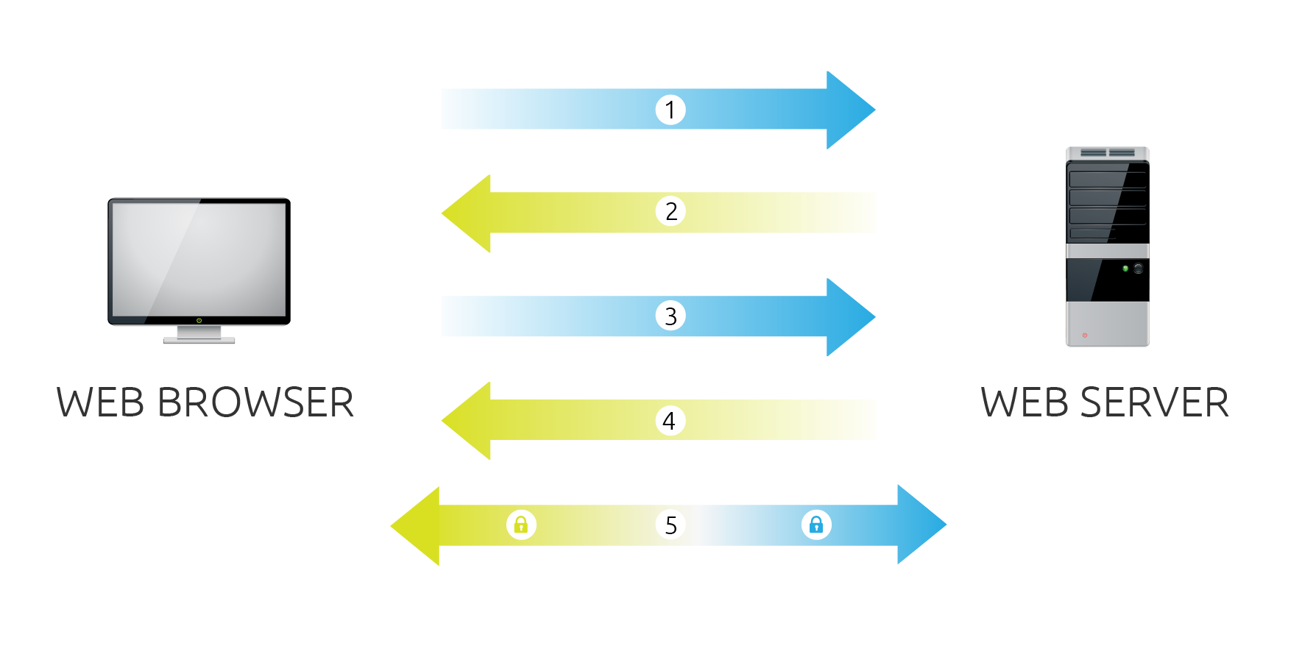
Details about TLS
Certificate
Authority
3’
Dierks, T. and E. Rescorla, "The Transport Layer Security (TLS) Protocol Version 1.2", RFC 5246, August 2008.

Slide 18
Details about TLS
Certificate
Authority
3’
CLIENT: I want to start a connection; here are the cipher suites I support
SERVER: Ok use this cipher suite; here is my certificate (and public key)
CLIENT: You checked out with the CA; here is a “secret” so we can switch to a faster symmetric encryption algorithm
SERVER: Ok, here is a small encrypted token to proove we are on the same page
… Send HTTP Messages …

Slide 19
Perfect Forward Secrecy
Using a key pair over extended periods of time is dangerous.
Use Different Keys for each connection, and use public key only for “authentication”

Slide 20

Thanks!
Discussion Question:
Who is concerned or not concerned about the NSA bulk collecting data?

Slide 21
More Reading
What is the difference between a hash, a MAC, and a digital signature?

Slide 22
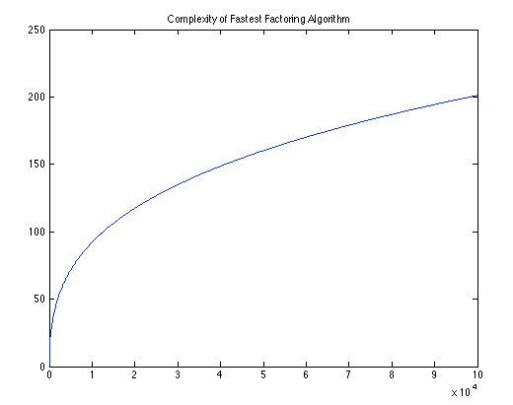
Cryptography Basics: Cryptographic Break
Any weakness that can be exploited faster than brute force.
Notes:
The break may still be infeasible in practice.

