Slide 1
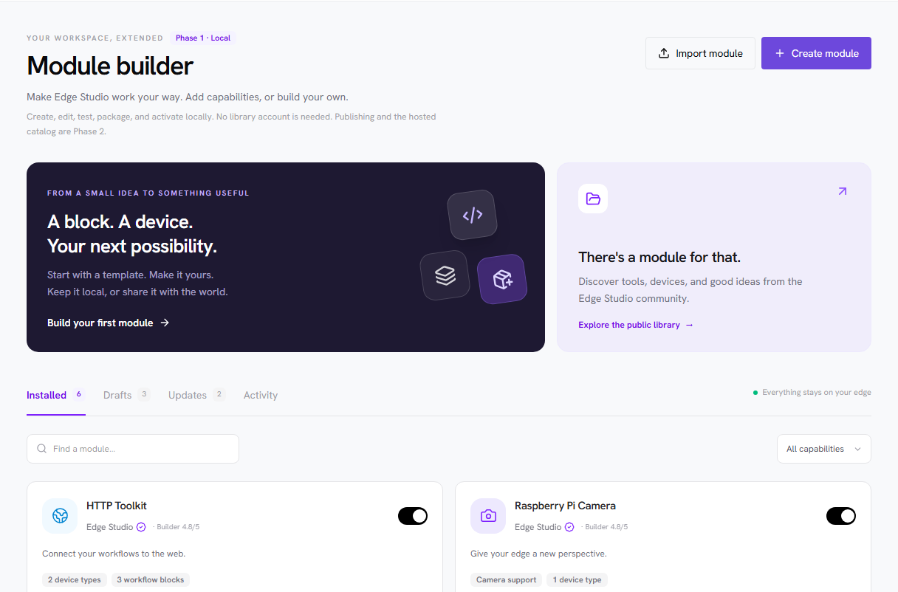
EDGE STUDIO / MODULE BUILDER
01 / 23
Module Builder
From an unsupported sensor to a shareable capability
A local creation journey
A separate hosted ecosystem
Frontend concept screenshots · Implementation not started
User journey, delivery phases, milestones and planning estimates · 28 October 2026
Notes:
Slide 1: Module Builder
Screenshot: screenshots/01-local-workspace.png. Original demo capture; no generated UI artwork.
Stakeholder walkthrough based on the revised workshop decisions. Every UI image is a fresh capture from the frontend demo. The extension runtime, backup/restore, hosted library and commerce are not implemented. Estimates are planning hypotheses, not commitments.

Slide 2
EDGE STUDIO / MODULE BUILDER
02 / 23
One package. Two delivery phases.
The local builder delivers value before the public library exists.
PHASE 1 · LOCAL
PHASE 2 · HOSTED
Create and use
Share and discover
Template → own AI harness → edit → preview/test → validate/package → back up → activate → export/import
Prepare → automated checks → publish → community inspection/reputation → discover → install
No module CLI. No built-in AI generation service. Local use does not require publication.
Notes:
Slide 2: One package. Two delivery phases.
AI generation is expected in the user's own harness, guided by a planned module-builder-skill. Code editing and the module tools are in the app. Automated acceptance checks run BEFORE publication; initial human spam/content moderation occurs AFTER publication. The second card is a conceptual list, not a reversal of that ordering.

Slide 3
EDGE STUDIO / MODULE BUILDER
03 / 23
01 / Start in your local workspace
PHASE 1 · DISCOVER YOUR LOCAL CAPABILITIES
Focus: Installed modules and local drafts
One place to manage
See installed capabilities, drafts, manual updates and recent activity.
Choose your next step
Create from a template or import a module from another instance.
Local first
Creation and local activation need no publisher account or hosted library.
Captured from the demo frontend; explanatory text is editable.
A missing capability can become a local project instead of a core-team feature request.
Notes:
Slide 3: 01 / Start in your local workspace
Screenshot: screenshots/01-local-workspace.png. Original demo capture; no generated UI artwork.
One place to manage: See installed capabilities, drafts, manual updates and recent activity.
Choose your next step: Create from a template or import a module from another instance.
Local first: Creation and local activation need no publisher account or hosted library.

Slide 4
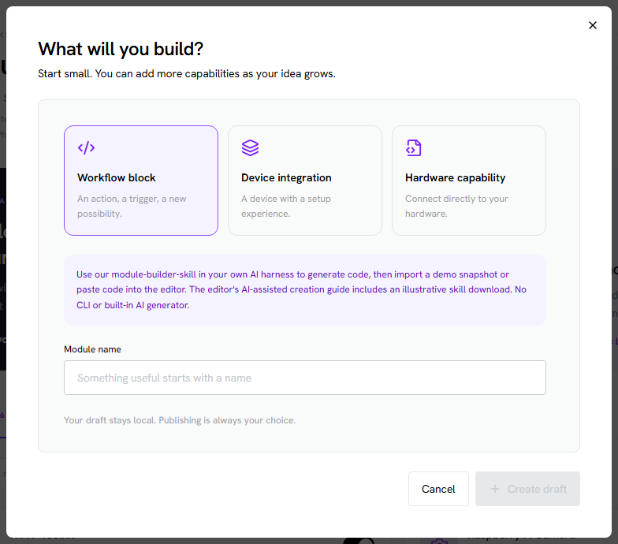
EDGE STUDIO / MODULE BUILDER
04 / 23
02 / Choose what the module contributes
PHASE 1 · CREATE
Focus: A useful starting point
Three contribution surfaces
Start with a workflow block, device integration or hardware capability.
Reduce boilerplate
Templates provide an example manifest, source, configuration schema and documentation.
Keep the contract clear
Modules integrate through defined contracts; arbitrary code is not automatically a device.
Captured from the demo frontend; explanatory text is editable.
Template authors and driver developers can use the same package model.
Notes:
Slide 4: 02 / Choose what the module contributes
Screenshot: screenshots/02-template-selection.png. Original demo capture; no generated UI artwork.
Three contribution surfaces: Start with a workflow block, device integration or hardware capability.
Reduce boilerplate: Templates provide an example manifest, source, configuration schema and documentation.
Keep the contract clear: Modules integrate through defined contracts; arbitrary code is not automatically a device.

Slide 5
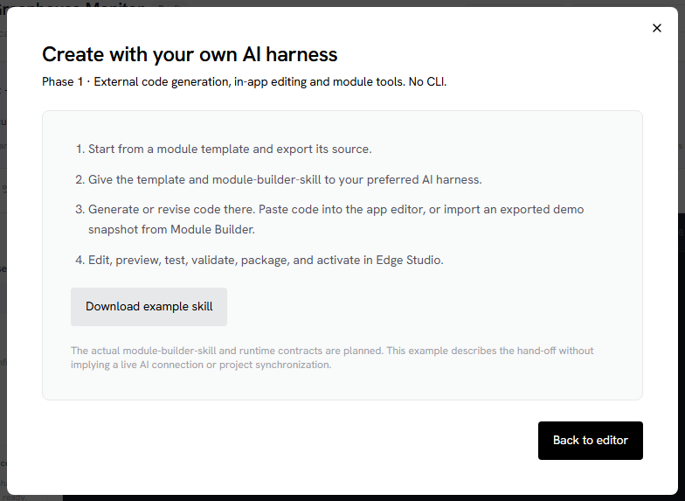
EDGE STUDIO / MODULE BUILDER
05 / 23
03 / Generate in your own AI harness
PHASE 1 · AUTHOR WITH YOUR TOOLS
Focus: The module-builder-skill hand-off
Bring the contract to the AI
Use our planned skill and template in the harness you already work with.
Bring code back to the app
Paste or import generated source, then edit and check it locally.
A deliberate product boundary
We provide the module journey without building an AI coding harness or CLI.
Captured from the demo frontend; explanatory text is editable.
The downloadable skill in this screenshot is illustrative, not a released developer contract.
Notes:
Slide 5: 03 / Generate in your own AI harness
Screenshot: screenshots/03-ai-harness-handoff.png. Original demo capture; no generated UI artwork.
Bring the contract to the AI: Use our planned skill and template in the harness you already work with.
Bring code back to the app: Paste or import generated source, then edit and check it locally.
A deliberate product boundary: We provide the module journey without building an AI coding harness or CLI.

Slide 6
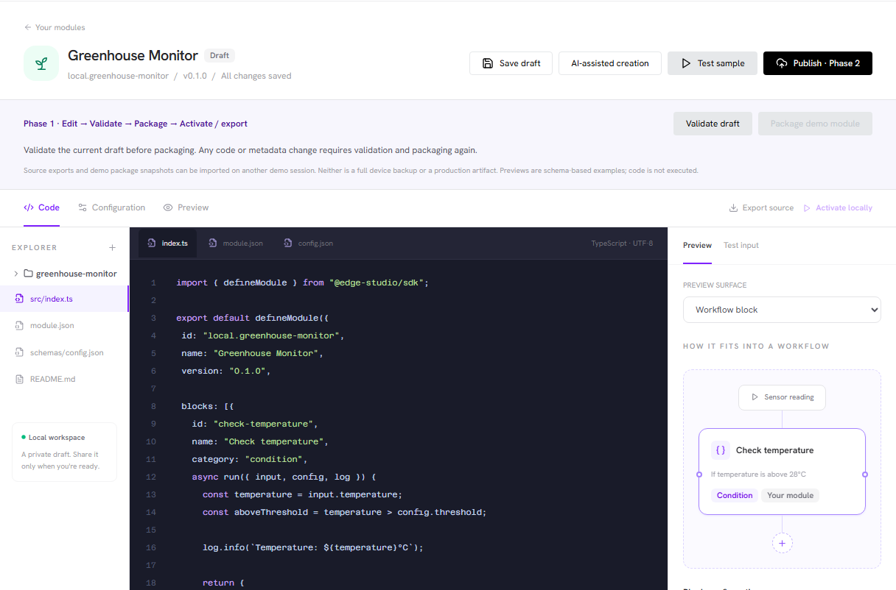
EDGE STUDIO / MODULE BUILDER
06 / 23
04 / Edit code with the outcome in view
PHASE 1 · EDIT
Focus: Source, configuration and preview
Code editing stays in the app
Inspect files and make changes after the external generation step.
Configuration is a schema
Forms, guides and wizard steps use common rendering contracts.
Scope stays focused
Arbitrary custom views and block editors wait for a concrete required example.
Captured from the demo frontend; explanatory text is editable.
The code editor supports module work; it is not a commitment to a full IDE.
Notes:
Slide 6: 04 / Edit code with the outcome in view
Screenshot: screenshots/04-edit-and-preview.png. Original demo capture; no generated UI artwork.
Code editing stays in the app: Inspect files and make changes after the external generation step.
Configuration is a schema: Forms, guides and wizard steps use common rendering contracts.
Scope stays focused: Arbitrary custom views and block editors wait for a concrete required example.

Slide 7
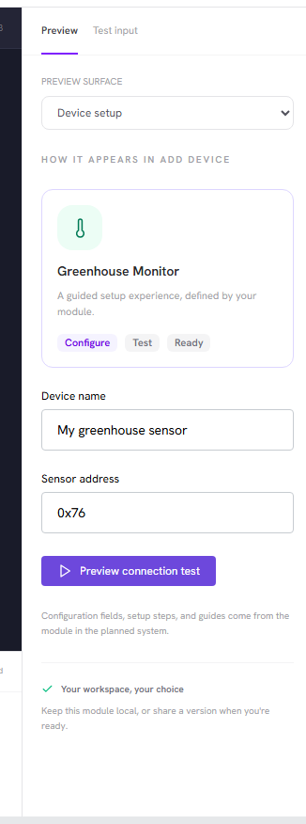
EDGE STUDIO / MODULE BUILDER
07 / 23
05 / Preview device setup
PHASE 1 · PREVIEW THE USER EXPERIENCE
Focus: A schema becomes a setup experience
Preview before activation
See the fields and guidance an operator would encounter when adding a device.
Keep the UI consistent
Modules contribute configuration and instructions to the existing app experience.
Separate preview from execution
A visual preview is not proof that a sensor, driver or host action works.
Captured from the demo frontend; explanatory text is editable.
The demo renders a fixed example; real hardware acceptance belongs in the implementation.
Notes:
Slide 7: 05 / Preview device setup
Screenshot: screenshots/05-device-schema-preview.png. Original demo capture; no generated UI artwork.
Preview before activation: See the fields and guidance an operator would encounter when adding a device.
Keep the UI consistent: Modules contribute configuration and instructions to the existing app experience.
Separate preview from execution: A visual preview is not proof that a sensor, driver or host action works.

Slide 8
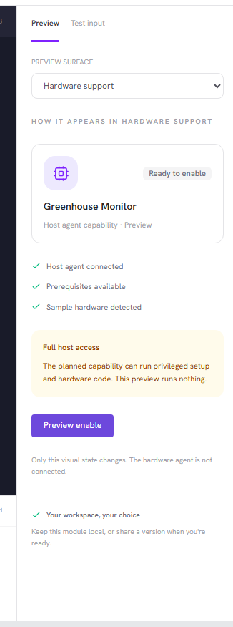
EDGE STUDIO / MODULE BUILDER
08 / 23
06 / Preview a hardware capability
PHASE 1 · DECLARE HOST BEHAVIOR
Focus: Hardware support is a module contribution
Declare lifecycle actions
Hardware packages need setup, enable/disable, status and cleanup behavior.
Full host access is intentional
A privileged extension is trusted host software, not sandboxed code.
Show the operational outcome
Explain prerequisites, failures, reboot needs and what uninstall can leave behind.
Captured from the demo frontend; explanatory text is editable.
Process supervision manages operation; it does not contain malicious root code.
Notes:
Slide 8: 06 / Preview a hardware capability
Screenshot: screenshots/06-hardware-preview.png. Original demo capture; no generated UI artwork.
Declare lifecycle actions: Hardware packages need setup, enable/disable, status and cleanup behavior.
Full host access is intentional: A privileged extension is trusted host software, not sandboxed code.
Show the operational outcome: Explain prerequisites, failures, reboot needs and what uninstall can leave behind.

Slide 9
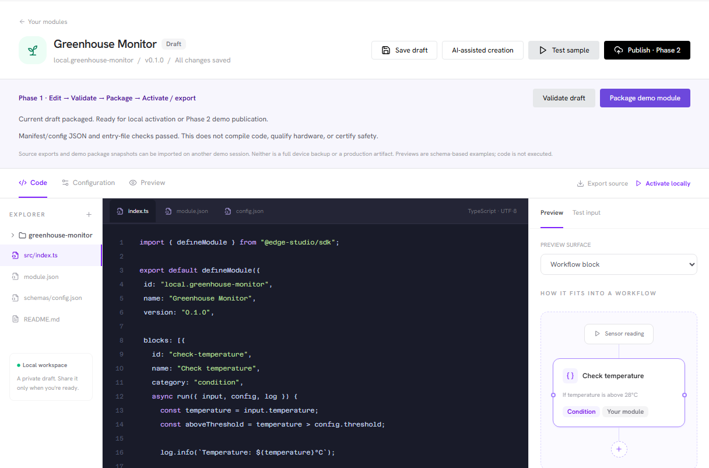
EDGE STUDIO / MODULE BUILDER
09 / 23
07 / Test, validate and package a revision
PHASE 1 · PREPARE A RELEASE
Focus: A visible preparation sequence
Try sample inputs
Preview representative outputs and inspect logs before activation.
Validate package structure
Check metadata, configuration and entry points; deeper implementation checks follow the runtime contract.
Package the exact revision
Code or metadata changes invalidate preparation and require a fresh package.
Captured from the demo frontend; explanatory text is editable.
The demo performs JSON/entry checks and exports a snapshot; it never compiles or executes code.
Notes:
Slide 9: 07 / Test, validate and package a revision
Screenshot: screenshots/07-validated-package.png. Original demo capture; no generated UI artwork.
Try sample inputs: Preview representative outputs and inspect logs before activation.
Validate package structure: Check metadata, configuration and entry points; deeper implementation checks follow the runtime contract.
Package the exact revision: Code or metadata changes invalidate preparation and require a fresh package.

Slide 10
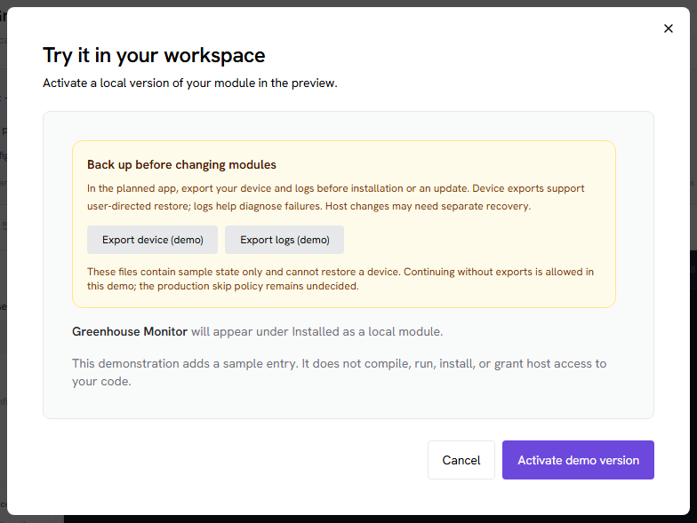
EDGE STUDIO / MODULE BUILDER
10 / 23
08 / Back up before changing the device
PHASE 1 · USER-DIRECTED RECOVERY
Focus: Device export plus diagnostic logs
Prompt before execution
Offer device and log exports before install/update hooks or local activation.
Restore managed state
The planned app-wide device backup must have a tested restore path.
Be precise about coverage
Logs are diagnostic. App backups do not universally undo OS, firmware or hardware changes.
Captured from the demo frontend; explanatory text is editable.
These demo downloads are explicitly non-restorable samples; the production skip policy remains open.
Notes:
Slide 10: 08 / Back up before changing the device
Screenshot: screenshots/08-backup-before-activation.png. Original demo capture; no generated UI artwork.
Prompt before execution: Offer device and log exports before install/update hooks or local activation.
Restore managed state: The planned app-wide device backup must have a tested restore path.
Be precise about coverage: Logs are diagnostic. App backups do not universally undo OS, firmware or hardware changes.

Slide 11

EDGE STUDIO / MODULE BUILDER
11 / 23
09 / Activate locally and retain control
PHASE 1 · USE AND MAINTAIN
Focus: Installed is different from active
Activate explicitly
A library installation first adds an inactive package; the operator chooses when to activate.
Keep lifecycle actions manual
Enable, disable and update through clear user actions.
Preserve useful state
Removal retains device/workflow configuration and history unless deletion is explicitly requested.
Captured from the demo frontend; explanatory text is editable.
The local builder remains usable with no production library connection.
Notes:
Slide 11: 09 / Activate locally and retain control
Screenshot: screenshots/09-local-activation.png. Original demo capture; no generated UI artwork.
Activate explicitly: A library installation first adds an inactive package; the operator chooses when to activate.
Keep lifecycle actions manual: Enable, disable and update through clear user actions.
Preserve useful state: Removal retains device/workflow configuration and history unless deletion is explicitly requested.

Slide 12
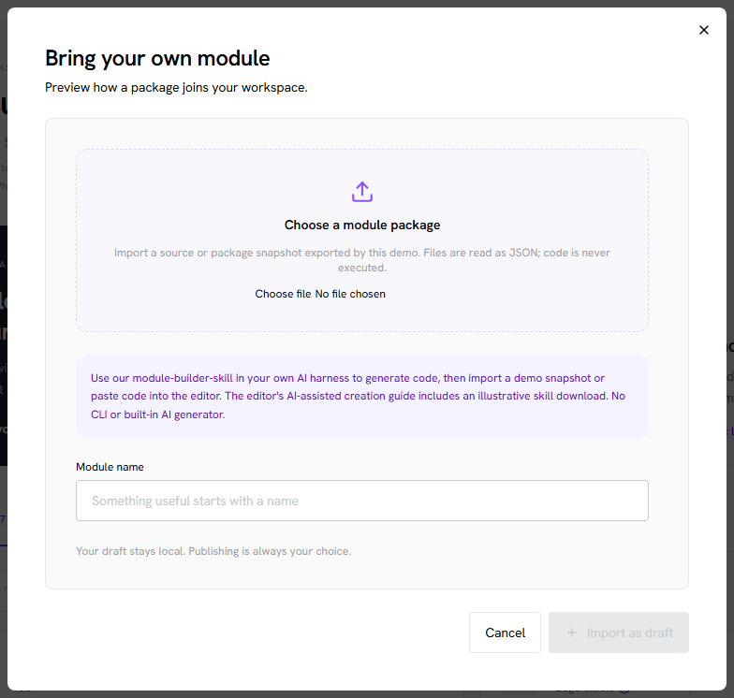
EDGE STUDIO / MODULE BUILDER
12 / 23
10 / Share directly between instances
PHASE 1 · EXPORT / IMPORT
Focus: A package is not a device backup
Export source or a package
Prepare a shareable module without exporting configured credentials or device history.
Import on another instance
Prove author independence without publishing or changing core source.
Keep three artifacts distinct
Source, installable packages and complete device backups serve different purposes.
Captured from the demo frontend; explanatory text is editable.
Demo source/package JSON snapshots round-trip locally; production package formats are still to be defined.
Notes:
Slide 12: 10 / Share directly between instances
Screenshot: screenshots/10-local-import-export.png. Original demo capture; no generated UI artwork.
Export source or a package: Prepare a shareable module without exporting configured credentials or device history.
Import on another instance: Prove author independence without publishing or changing core source.
Keep three artifacts distinct: Source, installable packages and complete device backups serve different purposes.

Slide 13
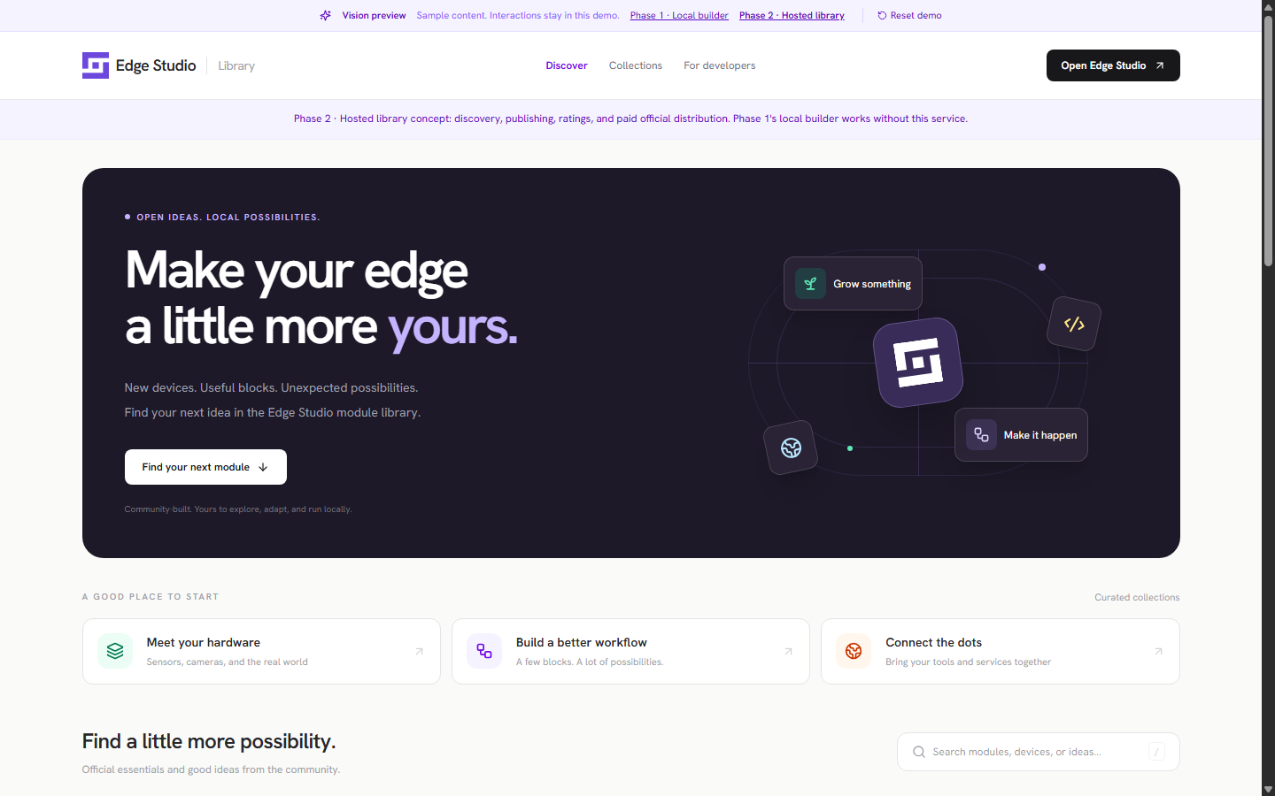
EDGE STUDIO / MODULE BUILDER
13 / 23
11 / Discover a module in the hosted library
PHASE 2 · DISCOVER
Focus: A public ecosystem around local packages
Find capabilities
Search by module and contribution type rather than waiting for a core release.
Understand the publisher
Publisher profiles, module ratings, aggregate builder ratings and downloads provide context.
Retain operator choice
Inspect a release and its requested access before adding it to the device.
Captured from the demo frontend; explanatory text is editable.
Ratings and download counts describe popularity and experience; they do not certify safety.
Notes:
Slide 13: 11 / Discover a module in the hosted library
Screenshot: screenshots/14-library-discovery.png. Original demo capture; no generated UI artwork.
Find capabilities: Search by module and contribution type rather than waiting for a core release.
Understand the publisher: Publisher profiles, module ratings, aggregate builder ratings and downloads provide context.
Retain operator choice: Inspect a release and its requested access before adding it to the device.

Slide 14
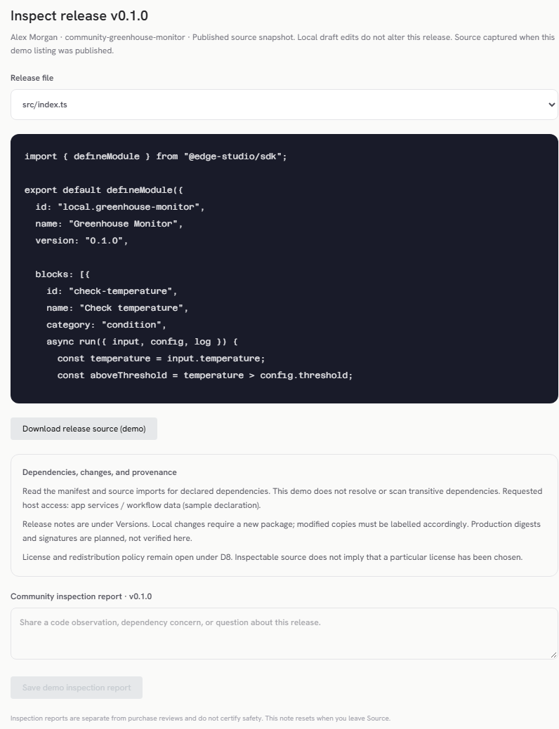
EDGE STUDIO / MODULE BUILDER
14 / 23
12 / Inspect the exact release source
PHASE 2 · INSPECT BEFORE INSTALLING
Focus: Published source and community inspection
Inspect a versioned snapshot
The published release remains unchanged when an author later edits a local draft.
Review dependencies and access
Read the manifest, source and release notes; provenance must match the installed artifact.
Separate the signals
Inspection reports are distinct from ratings and verified-purchase reviews.
Captured from the demo frontend; explanatory text is editable.
Seeded source is illustrative; this newly published example captures the actual demo draft text.
Notes:
Slide 14: 12 / Inspect the exact release source
Screenshot: screenshots/13-release-source.png. Original demo capture; no generated UI artwork.
Inspect a versioned snapshot: The published release remains unchanged when an author later edits a local draft.
Review dependencies and access: Read the manifest, source and release notes; provenance must match the installed artifact.
Separate the signals: Inspection reports are distinct from ratings and verified-purchase reviews.

Slide 15
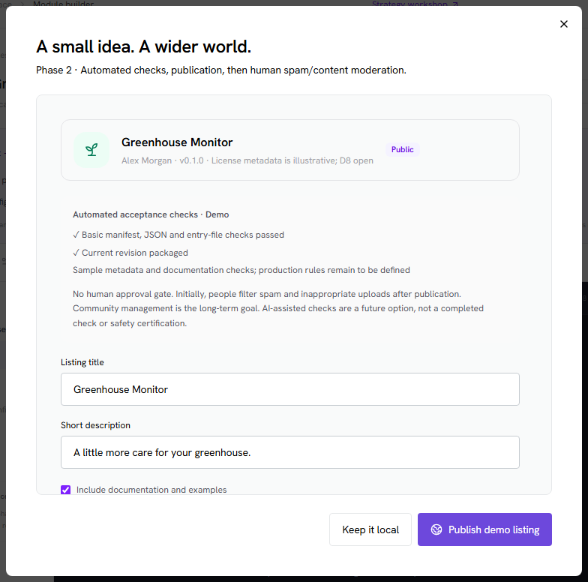
EDGE STUDIO / MODULE BUILDER
15 / 23
13 / Publish after automated acceptance checks
PHASE 2 · PUBLISH
Focus: No human approval gate
Package first
Publication uses a prepared revision plus metadata and documentation.
Run acceptance checks
Automated checks precede publication; exact production rules still need definition.
Acknowledge the contents
The author confirms their right to share; this is not a manual reviewer approval.
Captured from the demo frontend; explanatory text is editable.
AI-assisted checks are an option to evaluate, not an implemented safety guarantee.
Notes:
Slide 15: 13 / Publish after automated acceptance checks
Screenshot: screenshots/11-publishing-checks.png. Original demo capture; no generated UI artwork.
Package first: Publication uses a prepared revision plus metadata and documentation.
Run acceptance checks: Automated checks precede publication; exact production rules still need definition.
Acknowledge the contents: The author confirms their right to share; this is not a manual reviewer approval.

Slide 16
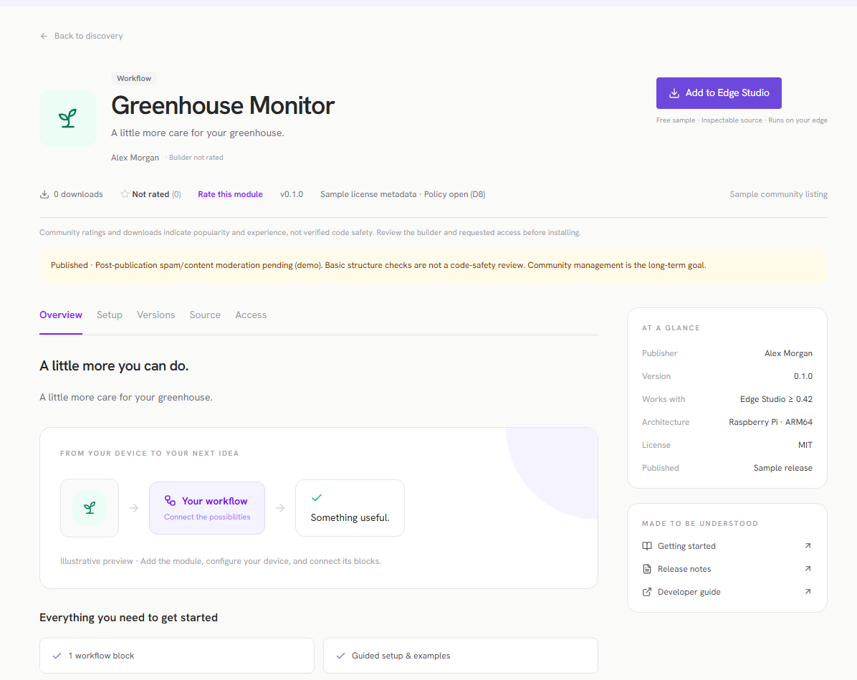
EDGE STUDIO / MODULE BUILDER
16 / 23
14 / Community feedback after publication
PHASE 2 · MODERATE AND LEARN
Focus: Immediate listing, later content moderation
Initial rollout
Human moderation after publication filters spam and inappropriate uploads.
Long-term operating model
Community-managed inspection, reports and moderation supported by automation.
Separate service ownership
The web library is maintained separately from community module creation.
Captured from the demo frontend; explanatory text is editable.
Named moderation owners, removal rules and transition criteria still need agreement.
Notes:
Slide 16: 14 / Community feedback after publication
Screenshot: screenshots/12-community-listing.png. Original demo capture; no generated UI artwork.
Initial rollout: Human moderation after publication filters spam and inappropriate uploads.
Long-term operating model: Community-managed inspection, reports and moderation supported by automation.
Separate service ownership: The web library is maintained separately from community module creation.

Slide 17
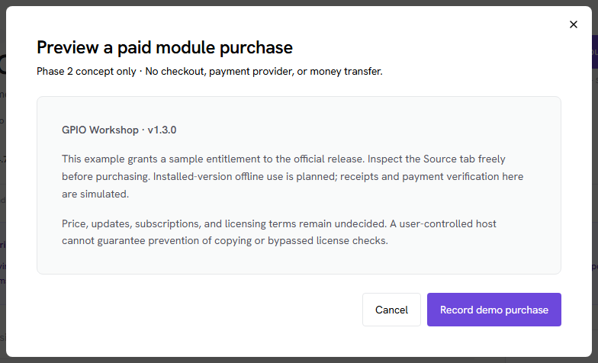
EDGE STUDIO / MODULE BUILDER
17 / 23
15 / Paid official distribution, inspectable source
PHASE 2 · COMMERCIAL OPTION
Focus: Entitlements without strong copy protection
Inspect before purchasing
Source remains inspectable; publisher identity and release provenance matter.
Use installed versions offline
The direction supports local entitlements without continuous license-server access.
Commerce is part of Phase 2
Paid distribution is required. Pricing, provider, subscription and redistribution/fork policies still need definition.
Captured from the demo frontend; explanatory text is editable.
This is a simulated purchase. No money, checkout service or verified receipt is involved.
Notes:
Slide 17: 15 / Paid official distribution, inspectable source
Screenshot: screenshots/15-paid-module-concept.png. Original demo capture; no generated UI artwork.
Inspect before purchasing: Source remains inspectable; publisher identity and release provenance matter.
Use installed versions offline: The direction supports local entitlements without continuous license-server access.
Commerce is part of Phase 2: Paid distribution is required. Pricing, provider, subscription and redistribution/fork policies still need definition.

Slide 18
EDGE STUDIO / MODULE BUILDER
18 / 23
Delivery: local value first, hosted services second
The phase boundary is agreed. The public service is not a prerequisite for local use.
PHASE 1
PHASE 2
M1 → M2 → M3
M4
Lifecycle proof
Default-capability parity
Independent local authoring proof
Hosted catalog and publishing
Source inspection and reputation
Moderation and required commerce
The Phase 1 demo library is a lifecycle-test fixture, not the production publishing service.
Notes:
Slide 18: Delivery: local value first, hosted services second
App-wide device/log export and tested restore are an enabling dependency for D7. M3 may begin once M1 contracts are usable and run alongside migration, but calendar estimates below conservatively avoid assuming free parallel capacity.

Slide 19
EDGE STUDIO / MODULE BUILDER
19 / 23
How to read the development estimates
Bottom-up planning ranges based on scope; low confidence until the first lifecycle slice works.
CAPACITY
MEASUREMENT
Two full-time engineers
Effort, then elapsed time
One backend/runtime/hardware focus; one frontend/tools focus. Part-time QA/hardware and infrastructure support available.
One engineer-week is five focused workdays. Raw elapsed weeks = effort ÷ 2. Scheduling envelopes add about 20% for interruptions/integration.
INCLUDED
EXCLUDED
Delivery, not just code
Separate budgets and scope
Engineering review, automated tests, docs, integration and representative Pi acceptance are included in effort. The current frontend demo is reused.
No fully featured IDE, in-app AI harness, module CLI, arbitrary custom UI, universal hardware qualification or managed automatic rollback. Ongoing library operations are separate.
No start date, staffing commitment or budget is implied. Re-estimate after M1.
Notes:
Slide 19: How to read the development estimates
These are original engineering judgments, not the workshop's ordinal resource scores or industry benchmarks. Two engineers are an explicit assumption pending stakeholder confirmation. QA/infrastructure availability is assumed, not counted as a zero-cost service; their separate staffing/cost is not estimated here. AI usage is not assigned an unsupported productivity multiplier.

Slide 20
EDGE STUDIO / MODULE BUILDER
20 / 23
Phase 1 estimates: prove local extensibility
Engineering effort includes testing and integration; elapsed ranges assume two dedicated engineers.
Milestone / enabling work
Engineer-weeks
Raw elapsed
Acceptance evidence
App-wide backup/restore prerequisite
6–10
3–5 weeks
Export managed state + logs; restore on a test device.
M1 · Contracts + lifecycle slice
8–12
4–6 weeks
HTTP/Fetch removal, real demo download, activation and restart.
M2 · Default capability parity
16–24
8–12 weeks
Hardware/devices/blocks extracted; Pi parity and missing states.
M3 · Local authoring proof
10–16
5–8 weeks
New sensor/block from another author; package and install elsewhere.
Phase 1 total: 40–62 engineer-weeks · 20–31 raw weeks · about 24–38 scheduled weeks.
Notes:
Slide 20: Phase 1 estimates: prove local extensibility
M1 covers capability inventory, contracts, local storage/installer/supervisor foundation and one vertical slice. M2 covers hardware supervisor migration, device registries, workflow dispatch, legacy-ID/state migration and parity/failure tests. M3 covers editing, templates, skill guidance, schema previews, test/log tooling, packaging/import/export and independent-author acceptance. Backup/restore is app-wide work, not a module-specific replacement. If delivered by another team, subtract its 6–10 engineer-weeks from this team's Phase 1 effort but retain the integration dependency. No overlap is subtracted from this total.

Slide 21
EDGE STUDIO / MODULE BUILDER
21 / 23
Phase 2 estimates: library and commerce
All three M4 work packages are included in the Phase 2 baseline.
M4 work package
Engineer-weeks
Raw elapsed
Acceptance evidence
M4a · Hosting + self-service publishing
10–16
5–8 weeks
Accounts, immutable artifacts, checks, listings and app delivery.
M4b · Reputation + community tools
6–10
3–5 weeks
Ratings, builder aggregates, counters, inspection and report flows.
M4c · Required commerce
8–14
4–7 weeks
Checkout, contributor payouts, refunds and offline entitlement.
M4 total · Includes commerce
24–40
12–20 weeks
Publish, inspect, buy, install and continue installed-version use offline.
Phase 2 total: 24–40 engineer-weeks · 12–20 raw weeks · about 15–24 scheduled weeks.
Notes:
Slide 21: Phase 2 estimates: library and commerce
M4a includes production-service setup, backups/monitoring and app-library integration, but not continuous operation after launch. M4b includes implementing post-publication moderation/reporting tools, not indefinite reviewer staffing. M4c commerce is REQUIRED in Phase 2. Its estimate assumes one established payment provider, a simple purchase model and agreed policies. Subscriptions, strict copy enforcement, multi-provider payments, hosted builds and automated AI review pipelines are not included. Legal/accounting policy, payment-provider approval and commercial terms are unestimated dependencies, not hidden zero-cost work.

Slide 22
EDGE STUDIO / MODULE BUILDER
22 / 23
A planning envelope, not a promised launch date
Conservative sequential arithmetic; no unsupported overlap or AI productivity discount.
PHASE 1 · LOCAL BUILDER
PHASE 2 · LIBRARY + COMMERCE
40–62 engineer-weeks
24–40 engineer-weeks
Includes device export/restore prerequisite. Two engineers: about 24–38 scheduled weeks.
Includes checkout, contributor payouts and offline entitlements. Two engineers: about 15–24 scheduled weeks.
Both phases: 64–102 engineer-weeks · 32–51 raw weeks · about 39–62 scheduled weeks.
Notes:
Slide 22: A planning envelope, not a promised launch date
Totals include the app-wide backup/restore prerequisite. Ranges are sums of milestone ranges, not calibrated statistical confidence intervals. They are not fixed commitments or monetary quotes. Reuse of existing backup work or scope reductions can reduce effort; unknown hardware/migration requirements can increase it. Sustainable operating staffing is separate from development effort.

Slide 23
EDGE STUDIO / MODULE BUILDER
23 / 23
Validate the first slice before committing the full build
The next estimate should be grounded in implementation evidence, not a closer radar polygon.
PROVE
RESOLVE
DECIDE
M1 acceptance
Cross-app dependencies
Phase 2 implementation policies
Remove → download → install inactive → activate → restart. Preserve existing configuration/history and expose missing-module states.
App-wide support policy, export/restore coverage and recovery route, module/runtime contracts and named owners.
Commerce is required. Define provider/purchase terms, redistribution policy, publication checks and moderation ownership.
Proposed checkpoint: review M1 evidence, re-estimate M2–M4, then confirm the next funding/staffing step.
Notes:
Slide 23: Validate the first slice before committing the full build
No funding, staffing or delivery-date commitment is implied by this deck. D1–D7 directions have qualifications; D8, detailed purchase/provider terms, checks/ownership and the backup skip policy remain open. Commerce is required within Phase 2. The source plan and workshop revision are the current references, not the older stakeholder deck.

