Slide 1
SQL Alchemy :
Databases and Objects Relational Mapping (ORM)
Hervé LEBAIL (FDM2-E)
PyCoD monthly online meeting, 06/2025
C1
Export Control – AL: 0E001 / ECCN: N/A

Slide 2
x
x
0E001

Slide 3
Why ? The Context

Slide 4
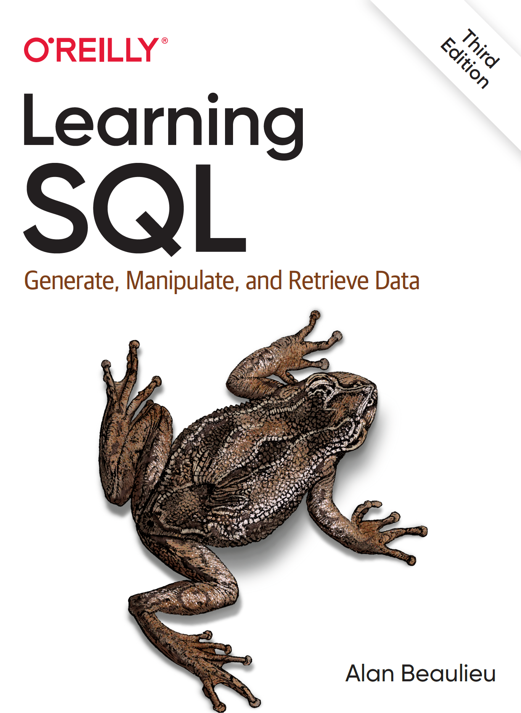
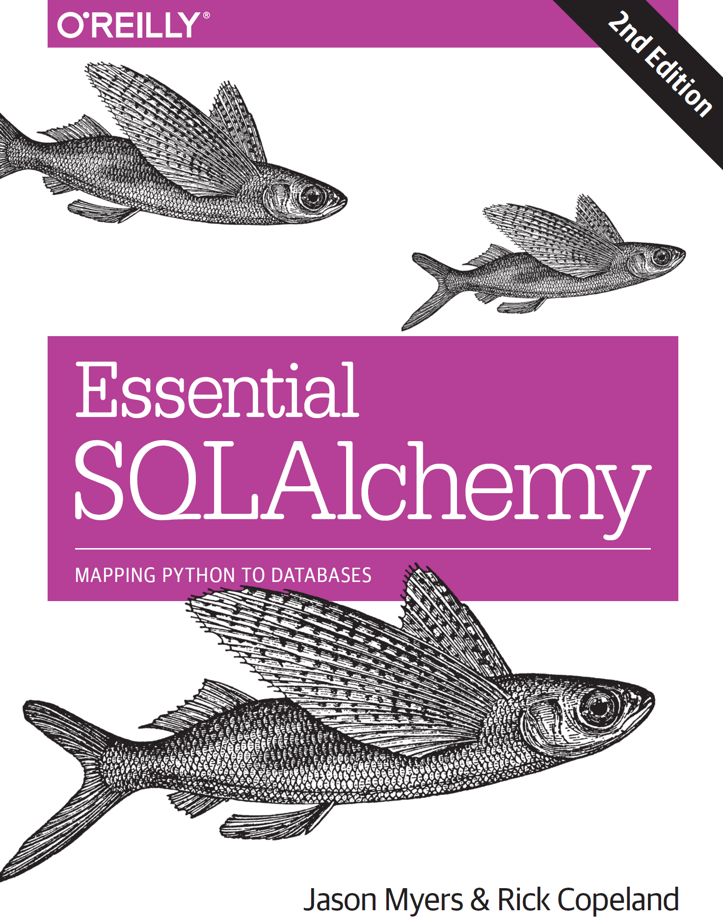
Resources
online description SQL Alchemy :
  https://www.sqlalchemy.org/
  could be steep
  learn a bit of SQL first
  ORM quickstart
Additional material for this presentation :
  see Gitlab repo
  examples
  see MarkDown explanations
A gateway to understanding how relational databases work — from table structure to SQL queries — before layering on the abstraction of an ORM."QL
How to turn raw SQL power into clean, Pythonic code — bridging your Python objects with relational data.

Slide 5
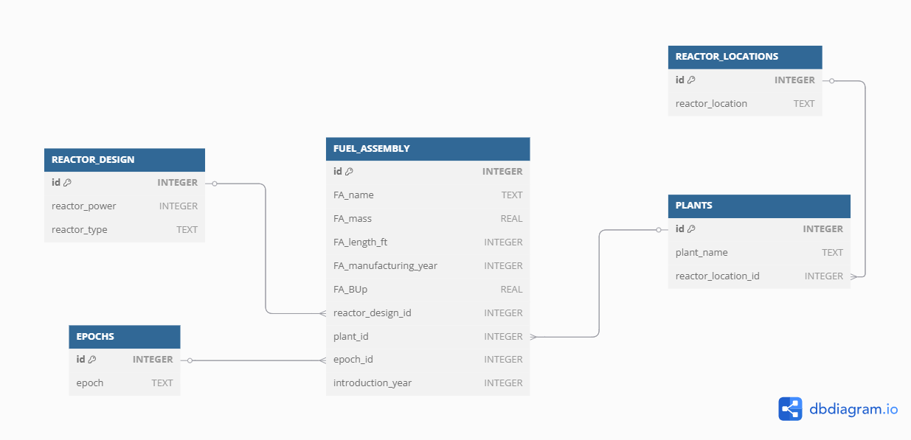
Our running example : FA database
Throughout this presentation, a fuel database will be our guiding thread — a concrete example to illustrate how we move from relational tables to ORM-mapped Python classes.
A relational scheme can be drawn from our domain work framework.
Here, Expert Knowledge is key to build this schematic (this is the What to model part)
The computer scientist assist in this process (this is the How to realize the model part)

Slide 6
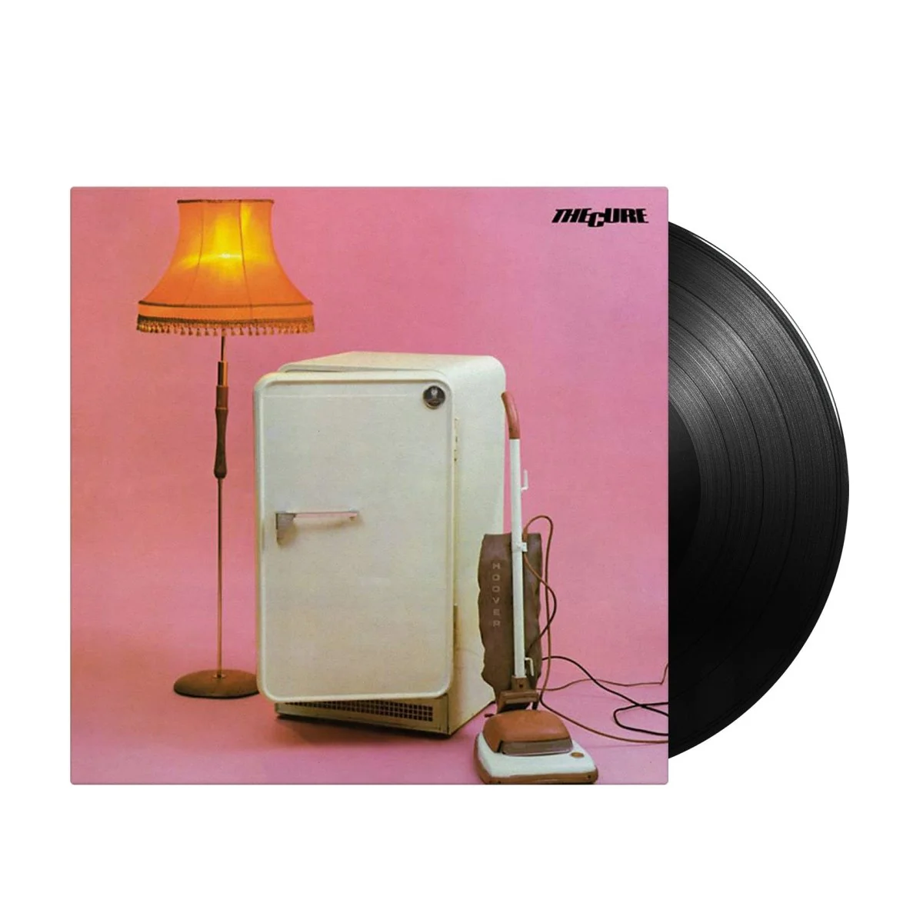

The Goodie
‘Object’ (1979) by The Cure reflects a world where people are treated as isolated, inert things — no depth, no connection. Much like database records without foreign keys: they exist but lack meaningful relationships.
SQL, in the early to late 70s, was the first attempt to structure these "objects" — basic tables, some links.
SQLAlchemy ORM can be seen as a cover version on steroids of such previous approach : it amplifies objects and relationships, adds introspection, and brings narrative to your data.
the original : https://www.youtube.com/watch?v=ftgL5gFTalc
a cover (with lyrics) : https://www.youtube.com/watch?v=HZAaIhIZaRw
"Object" can be interpreted as a critique of objectification and superficiality, particularly in the context of relationships and society. Here’s a breakdown of key ideas: Dehumanization: The title itself, Object, suggests people are being reduced to things—used, categorized, or discarded. This could be a commentary on how individuals are treated in modern life or in shallow relationships. Alienation: The cold, detached delivery typical of early Cure songs may reflect a sense of emotional distance or estrangement. The speaker seems to observe or describe rather than feel connected Identity and Roleplay: There's a recurring theme in The Cure’s early work about people wearing masks, playing roles, or losing themselves. "Object" contributes to that atmosphere of uncertainty about genuine selfhood. Early Cynicism: This track predates the deeply emotional and romantic works The Cure became known for later.
Special kudos to Michael DEMPSEY for the bass twist.

Slide 7
Why ? The Context

Slide 8
How ? SQL history, database schemes

Slide 9
A nuclear example

Slide 10
Multiple approaches : core

Slide 11
Multiple approaches : ORM

Slide 12
Take Away

