Slide 1
Computer Vision with Embedded Machine Learning
Convolutional Neural Network

Slide 2
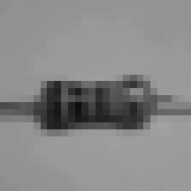
Input (2D array)
Popular input formats:
- Float [0.0..1.0]
- Uint8 [0..255]
- Int8 [-128..127]
2D Convolution
2D Max Pooling
Feature extraction
2D Convolution
2D Max Pooling
Flatten to Vector
Classifier (DNN)
Softmax
P(class1)
P(class2)
P(class3)

Slide 3
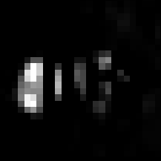
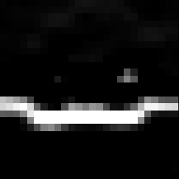


Number of filters: 4
Kernel: 3x3
Stride: 1
Padding: Same
2D Convolution
Conv.
Conv.
Conv.
Conv.
b₀
+
b₁
+
b₂
+
b₃
+

Slide 4
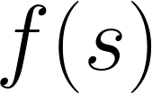











Number of filters: 4
Kernel: 3x3
Stride: 1
Padding: Same
2D Convolution
Conv.
Conv.
Conv.
Conv.
Sigmoid function
ReLU function
b₀
+
b₁
+
b₂
+
b₃
+
1
0
0
ReLU
ReLU
ReLU
ReLU
-128
127
ReLU
“neuron” or “node”
-128
127

Slide 5




28x28
2D Convolution
Shape: 2x2
Stride: 2
2D Max Pooling
28x28x4
Pool
Pool
Pool
Pool
14x14x4

Slide 6

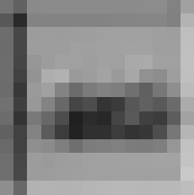


14x14x4
2D Convolution
Conv.
Conv.
2D Max Pooling
Number of filters: 2
Kernel: 3x3
Stride: 1
Padding: Same
b₀
+
b₁
+
2D Convolution
b₀
ReLU
ReLU
+
Kernel: 3x3x4
14x14x2

Slide 7


14x14x2
2D Convolution
Pool
Pool
2D Max Pooling
2D Convolution
Shape: 2x2
Stride: 2
7x7x2
2D Max Pooling

Slide 8

2D Convolution
2D Max Pooling
2D Convolution
2D Max Pooling
Flatten to Vector
7x7x2

Slide 9

2D Convolution
2D Max Pooling
2D Convolution
2D Max Pooling
Flatten to Vector
7x7x2

Slide 10

2D Convolution
2D Max Pooling
2D Convolution
2D Max Pooling
Flatten to Vector
7x7x2

Slide 11

2D Convolution
2D Max Pooling
2D Convolution
2D Max Pooling
Flatten to Vector
7x7x2
· · ·

Slide 12

2D Convolution
2D Max Pooling
2D Convolution
2D Max Pooling
Flatten to Vector
7x7x2
· · ·

Slide 13

2D Convolution
2D Max Pooling
2D Convolution
2D Max Pooling
Flatten to Vector
7x7x2
1x98
· · ·
· · ·

Slide 14
2D Convolution
2D Max Pooling
2D Convolution
2D Max Pooling
Flatten original image: 28x28 = 784
Flatten to Vector
1x98
· · ·
· · ·

Slide 15
Input (2D array)
28x28
2D Convolution
2D Max Pooling
Feature extraction
2D Convolution
2D Max Pooling
Flatten to Vector
1x98
Classifier (DNN)
Softmax
P(class1)
P(class2)
P(class3)

