Slide 1
Computer Vision with Embedded Machine Learning
Image Convolution and Filtering

Slide 2

Kernel
Image
0 | -1 | 0
-1 | 5 | -1
0 | -1 | 0
57 | 59 | 58 | 67 | 82
63 | 66 | 75 | 100 | 124
61 | 69 | 89 | 121 | 150
71 | 96 | 126 | 145 | 157
(57 ⋅ 0) + (59 ⋅ -1) + (58 ⋅ 0) +
(63 ⋅ -1) + (66 ⋅ 5) + (75 ⋅ -1) +
(61 ⋅ 0) + (69 ⋅ -1) + (89 ⋅ 0) = 64
Output
64

Slide 3
Kernel
Image
0 | -1 | 0
-1 | 5 | -1
0 | -1 | 0
57 | 59 | 58 | 67 | 82
63 | 66 | 75 | 100 | 124
61 | 69 | 89 | 121 | 150
71 | 96 | 126 | 145 | 157
(59 ⋅ 0) + (58 ⋅ -1) + (67 ⋅ 0) +
(66 ⋅ -1) + (75 ⋅ 5) + (100 ⋅ -1) +
(69 ⋅ 0) + (89 ⋅ -1) + (121 ⋅ 0) = 62
Output
64 | 62

Slide 4
Kernel
Image
0 | -1 | 0
-1 | 5 | -1
0 | -1 | 0
57 | 59 | 58 | 67 | 82
63 | 66 | 75 | 100 | 124
61 | 69 | 89 | 121 | 150
71 | 96 | 126 | 145 | 157
(58 ⋅ 0) + (67 ⋅ -1) + (82 ⋅ 0) +
(75 ⋅ -1) + (100 ⋅ 5) + (124 ⋅ -1) +
(89 ⋅ 0) + (121 ⋅ -1) + (150 ⋅ 0) = 113
Output
64 | 62 | 113

Slide 5
Kernel
Image
0 | -1 | 0
-1 | 5 | -1
0 | -1 | 0
57 | 59 | 58 | 67 | 82
63 | 66 | 75 | 100 | 124
61 | 69 | 89 | 121 | 150
71 | 96 | 126 | 145 | 157
(63 ⋅ 0) + (66 ⋅ -1) + (75 ⋅ 0) +
(61 ⋅ -1) + (69 ⋅ 5) + (89 ⋅ -1) +
(71 ⋅ 0) + (96 ⋅ -1) + (126 ⋅ 0) = 33
Output
64 | 62 | 113
33

Slide 6
Kernel
Image
0 | -1 | 0
-1 | 5 | -1
0 | -1 | 0
57 | 59 | 58 | 67 | 82
63 | 66 | 75 | 100 | 124
61 | 69 | 89 | 121 | 150
71 | 96 | 126 | 145 | 157
(66 ⋅ 0) + (75 ⋅ -1) + (100 ⋅ 0) +
(69 ⋅ -1) + (89 ⋅ 5) + (121 ⋅ -1) +
(96 ⋅ 0) + (126 ⋅ -1) + (145 ⋅ 0) = 54
Output
64 | 62 | 113
33 | 54

Slide 7
Kernel
Image
0 | -1 | 0
-1 | 5 | -1
0 | -1 | 0
57 | 59 | 58 | 67 | 82
63 | 66 | 75 | 100 | 124
61 | 69 | 89 | 121 | 150
71 | 96 | 126 | 145 | 157
(75 ⋅ 0) + (100 ⋅ -1) + (124 ⋅ 0) +
(89 ⋅ -1) + (121 ⋅ 5) + (150 ⋅ -1) +
(126 ⋅ 0) + (145 ⋅ -1) + (157 ⋅ 0) = 121
Output
64 | 62 | 113
33 | 54 | 121
stride = 1

Slide 8
Kernel
Image
0 | -1 | 0
-1 | 5 | -1
0 | -1 | 0
57 | 59 | 58 | 67 | 82
63 | 66 | 75 | 100 | 124
61 | 69 | 89 | 121 | 150
71 | 96 | 126 | 145 | 157
(57 ⋅ 0) + (59 ⋅ -1) + (58 ⋅ 0) +
(63 ⋅ -1) + (66 ⋅ 5) + (75 ⋅ -1) +
(61 ⋅ 0) + (69 ⋅ -1) + (89 ⋅ 0) = 64
Output
64
stride = 2

Slide 9
Kernel
Image
0 | -1 | 0
-1 | 5 | -1
0 | -1 | 0
57 | 59 | 58 | 67 | 82
63 | 66 | 75 | 100 | 124
61 | 69 | 89 | 121 | 150
71 | 96 | 126 | 145 | 157
(58 ⋅ 0) + (67 ⋅ -1) + (82 ⋅ 0) +
(75 ⋅ -1) + (100 ⋅ 5) + (124 ⋅ -1) +
(89 ⋅ 0) + (121 ⋅ -1) + (150 ⋅ 0) = 113
Output
64 | 113
stride = 2

Slide 10
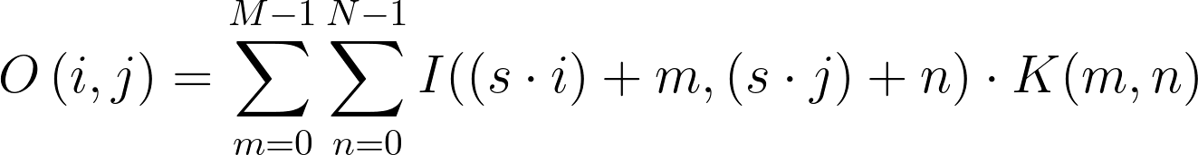
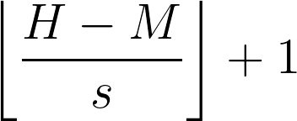
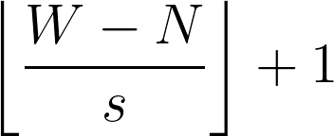
s: Stride
H: Number of rows in image (height)
W: Number of columns in image (width)
M: Number of rows in kernel (height)
N: Number of columns in kernel (width)
i goes from 0 to
j goes from 0 to

Slide 11
I₀₀ | I₀₁ | I₀₂ | I₀₃ | I₀₄
I₁₀ | I₁₁ | I₁₂ | I₁₃ | I₁₄
I₂₀ | I₂₁ | I₂₂ | I₂₃ | I₂₄
I₃₀ | I₃₁ | I₃₂ | I₃₃ | I₃₄
K₀₀ | K₀₁ | K₀₂
K₁₀ | K₁₁ | K₁₂
K₂₀ | K₂₁ | K₂₂
O₀₀ | O₀₁ | O₀₂
O₁₀ | O₁₁ | O₁₂
with stride = 1

Slide 12
Kernel
Image
1 | 5 | 1
5 | 5 | 5
1 | 5 | 1
57 | 59 | 58 | 67 | 82
63 | 66 | 75 | 100 | 124
61 | 69 | 89 | 121 | 150
71 | 96 | 126 | 145 | 157
(57 ⋅ 1) + (59 ⋅ 5) + (58 ⋅ 1) +
(63 ⋅ 5) + (66 ⋅ 5) + (75 ⋅ 5) +
(61 ⋅ 1) + (69 ⋅ 5) + (89 ⋅ 1) = 1925
Output
255
8-bit pixel values must be between 0 and 255!

Slide 13
Kernel
Image
1 | 5 | 1
5 | 5 | 5
1 | 5 | 1
57 | 59 | 58 | 67 | 82
63 | 66 | 75 | 100 | 124
61 | 69 | 89 | 121 | 150
71 | 96 | 126 | 145 | 157
Output
255 | 255 | 255
255 | 255 | 255
8-bit pixel values must be between 0 and 255!

Slide 14
Kernel
Image
1 | 5 | 1
5 | 5 | 5
1 | 5 | 1
0.22 | 0.23 | 0.23 | 0.26 | 0.32
0.25 | 0.26 | 0.29 | 0.39 | 0.49
0.24 | 0.27 | 0.35 | 0.47 | 0.59
0.28 | 0.38 | 0.49 | 0.57 | 0.62
Output
1.0 | 1.0 | 1.0
1.0 | 1.0 | 1.0
Floating point pixel values will likely be between 0.0 and 1.0

Slide 15
Valid Padding
Animations from github.com/vdumoulin/conv_arithmetic (MIT license)

Slide 16
Valid Padding
Image
Kernel
57 | 59 | 58 | 67 | 82
63 | 66 | 75 | 100 | 124
61 | 69 | 89 | 121 | 150
71 | 96 | 126 | 145 | 157
0 | -1 | 0
-1 | 5 | -1
0 | -1 | 0
Output
64
113
stride = 2

Slide 17
Same Padding
Animations from github.com/vdumoulin/conv_arithmetic (MIT license)

Slide 18
Padding with stride=2
Animations from github.com/vdumoulin/conv_arithmetic (MIT license)

Slide 19
0 | 0 | 0 | 0 | 0 | 0 | 0
0 | 57 | 59 | 58 | 67 | 82 | 0
0 | 63 | 66 | 75 | 100 | 124 | 0
0 | 61 | 69 | 89 | 121 | 150 | 0
0 | 71 | 96 | 126 | 145 | 157 | 0
0 | 0 | 0 | 0 | 0 | 0 | 0

Slide 20
57 | 57 | 59 | 58 | 67 | 82 | 82
57 | 57 | 59 | 58 | 67 | 82 | 82
64 | 63 | 66 | 75 | 100 | 124 | 124
61 | 61 | 69 | 89 | 121 | 150 | 150
71 | 71 | 96 | 126 | 145 | 157 | 157
71 | 71 | 96 | 126 | 145 | 157 | 157

Slide 21
Kernel
Image (without padding)
0 | -1 | 0
-1 | 5 | -1
0 | -1 | 0
Without padding:
- Smaller output
- Information on borders is lost
57 | 59 | 58 | 67 | 82
63 | 66 | 75 | 100 | 124
61 | 69 | 89 | 121 | 150
71 | 96 | 126 | 145 | 157
Output
64 | 62 | 113
33 | 54 | 121
stride = 1

Slide 22
Kernel
Input Image (with padding)
0 | -1 | 0
-1 | 5 | -1
0 | -1 | 0
With padding:
- Larger output matrix
- Information on
borders is maintained
0 | 0 | 0 | 0 | 0 | 0 | 0
0 | 57 | 59 | 58 | 67 | 82 | 0
0 | 63 | 66 | 75 | 100 | 124 | 0
0 | 61 | 69 | 89 | 121 | 150 | 0
0 | 71 | 96 | 126 | 145 | 157 | 0
0 | 0 | 0 | 0 | 0 | 0 | 0
Output
163 | 114 | 89 | 95 | 219
131 | 64 | 62 | 113 | 255
102 | 33 | 54 | 121 | 255
198 | 214 | 255 | 255 | 255
stride = 1

Slide 23




Original image
RGB channels
0 | -1 | 0
-1 | 5 | -1
0 | -1 | 0
0 | -1 | 0
-1 | 5 | -1
0 | -1 | 0
0 | -1 | 0
-1 | 5 | -1
0 | -1 | 0
Kernel

Slide 24
Original image
RGB channels
0 | -1 | 0
-1 | 5 | -1
0 | -1 | 0
-1 | -2 | -1
0 | 0 | 0
1 | 2 | 1
-1 | -1 | -1
-1 | 8 | -1
-1 | -1 | -1
Kernel

Slide 25
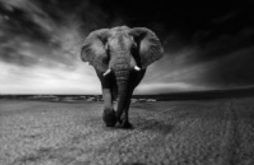

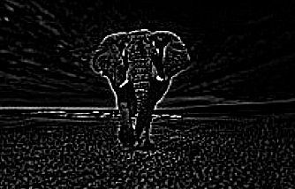
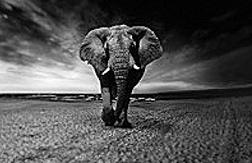
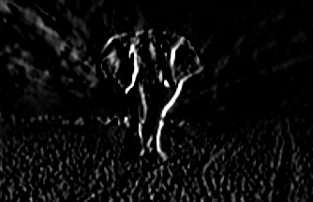
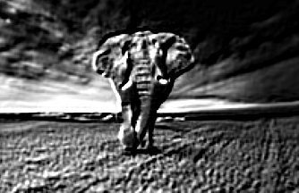
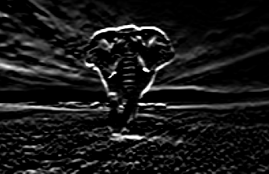
Original image
(200x130)
1/16 | 1/8 | 1/16
1/8 | 1/4 | 1/8
1/16 | 1/8 | 1/16
-1 | -1 | -1
-1 | 8 | -1
-1 | -1 | -1
Gaussian blur
Outline
0 | -1 | 0
-1 | 5 | -1
0 | -1 | 0
1 | 0 | -1
2 | 0 | -2
1 | 0 | -1
Sharpen
Left Sobel
-2 | -1 | 0
-1 | 1 | 1
0 | 1 | 2
1 | 2 | 1
0 | 0 | 0
-1 | -2 | -1
Emboss
Top Sobel

Slide 26
Kernel
Image
1 | 5 | 1
5 | 5 | 5
1 | 5 | 1
57 | 59 | 58 | 67 | 82
63 | 66 | 75 | 100 | 124
61 | 69 | 89 | 121 | 150
71 | 96 | 126 | 145 | 157
(57 ⋅ 1) + (59 ⋅ 5) + (58 ⋅ 1) +
(63 ⋅ 5) + (66 ⋅ 5) + (75 ⋅ 5) +
(61 ⋅ 1) + (69 ⋅ 5) + (89 ⋅ 1) = 1925
Output
255
8-bit pixel values must be between 0 and 255!

