Slide 1
Computer Vision with Embedded Machine Learning
Pooling Layer

Slide 2

Average Pooling
Image
57 | 59 | 58 | 67 | 82
63 | 66 | 75 | 100 | 124
61 | 69 | 89 | 121 | 150
71 | 96 | 126 | 145 | 157
Window: 2x2
Stride: 2
Find average under window:
(57 + 59 + 63 + 66) / 4 = 61.25
Output
61

Slide 3
Average Pooling
Image
57 | 59 | 58 | 67 | 82
63 | 66 | 75 | 100 | 124
61 | 69 | 89 | 121 | 150
71 | 96 | 126 | 145 | 157
Window: 2x2
Stride: 2
Find average under window:
(58 + 67 + 75 + 100) / 4 = 75
Output
61 | 75

Slide 4
Average Pooling
Image
57 | 59 | 58 | 67 | 82
63 | 66 | 75 | 100 | 124
61 | 69 | 89 | 121 | 150
71 | 96 | 126 | 145 | 157
Window: 2x2
Stride: 2
Find average under window:
(61 + 69 + 71 + 96) / 4 = 74.25
Output
61 | 75
74

Slide 5
Average Pooling
Image
57 | 59 | 58 | 67 | 82
63 | 66 | 75 | 100 | 124
61 | 69 | 89 | 121 | 150
71 | 96 | 126 | 145 | 157
Window: 2x2
Stride: 2
Find average under window:
(89 + 121 + 126 + 145) / 4 = 120.25
Output
61 | 75
74 | 120

Slide 6
Max Pooling
Image
57 | 59 | 58 | 67 | 82
63 | 66 | 75 | 100 | 124
61 | 69 | 89 | 121 | 150
71 | 96 | 126 | 145 | 157
Window: 2x2
Stride: 2
Find maximum value under window: 66
Output
66

Slide 7
Max Pooling
Image
57 | 59 | 58 | 67 | 82
63 | 66 | 75 | 100 | 124
61 | 69 | 89 | 121 | 150
71 | 96 | 126 | 145 | 157
Window: 2x2
Stride: 2
Find maximum value under window: 100
Output
66 | 100

Slide 8
Max Pooling
Image
57 | 59 | 58 | 67 | 82
63 | 66 | 75 | 100 | 124
61 | 69 | 89 | 121 | 150
71 | 96 | 126 | 145 | 157
Window: 2x2
Stride: 2
Find maximum value under window: 96
Output
66 | 100
96

Slide 9
Max Pooling
Image
57 | 59 | 58 | 67 | 82
63 | 66 | 75 | 100 | 124
61 | 69 | 89 | 121 | 150
71 | 96 | 126 | 145 | 157
Window: 2x2
Stride: 2
Find maximum value under window: 145
Output
66 | 100
96 | 145

Slide 10
Global Pooling
Image
57 | 59 | 58 | 67 | 82
63 | 66 | 75 | 100 | 124
61 | 69 | 89 | 121 | 150
71 | 96 | 126 | 145 | 157
Global average output: 91.8
92
Global max output: 157
157

Slide 11
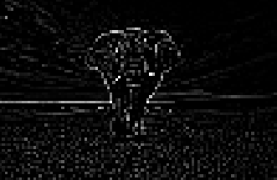
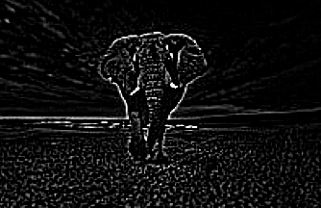
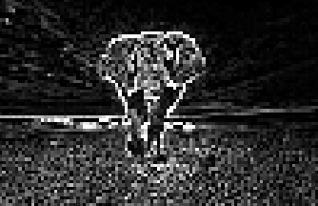
(99x64)
Filtered image
(198x128)
Average
Pooling
(99x64)
Max
Pooling

Slide 12
Local Translation Invariance
128 | 255 | 0 | 0
255 | 128 | 0 | 0
255 | 0 | 0 | 0
255 | 0 | 0 | 0
Output
255 | 0
255 | 0
Max
Pooling
Window: 2x2
Stride: 2

Slide 13
Local Translation Invariance
0 | 128 | 255 | 0
0 | 255 | 128 | 0
0 | 255 | 0 | 0
0 | 255 | 0 | 0
Output
255 | 255
255 | 0
Max
Pooling
Window: 2x2
Stride: 2

