Slide 1
Computer Vision with Embedded Machine Learning
Introduction to Object Detection

Slide 2
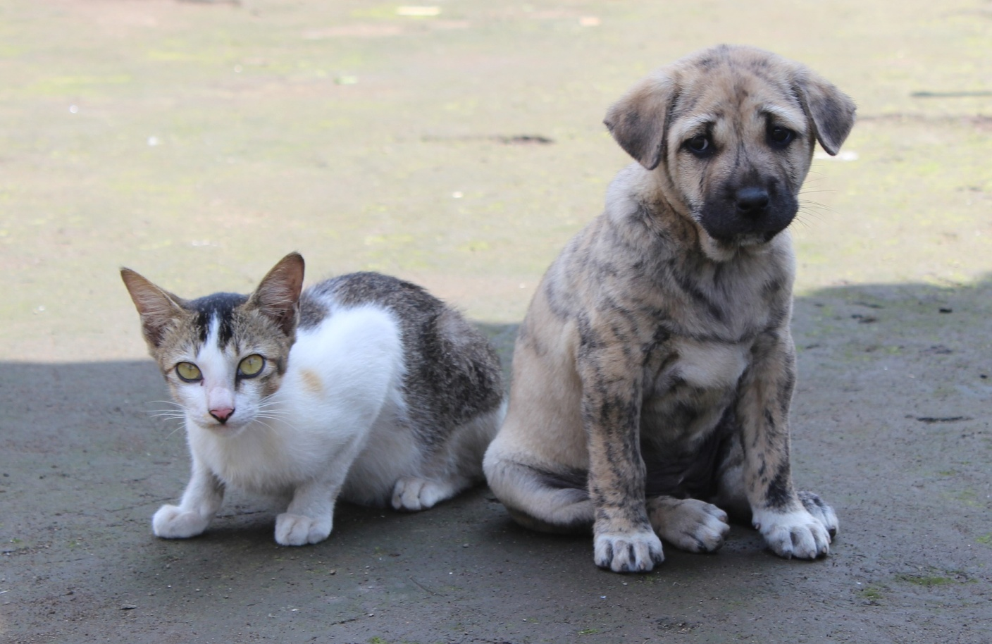

Slide 3


Background | Capacitor | Diode | LED | Resistor
0.0 | 0.04 | 0.0 | 0.28 | 0.68
Background | Capacitor | Diode | LED | Resistor
0.0 | 0.77 | 0.0 | 0.0 | 0.23

Slide 4
Definitions
Image Classification: Predict class of object in an image
Object Localization: Locate presence of object(s) in an image
Object Detection: Locate and classify object(s) in an image

Slide 5
dog 0.83
Bounding box
cat 0.98
+
+

Slide 6
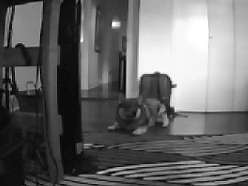
48 x 48
Model
dog
background

Slide 7
stride
Model
dog
background

Slide 8
Model
dog
background

Slide 9
Model
dog
background

Slide 10
Model
dog
background

Slide 13
dog 0.97

Slide 14
96 x 96
Resize
48 x 48
Model
dog
background

Slide 15
dog 0.85

Slide 16
48 x 100 ms =
4.8 seconds!
(~0.208 fps)

Slide 17
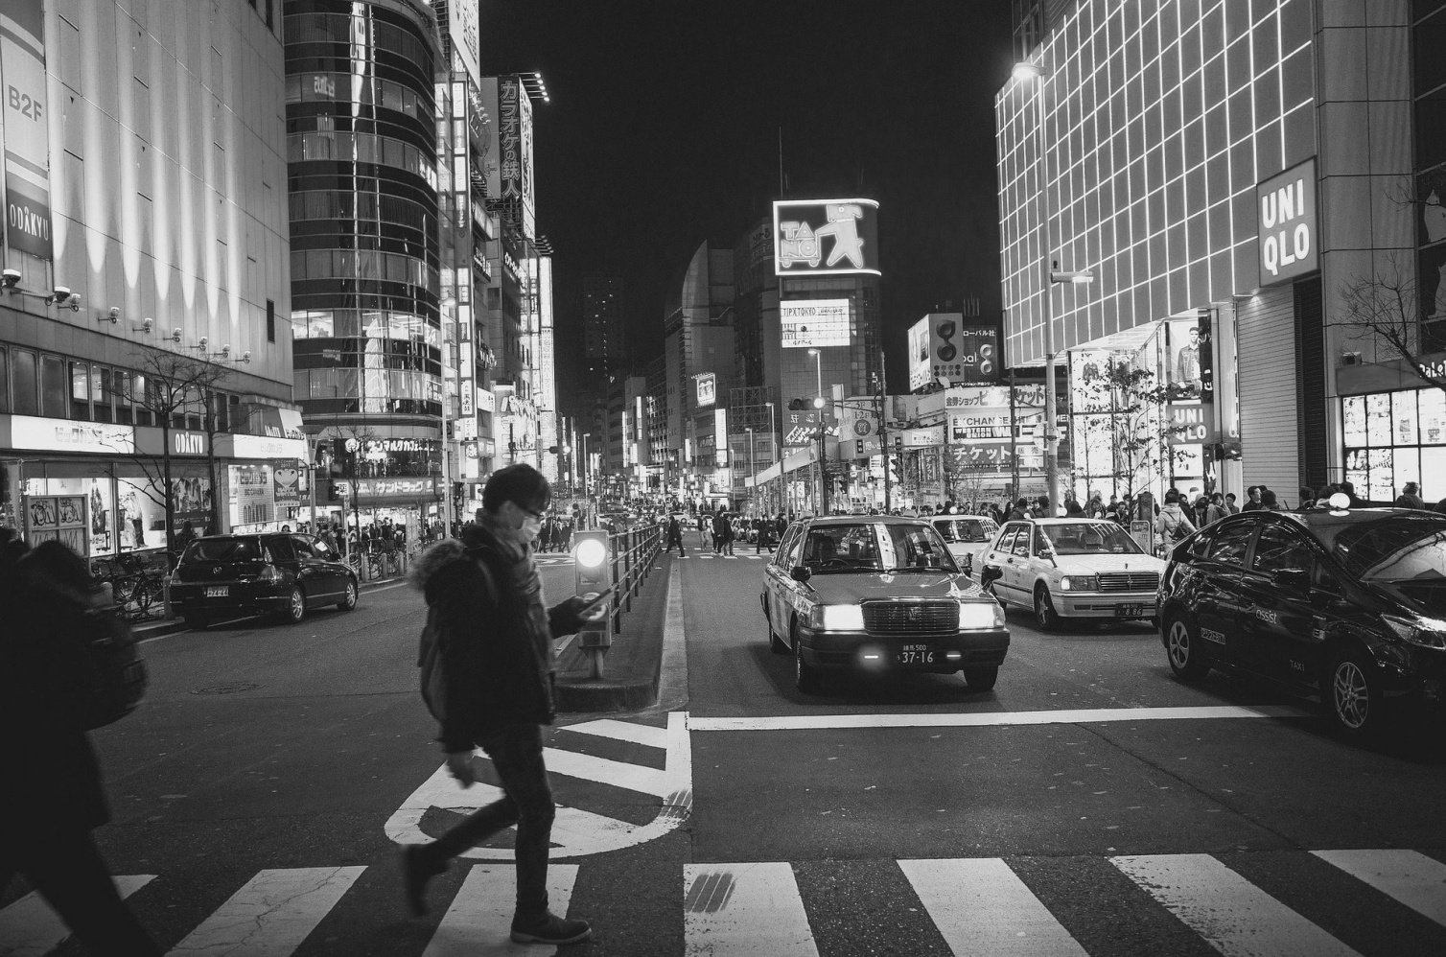

Slide 19
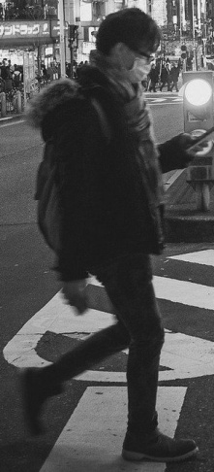


Slide 21
Region of Interest (ROI)
Region Proposal

Slide 23
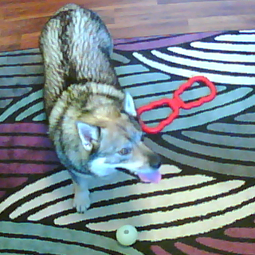
Object 1
Class: dog (0.92)
Bounding box
(x₁, y₁)
(w₁, h₁)
Object 2
Class: toy (0.85)
Bounding box
(x₂, y₂)
(w₂, h₂)
Object 3
Class: ball (0.77)
Bounding box
(x₃, y₃)
(w₃, h₃)
Object Detection Model

