Slide 1
Computer Vision with Embedded Machine Learning
Overview of Digital Images

Slide 2
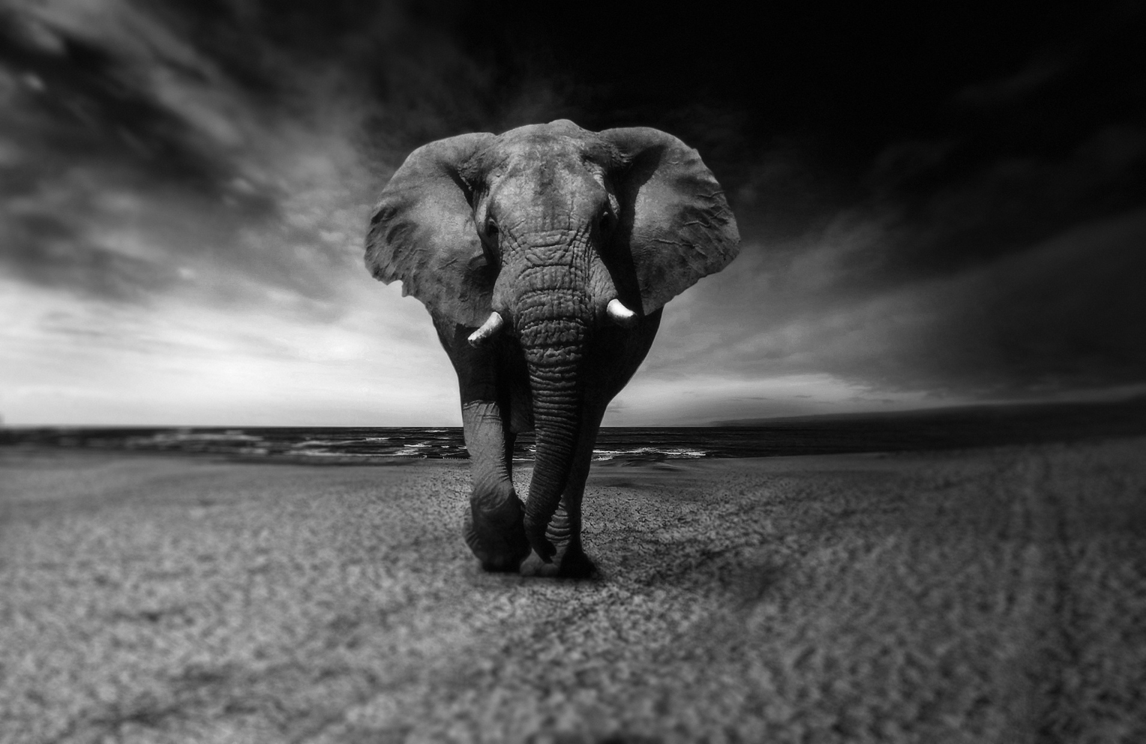

Slide 3

picture element (“pixel”)

Slide 4


Slide 5
0.22 | 0.23 | 0.23 | 0.26 | 0.32
0.25 | 0.26 | 0.29 | 0.39 | 0.49
0.24 | 0.27 | 0.35 | 0.47 | 0.59
0.28 | 0.38 | 0.49 | 0.57 | 0.62

Slide 6
57 | 59 | 58 | 67 | 82
63 | 66 | 75 | 100 | 124
61 | 69 | 89 | 121 | 150
71 | 96 | 126 | 145 | 157
Bit depth: 8 bits
0 = black
255 = white

Slide 7
Width = 2290 pixels
Resolution:
2290 x 1487
( W x H )
Height = 1487 pixels
Size: 2290 x 1487 x 1 = 3,405,230 bytes
W x H x (bit depth in bytes)

Slide 8
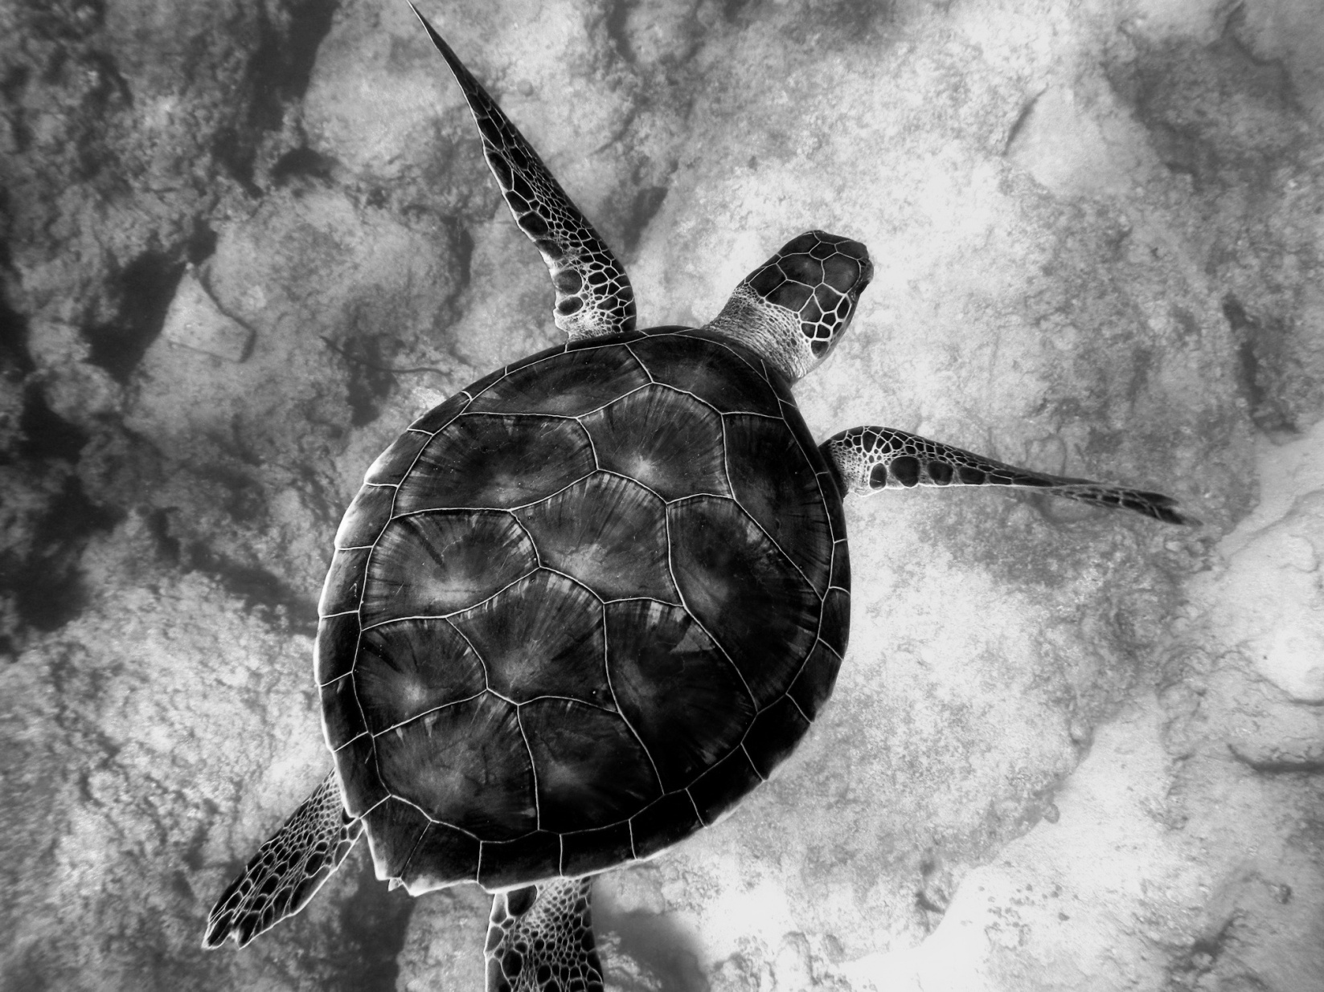

Slide 9
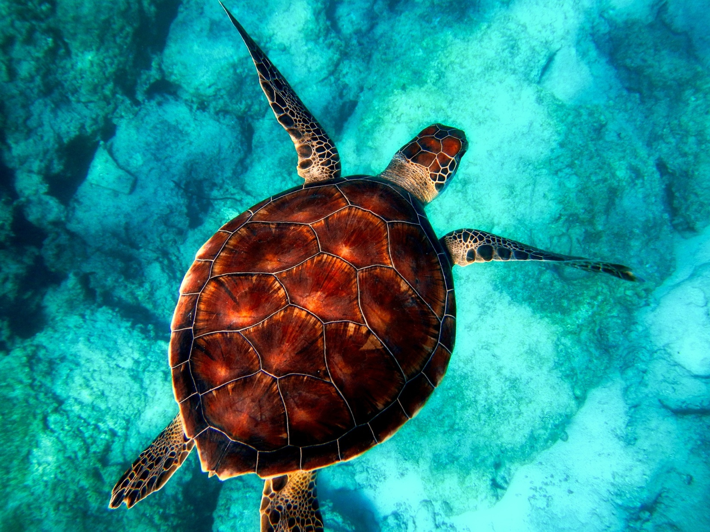

Slide 10

R: 16 G: 159 B: 165 | R: 34 G: 179 B: 176 | R: 30 G: 161 B: 147 | R: 55 G: 163 B: 131 | R: 131 G: 204 B: 148
R: 19 G: 160 B: 152 | R: 34 G: 166 B: 145 | R: 55 G: 161 B: 125 | R: 119 G: 187 B: 136 | R: 184 G: 200 B: 135
R: 44 G: 166 B: 143 | R: 73 G: 173 B: 135 | R: 140 G: 204 B: 152 | R: 186 G: 208 B: 144 | R: 208 G: 181 B: 112
R: 101 G: 189 B: 149 | R: 162 G: 215 B: 159 | R: 203 G: 212 B: 145 | R: 216 G: 190 B: 116 | R: 208 G: 151 B: 80
Bit depth: 24 bits
1 byte: Red
1 byte: Green
1 byte: Blue
Optional:
1 byte: Alpha

Slide 11


Slide 12




