Slide 1
Computer Vision with Embedded Machine Learning
Review of Neural Networks

Slide 2
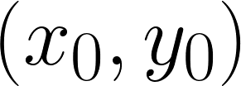
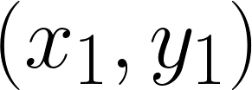
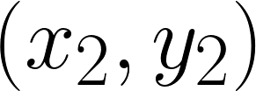


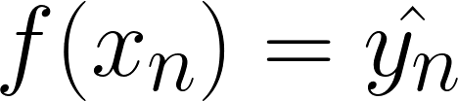

Supervised Learning
Training data:
Inference: using the trained machine learning model to make predictions with new, unseen data
Model
Goal:
where

Slide 3
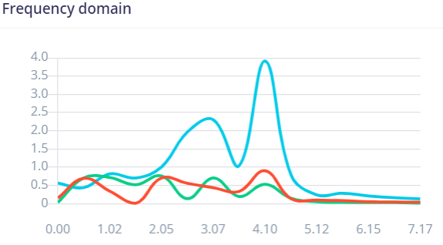
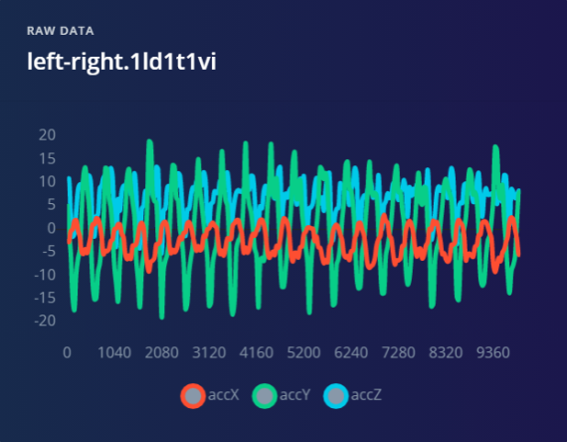
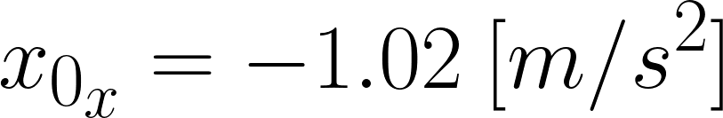
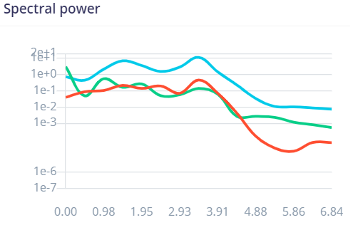
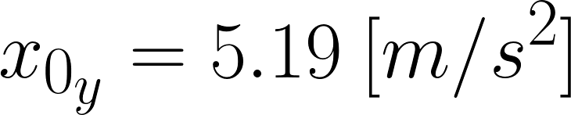
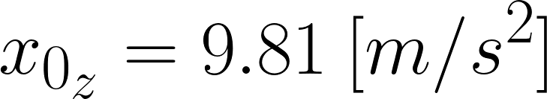
Features
Feature: individual measurable property or characteristic of a phenomenon
Single 3-axis accelerometer measurement
Accelerometer measurements over time

Slide 4

Features
Example of sample x₀
x₀₀ = 0.22
x₀₁ = 0.23
x₀₂ = 0.23
x₀₃ = 0.26
X₀₄ = 0.32
x₀₅ = 0.25
x₀₆ = 0.26
x₀₀ | x₀₁ | x₀₂ | x₀₃ | x₀₄
x₀₅ | x₀₆ | x₀₇ | x₀₈ | x₀₉
x₀₁₀ | x₀₁₁ | x₀₁₂ | x₀₁₃ | x₀₁₄
x₀₁₅ | x₀₁₆ | x₀₁₇ | x₀₁₈ | x₀₁₉
∙∙∙

Slide 5
Datasets
Dataset
Test
set
10% - 20%
Validation set
10% - 20%
Training
set
60% - 80%

Slide 6
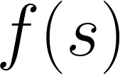








Node (Neuron)
Sigmoid function
1
0
Weighted
Sum
Activation Function
∙∙∙
ReLU function
0

Slide 7




Dense Neural Network (DNN)
Input layer
Example:
- Accelerometer: -20…20 m/s²
- Light sensor: 0...120,000 lux
Hidden layer
Normalize input: [0, 255] → [0.0, 1.0]
Output layer
Softmax
P(class1)
P(class2)
P(class3)

Slide 8
Training
Initialize weights with random values
Input features from training sample
Perform forward pass
Calculate loss
Perform backpropagation
Repeat 2-5 until desired/acceptable performance
Softmax
P(class1)
P(class2)
P(class3)

Slide 9
Terminology
Gradient descent: Algorithm to adjust parameters in a model to minimize loss during backpropagation
Epoch: All training samples have been passed through the model to compute the loss and gradient(s)
Batch gradient descent: Update parameters with gradient descent once after computing the average gradient from all training data (1 iteration of gradient descent for 1 epoch)
Stochastic gradient descent (SGD): Update parameters with gradient descent once after computing the gradient from one training sample (1 iteration of gradient descent for 1 sample)
Mini-batch gradient descent: Update parameters with gradient descent once per group of training samples (1 iteration of gradient descent for 2..(n-1) samples, where n is the number of training samples.

Slide 10
Spotting Underfitting and Overfitting
100%
100%
100%
training
training
validation
validation
Accuracy
Accuracy
Accuracy
training
0%
validation
0%
0%
Time (epochs)
Time (epochs)
Time (epochs)
Underfit: Model performs poorly on training and validation data
Good fit: Model generalizes well from training to validation data
Overfit: Model predicts training data well but fails to generalize to validation data

Slide 11
Spotting Underfitting and Overfitting
validation
Loss
training
Loss
Loss
validation
validation
training
training
0
0
0
Time (epochs)
Time (epochs)
Time (epochs)
Underfit: Model performs poorly on training and validation data
Good fit: Model generalizes well from training to validation data
Overfit: Model predicts training data well but fails to generalize to validation data

Slide 12
Confusion Matrix
Predicted Label
 | Cat | Dog | Bird | Human
Cat | 205 | 10 | 1 | 46
Dog | 6 | 199 | 0 | 32
Bird | 9 | 17 | 223 | 34
Human | 21 | 8 | 3 | 186
Actual Label
True Positive (TP): Predicted positive matches actual positive
True Negative (TN): Predicted negative matches actual negative
False Positive (FP) (“Type I Error”): Predicted positive does not match actual negative
False Negative (FN) (“Type II Error”): Predicted negative does not match actual positive

Slide 13

Confusion Matrix
Predicted Label
 | Cat | Dog | Bird | Human
Cat | 205 | 10 | 1 | 46
Dog | 6 | 199 | 0 | 32
Bird | 9 | 17 | 223 | 34
Human | 21 | 8 | 3 | 186
Actual Label
Total accuracy:

Slide 14
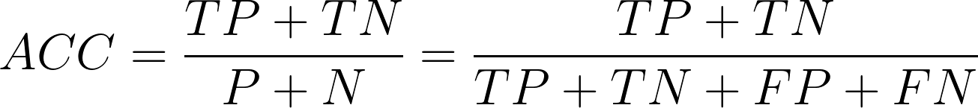
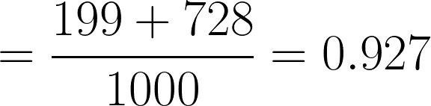
Confusion Matrix
Predicted Label
 | Cat | Dog | Bird | Human
Cat | 205 | 10 | 1 | 46
Dog | 6 | 199 | 0 | 32
Bird | 9 | 17 | 223 | 34
Human | 21 | 8 | 3 | 186
Actual Label
+
=
Total

Slide 15
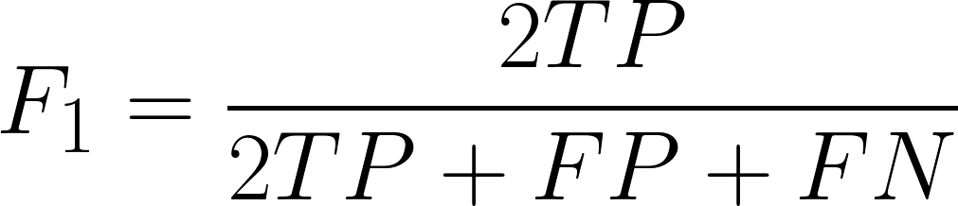


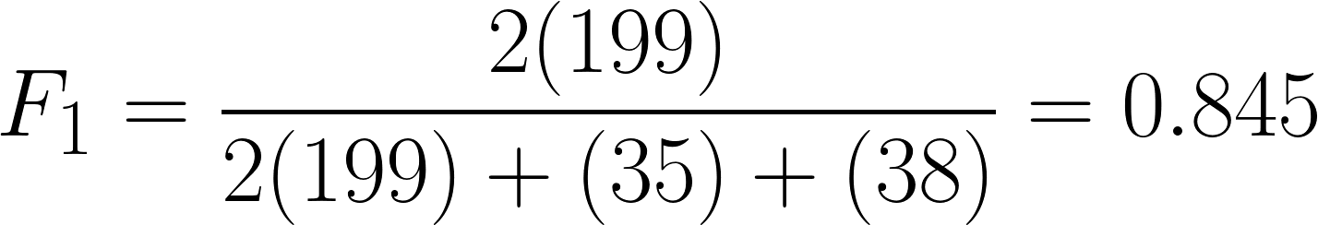
Confusion Matrix
Predicted Label
 | Cat | Dog | Bird | Human
Cat | 205 | 10 | 1 | 46
Dog | 6 | 199 | 0 | 32
Bird | 9 | 17 | 223 | 34
Human | 21 | 8 | 3 | 186
Actual Label
=
2
2

Slide 16
Confusion Matrix
Predicted Label
 | Cat | Dog | Bird | Human
Cat | 205 | 10 | 1 | 46
Dog | 6 | 199 | 0 | 32
Bird | 9 | 17 | 223 | 34
Human | 21 | 8 | 3 | 186
Actual Label
Per-class accuracy
0.907
0.927
0.936
0.856
F1 scores
0.815
0.845
0.875
0.721
Total accuracy:
0.813
F1 average:
0.818

