Slide 1
Introduction to Embedded ML and Computer Vision
Workshop Introduction

Slide 2
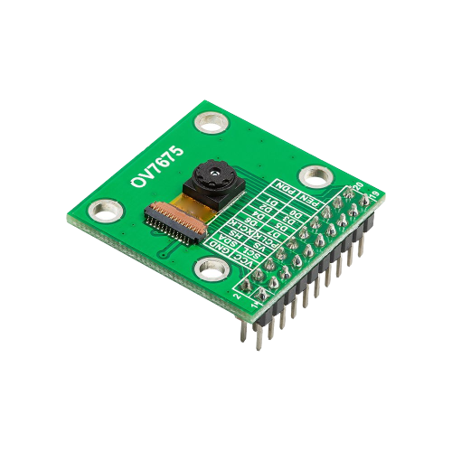
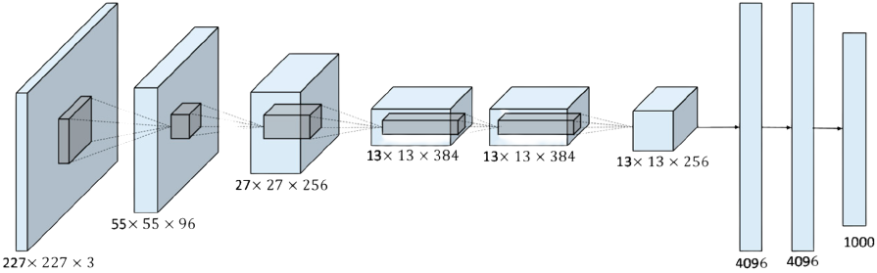

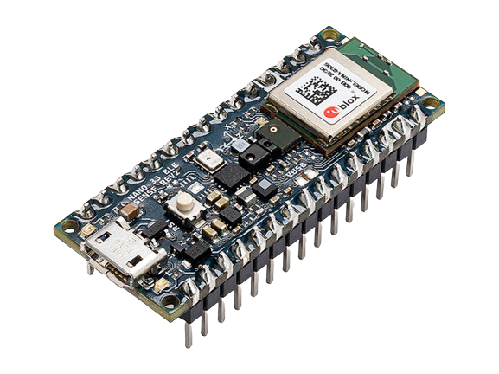
Hands-on Embedded Machine Learning
Rock
Paper
Scissors
Copyright (c) 2022 TinyMLedu.
All rights reserved.
CC BY-NC-SA 4.0

Slide 3
Schedule
Overview of embedded machine learning
Overview of computer vision
Data collection
Data augmentation
Model training
Model testing
Live inference on Arduino

Slide 4

Shawn Hymel
Senior DevRel Engineer
Edge Impulse
shawnhymel.com

