Slide 1
Computer Vision with Embedded Machine Learning
What is Image Classification?

Slide 2
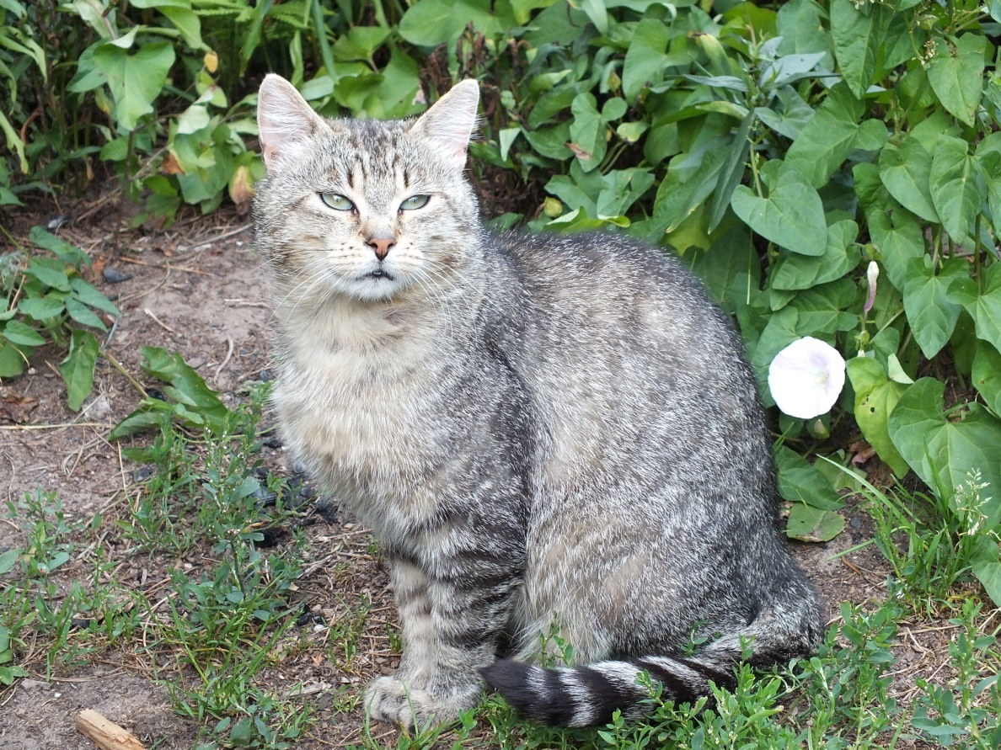
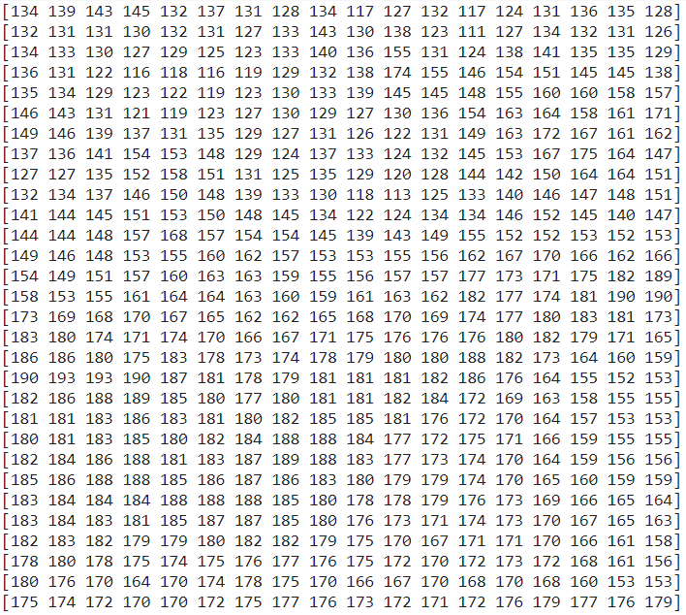
Resolution: 2048 x 1536 pixels
Bit depth: 24 bits
Numpy array shape: (1536, 2048, 3)

Slide 3
Model
Cat

Slide 4
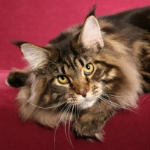
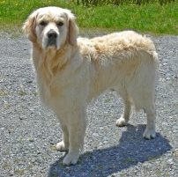
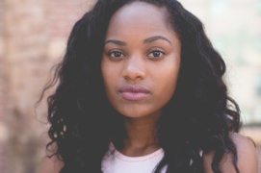
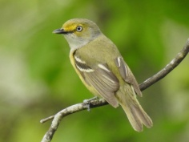
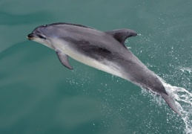
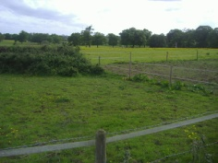
Binary Classification
One-vs-One
One-vs-Rest
vs.
vs.

Slide 5
Multiclass Classification
vs.
vs.
vs.
vs.
vs.

Slide 6


Multiclass: One-vs-One
vs.
vs.
vs.
vs.
vs.
vs.
vs.
vs.
vs.
vs.
vs.
vs.

Slide 7
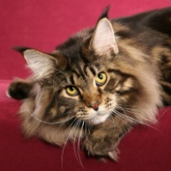
Multiclass: One-vs-Rest
vs.
vs.

Slide 8
k-Nearest Neighbors (k-NN)
255
Cat
Dog
Unknown
Pixel 1
0
Pixel 2
255

Slide 9
Support Vector Machine (SVM)
255
Cat
Dog
Unknown
Pixel 1
0
Pixel 2
255

Slide 10
Neural Network (NN)
Pixel 1 value [0, 1]
Pixel 2 value [0, 1]
Input layer
Hidden layer
Output layer
P(cat)

Slide 11
Neural Network (NN)
Pixel 1 value [0, 1]
Pixel 2 value [0, 1]
cat
vs.
rest
dog
vs.
rest
bird
vs.
rest
human
vs.
rest
dolphin
vs.
rest
field
vs.
rest

Slide 12
Neural Network (NN)
Pixel 1 value [0, 1]
Pixel 2 value [0, 1]
P(cat) + P(dog) + P(bird) + P(human) + P(dolphin) + P(field) = 1.0
Softmax
P(cat)
P(dog)
P(bird)
P(human)
P(dolphin)
P(field)
0.06
0.63
0.02
0.26
0.00
0.03

Slide 13
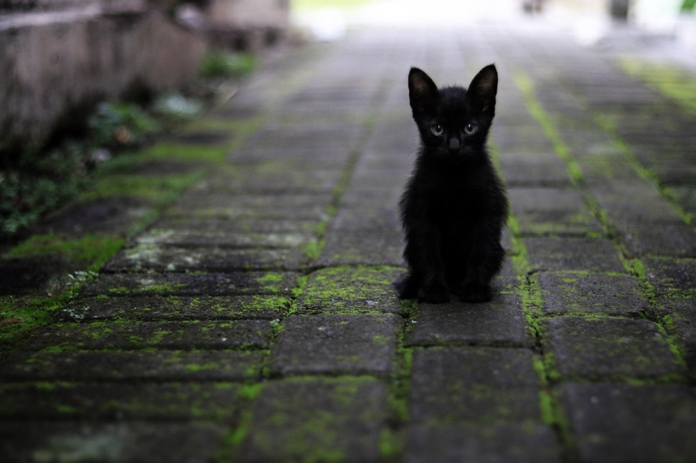
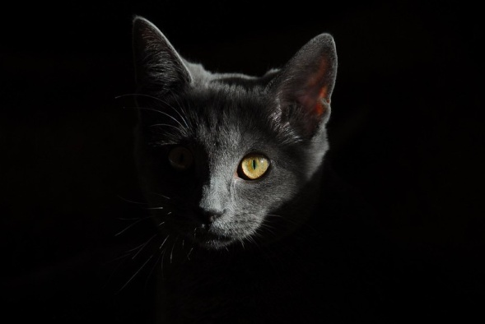
Challenge: Illumination

Slide 14

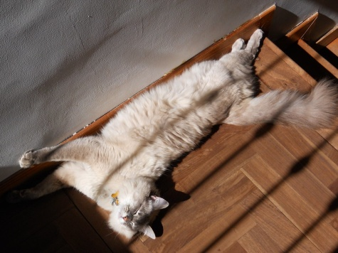

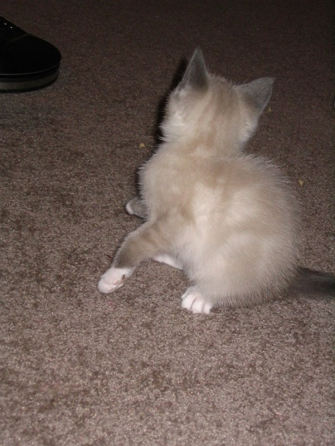
Challenge: Deformation

Slide 15
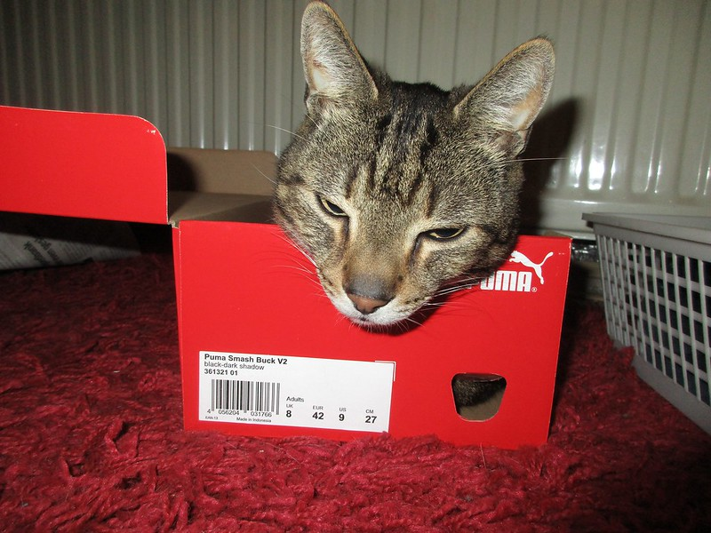
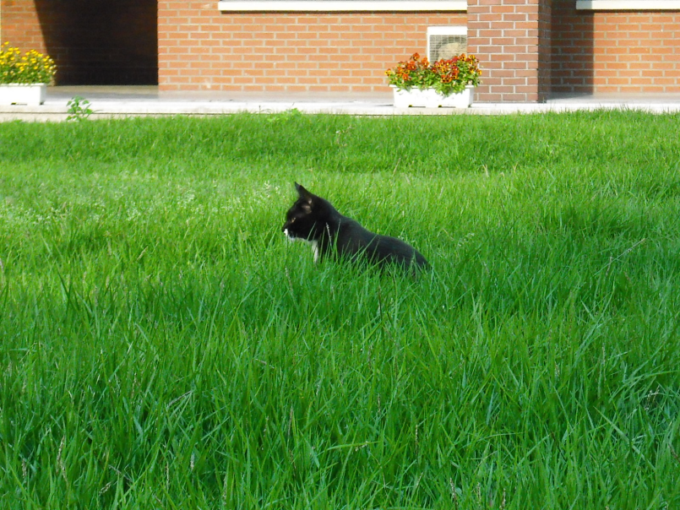
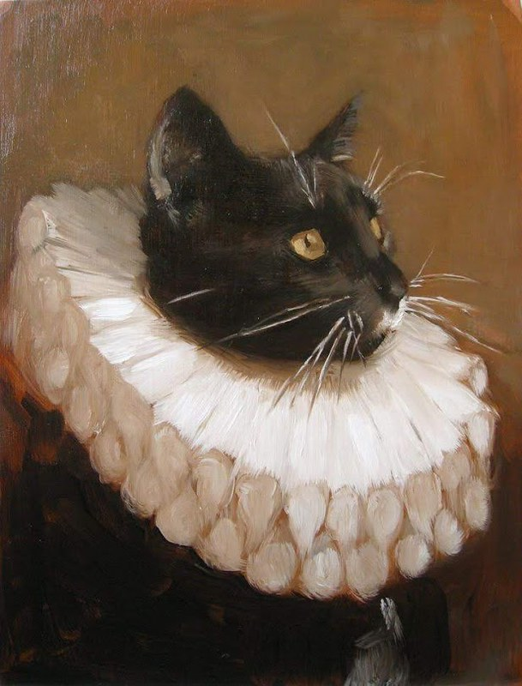
Challenge: Occlusion

Slide 16
