Slide 1
AI-Powered Poster Personalization Tool
Tech Stack & Development Flow

Slide 2
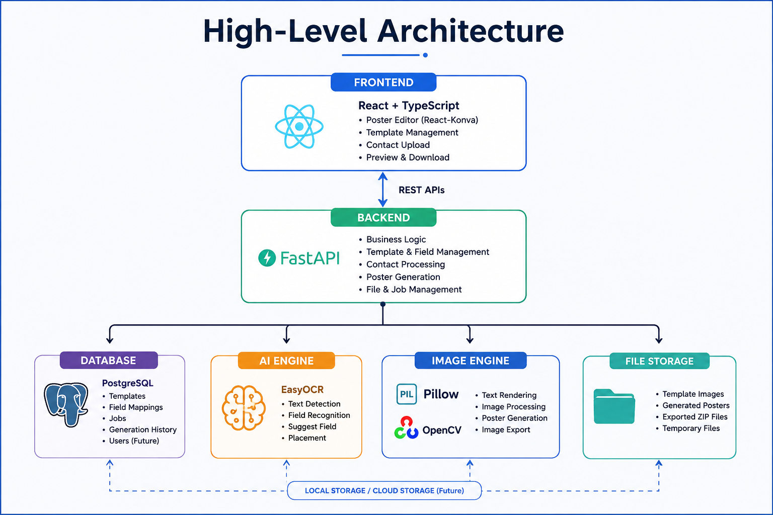
High-Level Architecture

Slide 3
Final Tech Stack
Frontend: React 19, TypeScript, Vite, Material UI, React-Konva
Backend: FastAPI, Python 3.12
Database: PostgreSQL, SQLAlchemy, Alembic
Image Processing: Pillow, OpenCV
Data Processing: Pandas, OpenPyXL
AI: EasyOCR, GPT-4o Vision (Future)
Deployment: Docker, Docker Compose

Slide 4
Development Flow
Requirements Analysis
↓
System Design
↓
UI/UX Design
↓
Frontend Development
↓
Backend Development
↓
Integration
↓
Testing
↓
Deployment

Slide 5
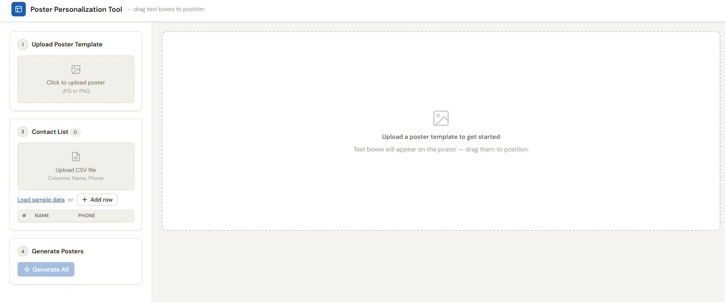
Expected Output:

Slide 6
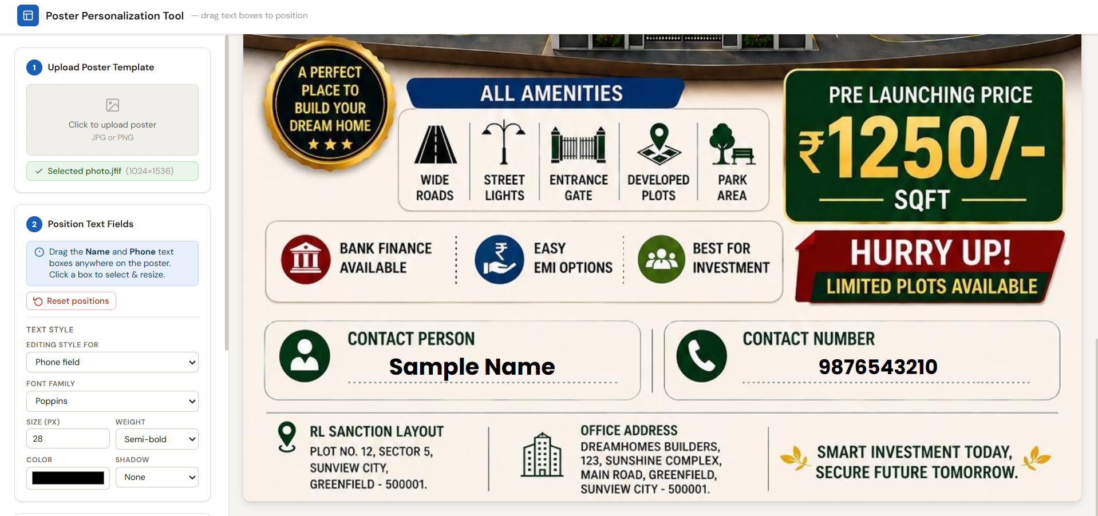

Slide 7
Module-Wise Roadmap
Phase 1: Foundation Setup
Phase 2: Poster Editor
Phase 3: Styling Engine
Phase 4: Template Management
Phase 5: Contact Management
Phase 6: Poster Generation Engine
Phase 7: ZIP Export
Phase 8: AI Detection Module
Phase 9: Testing & Deployment

