Slide 1
Test Driven Development
Improving code confidence

Slide 2
The ‘Push and Pray’ Process
Production code is written
Production code is duplicated in a test script
Harmful dependencies are commented
Remaining code is tested
Production code is released
Pray any bugs are caught in UAT

Slide 3
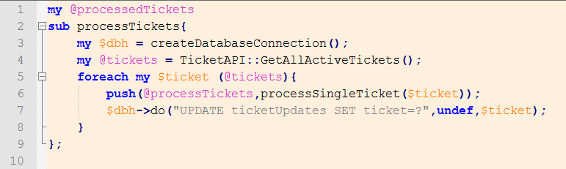
The Problem
Our code wasn’t made to be tested.
This code is tightly coupled to the database and the TicketAPI. It also relies on global variables. You would want to comment out, at the very least, the update to the database in a test script.

Slide 4
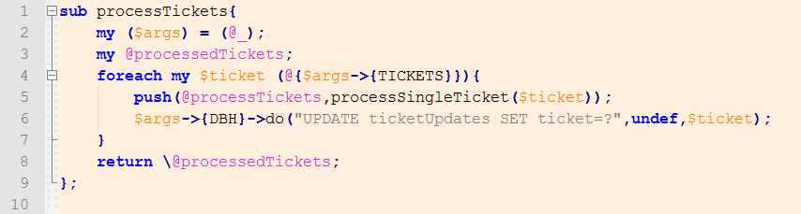
The Solution
This code is loosely coupled to the database and doesn’t even know about the TicketAPI. It may look like it will call a database handle here, but we can replace that handle with whatever we want.
This is called ‘Dependency Injection’.
It makes our code easier to test.

Slide 5
Definitions
Dependency: Requirements that a unit of code needs to function.
Dependency Injection: The method by which dependencies are introduced to the unit.
Unit Test: A test that confirms a result from an individual unit of code.
Integration Test: A test that confirms a result from several units at once.
Regression Testing Suite: A series of unit and integration tests that, when run, can confirm that the code is working as intended.

Slide 6
The Test Driven Process
Repeat the following…
Write a unit test that fails (make sure it fails the way you expect)
Write only enough production code to pass the test
Refactor the code you’ve written
As unit tests are finished, write final integration tests that prove all units work together
Push up fully tested production code, and the leftover unit and integration tests (now our regression testing suite)

Slide 7
Making a Unit Test in Perl
What do we use?
Test::Most – A loose testing harness for Perl
Test::MockModule – A tool for mocking used modules
DBI::Mock – A tool for mocking the database

Slide 8
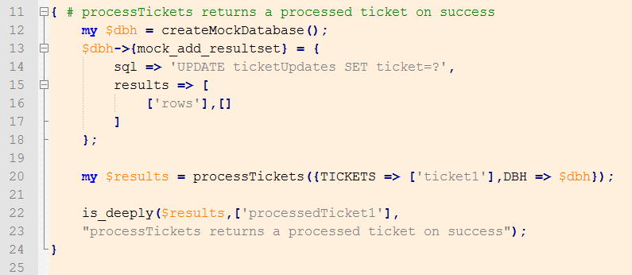
Making a Unit Test in Perl
This is a unit test for our previous processTickets sub. This code uses DBI::Mock to mock a successful response from our database when that update SQL is run. NOTE: createMockDatabase is not a function in DBI::Mock. That’s a function that we wrote.

Slide 9
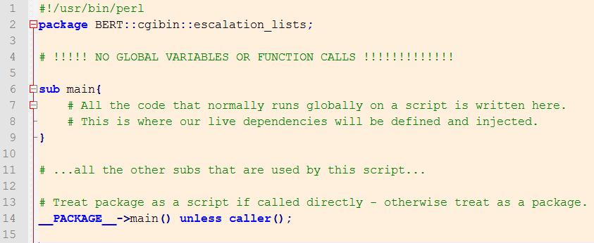
Making a Testable Script
By defining a package name for the script, we’re able to call it from a test script just like a module. The last line will cause the main sub to be called automatically when run as a stand alone script (ajax, cron, command line), but not if it’s called from another perl script.

Slide 10
How Tests Are Used Later…
Your tests will be run by whoever is doing QA. If they don’t pass, your code won’t be merged.
Your tests will be run whenever you or someone else has their code merged in. A release can’t be made until these failing tests are corrected.

