Slide 1
Hydraulic Systems Fundamentals
Module 1: fixture deck for the training-workbench contract

Slide 2
Pascal's Law
Pressure applied to a confined fluid is transmitted equally in all directions
Force equals pressure multiplied by piston area
A small input piston can lift a large load

Slide 3
Hydraulic Pumps
Gear pumps are simple and tolerant of contamination
Vane pumps run quietly at moderate pressure
Piston pumps deliver the highest pressure

Slide 4
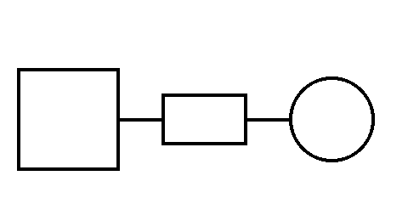
Reservoir Schematic
Figure 1: reservoir, filter and pump in series

