Slide 1
Connector Identification Guide
Contact sheets

Slide 2

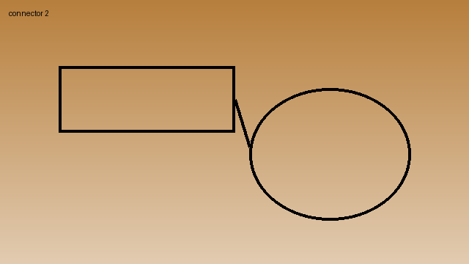

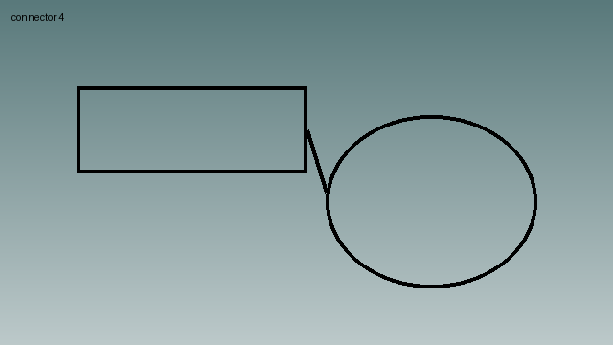

Slide 3
Notes
Match keying before mating

Slide 4

